Slide 1
Fuzzy Control
Lecture 1 Introduction
Basil Hamed
Electrical Engineering
Islamic University of Gaza

Slide 2
Outline
Introduction, Definitions and Concepts
Control
Intelligent Control
History of Fuzzy Logic
Fuzzy Logic
Fuzzy Control
Rule Base
Why Fuzzy system
Fuzzy Control Applications
Crisp Vs. Fuzzy
Fuzzy Sets

Slide 3
Control
Control: Mapping sensor readings to actuators
  Essentially a reactive system
Traditionally, controllers utilize plant model
  A model of the system to be controlled
  Given in differential equations
Control theory has proven methods using such models
  Can show optimality, stability, etc.
  Common term: PID (proportional-integral-derivative) control

Slide 4
CONVENTIONAL CONTROL
Controller Design:
Proportional-integral-derivative (PID) control: Over 90% of the controllers in operation today are PID controllers. Often, heuristics are used to tune PID controllers (e.g., the Zeigler-Nichols tuning rules).
Classical control: Lead-lag compensation, Bode and Nyquist methods, root-locus design, and so on.
State-space methods: State feedback, observers, and so on.

Slide 5
CONVENTIONAL CONTROL
Controller Design:
Optimal control: Linear quadratic regulator, use of Pontryagin’s minimum principle or dynamic programming, and so on.
Robust control: H2 or H∞ methods, quantitative feedback theory, loop shaping, and so on.
Nonlinear methods: Feedback linearization, Lyapunov redesign, sliding mode control, backstepping, and so on.

Slide 6
CONVENTIONAL CONTROL
Controller Design:
Adaptive control: Model reference adaptive control, self-tuning regulators, nonlinear adaptive control, and so on.
Stochastic control: Minimum variance control, linear quadratic gaussian (LQG) control, stochastic adaptive control, and so on.
Discrete event systems: Petri nets, supervisory control, infinitesimal perturbation analysis, and so on.

Slide 7
Intelligent Control
is a class of control techniques.
Intelligent control describes the discipline where control methods are developed that attempt to emulate important characteristics of human intelligence. These characteristics include adaptation and learning, planning under large uncertainty and coping with large amounts of data.

Slide 8
Intelligent Control
Intelligent control can be divided into the following major sub-domains:
Neural network control
Fuzzy (logic) control
Neuro-fuzzy control
Expert Systems
Genetic control

Slide 9
“As complexity increases, precise statements lose meaning and meaningful statements lose precision. “
Professor Lofti Zadeh
University of California at Berkeley
“So far as the laws of mathematics refer to reality, they are not certain. And so far as they are certain, they do not refer to reality.”
Albert Einstein

Slide 10
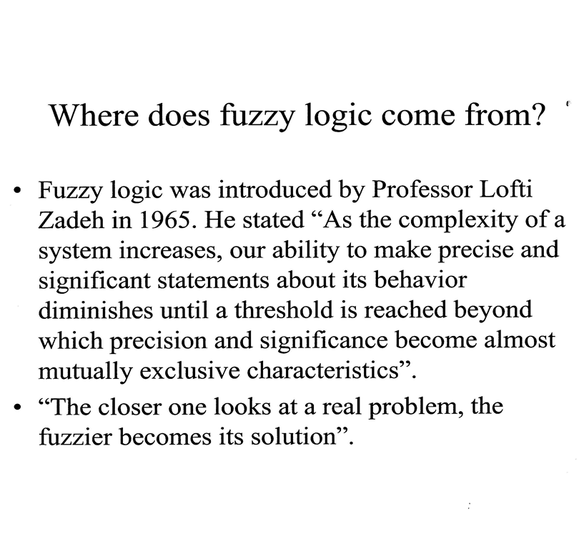

Slide 11
Lotfi Zadeh
The concept of Fuzzy Logic (FL) was first conceived by Lotfi Zadeh, a professor at the University of California at Berkley, and presented not as a control methodology, but as a way of processing data by allowing partial set membership rather than crisp set membership or nonmembership.

Slide 12
Brief history of FL The Beginning
This approach to set theory was not applied to control systems until the 70's due to insufficient small-computer capability prior to that time.
Unfortunately, U.S. manufacturers have not been so quick to embrace this technology while the Europeans and Japanese have been aggressively building real products around it.
Professor Zadeh reasoned that people do not require precise, numerical information input, and yet they are capable of highly adaptive control.

Slide 13
Brief history of FL
In the year 1987, the first subway system was built which worked with a fuzzy logic-based automatic train operation control system in Japan. It was a big success and resulted in a fuzzy boom.
For a long time, a lot of Western scientists have been reluctant to use fuzzy logic because they felt that it threatened the integrity of scientific thought. The term ‘fuzzy’ also didn’t helped to spread the new approach.
Today, Fuzzy Logic concept used widely in many implementations like automobile engine & automatic gear control systems, air conditioners, video enhancement in TV sets, washing machines, mobile robots, sorting and handling data, Information Systems, Pattern Recognition (Image Processing, Machine Vision), decision support, traffic control systems and many, many others.

Slide 14
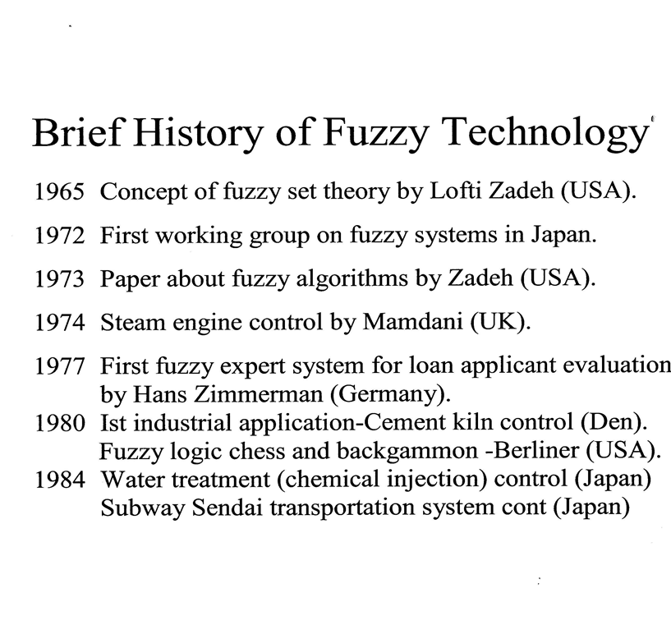

Slide 15
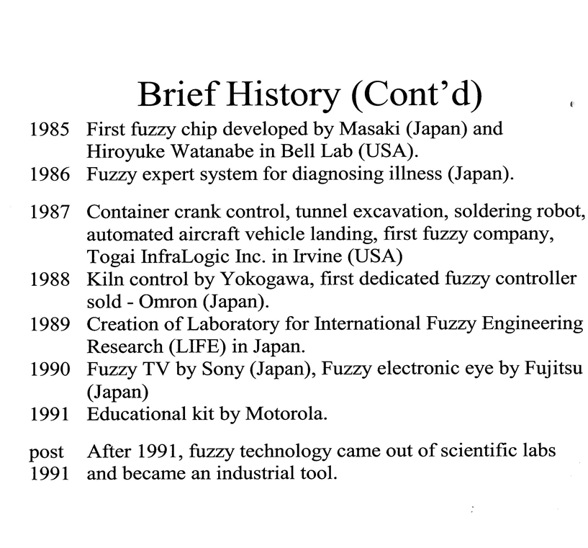

Slide 16
Fuzzy Logic
Fuzzy logic makes use of human common sense. It lets novices build control systems that work in places where even the best mathematicians and engineers, using conventional approaches to control, cannot define and solve the problem.
Fuzzy Logic approach is mostly useful in solving cases where no deterministic algorithm available or it is simply too difficult to define or to implement, while some intuitive knowledge about the behavior is present.

Slide 17
Fuzzy Logic
Traditional “Aristotlean” (crisp) Logic
  Builds on traditional set theory
  Maps propositions to sets T (true) and F (false)
  Proposition P cannot be both true and false
Fuzzy Logic admits degrees of truth
  Determined by membership function

Slide 18
Fuzzy Logic
Fuzzy logic:
  A way to represent variation or imprecision in logic
  A way to make use of natural language in logic
  Approximate reasoning
Humans say things like "If it is sunny and warm today, I will drive fast“
Linguistic variables:
  Temp: {freezing, cool, warm, hot}
  Cloud Cover: {overcast, partly cloudy, sunny}
  Speed: {slow, fast}

Slide 19
Fuzzy Logic
Fuzzy logic is used in system control and analysis design, because it shortens the time for engineering development and sometimes, in the case of highly complex systems, is the only way to solve the problem.
Fuzzy logic is the way the human brain works, and we can mimic this in machines so they will perform somewhat like humans (not to be confused with Artificial Intelligence, where the goal is for machines to perform EXACTLY like humans).

Slide 20
Fuzzy Logic
A type of logic that recognizes more than simple true and false values. With fuzzy logic, propositions can be represented with degrees of truthfulness and falsehood. For example, the statement, today is sunny, might be 100% true if there are no clouds, 80% true if there are a few clouds, 50% true if it's hazy and 0% true if it rains all day.

Slide 21
Fuzzy Logic
What about this rose?
Is this glass full or empty?

Slide 22
Fuzzy Vs. Probability
Walking in the desert, close to being dehydrated,
you find two bottles of water:
The first contains deadly poison with a probability
of 0.1, The second has a 0.9 membership value in
The Fuzzy Set “Safe drinks”
Which one will you choose to drink from???

Slide 23
Fuzzy Control
Fuzzy control is a methodology to represent and implement a (smart) human’s knowledge about how to control a system
Fuzzy Control combines the use of fuzzy linguistic variables with fuzzy logic
Example: Speed Control
How fast am I going to drive today?
It depends on the weather.

Slide 24
Fuzzy Control
Useful cases:
The control processes are too complex to analyze by conventional quantitative techniques.
The available sources of information are interpreted qualitatively, inexactly, or uncertainly.
Advantages of FLC:
Parallel or distributed control multiple fuzzy rules – complex nonlinear system
Linguistic control. Linguistic terms - human knowledge
Robust control. More than 1 control rules – a error of a rule is not fatal

Slide 25
Fuzzy Logic Control
Four main components of a fuzzy controller:
(1) The fuzzification interface : transforms input crisp values into fuzzy values
(2) The knowledge base : contains a knowledge of the application domain and the control goals.
(3) The decision-making logic :performs inference for fuzzy control actions
(4) The defuzzification interface

Slide 26
Fuzzy Logic Control

Slide 27
Types of Fuzzy Control
• Mamdani
• Larsen
• Tsukamoto
• TSK (Takagi Sugeno Kang)
• Other methods

Slide 28
Rule Base
FL incorporates a simple, rule-based IF X AND Y THEN Z approach to solve control problem rather than attempting to model a system mathematically. The FL model is empirically-based, relying on an operator's experience rather than their technical understanding of the system. For example ,dealing with temperature control in terms such as:
"IF (process is too cool) AND (process is getting colder) THEN (add heat to the process)"
or: "IF (process is too hot) AND (process is heating rapidly) THEN (cool the process quickly)".
These terms are imprecise and yet very descriptive of what must actually happen.

Slide 29
Rule Base Example
As an example, the rule base for the two-input and one-output controller consists of a finite collection of rules with two antecedents and one consequent of the form:

Slide 30
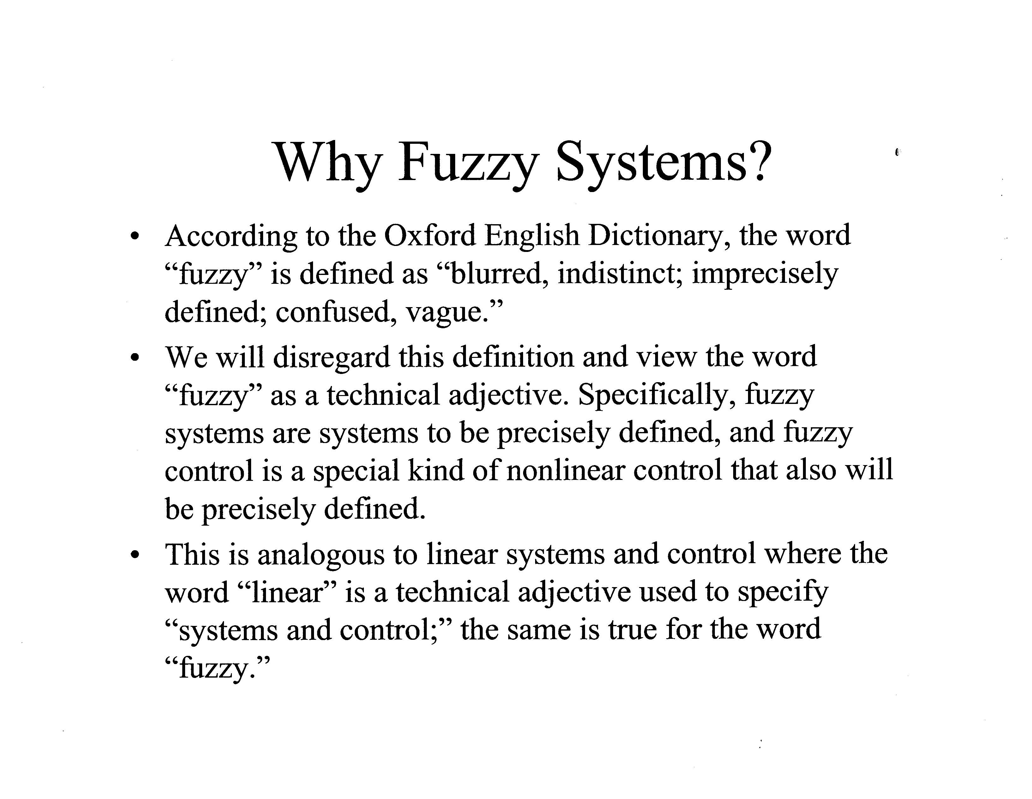

Slide 31
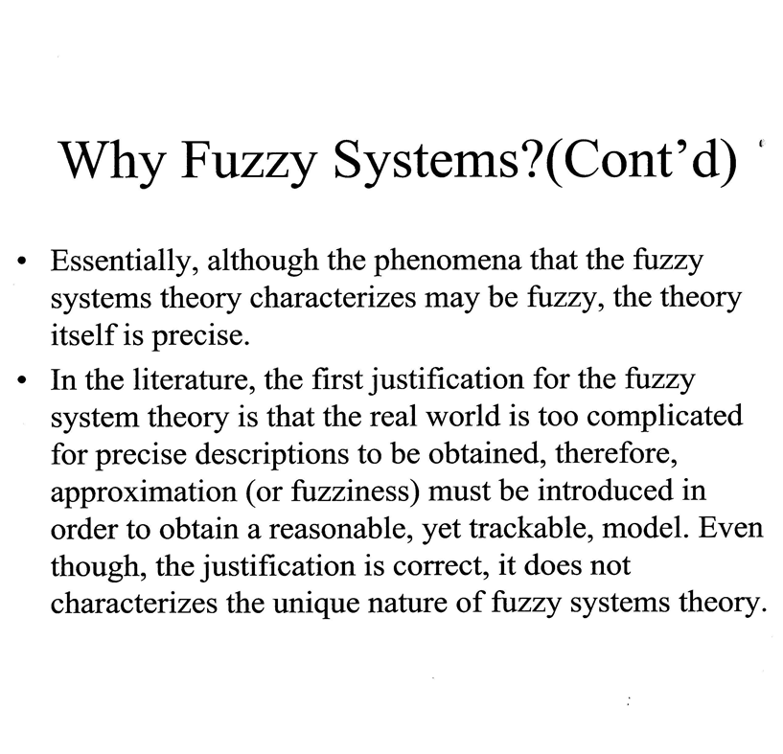

Slide 32
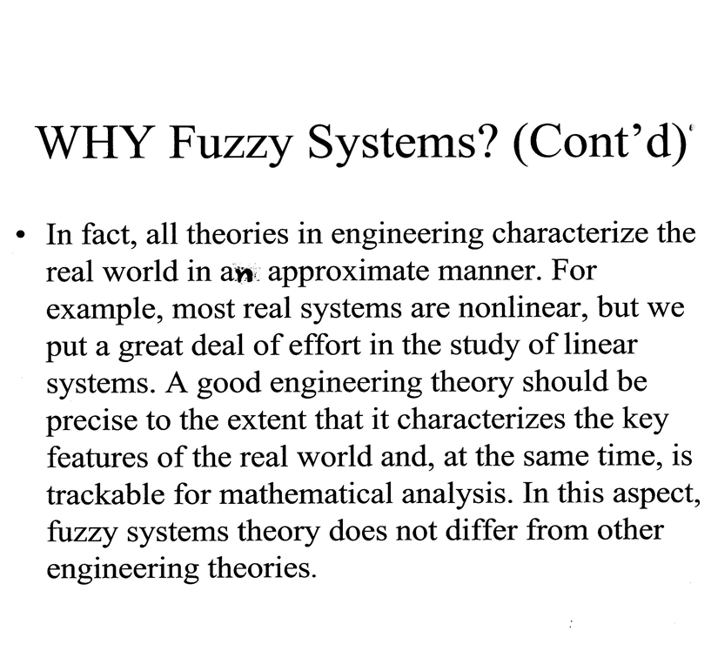

Slide 33
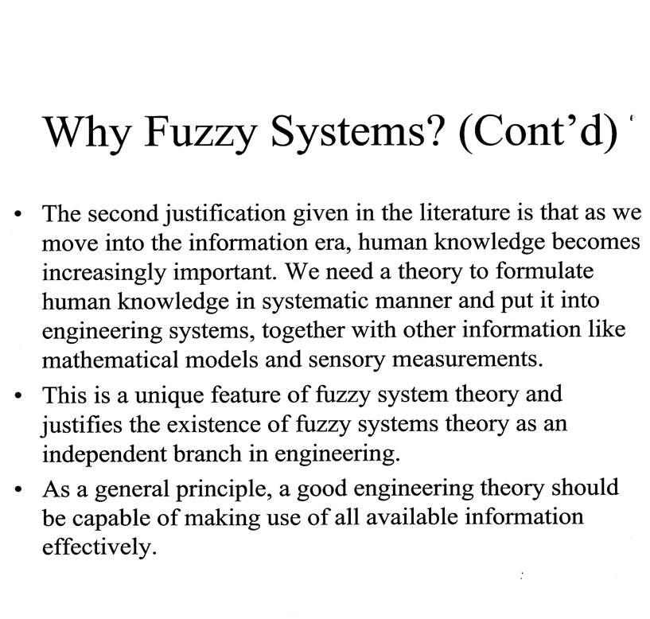

Slide 34
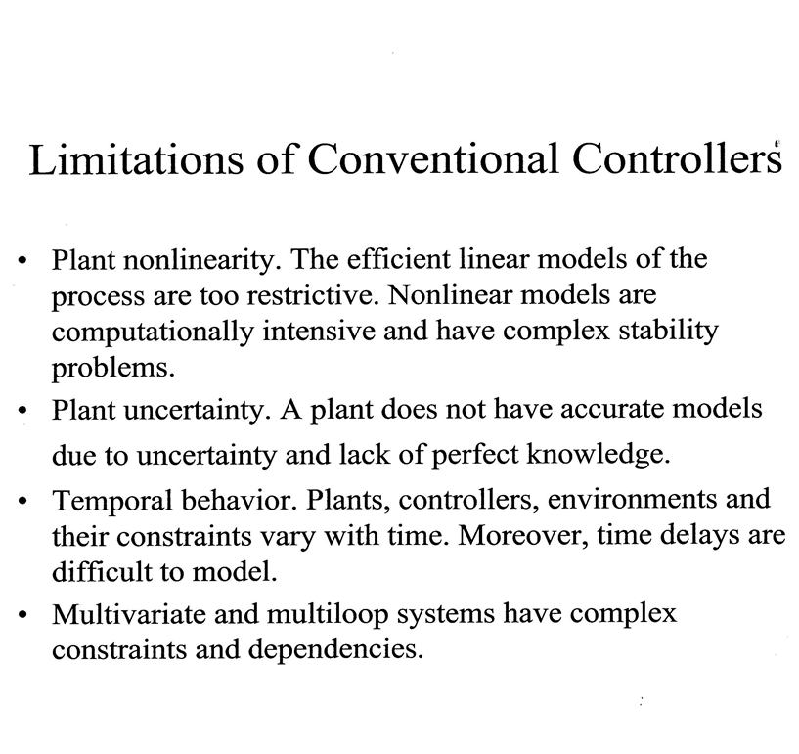

Slide 35
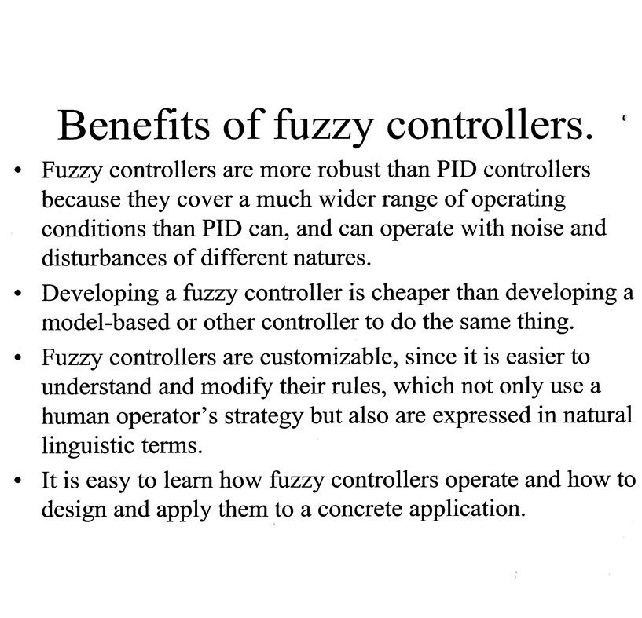

Slide 36
WHY USE FL?
It is inherently robust since it does not require precise, noise-free inputs and can be programmed to fail safely if a feedback sensor quits or is destroyed.
Since the FL controller processes user-defined rules governing the target control system, it can be modified and tweaked easily to improve or drastically alter system performance.
FL is not limited to a few feedback inputs and one or two control outputs, nor is it necessary to measure or compute rate-of-change parameters in order for it to be implemented.
FL can control nonlinear systems that would be difficult or impossible to model mathematically.

Slide 37
HOW IS FL USED?
Define the control objectives and criteria: What am I trying to control? What do I have to do to control the system? What kind of response do I need?
Determine the input and output relationships and choose a minimum number of variables for input to the FL engine (typically error and rate-of-change-of-error).
Using the rule-based structure of FL, break the control problem down into a series of IF X AND Y THEN Z rules that define the desired system output response for given system input conditions.
Create FL membership functions that define the meaning (values) of Input/Output terms used in the rules.
Test the system, evaluate the results, tune the rules and membership functions, and retest until satisfactory results are obtained.

Slide 38
Fuzzy Logic Applications
Aerospace
– Altitude control of spacecraft, satellite altitude control, flow and mixture regulation in aircraft deicing vehicles.
Automotive
– Trainable fuzzy systems for idle speed control, shift scheduling method for automatic transmission, intelligent highway systems, traffic control, improving efficiency of automatic transmissions
Chemical Industry
– Control of pH, drying, chemical distillation processes, polymer extrusion production, a coke oven gas cooling plant

Slide 39
Fuzzy Logic Applications
Robotics
– Fuzzy control for flexible-link manipulators, robot arm control.
Electronics
– Control of automatic exposure in video cameras, humidity in a clean room, air conditioning systems, washing machine timing, microwave ovens, vacuum cleaners.
Defense
– Underwater target recognition, automatic target recognition of thermal infrared images, naval decision support aids, control of a hypervelocity interceptor, fuzzy set modeling of NATO decision making.

Slide 40
Fuzzy Logic Applications
Industrial
– Cement kiln controls (dating back to 1982), heat exchanger control, activated sludge wastewater treatment process control, water purification plant control, quantitative pattern analysis for industrial quality assurance, control of constraint satisfaction problems in structural design, control of water purification plants Signal Processing and
Telecommunications
– Adaptive filter for nonlinear channel equalization control of broadband noise
Transportation
– Automatic underground train operation, train schedule control, railway acceleration, braking, and stopping

Slide 41
Fuzzy Logic Applications
Marine
– Autopilot for ships, optimal route selection, control of autonomous underwater vehicles, ship steering.
Medical
– Medical diagnostic support system, control of arterial pressure during anesthesia, multivariable control of anesthesia, modeling of neuropathological findings in Alzheimer's patients, radiology diagnoses, fuzzy inference diagnosis of diabetes and prostate cancer.

Slide 42
Types of Uncertainty
Stochastic uncertainty
  E.g., rolling a dice
Linguistic uncertainty
  E.g., low price, tall people, young age
Informational uncertainty
  E.g., credit worthiness, honesty

Slide 43


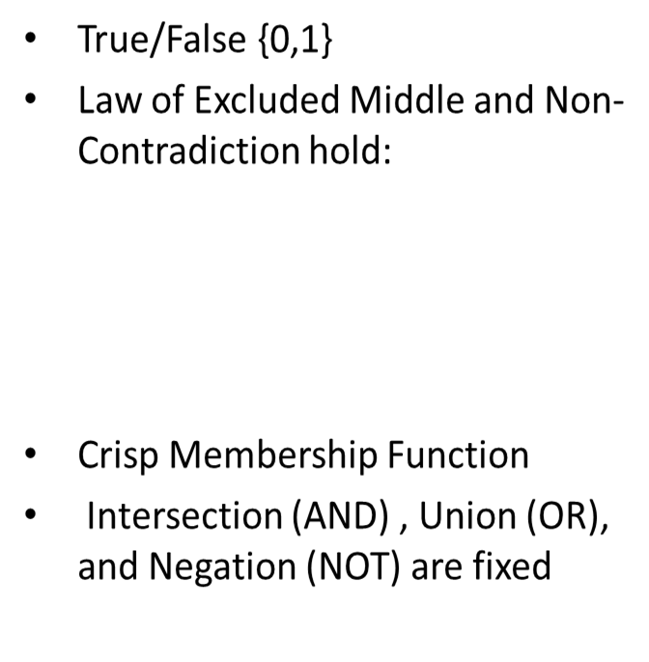
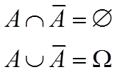
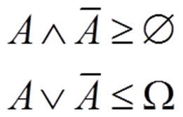
Crisp Vs. Fuzzy
Membership values on [0,1]
Law of Excluded Middle and Non-Contradiction do not necessarily hold:
Fuzzy Membership Function
Flexibility in choosing the Intersection (T-Norm), Union (S-Norm) and Negation operations

Slide 44
Crisp or Fuzzy Logic
Crisp Logic
  A proposition can be true or false only.
    Bob is a student (true)
    Smoking is healthy (false)
  The degree of truth is 0 or 1.
Fuzzy Logic
  The degree of truth is between 0 and 1.
    William is young (0.3 truth)
    Ariel is smart (0.9 truth)

Slide 45


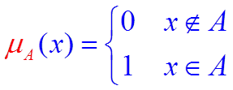

Crisp Sets
Classical sets are called crisp sets
  either an element belongs to a set or not, i.e.,
  Or
Member Function of crisp set

Slide 46

Crisp Sets
P : the set of all people.
Y : the set of all young people.
P
Y
1
25
y

Slide 47
Fuzzy Set
A fuzzy set is almost any condition for which we have words: short men, tall women, hot, cold, new buildings, accelerator setting, ripe bananas, high intelligence, speed, weight, spongy, etc., where the condition can be given a value between 0 and 1. Example: A woman is 6 feet, 3 inches tall. In my experience, I think she is one of the tallest women I have ever met, so I rate her height at .98. This line of reasoning can go on indefinitely rating a great number of things between 0 and 1.

Slide 48

Fuzzy Set
Fuzzy set theory uses Linguistic variables, rather than quantitative variables to represent imprecise concepts.
A Fuzzy Set is a class with different degrees of membership. Almost all real world classes are fuzzy!
Examples of fuzzy sets include: {‘Tall people’}, {‘Nice day’},
{‘Round object’} …
If a person’s height is 1.88 meters is he considered ‘tall’?
What if we also know that he is an NBA player?

Slide 49
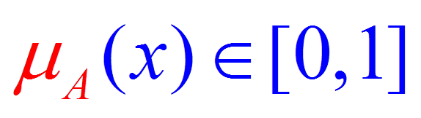
Fuzzy Sets
Example
1
y

Slide 50
EXAMPLE
Crisp logic needs hard decisions. Like in this chart. In this example, anyone lower than 175 cm considered as short, and behind 175 considered as high. Someone whose height is 180 is part of TALL group, exactly like someone whose height is 190
Fuzzy Logic deals with “membership
in group” functions. In this example,
someone whose height is 180, is
a member in both groups. Since
his membership in group of TALL is
0.5 while in group of SHORT only 0.1,
it may be seen that he is much more
TALL than SHORT.

Slide 51
Example
Another way to look at the fuzzy “membership in group”: each circle represents a group. As closer to center to particular circle (group), the membership in that group is “stronger”. In this example, a valid value may be member of Group 1, Group 2, both or neither.

Slide 52
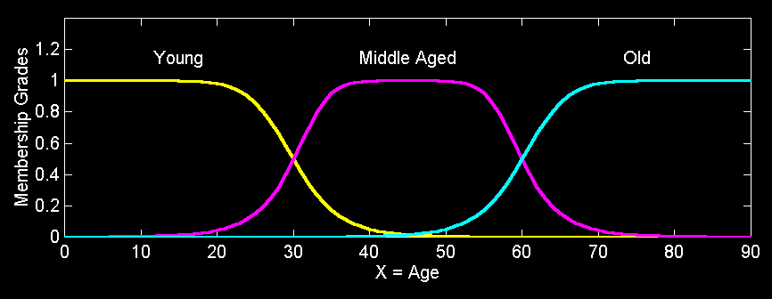
Fuzzy Partition
Fuzzy partitions formed by the linguistic values “young”, “middle aged”, and “old”:

Slide 53
Follow-up Points
Fuzzy Logic Control allows for the smooth interpolation between variable centroids with relatively few rules
This does not work with crisp (traditional Boolean) logic
Provides a natural way to model some types of human expertise in a computer program

Slide 54
Drawbacks to Fuzzy logic
Requires tuning of membership functions
Fuzzy Logic control may not scale well to large or complex problems
Deals with imprecision, and vagueness, but not uncertainty

