Slide 1
Fuzzy Logic
Alexander Mathews
Yuki Osada
Perry Brown

Slide 2
Outline
Fundamental fuzzy concepts
Fuzzy propositional and predicate logic
Fuzzification
Defuzzification
Fuzzy control systems
Types of fuzzy algorithms
Applications of fuzzy logic

Slide 3
Introduction
Fuzzy concepts first introduced by Zadeh in the 1960s and 70s
Traditional computational logic and set theory is all about
true or false
zero or one
in or out (in terms of set membership)
black or white (no grey)
Not the case with fuzzy logic and fuzzy sets!

Slide 4
Basic Concepts
Approximation (“granulation”)
A colour can be described precisely using RGB values, or it can be approximately described as “red”, “blue”, etc.
Degree (“graduation”)
Two different colours may both be described as “red”, but one is considered to be more red than the other
Fuzzy logic attempts to reflect the human way of thinking

Slide 5
Terminology
Fuzzy set
A set X in which each element y has a grade of membership µ_{X}(y) in the range 0 to 1, i.e. set membership may be partial e.g. if cold is a fuzzy set, exact temperature values might be mapped to the fuzzy set as follows:
15 degrees → 0.2 (slightly cold)
10 degrees → 0.5 (quite cold)
0 degrees → 1 (totally cold)
Fuzzy relation
Relationships can also be expressed on a scale of 0 to 1 e.g. degree of resemblance between two people

Slide 6
Terminology (cont’d)
Fuzzy variable
Variable with (labels of) fuzzy sets as its values
Linguistic variable
Fuzzy variable with values that are words or sentences in a language e.g. variable colour with values red, blue, yellow, green…
Linguistic hedge
Term used as a modifier for basic terms in linguistic values e.g. words such as very, a bit, rather, somewhat, etc.

Slide 7
Formal Fuzzy Logic
Fuzzy logic can be seen as an extension of ordinary logic, where the main difference is that we use fuzzy sets for the membership of a variable
We can have fuzzy propositional logic and fuzzy predicate logic
Fuzzy logic can have many advantages over ordinary logic in areas like artificial intelligence where a simple true/false statement is insufficient

Slide 8
Traditional Logic
Propositional logic:
Propositional logic is a formal system that uses true statements to form or prove other true statements
There are two types of sentences: simple sentences and compound sentences
Simple sentences are propositional constants; statements that are either true or false
Compound sentences are formed from simpler sentences by using negations ¬, conjunctions ∧, disjunctions ∨, implications ⇒, reductions ⇐, and equivalences ⇔
Predicate logic:
Onto propositional logic, this adds the ability to quantify variables, so we can manipulate statements about all or some things
Two common quantifiers are the existential ∃ and universal ∀ quantifiers

Slide 9
Formal Fuzzy Logic
Fuzzy Propositional Logic
Like ordinary propositional logic, we introduce propositional variables, truth-functional connectives, and a propositional constant 0
Some of these include:
Monoidal t-norm-based propositional fuzzy logic
Basic propositional fuzzy logic
Łukasiewicz fuzzy logic
Gödel fuzzy logic
Product fuzzy logic
Rational Pavelka logic
Fuzzy Predicate Logic
These extend fuzzy propositional logic by adding universal and existential quantifiers in a manner similar to the way that predicate logic is created from propositional logic

Slide 10
Simple Fuzzy Operators
As described by Zadeh (1973)…
NOT X = 1 - µ_{X}(y)
e.g. 0.8 cold → (1 – 0.8) = 0.2 NOT cold
X OR Y (union) = max(µ_{X}(y), µ_{Y}(y))
e.g. 0.8 cold, 0.5 rainy → 0.8 cold OR rainy
X AND Y (intersection) = min(µ_{X}(y), µ_{Y}(y))
e.g. 0.9 hot, 0.7 humid → 0.7 hot AND humid

Slide 11
Alternative Interpretations of AND and OR
Zadeh’s definition of AND used the Gödel t-norm, but other definitions are possible using different t-norms
Common examples:
Product t-norm: µ_{X}(y) * µ_{Y}(y) e.g. 0.9 hot, 0.7 humid → 0.63 hot AND humid
Lukasiewicz t-norm: max(µ_{X}(y) + µ_{Y}(y) - 1, 0) e.g. 0.9 hot, 0.7 humid → 0.6 hot AND humid
Similar possibilities for OR using corresponding t-conorms:
Product t-conorm: µ_{X}(y) + µ_{Y}(y) - µ_{X}(y) * µ_{Y}(y) e.g. 0.8 cold, 0.5 rainy → 0.9 cold OR rainy
Lukasiewicz t-conorm: min(µ_{X}(y) + µ_{Y}(y), 1) e.g. 0.8 cold, 0.5 rainy → 1 cold OR rainy

Slide 12
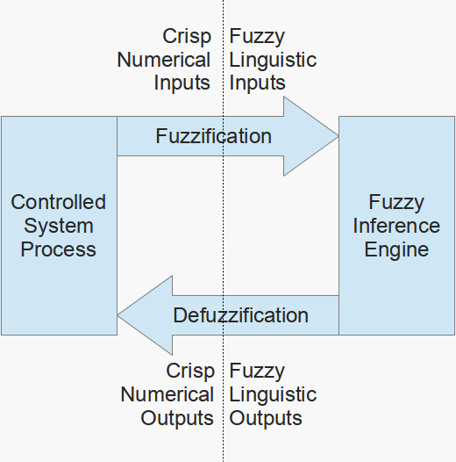
Fuzzy System Overview
When making inferences, we want to clump the continuous numerical values into sets
Unlike Boolean logic, fuzzy logic uses fuzzy sets rather than crisp sets to determine the membership of a variable
This allows values to have a degree of membership with a set, which denotes the extent to which a proposition is true
The membership function may be triangular, trapezoidal, Gaussian or any other shape

Slide 13
Fuzzification
To apply fuzzy inference, we need our input to be in linguistic values
These linguistic values are represented by the degree of membership in the fuzzy sets
The process of translating the measured numerical values into fuzzy linguistic values is called fuzzification
In other words, fuzzification is where membership functions are applied, and the degree of membership is determined

Slide 14
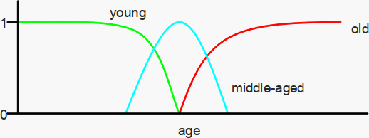
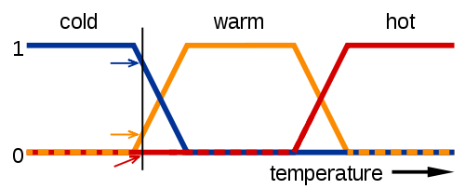
Membership Functions
There are largely three types of fuzzifiers:
singleton fuzzifier,
Gaussian fuzzifier, and
trapezoidal or triangular fuzzifier
Gaussian
Trapezoidal

Slide 15
Defuzzification
Defuzzification is the process of producing a quantifiable result in fuzzy logic
The fuzzy inference will output a fuzzy result, described in terms of degrees of membership of the fuzzy sets
Defuzzification interprets the membership degrees in the fuzzy sets into a specific action or real-value

Slide 16
Methods of Defuzzification
There are many methods for defuzzification
One of the more common types of defuzzification technique is the maximum defuzzification techniques. These select the output with the highest membership function
They include:
First of maximum
Middle of maximum
Last of maximum
Mean of maxima
Random choice of maximum

Slide 17
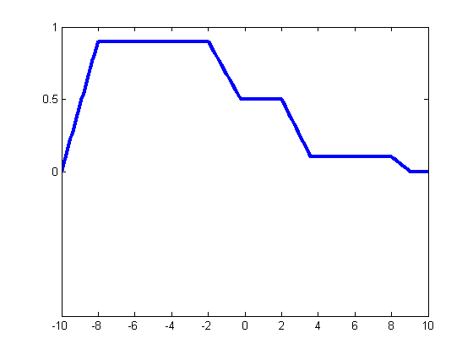
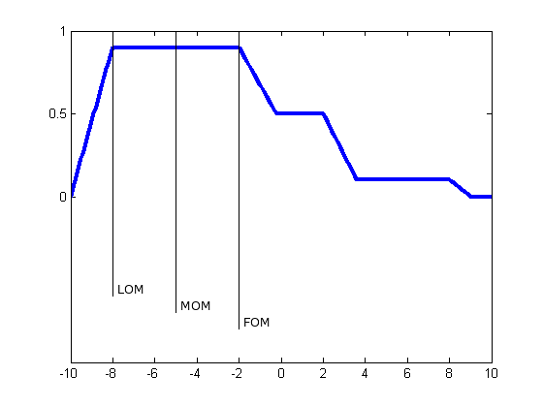
Methods of Defuzzification
Given the fuzzy output:
The first of maximum, middle of maximum, and last of maximum would be -2, -5, and -8 respectively as seen in the diagram
The mean would give the same result as middle unless there is more than one plateau with the maximum value
Image Source: http://www.mathworks.com.au/products/fuzzy-logic/examples.html?file=/products/demos/shipping/fuzzy/defuzzdm.html

Slide 18
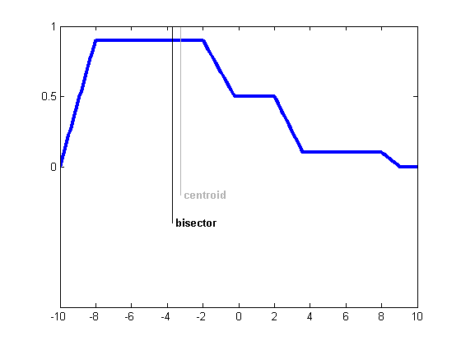
Methods of Defuzzification
Two other common methods are:
Centre of gravity:
Calculates the centre of gravity for the area under the curve
Bisector method:
Finds the value where the area on one side of that value is equal to the area on the other side
Image Source: http://www.mathworks.com.au/products/fuzzy-logic/examples.html?file=/products/demos/shipping/fuzzy/defuzzdm.html

Slide 19
Fuzzy Control Systems
A simple example application: an automated cooling fan that can adjust its speed according to the room temperature
Temperature values are mapped to the fuzzy sets cold, warm and hot based on the following mapping functions for each:
Image: http://en.wikipedia.org/w/index.php?title=File:Fuzzy_logic_temperature_en.svg&page=1

Slide 20
Fuzzy Control Systems
The inference engine in a fuzzy system consists of linguistic rules
The linguistic rules consist of two parts:
an antecedent block (the conditions), which consists of the linguistic variables
a consequent block (the output)
Fuzzy algorithm
Algorithm that includes at least some fuzzy instructions, such as conditional or unconditional action statements
Fuzzy conditional statement (A → B)
Conditional statement in which A and/or B are fuzzy sets e.g. IF temperature is hot THEN fan speed is high
Defined in terms of a fuzzy relation between the respective “universes of discourse” of A and B (compositional rule of inference) e.g. relation between temperature groupings and fan speeds

Slide 21
A Simple Fuzzy Algorithm Example
The algorithm used by our cooling fan controller might look like this:
WHILE fan is switched on IF cold THEN stop fan IF warm AND NOT cooling down THEN increase fan speed slightly IF hot THEN increase fan speed substantially etc…

Slide 22
Types of Fuzzy Algorithms
Definitional algorithms
Define a fuzzy set or calculate grades of membership of elements, e.g.:
handwritten characters (what could an “M” look like?)
measures of proximity (what counts as close?)
Generational algorithms
Generate a fuzzy set e.g. an arbitrary sentence in some natural language that needs to be grammatically valid according to various rules

Slide 23
Types of Fuzzy Algorithms (cont’d)
Relational algorithms
Describe a relation between fuzzy variables
Can be used to approximately describe behaviour of a system
e.g. in our cooling fan example, describing the relation between the input variable (temperature) and output variable (fan speed)
Decisional algorithms
Approximately describe a strategy for performing some task, e.g.:
approaching a set of traffic lights (should we slow down, stop or proceed at current speed?)
navigating a robot towards a goal while avoiding obstacles

Slide 24
Applications of Fuzzy Logic
Control Systems
Consumer systems
automatic transmissions
washing machines
camera autofocus
Industrial systems
aircraft engines
power supply regulation
steam turbine start-up
A commercial tool for building embedded fuzzy systems
Image source: http://www.bytecraft.com/Fuzz-C__Fuzzy_Logic_Preprocessor

Slide 25
Applications of Fuzzy Logic
Artificial Intelligence
Robot motion planning
Image segmentation
Medical diagnosis systems

Slide 26
Fuzzy Logic Control Systems
Why use fuzzy logic for control?
Simple systems:
Low development costs
Low maintenance costs
Complex systems:
Reduced run-time
Reduced search space for efficient optimisation
How can fuzzy logic achieve this?

Slide 27
Fuzzy Control System Development
Fuzzy logic:
Is used to quickly translate from expert knowledge to code
Expert knowledge reduces the search space when optimising the system

Slide 28
Fuzzy Control System Development
Identify performance measure
Select input/output variables
Determine fuzzy rules
Talking to an expert
Data mining
Decide on membership functions for the fuzzy variables
Tune membership functions and/or rules

Slide 29
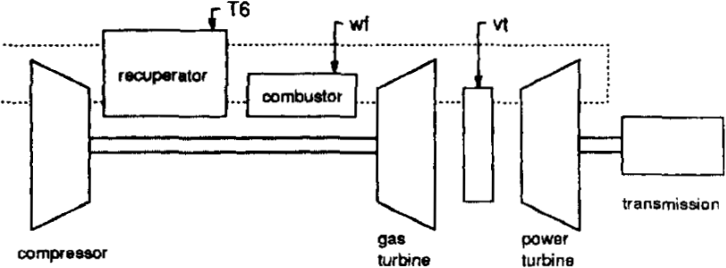
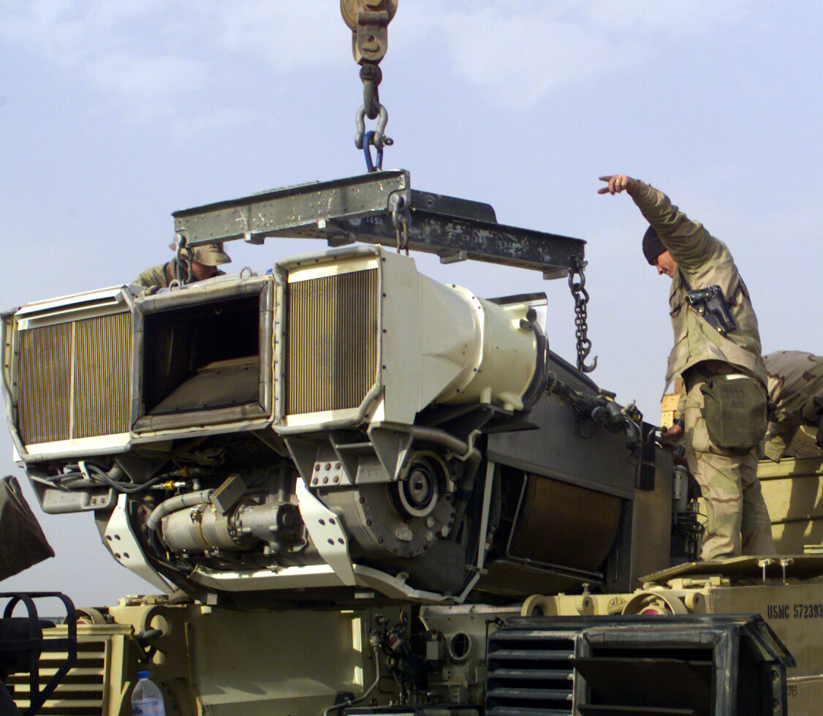
Aircraft Engine Control
Engine:
General Electric's LV100 Turboshaft engine
Existing solution:
10 low level controllers
Only one controller runs at a time
The controller is selected based on current conditions (a crisp mode selector)
Problem:
Abrupt changes when switching controllers
Poor fuel economy
High peak operating temperature
Schematic of the LV100 engine.
An AGT1500 Turboshaft engine being installed into a tank. The AGT1500 is the predecessor to the LV100.
Top Image Source: Bonissone et al. 1995
Bottom Image Source: http://en.wikipedia.org/wiki/Honeywell_AGT1500

Slide 30
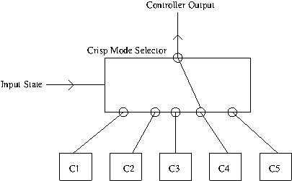
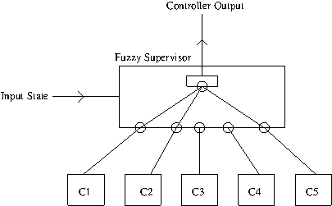
Engine Control: Solution
Replace the crisp mode selector with:
A Fuzzy Supervisor
24 operation modes → 24 operation rules
Blend outputs of existing controllers
Result (from simulation):
Significantly reduced fuel consumption
Did not achieve desired reduction in operating temperature

Slide 31
Engine Control: Solution 2
Hierarchical fuzzy control system
Use a fuzzy supervisor
Replace the low level controllers with fuzzy controllers
6 fuzzy controllers used, 49 rules each
Controllers govern: fuel flow, turbine nozzle area
Fuzzy controllers act on small time scales
Fuzzy supervisor acts on large time scales

Slide 32
Engine Control: Results
Reduced fuel consumption
Lower maximum temperature
Increased component life
Improved performance
Development time was ¼ of the time taken to develop the existing control system

Slide 33
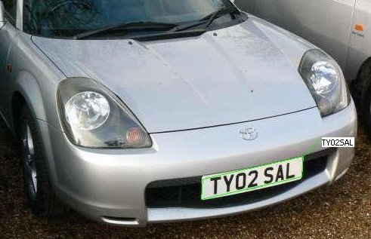
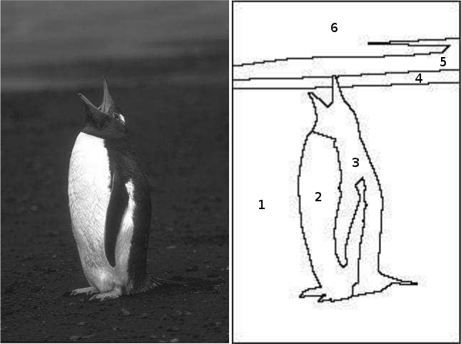
Image Segmentation
Decompose an image into regions
Regions have similar properties
Colour, Texture
Can be a clustering problem or a classification problem
An example of licence plate segmentation.
An example of image segmentation. The input image is on the left. The output image is on the right.
Top Image Source: http://en.wikipedia.org/wiki/Automatic_number_plate_recognition
Bottom Image Source: www.cs.toronto.edu/~jepson/csc2503/segmentation.pdf

Slide 34
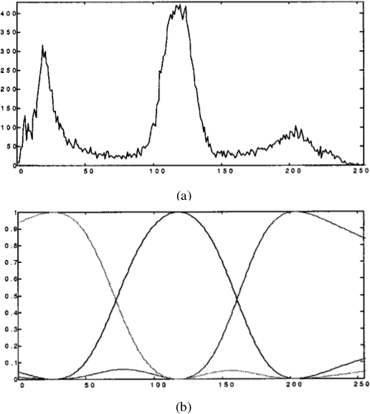
Neuro-Fuzzy Image Segmentation
Decide on the number of fuzzy variables (number of regions)
Calculate the grey-scale histogram
Apply fuzzy c-Means (FCM) to get membership functions
a) a grey scale histogram
b) three fuzzy membership functions for (a)
Image Source: Boskovitz & Guterman 2002

Slide 35
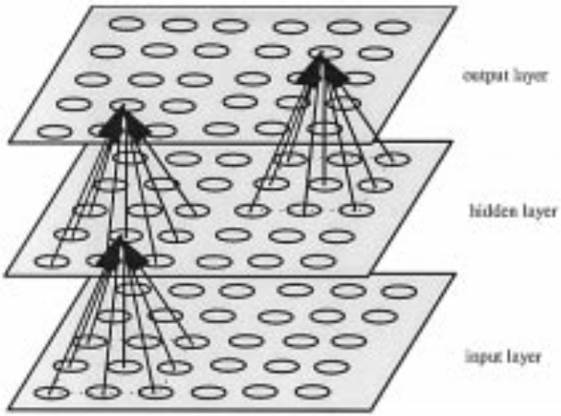
Neuro-Fuzzy Image Segmentation
Pass the MxN image through an LP with layers of size MxN
Fuzzify the pixels in the output layer
The structure of the neural network. Circles are neurons. Arrows are connections between neurons.
Image Source: Boskovitz & Guterman 2002

Slide 36
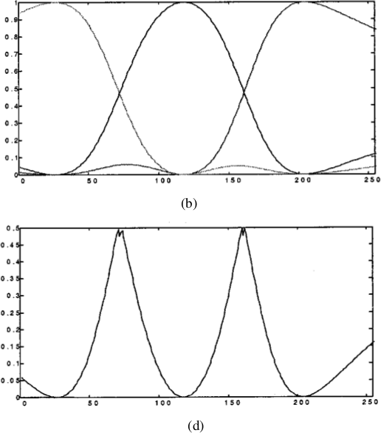
Neuro-Fuzzy Image Segmentation
Calculate the total fuzziness (entropy) of the output
Using fuzzy entropy as the error function, train the MLP with back-propagation
b) three fuzzy membership functions for histogram (a)
d) the fuzziness of each possible grey-scale value
Image Source: Boskovitz & Guterman 2002

Slide 37
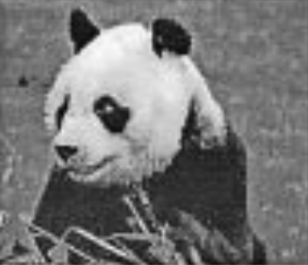
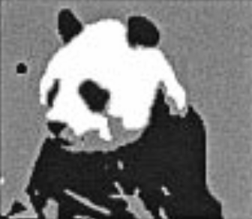
Neuro-Fuzzy Image Segmentation
Input panda image
Output panda image
Image Source: Boskovitz & Guterman 2002

Slide 38
References – General
Zadeh, L.A., “Outline of a New Approach to the Analysis of Complex Systems and Decision Processes”, Systems, Man, and Cybernetics, IEEE Transactions on, 1973 Volume 3, Number 1, 28--44.
M. Navara. (2007). Triangular norms and conorms – Scholarpedia [Online]. Available: http://www.scholarpedia.org/article/Triangular_norms_and_conorms
Unknown author. (2010). Fuzzy Logic Example [Online]. Available: http://petro.tanrei.ca/fuzzylogic/index.html

Slide 39
References – Applications
Bonissone, P.P. and Badami, V. and Chiang, K.H. and Khedkar, P.S. and Marcelle, K.W. and Schutten, M.J., ”Industrial applications of fuzzy logic at General Electric”, Proceedings of the IEEE, 1995, Volume 83, 450--465
Boskovitz, V. and Guterman, H., “An adaptive neuro-fuzzy system for automatic image segmentation and edge detection”, Fuzzy Systems, IEEE Transactions on, 2002, Volume 10, 247--262
Klement, E.P. and Slany, W., “Fuzzy logic in artificial intelligence”, Christian Doppler Laboratory Technical Reports, 1994, Volume 67

