Slide 1
Attacking Authentication
Adam Fremd

Slide 2
Overview
Authentication also lies at the heart of an application’s protection against malicious attack
Front line of defense
What could an attacker achieve if he were to target our authentication mechanism?

Slide 3
Authentication Technologies
HTML forms-based authentication.
Multi-factor mechanisms, such as those combining passwords and physical tokens.
Client SSL certificates and/or smartcards.
HTTP basic and digest authentication.
Windows-integrated authentication using NTLM or Kerberos.
Authentication services.

Slide 4
HTML
the most common authentication mechanism → username and password
90% of applications
Range from simple logins to multiple stage and multi-factor mechanisms using physical tokens

Slide 5
Design Flaws in Authentication Mechanisms
Authentication functionality is subject to more design weaknesses than any other security mechanism commonly employed in web applications
Bad Passwords
Very short or blank
Common dictionary words or names
Set to the same as the username
Still set to a default value

Slide 6
Bad Passwords
HACK STEPS
Attempt to discover any rules regarding password quality:
Review the web site for any description of the rules.
If self-registration is possible, attempt to register several accounts with different kinds of weak passwords to discover what rules are in place.
If you control a single account and password change is possible, attempt to change your password to various weak values.

Slide 7
Bad Passwords

Slide 8
Brute-Forcible Login
If the application allows an attacker to make repeated login attempts with different passwords until the correct one is guessed, then it is highly vulnerable even to an amateur attacker who manually enters some common usernames and passwords into their browser.

Slide 9
Brute-Forcible Login
test
testuser
admin
administrator
demo
demouser
password
password1
password123
qwerty
test123
letmein
[organization’s name]

Slide 10
Brute-Forcible Login
Given today’s bandwidth and processing capabilities, it is possible to make thousands of login attempts per minute from a standard PC and DSL connection.

Slide 11
Brute-Forcible Login

Slide 12
Brute-Forcible Login
HACK STEPS
Submit several bad login attempts for an account you control, monitoring the error messages received.
After around 10 failed logins, if the application has not returned any message about account lockout, attempt to login correctly. If this succeeds, there is probably no account lockout policy.
If you do not control any accounts, attempt to enumerate a valid username and make several bad logins using this, monitoring for any error messages about account lockout.
To mount a brute-force attack, first identify a difference in the application’s behavior in response to successful and failed logins, which can be used to discriminate between these during the course of the automated attack.

Slide 13
Brute-Forcible Login
Obtain a list of common usernames and a list of common passwords. Use any information obtained about password quality rules to tailor the password list so as to avoid superfluous test cases.
Use a suitable tool or a custom script to quickly generate login requests using all permutations of these usernames and passwords. Monitor the server’s responses to identify login attempts that are successful
If you are targeting several usernames at once, it is usually preferable to perform this kind of brute-force attack in a breadth-first rather than a depth-first manner. This involves iterating through a list of passwords (starting with the most common) and attempting each password in turn on every username. This approach has two benefits: first, you will discover accounts with common passwords more quickly, and second, you are less likely to trigger any account lockout defenses, because there is a time delay between successive attempts using each individual account.

Slide 14
Verbose Failure Messages
If an application informs you as to which piece of information was invalid, you can exploit this behavior to considerably diminish the effectiveness of the login mechanism. Then use brute-forcible login attack

Slide 15
Verbose Failure Messages
HACK STEPS
If you already know one valid username (for example, an account you control), submit one login using this username and an incorrect password,
and another login using a completely random username.
Record every detail of the server’s responses to each login attempt,
including the status code, any redirects, information displayed on screen,
and any differences hidden away in the HTML page source. Use your
intercepting proxy to maintain a full history of all traffic to and from the
server.
Attempt to discover any obvious or subtle differences in the server’s
responses to the two login attempts.
If this fails, repeat the exercise everywhere within the application where a username can be submitted (for example, self-registration, password change, and forgotten password).

Slide 16
Verbose Failure Messages
If a difference is detected in the server’s responses to valid and invalid usernames, obtain a list of common usernames and use a custom script or automated tool to quickly submit each username and filter the responses that signify that the username is valid.
Before commencing your enumeration exercise, verify whether the application performs any account lockout after a certain number of failed login attempts. For example, if the application will grant you only three failed login attempts with any given account, you run the risk of “wasting” one of these for every username that you discover through automated enumeration. Therefore, when performing your enumeration attack, do not submit a completely far-fetched password with each login attempt, but rather submit either (a) a single common password such as “password1” or (b) the username itself as the password. If password quality rules are weak, it is highly likely that some of the attempted logins that you perform as part of your enumeration exercise will actually be successful and disclose both the username and password in one single hit. To implement option (b) and set the password field to the same as the username, you can use the “battering ram” attack mode in Burp Intruder to insert the same payload at multiple positions in your login request.

Slide 17
Vulnerable Transmission of Credentials
Potential eavesdroppers that look for unencrypted HTTP connections may reside:
On the user’s local network
Within the user’s IT department
Within the user’s ISP
On the Internet backbone
Within the ISP hosting the application
Within the IT department managing the application

Slide 18
Vulnerable Transmission of Credentials
Even on a secure HTTPS connection, unauthorized parties may exist:
Within the user’s browser history, within the web server logs, and within the logs of any reverse proxies employed within the hosting infrastructure.
When the login request being handled via a redirect to a different URL with the same credentials passed as query string parameters.
When Web applications store user credentials in cookies, usually to implement poorly designed mechanisms for login, password change, “remember me,” and so on.

Slide 19
Vulnerable Transmission of Credentials
HACK STEPS
Carry out a successful login while monitoring all traffic in both directions between the client and server.
Identify every case in which the credentials are transmitted in either direction.
If any instances are found in which credentials are submitted in a URL query string, or as a cookie, or are transmitted back from the server to the client, understand what is happening. Try to find every means by which an attacker might interfere with the application to compromise other users’ credentials.
If any sensitive information is transmitted over an unencrypted channel, this is, of course, vulnerable to interception.
If credentials are submitted using HTTPS but the login form is loaded using HTTP, then the application is vulnerable to a man-in-the-middle attack, which may be used to capture credentials.

Slide 20
Password Change Functionality
Applications should have password change functions to:
Mitigate the threat of password compromise by reducing the window in which a given password can be targeted in a guessing attack and by reducing the window in which a compromised password can be used without detection by the attacker.
Be able to quickly change their password to reduce the threat of unauthorized use.

Slide 21
Password Change Functionality
The password change functions my be vulnerable if it:
Provides a verbose error message indicating whether the requested username is valid.
Allows unrestricted guesses of the “existing password” field.
Only check whether the “new password” and “confirm new password” fields have the same value after validating the existing password, thereby allowing an attack to succeed in discovering the existing password noninvasively.

Slide 22
Password Change Functionality
HACK STEPS
Identify any password change functionality within the application. If this is not explicitly linked from published content, it may still be implemented.
Make various requests to the password change function, using invalid usernames, invalid existing passwords, and mismatched “new password” and “confirm new password” values.
Try to identify any behavior that can be used for username enumeration or brute-force attacks

Slide 23
Forgotten Password Functionality
Design weaknesses in forgotten password functions frequently make this the weakest link at which to attack the application’s overall authentication logic.
Often involves secondary challenge such as questions about mothers’ maiden names, memorable dates, favorite colors, and the like will generally have a much smaller set of potential answers than the set of possible passwords.
This challenge is often much easier for an attacker to respond to than attempting to guess the user’s password

Slide 24
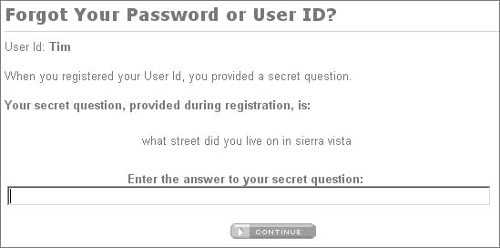
Forgotten Password Functionality

Slide 25
Forgotten Password Functionality
Users are inclined to set extremely insecure challenges, presumably on the false assumption that only they will ever be presented with them, for example: “Do I own a boat?”
If an application allows unrestricted attempts to answer password recovery challenges, then it is highly likely to be compromised by a determined attacker.

Slide 26
Forgotten Password Functionality
In some applications, the recovery challenge is replaced with a simple password “hint” that is configurable by users during registration. Users commonly set extremely obvious hints, even one that is identical to the password itself, on the false assumption that only they will ever see them.

Slide 27
Forgotten Password Functionality
How to combat these vulnerabilities:
One reasonably secure means of implementing this is to send a unique, unguessable, time-limited recovery URL to the email address that the user provided during registration. Visiting this URL within a few minutes enables the user to set a new password.
But there are vulnerabilities to this method also, as attackers can be disclosed the password after successful login or disclosing the email used to the attacker.

Slide 28
Forgotten Password Functionality
HACK STEPS
Identify any forgotten password functionality within the application. If this is not explicitly linked from published content, it may still be implemented.
Understand how the forgotten password function works by doing a complete walk-through.
If the mechanism uses a challenge, determine whether users are able to set or select their own challenge and response. If so, use a list of enumerated or common usernames to harvest a list of challenges, and review this for any that appear easily guessable.
If the mechanism uses a password “hint,” do the same exercise to harvest a list of password hints, and target any that are easily guessable.
Try to identify any behavior in the forgotten password mechanism that can be exploited as the basis for username enumeration or brute-force attacks.
If the application generates an email containing a recovery URL in response to a forgotten password request, obtain a number of these URLs, and attempt to identify any patterns that may enable you to predict the URLs issued to other users. Employ the same techniques as are relevant to analyzing session tokens for predictability.

Slide 29
“Remember Me” Functionality
Applications often implement “remember me” functions as a convenience to users, to prevent them needing to reenter their username and password each time.
This function is often insecure by design and leaves the user exposed to attack both locally and by users on other computers.

Slide 30
“Remember Me” Functionality
“Remember Me” function generally uses a cookie. When this cookie is submitted to the initial application page, the application trusts the cookie to authenticate the user, and creates an application session for that person, bypassing the login.

Slide 31
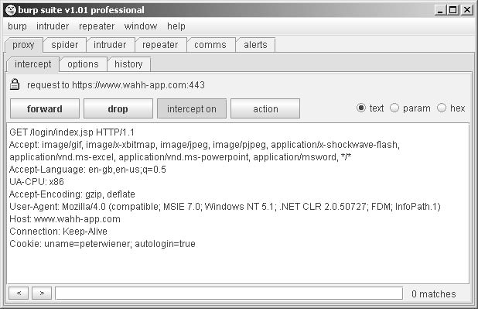
“Remember Me” Functionality

Slide 32
“Remember Me” Functionality
Even if the information stored in a cookie for re-identifying users is suitably protected (e.g., encrypted) to prevent other users from determining or guessing it, the information may still be vulnerable to capture through a bug such as cross-site scripting

Slide 33
“Remember Me” Functionality
HACK STEPS
Activate any “remember me” functionality, and determine whether the functionality indeed does fully “remember” the user or whether it only remembers their username and still requires them to enter a password on subsequent visits.
Closely inspect all persistent cookies that are set. Look for any saved data that identifies the user explicitly or appears to contain some predictable identifier of the user.
Even where data stored appears to be heavily encoded or obfuscated, review this closely and compare the results of “remembering” several very similar usernames and/or passwords to identify any opportunities for reverse engineering the original data.
Attempt to modify the contents of the persistent cookie to try and convince the application that another user has saved his details on your computer.

Slide 34
User Impersonation Functionality
Some applications allow privileged users of the application to impersonate other users, in order to access data and carry out actions within their user context.
Some banking applications allow helpdesk operators to verbally authenticate a telephone user and then switch their application session into that user’s context in order to assist them.
This function has some design flaws though

Slide 35
User Impersonation Functionality
It may be implemented as a “hidden” function, which is not subject to proper access controls. For example, anyone who knows or guesses the URL /admin/ImpersonateUser.jsp may be able to make use of the function and impersonate any other user.
The application may trust user-controllable data when determining whether the user is performing impersonation. For example, in addition to a valid session token, a user may also submit a cookie specifying which account their session is currently using. An attacker may be able to modify this value and gain access to other user accounts without authentication.

Slide 36
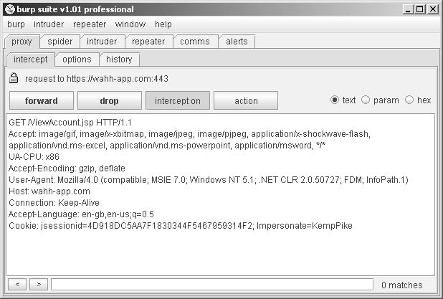
User Impersonation Functionality

Slide 37
User Impersonation Functionality
If an application allows administrative users to be impersonated, then any weakness in the impersonation logic may result in a vertical privilege escalation vulnerability → an attacker may gain full control of the application.

Slide 38
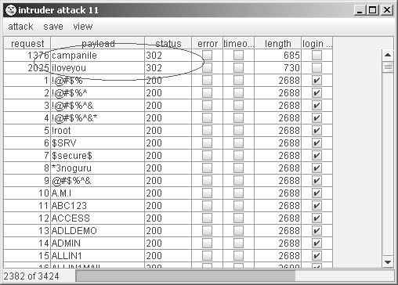
User Impersonation Functionality
Back-door password is also vulnerable to discovery by an attacker if matched with the user’s actual password

Slide 39
User Impersonation Functionality
HACK STEPS
Identify any impersonation functionality within the application. If this is not explicitly linked from published content, it may still be implemented.
Attempt to use the impersonation functionality directly to impersonate other users.
Attempt to manipulate any user-supplied data that is processed by the impersonation function in an attempt to impersonate other users.
If you succeed in making use of the functionality, attempt to impersonate any known or guessed administrative users, in order to elevate privileges.
When carrying out password guessing attacks, review whether any users appear to have more than one valid password, or whether a specific password has been matched against several usernames. Also, log in as many different users with the credentials captured in a brute-force attack, and review whether everything appears normal. Pay close attention to any “logged in as X” status message.

Slide 40
Incomplete Validation of Credentials
Some poorly designed authentication mechanisms not only do not enforce the good practices of a minimum length or the presence of both uppercase and lowercase characters in passwords, but also do not take account of users’ own attempts to comply with them.

Slide 41
Incomplete Validation of Credentials
HACK STEPS
Using an account you control, attempt to log in with variations on your own password: removing the last character, changing the case of a character, and removing any special typographical characters. If any of these attempts is successful, continue experimenting to try and understand what validation is actually occurring.
Feed any results back into your automated password guessing attacks, to remove superfluous test cases and improve the chances of success.

Slide 42
Non-Unique Usernames
Flaws:
One user who shares a username with another user may also happen to select the same password as that user, either during registration or in a subsequent password change.
An attacker may exploit this behavior to carry out a successful brute-force attack, even though this may not be possible elsewhere due to restrictions on failed login attempts.
An attacker can register a specific username multiple times with different passwords, while monitoring for the differential response that indicates that an account with that username and password already existed.

Slide 43
Non-Unique Usernames
HACK STEPS
If self-registration is possible, attempt to register the same username twice with different passwords.
If the application blocks the second registration attempt, you can exploit this behavior to enumerate existing usernames even if this is not possible on the main login page or elsewhere. Make multiple registration attempts with a list of common usernames to identify the already registered names that the application blocks.
If the registration of duplicate usernames succeeds, attempt to register the same username twice with the same password, and determine the application’s behavior:
If an error message results, you can exploit this behavior to carry out a brute-force attack, even if this is not possible on the main login page. Target an enumerated or guessed username, and attempt to register this username multiple times with a list of common passwords. When the application rejects one specific password, you have probably found the existing password for the targeted account.
If no error message results, log in using the credentials you specified and see what happens. You may need to register several users, and modify different data held within each account, to understand whether this behavior can be used to gain unauthorized access to other users’ accounts.

Slide 44
Predictable Usernames
Attackers can quickly discern names and passwords if an application has usernames in a particular sequence such as cust5331, cust5332, etc.
HACK STEPS
If usernames are generated by the application, try to obtain several usernames in quick succession and determine whether any sequence or pattern can be discerned.
If so, extrapolate backwards to obtain a list of possible valid usernames. This can be used as the basis for a brute-force attack against the login and other attacks where valid usernames are required, such as the exploitation of access control flaws.

Slide 45
Predictable Initial Passwords
In some applications, users are created all at once or in sizeable batches and are automatically assigned initial passwords, which are then distributed to them through some means.
Results in predictable passwords that attackers can break
More common on intranet-based corporate applications— for example, where every employee has an account created on their behalf, and receives a printed notification of their password.

Slide 46
Predictable Initial Passwords
HACK STEPS
If passwords are generated by the application, try to obtain several passwords in quick succession and determine whether any sequence or pattern can be discerned.
If so, extrapolate the pattern to obtain a list of passwords for other application users.
If passwords demonstrate a pattern that can be correlated with usernames, you can try to log in using known or guessed usernames and the corresponding inferred passwords.
Otherwise, you can use the list of inferred passwords as the basis for a

Slide 47
Insecure Distribution of Credentials
If the message distributed contains both username and password, there is no time limit on their use, and there is no requirement for the user to change password on first login, then it is highly likely that a large number, even a majority, of application users will not modify their initial credentials and that the distribution messages will remain in existence for a lengthy period during which they may be accessed by an unauthorized party.

Slide 48
Insecure Distribution of Credentials
HACK STEPS
Obtain a new account. If you are not required to set all credentials during registration, determine the means by which the application distributes credentials to new users.
If an account activation URL is used, try to register several new accounts in close succession and identify any sequence in the URLs you receive. If a pattern can be determined, try to predict the activation URLs sent to recent and forthcoming users, and attempt to use these URLs to take ownership of their accounts.
Try to reuse a single reactivation URL multiple times, and see if the application allows this. If not, try locking out the target account before reusing the URL, and see if it now works.

Slide 49
Implementation Flaws in Authentication
More subtle and harder to detect

Slide 50
Fail-Open Login Mechanisms
Changing the log-in code to find any design flaws
HACK STEPS
Perform a complete, valid login using an account you control. Record every piece of data submitted to the application, and every response received, using your intercepting proxy.
Repeat the login process numerous times, modifying pieces of the data submitted in unexpected ways. For example, for each request parameter or cookie sent by the client:
Submit an empty string as the value.
Remove the name/value pair altogether.
Submit very long and very short values.
Submit strings instead of numbers and vice versa.
Submit the same item multiple times, with the same and different values.
For each malformed request submitted, review closely the application’s response to identify any divergences from the base case.
Feed these observations back into framing your test cases. When one modification causes a change in behavior, try to combine this with other changes to push the application’s logic to its limits.

Slide 51
Defects in Multistage Login Mechanisms
Elaborate login mechanisms involving multiple stages:
Entry of a username and password.
A challenge for specific digits from a PIN or a memorable word.
The submission of a value displayed on a changing physical token.
In several cases where a combination of flaws is present, multistage logins can even result in a solution that is less secure than a normal login based on username and password.

Slide 52
Defects in Multistage Login Mechanisms
Flaws:
Attackers may bypass stages in the login if the application is designed to assume that previous logins were correct.
Attackers may interfere with login transition red flags and modify application to allow procession with only partial credentials.
Attackers may use multiple identities and passwords on the same user identity at different stages of the login process.

Slide 53
Defects in Multistage Login Mechanisms
HACK STEPS
Perform a complete, valid login using an account you control. Record every piece of data submitted to the application using your intercepting proxy.
Identify each distinct stage of the login and the data that is collected at each stage. Determine whether any single piece of information is collected more than once or is ever transmitted back to the client and resubmitted, via a hidden form field, cookie, or preset URL parameter.
Repeat the login process numerous times with various malformed requests:
Try performing the login steps in a different sequence.
Try proceeding directly to any given stage and continuing from there.
Try skipping each stage and continuing with the next.
Use your imagination to think of further ways of accessing the different stages that the developers may not have anticipated.

Slide 54
Defects in Multistage Login Mechanisms
HACK STEPS
If any data is submitted more than once, try submitting a different value at different stages, and see whether the login is still successful. It may be that some of the submissions are superfluous and are not actually processed by the application. It might be that the data is validated at one stage and then trusted subsequently — in this instance, try to provide the credentials of one user at one stage, and then switch at the next to actually authenticate as a different user. It might be that the same piece of data is validated at more than one stage, but against different checks — in this instance, try to provide (for example) the username and password of one user at the first stage, and the username and PIN number of a different user at the second stage.
Pay close attention to any data being transmitted via the client that was not directly entered by the user. This may be used by the application to store information about the state of the login progress, and may be trusted by the application. For example, if the request for stage three includes the parameter “stage2complete=true” then it may be possible to advance straight to stage three by setting this value. Try to modify the values being submitted and determine whether this enables you to advance or skip stages.

Slide 55
Defects in Multistage Login Mechanisms
Attackers may be able to break the “secret” questions on logins by:
Discovery of question and answer within a hidden HTML form field or cookie
Cycling through questions until they arrive at one which they know the answer to

Slide 56
Defects in Multistage Login Mechanisms
HACK STEPS
If one of the login stages uses a randomly varying question, verify whether the details of the question are being submitted together with the answer. If so, change the question, and submit the correct answer associated with that question, and verify whether the login is still successful.
If the application does not enable an attacker to submit an arbitrary question and answer, perform a partial login several times with a single account, proceeding each time as far as the varying question. If the question changes on each occasion, then an attacker can still effectively choose which question to answer.

Slide 57
Insecure Storage of Credentials
It is very common to encounter web applications in which user credentials are stored in unencrypted form within the database.
HACK STEPS
Review the entire authentication-related functionality of the application, and also any functions relating to user maintenance. If any instances are found in which a user’s password is transmitted back to the client, then this may indicate that passwords are being stored in an insecure manner.
If any kind of arbitrary command or query execution vulnerability is identified within the application, attempt to find the location within the application’s database or file system where user credentials are stored. Query these to determine whether passwords are being stored in unencrypted form.

Slide 58
Securing Authentication
Need to counterbalance defense against threats with actual user-friendliness

Slide 59
Using Strong Credentials
Suitable minimum password quality requirements
Minimum length; character, numbers; lower and upper case, etc.
Unique
Non-sequenced and non-predictable
Allowance of longer passwords and wide range of characters

Slide 60
Handle Credentials Secretively
Created using a well-established cryptographic technology, such as SSL
HTTP for unauthenticated areas and HTTPS for the login form itself
Credentials should never be placed in URL parameters or cookies
All server-side application components should store credentials in a manner that does not allow their original values to be easily recovered
“Remember me” functionality should in general only remember non-secret items such as usernames.
Passwords should be changed periodically
Drop down menus should be used in place of text fields for user’s login info in regards to hints and memorable words

Slide 61
Validate Credentials Properly
All authentication logic should be closely code-reviewed to identify logic errors such as fail-open conditions.
Multistage logins should
Not allows users to enter the same information more than once or change it once the page was been processed
The first task carried out at every stage should be to verify that all prior stages have been correctly completed.
To prevent information leakage about which stage of the login failed, the application should always proceed through all stages of the login, even if the user has failed to complete earlier stages correctly, and even if the original username was invalid.

Slide 62
Validate Credentials Properly
Ensure that an attacker is not able to effectively choose his own question in the random varying question process
First user should identify themselves, then have the question at a later stage
Validate saved answers versus saved questions

Slide 63
Prevent Information Leakage
An attacker should have no means of determining which piece of the various items submitted has caused a problem.
A single code component should be responsible for responding to all failed login attempts, with a generic message.

Slide 64
Prevent Brute-Force Attacks
Measures should be taken to prevent attacks via automation such as the use of unpredictable usernames.
A more balanced policy, suitable for most security-aware applications, is to suspend accounts for a short period (e.g., 30 minutes) following a small number of failed login attempts (e.g., three). → slows down password guessing attacks

Slide 65
Prevent Brute-Force Attacks
Temporary account suspension:
The application should never indicate that any specific account has been suspended.
Instead, a message advising that accounts are suspended if multiple failures occur and that the user should “try again later.”
Login attempts should be rejected without even checking the credentials, when accounts are suspended to prevent attackers from continuing to attempt to login

Slide 66
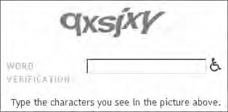
Prevent Brute-Force Attacks
An application can specifically protect itself against this kind of attack through the use of CAPTCHA (“Completely Automated Public Turing test to tell Computers and Humans Apart”) challenges on every page that may be a target for brute-force attacks

Slide 67
Prevent Misuse of the Password Change Function
Use of password change functions
Periodic password expiration and user controlled changes
Password can only be changed during a session
New password should be entered twice to prevent mistakes → compare the “new password” and “confirm new password” fields

Slide 68
Prevent Misuse of the Account Recovery Function
Automated recovery function
NEVER use password “hints”
Best is to email the user a unique, time-limited, unguessable, single-use recovery URL.
May also use a secondary function
Same question for everyone to prevent weak question selection
Answers should not be easily guessable
Accounts should be suspended after a set number of failed guesses
Successful reactivation should only be communicated via email on a reactivation URL

Slide 69
Log, Monitor, and Notify
All authentication-related events should be logged by the application, including login, logout, password change, password reset, account suspension, and account recovery.
Anomalies in authentication events should be processed by the application’s real-time alerting and intrusion prevention functionality.
Users should be communicated with via out-of-band such as email if changes to their accounts are made

Slide 70
Chapter 6 Summary
Authentication functions are perhaps the most prominent target in a typical application’s attack surface.
They lie at the core of the security mechanisms that an application employs to defend itself, and are the front line of defense against unauthorized access.
Protective measures need to taken against design and implementation flaws
Measures against bad passwords, usernames and brute-force attacks
Logins need to be created to ensure protection and security of vulnerable information

