Slide 1
AUTHENTICATION IN the CLOUD
Are we really safe in the cloud?
G-Force
Veronica, Jason, Doug and Socrates

Slide 2
Outline
1. Problem definition
2. Businesses and cloud
3. Cloud models and Issues
3. The difference
3. Authentication issues

Slide 3
Security Problem Selected
The security problem that G Force has selected is the authentication of different devices and users in cloud computing.
This is an important issue all of our employers have in common as more companies migrate to cloud computing and they need more secure solutions implemented. Corporate concerns are:
Single point of failure for authentication
Data breaches because of weak authentication
Security in the cloud is the #1 concern of businesses
All sectors are migrating to cloud computing because IT costs can be cut, it reduces capital expenses, and is a viable option to modernize legacy systems.

Slide 4
Businesses and cloud
Business requirements: Netflix, Adobe connect, Expense reporting, Timesheet, Payroll systems
Support customers with multiple devices accessing their system
Moving existing applications out of the datacenter and into virtual private and fully public clouds.
Fully embracing virtual datacenters, which means consolidating physical datacenters, and (if the company’s large enough) forming a private cloud.
Outsourcing applications. There’s SaaS applications like Workday, ADP, Concur, and SalesForce.com that have replaced functions that used to run in the datacenter, and then there’s also custom apps for data that’s proprietary, sensitive or regulated, which many people are running in a platform-as-a-service (PaaS) extension.

Slide 5
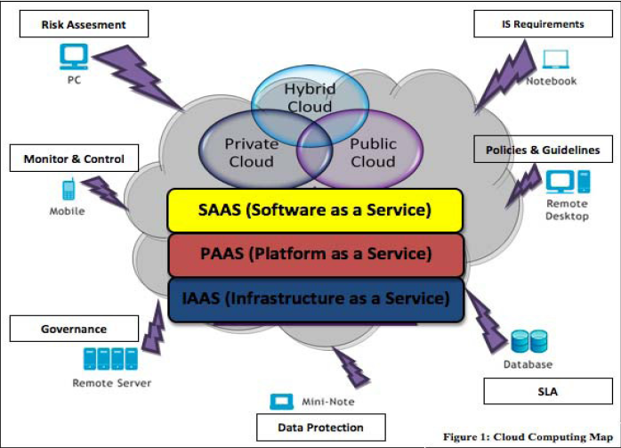
Cloud models and Issues
Different deployment models: Private, Public, and Hybrid
Private: Issue “still have to buy, build, and manage them”
Public: No direct connection and control. Amazon, Microsoft and
Google
Hybrid : lack the flexibility, security and certainty of in-
house applications

Slide 6
The difference
Internal System
More secure authentication like LDAP, KERBOES
Company has a control over the data and process
User management is easy and more controlled
Cloud System
Proprietary authentication system
It is a nightmare to manage the users remotely. We wont know what the vendor is doing
Migration is very difficult. It is difficult to synchronise login and authentication data between external clouds and internal systems without exposing internal security data.

Slide 7
Cloud Authentication issues
Cloud service providers request customers to store their account information in the cloud, cloud service providers have the access to these information. This presents a privacy issue to the customer’s privacy information.
Many SLAs have specified the privacy of the sensitive information, however, it is difficult for customers to make sure the proper rules are enforced. There is a lack of transparency in the cloud that allows the customers to monitor their own privacy information.
When a customer decide to use multiple cloud service, the customer will have to store his/her password in multiple cloud, the more cloud service the customer is subscript to, the more copy of the user’s information will be. This is a security issue for the customers and the cloud service providers.
The multiple copies of account will lead to multiple authentication processes. For every cloud service, the customer needs to exchange his/her authentication information. This redundant actions may lead to an exploit of the authentication mechanism.
Cloud service providers use different authentication technologies for authenticating users, this may have less impact on SaaS than PaaS and IaaS, but it is present a challenge to the customers.

Slide 8
Authentication issues - contd
Wells Fargo Customer Data Breached – How Did Cyber-Criminals Get The Access Codes? – Why No Strong Authentication?
Dictionary attack?
Security issues in cloud computing has played a major role in slowing down its acceptance, in fact security ranked first as the greatest challenge issue of cloud computing as depicted in the chart.

Slide 9
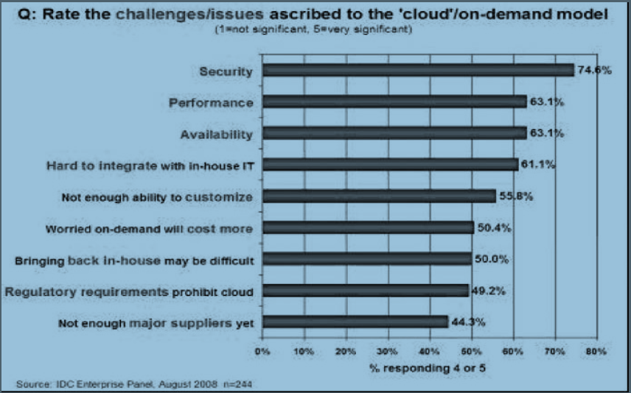
Survey on Cloud computing

Slide 10
References
http://en.wikipedia.org/wiki/Two-factor_authentication
http://blog.ironkey.com/?p=437
http://cscjournals.org/csc/manuscript/Journals/IJCN/volume3/Issue5/IJCN-176.pdf
http://en.wikipedia.org/wiki/Cloud_computing#Hybrid_cloud
http://www.sersc.org/journals/IJMUE/vol7_no3_2012/18.pdf
http://data-protection.safenet-inc.com/2012/05/cloud-computing-migration-from-physical-datacenter-to-the-cloud/

