Slide 1
Hacking the Bluetooth Pairing Authentication Process
Graduate Operating System Mini Project
Siyuan Jiang and Haipeng Cai

Slide 2
Content Overview
Linux Bluetooth Architecture
structure of the kernel and user code
Protocol Stack
including where passcode request starts
Pairing Authentication
details of the authentication process
Adapt to Using Byte Sequence Passcode
modifications required for byte-seq passcode
Conclusion

Slide 3
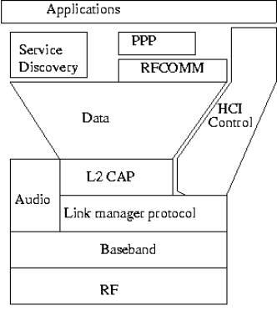
Linux Bluetooth Architecture
-RF and Baseband
- physical layer
- IEEE 802.15.1
- 2.5GHz band (ISM)
-Link manager and L2CAP²
- Media Access Control
- link setup, security
User
Modules
Kernel
Module
Module Architecture of Common Bluetooth¹
1: figure from http://progtutorials.tripod.com/Bluetooth_Technology.htm
2: Logical Link Control and Adaptation Protocol

Slide 4
Linux Bluetooth Architecture
-Host Controller Interface
- command interface to
the layers below
- part in kernel, part in
user space
-RFCOMM
- serial port emulation over
L2CAP
-Service Discovery
- search pair devices
User
Modules
Kernel
Module
Module Architecture of Common Bluetooth¹

Slide 5
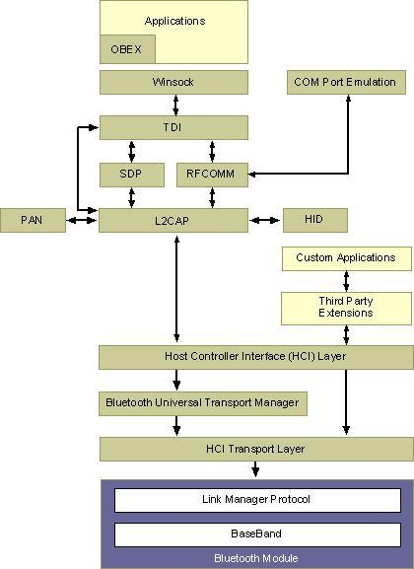
Protocol Stack
- Pairing with passcode
goes through the
HCI interface
Pairing Authentication by Passcode/PinCode
figure from http://msdn.microsoft.com/en- us/library/ms890956.aspx
2. "Winsock" can be general socket instead

Slide 6
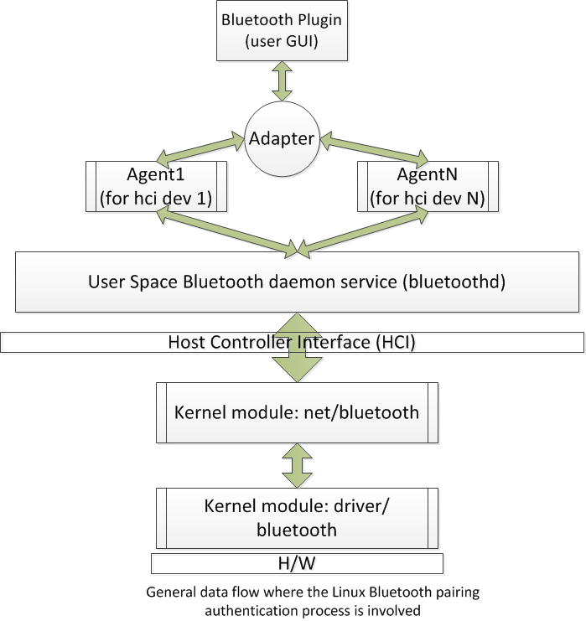
Pairing Authentication
User initiates the pairing process
- Normally done with
PinCode, an ASCII
string up to 32
characters in length
- Transfer of the pincode
as a string happens only
to the user space code

Slide 7
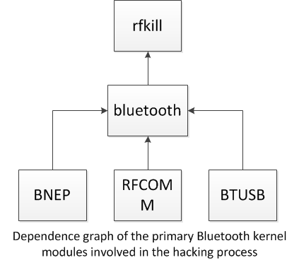
Pairing Authentication
- Connect
1. kernel module loaded (auto with the kernel boot)
- sub-modules loaded in order:
bluetooth->bnep->rfcomm->btusb
- Bluetooth core started
- HCI device and connection manager
initialized
- HCI socket layer initialized
- L2CAP socket layer initialized
- Bluetooth USB driver initialized
(kernel module: kernel/driver/bluetooth/btusb.c)

Slide 8
Pairing Authentication
- BNEP (Ethernet Emulator) started
- HCI device (hci0, for instance) opened
(kernel module: kernel/net/bluetooth/hci_event.c)
- RFCOMM TTY and socket layer initialized
(now HCI device will send frames by socket to the peer from the next step to respond connection/authentication event handling)
2. Bluetooth daemon started (bluetoothd in user space)
- SDP (service discovery protocol) server started with configurations loaded (user module: src/sdpd-server.c)
- adapter (sub-component of the bluez user space module)
enabled (user module: src/adapter.c)
- start waiting for HCI events from the device opened before
(hci0, for instance)

Slide 9
Pairing Authentication
3. Connection established
- adapter launches an SDP session to search for available peer devices once user opened the "device setup" interface provided via the GUI plugin (user module: plugins/hciops.c)
- available devices listed (devices previously paired do not show up again) and user selects one to connect. Now adapter initiates an agent for the selected peer
- SDP session stops once the plugin starts connecting to the picked device via the HCI interface, which connects to the peer by sending connection event to the kernel module that then connects to the device via socket (through the protocol stack with the driver code invoked) (user module: plugins/hciops.c --> src/device.c --> kernel module: net/bluetooth/hci_event. --> net/bluetooth/hci_core.c --> driver code...)

Slide 10
Pairing Authentication
Passcode request starts here
- Pairing
4. User module request sent
- plugin sends "authentication pin request" to adapter after connection completed (user module: src/hciops.c --> src/adapter.c --> src/event.c)
- adapter responds to the event and requests the HCI device for authentication with pincode via the agent (created before)
(user module: src/adapter.c --> src/device.c --> src/agent.c)
- agent generates a pincode (according to user options received from the plugin) and sends a "pincode reply" event back to adapter, which returns to the plugin
(user module: src/agentr.c --> src/event.c)

Slide 11
Pairing Authentication
- plugin received the pincode and showed it on the plugin GUI (a string pincode, 6 digits in length by default)
(user module: src/hciops.c --> src/adapter.c --> src/event.c)
- adapter starts waiting for the response from the peer device with a preset timeout (30s as default)
(user module: src/adapter.c --> src/event.c,agent.c)
- agent sends request for pincode to the peer device via the HCI by socket for authentication, which goes to kernel module
(user module: src/agent.c --> src/hci.c --> kernel module: net/bluetooth/hci_core.c -->
net/bluetooth/hci_event.c)

Slide 12
Pairing Authentication
Switched from user to kernel space
5. Kernel module request sent
- kernel module sends request to peer device
- if the peer does not respond, goto step 8, otherwise goto 6
(kernel module: net/bluetooth/hci_event.c --> net/bluetooth/hci_core.c --> driver code)
6. Kernel module received peer response
- net layer sends peer passcode back to user space via socket
(kernel module: net/bluetooth/hci_core --> net/bluetooth/hci_event.c --> user module: src/event.c --> src/adapter.c)
7. User module received passcode
- adapter returns to plugin
(user module: src/device.c --> src/adapter.c --> plugins/hciops.c)
- if pincode does not match the one sent out, goto 8
(user module: src/adapter.c --> src/event.c,agent.c --> src/hciops.c)
Switched back from kernel to user space

Slide 13
Pairing Authentication
- if matched, adapter retrieves further info of the peer device and then created a serial device and added it to the "paired device list" via a serial manager (app-level).
(user module: src/adapter.c --> src/device.c --> serial/manager.c)
8. Pairing finished
- adapter cancels the authentication, releases the connection and related agent.
- an "authentication complete" event sent to kernel module
(user module: src/adapter.c --> src/device.c, serial/manager.c --> src/event.c,agent.c -->
src/hciops.c --> kernel module: net/bluetooth/hci_core.c --> net/bluetooth/hci_event.c)
* If pairing successfully finished, as next time connection to the same peer device is initiated, no passcode will be asked again until user deletes the paired device in the plugin GUI

Slide 14
Adapt to Byte Sequence Pincode
Overview
viability: affirmatively it is viable
change from the string (char*) type to byte sequence will use a unit64 type - 8-byte is long enough for a pincode, using the bdaddr for wiimote auto-pair for instance)
code modifications do NOT involve everywhere the pincode is defined and used (sent or received) in the pairing process detailed before

Slide 15
Adapt to Byte Sequence Pincode
No code changes needed in kernel module
kernel module uses _u8[16] (16 bytes) to store the pincode as byte sequence already (net/bluetooth/hci.h)
bdaddr (bluetooth MAC) takes 6 bytes only (_u8[6]). we can specify the "pin_len" field (to 6 instead of 16 by default) in the pincode structure at the user module level to easily adapt to this mere change in data length.

Slide 16
Adapt to Byte Sequence Pincode
Changes required in the user modules
modify everywhere the pincode is defined and passed between functions throughout all the following files (resprented in the form of file::function)
Plugin will still use the string to show pincode but convert to byte sequence when invoking the functions in HCI, adapter and agent, etc.
plugins/hciops.c::hciops_pincode_reply
plugins/mgmtops.c::mgmtops_pincode_reply
src/device.c::pincode_cb (and the "authoentication_req struct)
src/agent.c::display_pincode_request_new,agent_display_pincode
src/adapter.h,adapter.c::pincode_reply, btd_adapter_pincode_reply, btd_adapter_get_pin
src/event.c::pincode_cb
src/storage.c::read_pin_code

Slide 17
Adapt to Byte Sequence Pincode
Wiimote auto-pairing proposal
plugin will not show pincode prompt since we do auto-pairing
the entry point where the pincode is first used as a string and sent out for authentication is: src/event.c::btd_event_request_pin
eventual code changes:
in src/adapter.c::btd_adapter_get_pin, bypass the call to read_pin_code, retrieve the bdaddr of the peer device and copy it into the in-out parameter "pin_buf" and let the length of the bdaddr (6 bytes by default) as the function return
* alternative: directly change src/storage.c::read_pin_code to copy the bdaddr to the in-out parameter "pin" and return the length

Slide 18
Conclusion
Bluetooth pairing authentication process, across the kernel and user modules, fully presented (where and how the passcode is requested)
Code changes for using byte sequence pincode instead of string described (what modifications necessary for the adaption are)
Auto-pairing for wiimote connection roughly proposed (Demo planned, to be shown)

Slide 19
Appendex
Some hacking screen shots
Kernel module loaded
Pincode request received in the kernel space

Slide 20
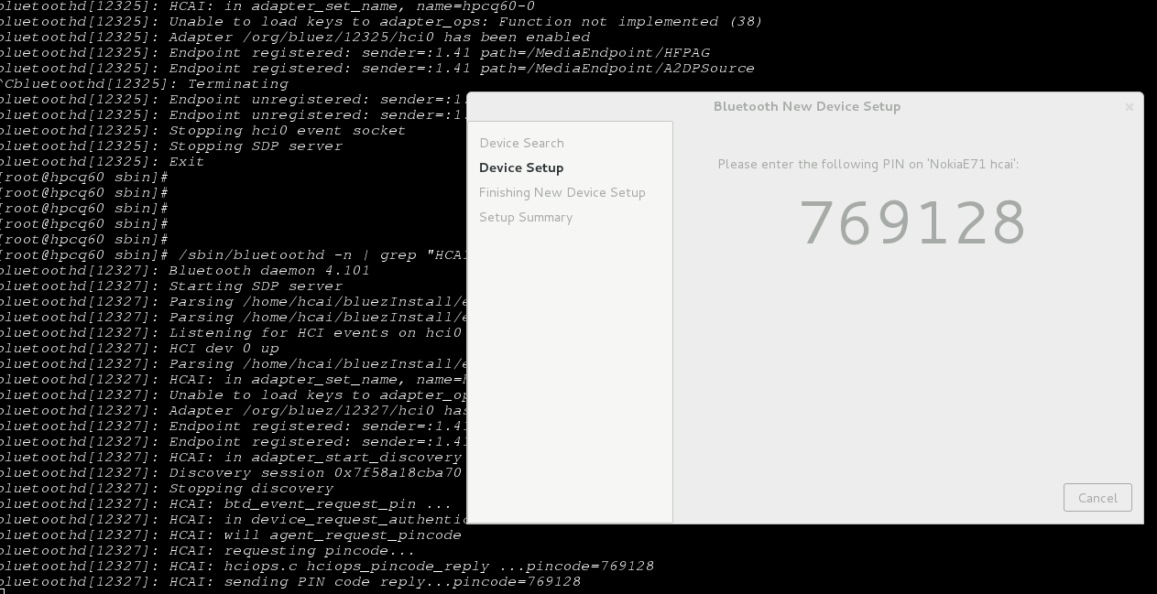
Appendex
Some hacking screen shots
User module and the plugin in the pairing process

