Slide 1
Malware clustering and classification
Peng Li
pengli@cs.unc.edu

Slide 2
3 Papers
“Behavioral Classification”.
T. Lee and J. J. Mody. In EICAR (European Institute for Computer Antivirus Research) Conference, 2006.
“Learning and Classification of Malware Behavior”.
Konrad Rieck, Thorsten Holz, Carsten Willems, Patrick Düssel, Pavel Laskov. In Fifth. Conference on Detection of Intrusions and Malware & Vulnerability Assessment (DIMVA 08)
“Scalable, Behavior-Based Malware Clustering”.
Ulrich Bayer, Paolo Milani Comparetti, Clemens Hlauschek, Christopher Kruegel, and Engin Kirda. In Proceedings of the Network and Distributed System Security Symposium (NDSS’09), San Diego, California, USA, February 2009

Slide 3
Malware
Malware, short for malicious software, is software designed to infiltrate or damage a computer system without the owner's informed consent.
Viruses (infecting) and worms (propagating)
Trojan horses (inviting), rootkits (hiding), and backdoors (accessing)
Spyware (commercial), botnets (chat channel), keystroke loggers (logging), etc

Slide 4
Battles between malware and defenses
Malware development:
Encryption; (payload encrypted)
Polymorphism; (payload encrypted, varying keys)
Metamorphism; (diff instructions, same functionality)
Obfuscation; (semantics preserving)
Defenses:
Scanner; (static, on binary to detect pattern)
Emulator; (dynamic execution)
Heuristics;
[Polychronakis, 07]

Slide 5
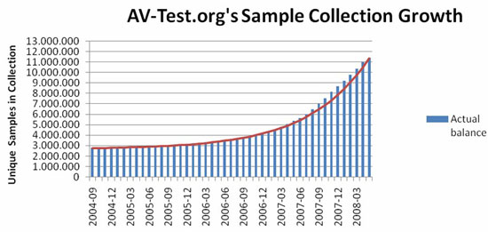
Malware variants
Encrypted;
Polymorphic;
Metamorphic;
Obfuscated;
http://www.pandasecurity.pk/collective_intelligence.php

Slide 6
Invariants in malware
Code re-use;
Byte stream;
Opcode sequence;
Instruction sequence;
Same semantics;
System Call;
API Call;
System Objects Changes;
8F | 0C | F3 | 57 | A4
CALL | XOR | INC | INC | LOOP

Slide 7
Malware Classification
Effectively capture knowledge of the malware to represent;
The representation can enable classifiers to efficiently and effectively correlate data across large number of objects.
Malicious software is classified into families, each family originating from a single source base and exhibiting a set of consistent behaviors.

Slide 8
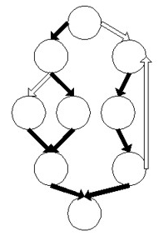
Static Analysis vs. Runtime Analysis
Static Analysis (source code or binary)
Bytes;
Tokens;
Instructions;
Basic Block;
CFG and CG;
Runtime Analysis (emulator)
Instructions;
Basic Blocks;
System calls;
API calls;
System object dynamics;

Slide 9
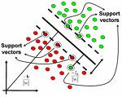
Representations
Sets;
Sequences;
Edit distance, hamming distance, etc
Feature vectors;
SVM

Slide 10
Behavioral Classification T. Lee and J. J. Mody. In EICAR (European Institute for Computer Antivirus Research) Conference, 2006.

Slide 11
Roadmap
Events are recorded and ordered (by time);
Format events;
Compute (pairwise) Levenshtein Distance (string edit distance) on sequences of events;
Do K-medoid clustering;
Do Nearest Neighbor classification.

Slide 12
Events from APIs

Slide 13
Event Formalization
To capture rich behavior semantics, each event contains the following information
Event ID
Event object (e.g registry, file, process, socket, etc.)
Event subject if applicable (i.e. the process that takes the action)
Kernel function called if applicable
Action parameters (e.g. registry value, file path, IP address)
Status of the action (e.g. file handle created, registry removed, etc.)
For example, a registry open key event will look like this,
Tag | Value
Event ID | 8
Event Object | Registry
Kernel Function | ZwOpenKey
Parameter 1 | 0x80000000 (DesiredAccess)
Parameter 2 | \Registry\Machine\Software\Microsoft\Windows NT\CurrentVersion\Image File Execution Options\iexplore.exe
Event Subject | 1456 (process id), image path \Device\HarddiskVolume1\Program Files\Internet Explorer\IEXPLORE.EXE
Status | Key handle

Slide 14
Levenshtein Distance
Operation = Op (Event)
Operations include but not limited to
Insert (Event)
Remove (Event)
Replace (Event1, Event2)
The cost of a transformation from one event sequence to another is defined by the cost of applying an ordered set of operations required to complete the transformation.
Cost (Transformation) = Σ_{i} Cost (Operation_{i})
The distance between two event sequence is therefore minimum cost incurred by one of the transformations. (Dynamic programming using a m*n matrix)

Slide 15
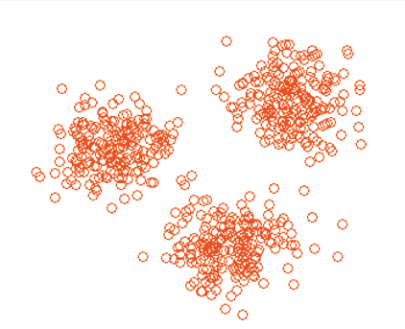
K-medoids Clustering
Step | Description
1 | Randomly pick k objects out of the n objects as the initial medoids
2 | Assign each object to the group that has the closest medoid
3 | When all objects have been assigned, recalculate the positions of the k medoid; for each group, choosing the new medoid to be the object i with
4 | Repeat Steps 2 and 3 until the medoid no longer move

Slide 16
Classification
Step | Description
1 | Compare the new object to all the medoids
2 | Assign the new object the family name of the closest medoid
?

Slide 17
Evaluation
Sample Sets:
 | Families | Number of Samples
Experiment A | Berbew | 218
 | Korgo | 133
 | Kelvir | 110
Experiment B | Berbew | 218
 | Korgo | 133
 | Kelvir | 110
 | HackDef | 88
 | Bofra | 7
 | Bobax | 159
 | Bagz | 31
 | Bropia | 7
 | Lesbot | 2
 | Webber | 1
 | Esbot | 4

Slide 18
Setting up
Randomly, 90% of data for training and 10% for testing
K (# of clusters) is set to the multiples of the number of families in the dataset (m) from 1 to 4 (i.e. k = m, 2*m, 3*m and 4*m). E (max # of events) is set to 100, 500 and 1000.
Two metrics for evaluations:
Error rate: ER = number of incorrectly classified samples / total number of samples. Accuracy is defined as AC = 1 – ER
Accuracy Gain of x over y is defined as G(x,y) = | (ER(y) – ER(x))/ER(x) |

Slide 19
Results
Experiment A:
#Events /#Clusters | 100 | 500 |  | 1000
 | Error rate (%) | Error rate (%) | Gain over 100 events | Error rate (%) | Gain over 100 events
3 | 24.13 | 21.52 | 0.108164 | 20.65 | 0.144219
6 | 23.7 | 12.13 | 0.488186 | 12.39 | 0.477215
9 | 18.17 | 9.76 | 0.462851 | 10.12 | 0.443038
12 | 16.12 | 8.15 | 0.494417 | 9.05 | 0.438586
Experiment B:
#Events /#Clusters | 100 | 500 |  | 1000
 | Error rate (%) | Error rate (%) | Gain over 100 events | Error rate (%) | Gain over 100 events
11 | 28.17 | 16.63 | 0.409656 | 15.32 | 0.456159
22 | 26.72 | 12.14 | 0.545659 | 11.67 | 0.563249
33 | 25.87 | 10.98 | 0.57557 | 9.65 | 0.626981
44 | 21.06 | 8.87 | 0.578822 | 7.84 | 0.62773

Slide 20
Results
Accuracy vs. #Clusters Error rate reduces as number of clusters increase.
Accuracy vs. Maximum #Events Error rate reduces as the event cap increases, because the more events we observe, the more accurately we can capture the behavior of the malware.
Accuracy Gain vs. Number of Events The gain in accuracy is more substantial at lower event caps (100 vs. 500) than at higher event caps (500 vs. 1000), which indicates that between 100 to 500 events, the clustering had most of the information it needs to form good quality clusters.
Accuracy vs. Number of Families The 11-family experiment outperforms in accuracy the 3-family experiment in high event cap tests (1000), but the result is opposite in lower event cap tests (100). As we investigate further, we found that the same outliers were found in both experiments, and because there were more semantic clusters (11 vs. 3), the outlier effects were contained.

Slide 21
Learning and Classification of Malware Behavior Konrad Rieck, Thorsten Holz, Carsten Willems, Patrick Düssel, Pavel Laskov. In Fifth. Conference on Detection of Intrusions and Malware & Vulnerability Assessment (DIMVA 08)

Slide 22
Compared to paper 1
Both obtain traces dynamically;
Different representation of events;
Paper 1: structure
Paper 2: strings directly from API
Different organization of events;
Paper 1: sequences
Paper 2: strings as features
4. Different classification techniques;

Slide 23
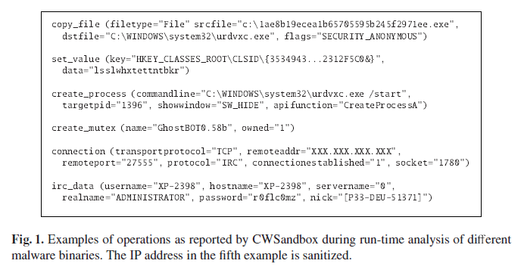
Run-time analysis report

Slide 24
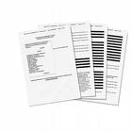
Feature vector from report
A document – in our case an analysis report – is characterized by frequencies of contained strings.
All reports X;
The set of considered strings as feature set F;
Take
We derive an embedding function which maps analysis report to an |F|-dimensional vector space by considering the frequencies of all strings in F:
5 | 3 | 1 | 1 | 2 | 1 | 2 | 3 | 1 | 2
|F|

Slide 25
SVM
The optimal hyperplane is represented by a vector w and a scalar b such that the inner product of w with vectors (y_{i}) of the two classes are separated by an interval between -1 and +1 subject to b:
Kernel function:
SVM classifies a new report x :

Slide 26
Multi-class
Maximum distance. A label is assigned to a new behavior report by choosing the classifier with the highest positive score, reflecting the distance to the most discriminative hyperplane.
Maximum probability estimate. Additional calibration of the outputs of SVM classifiers allows to interpret them as probability estimates. Under some mild probabilistic assumptions, the conditional posterior probability of the class +1 can be expressed as:
where the parameters A and B are estimated by a logistic regression fit on an independent training data set. Using these probability estimates, we choose the malware family with the highest estimate as our classification result.

Slide 27
Setting up
The malware corpus of 10,072 samples is randomly split into three partitions, a training, validation and testing partition. (labeled by Avira AntiVir)
The training partition is used to learn individual SVM classifiers for each of the 14 malware families using different parameters for regularization and kernel functions. The best classifier for each malware family is then selected using the classification accuracy obtained on the validation partition.
Finally, the overall performance is measured using the combined classifier (maximum distance) on the testing partition.

Slide 28
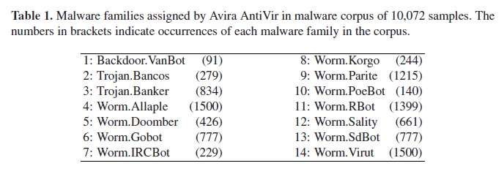
Samples

Slide 29
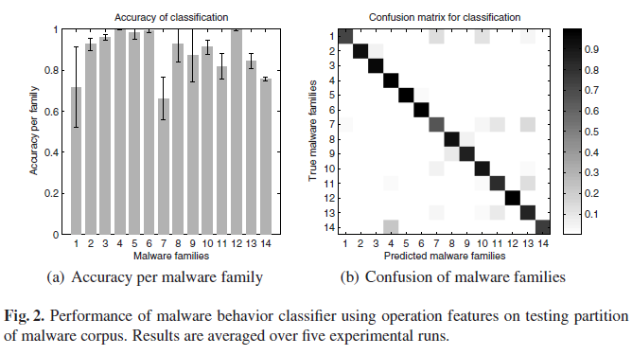
Experiment 1(general)
Maximal distance as the multi-class classifier.

Slide 30
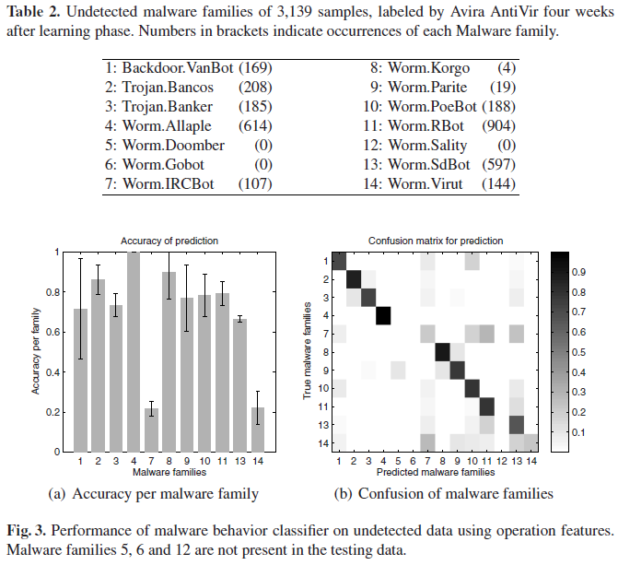
Experiment 2 (prediction)
Maximal distance as the multi-class classifier.

Slide 31
Experiment 3(unknown behavior)
Instead of using the maximum distance to determine the current family we consider probability estimates for each family. i.e. Given a malware sample, we now require exactly one SVM classifier to yield a probability estimate larger 50% and reject all other cases as unknown behavior.
All using extended classifier for the following sub-experiments:
Sub-experiment 1: using the same testing set as in experiment 1;
Sub-experiment 2: using 530 samples not contained in the learning corpus;
Sub-experiment 3: using 498 benign binaries;

Slide 32
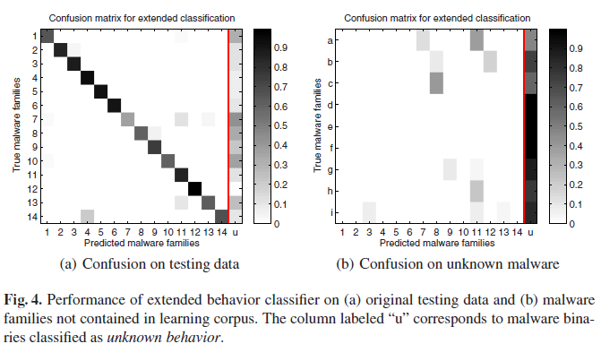
Experiment 3(unknown behavior)
For sub-experiment 1, accuracy dropped from 88% to 76% but with strong confidence
For sub-experiment 3, not shown here, all reports are assigned to unknown.

Slide 33
Scalable, Behavior-Based Malware Clustering Ulrich Bayer, Paolo Milani Comparetti, Clemens Hlauschek, Christopher Kruegel, and Engin Kirda In Proceedings of the Network and Distributed System Security Symposium (NDSS’09), San Diego, California, USA, February 2009

Slide 34
Compared to paper 1&2
Also collecting traces dynamically;
In addition to the info collected for paper 1 & 2, they also do system call monitoring and do data flow and control flow dependency analysis; (e.g. a random filename is associated with a source of random; user intended cmp or not)
Scalable clustering using LSH;
Unsupervised learning, to facilitate manually malware classification process on a large data set.

Slide 35
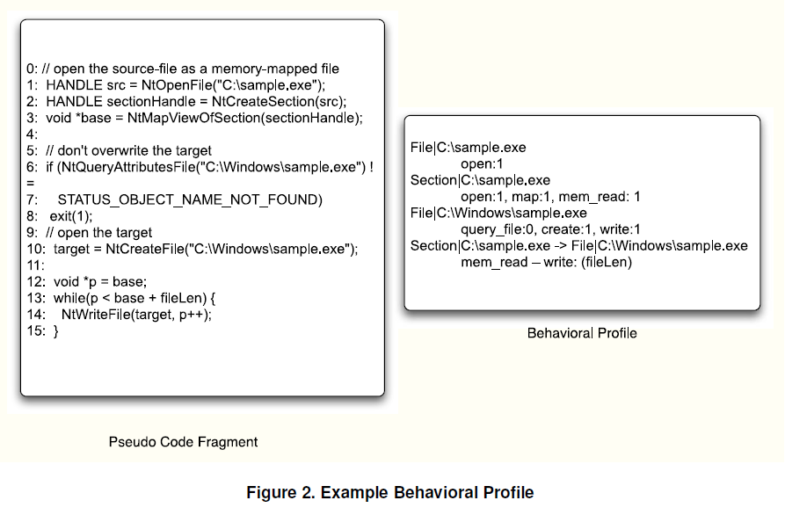
Profiles

Slide 36
Profiles to features
As mentioned previously, a behavioral profile captures the operations of a program at a higher level of abstraction. To this end, we model a sample’s behavior in the form of OS objects, operations that are carried out on these objects, dependences between OS objects and comparisons between OS objects.

Slide 37
LSH
Jaccard index as a measure of similarity between two samples a and b, defined as
A family H of hash functions such that Pr[h(a) = h(b)] = similarity(a, b), for a, b points in our feature space, and h chosen uniformly at random from H.
By defining the locality sensitive hash of a as lsh(a) = h1(a), .., hk(a),
with k hash functions chosen independently and uniformly at random from H, we then have Pr[lsh(a) = lsh(b)] = similarity(a, b)k.
Given a similarity threshold t, we employ the LSH algorithm to compute a set S which approximates the set T of all near pairs in A × A, defined as

Slide 38
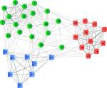
Generate S which approximates T
Given the threshold t, we first choose the number k of hash functions in each LSH hash, and the number of iterations l. Furthermore, we initialize the set S of candidate near pairs to the empty set. Then, for each iteration, the following steps are performed:
choose k hash functions h1, .., hk at random from H
compute lsh(a) = h1(a), .., hk(a) for each a in A
sort the samples based on their LSH hashes
add all pairs of samples with identical LSH hashes to S
h1(a), …, hk(a)
h1(a), …, hk(a)
h1(b), …, hk(b)
h1(c), …, hk(c)
S
h1(c), …, hk(c)
h1(b), …, hk(b)
h1(d), …, hk(d)
h1(d), …, hk(d)
… …
… …

Slide 39
Approximation of all near pairs using LSH
Jaccard index as a measure of similarity between two samples a and b, defined as
Given a similarity threshold t, we employ the LSH algorithm (Property: Pr[h(a) = h(b)] = similarity(a, b)) to compute a set S which approximates the set T of all near pairs in A × A, defined as
Refining: for each pair a, b in S, we compute the similarity J(a, b) and discard the pair if J(a, b) < t

Slide 40
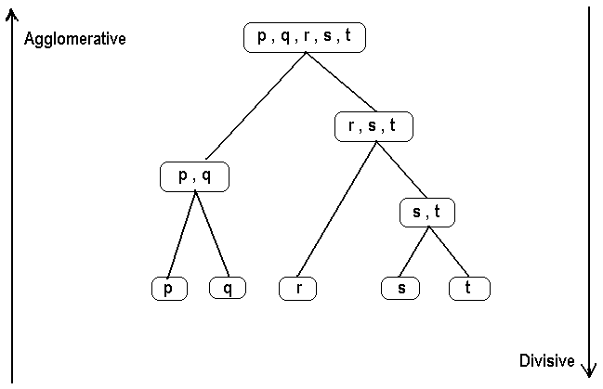
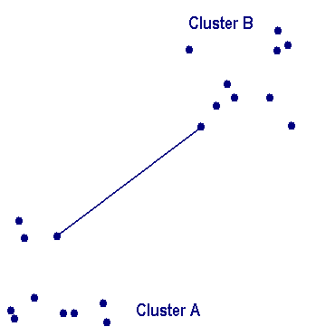
Hierarchical clustering
Then, we sort the remaining pairs in S by similarity. This allows to produce an approximate, single-linkage hierarchical clustering of A, up to the threshold value t.
Single-linkage clustering: distance between groups = distance between the closest pair of objects

Slide 41
Setting up
First, obtained a set of 14,212 malware samples that were submitted to ANUBIS in the period from October 27, 2007 to January 31, 2008.
Then, scanned each sample with 6 different anti-virus programs. For the initial reference clustering, we selected only those samples for which the majority of the anti-virus programs reported the same malware family (this required us to define a mapping between the different labels that are used by different anti-virus products). This resulted in a total of 2,658 samples.

Slide 42
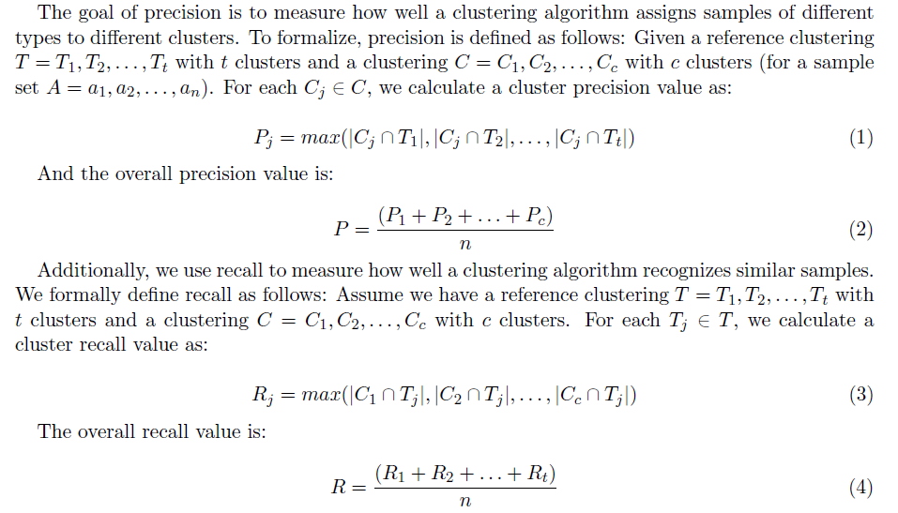
Comparing clusterings
Example:
Testing clustering: 1 ||2, 3, 4, 5, 6, 7, 8, 9, 10
Precision: 1 + 5 = 6
Recall: 4 + 5 = 10
Reference clustering: 1, 2, 3, 4, 5 || 6, 7, 8, 9, 10

Slide 43
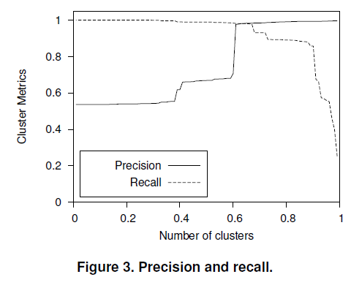
Evaluation
Our system produced 87 clusters, while the reference clustering consists of 84 clusters. For our results, we derived a precision of 0.984 and a recall of 0.930 (t = 0.7)

Slide 44
Thanks!

