Slide 1
Using Web Services as a
Data Source in MicroStrategy

Slide 2
What Is a Web Service?
W3C definition: a software system designed to support interoperable machine-to-machine interaction over a network.
A method of integrating web-based applications using open standards including but not limited to HTTP, XML, SOAP, WSDL, and JSON.
Client and server exchange information in the form of service request and service response
Information is passed in a technology-independent format
Facilitates loosely coupled architecture—where client and server components may have no prior knowledge of each other except for when they need to invoke/respond to a service

Slide 3
Example Web Services
3

Slide 4
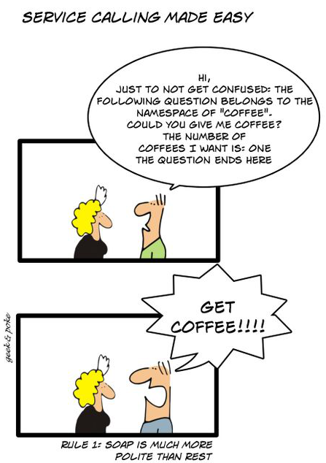
Primary Web Services Protocols
SOAP
Simple Object Access Protocol
Not so simple—requires toolkits to build Web services
REST
REpresentational State Transfer
Easy to build—requires basic knowledge of HTTP and XML
4
Notes:
A web service deployment publishes a contract that specifies the service that it provides. Using this specification, an XQuery script is either written by hand or can be generated using a companion product called XQuery Generator. The XQuery script should contain three sections: (a) a request section specifying the parameters that are needed to access the web service and to send a request, (b) a response section where the response (usually in XML format) from the web service is parsed, and (c) a transformation section which contains instructions to transform the response into an XML that conforms to Microstrategy XML Schema for tabular data. The end result is an XML that is loaded into memory as a tabular data following which the full analytics magic of the Microstrategy product is available. Finally, the feature also supports state of the art in data security and authentication which is very important when it comes to accessing data in the cloud.

Slide 5
REST and SOAP—Service Request
REST
http://webservice.com/weather/22102
<?xml version="1.0"?>
<soap:Envelope xmlns:soap="http://www.w3.org/2001/12/soap-envelope">
<soap:Body> <m:GetWeather xmlns:m="http://mywebservice.com/weather"> <m:Zip> 22102 </m:Zip>
</m:GetWeather> </soap:Body>
</soap:Envelope>
SOAP
5
Notes:
There is an ongoing debate about the proper structure of RESTful URLs. You may encounter two different URL structures when accessing RESTful Web services.
The SOAP request on the slide is simplified. The actual request must also contain the header. You will learn about it later in this presentation.
The service on the slide is fictional, do not try to run it.

Slide 6
XQuery Basics: What is it?
MicroStrategy uses XQuery to access Web Services as a data source
XQuery is a query language designed by the W3C to extract data from XML files and format/transform the results.
XQuery is to XML as SQL is to tables in a relational database.
XQuery allows you to:
Query XML data elements of interest using XPath expressions
Transform and restructure XML data
Select information based on specific criteria
Search and join data from multiple documents
Perform arithmetic calculations on number and dates
Manipulate strings

Slide 7
Developing an XQuery Report in MicroStrategy
Web Services reports are developed by writing XQuery statements in the Freeform XQuery Editor
MicroStrategy XQuery Editor and Generator (XEG) can be used to automate the generation of XQuery scripts
Steps for generating an XQuery report:
Identify the Web Service APIs
(optional) Test Web Service API from the server running I-Server using a browser (REST) or browser plug-in (when header or message body must be defined)
Generate the XQuery script in XEG:
Identify source type (REST, SOAP, XML, WebDAV, REST-JSON)
Specify authentication mode
Invoke the web service to capture the XML response
Define report columns from the available XML nodes
Generate the XQuery script
Copy-and-paste the XQuery script into Free Form XQuery Editor

Slide 8
References and Tools for Developing in XQuery
Tutorials: http://www.w3schools.com/xquery/ http://www.w3schools.com/xpath/
Publicly Available Web Services: www.programmableweb.com www.usgovxml.com
MicroStrategy XQuery Editor and Generator (XEG)
Firefox Add-Ons
REST Client, SOA Client and Poster plug-ins to interact with and troubleshoot web services.
HttpFox allows developer to analyze traffic between web browsers and web servers.
Eclipse with XQuery-related plug-ins
Eclipse 3.6 or higher
Zorba XQuery Processor 1.4 or higher
Dynamic Languages Toolkit (DLTK) 2.0 Eclipse Plug-ins
XQDT Eclipse plug-in
TcpTrace – useful for tracing traffic between Intelligence Server and web servers
Notes:
http://www.zorba-xquery.com/index.php/tutorials/

