Slide 1
Airborne Firmware Upgrade

Slide 2
Web Interface

Slide 3
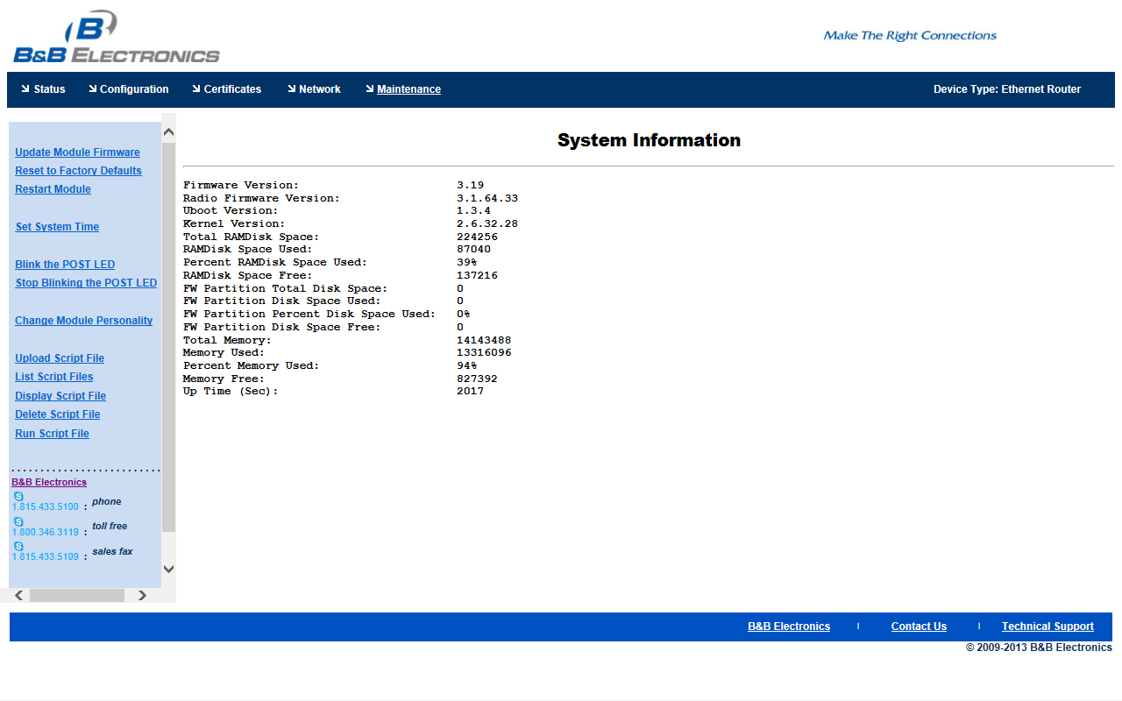
Maintenance

Slide 4
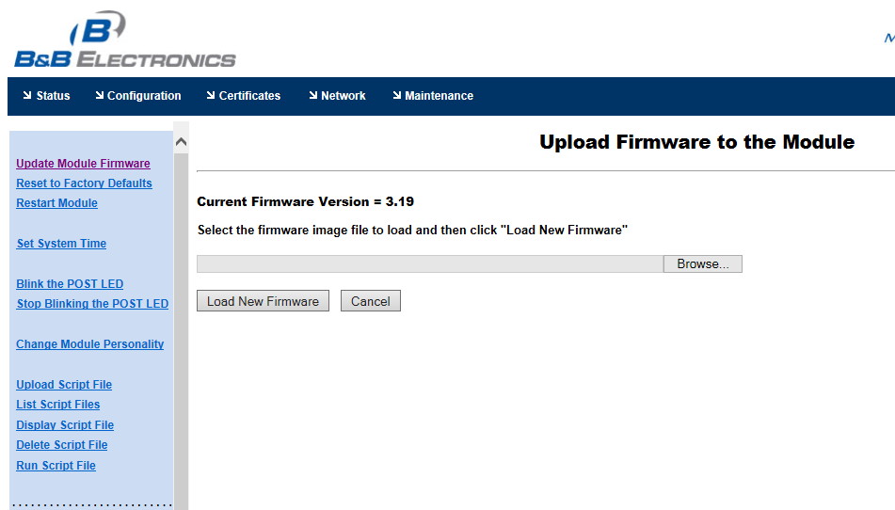
Update Module Firmware

Slide 5
Browse to firmware

Slide 6
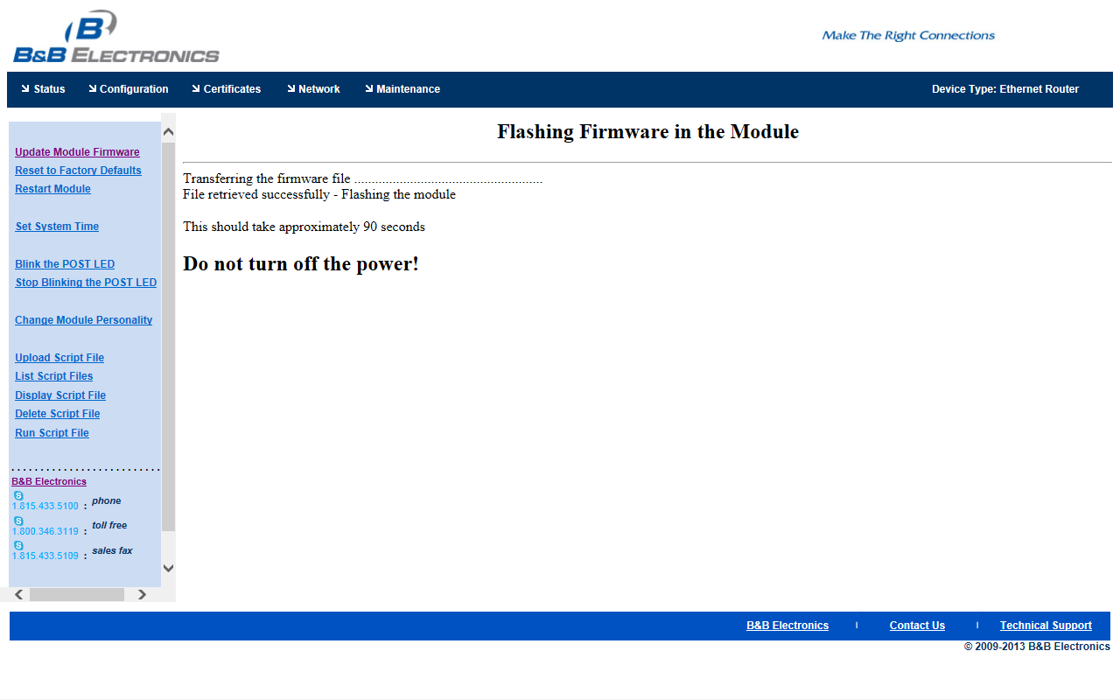
Flashing Firmware

Slide 7
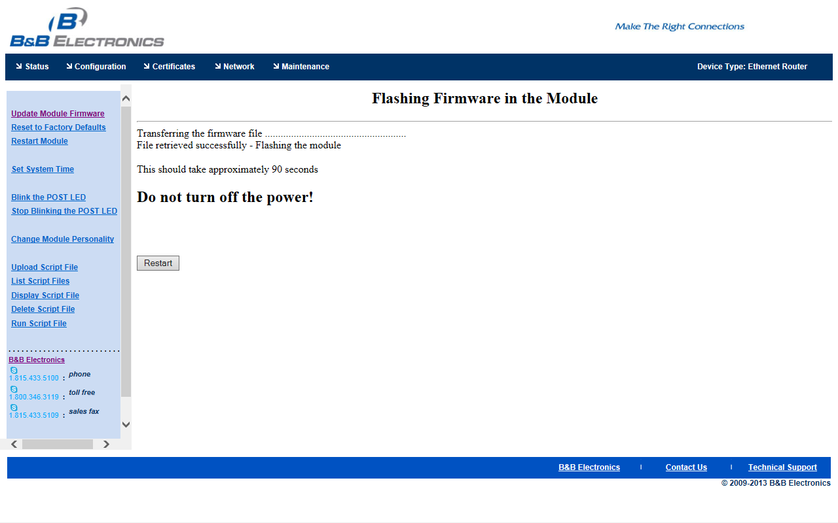
Restart Module

Slide 8
Restarting Module

Slide 9
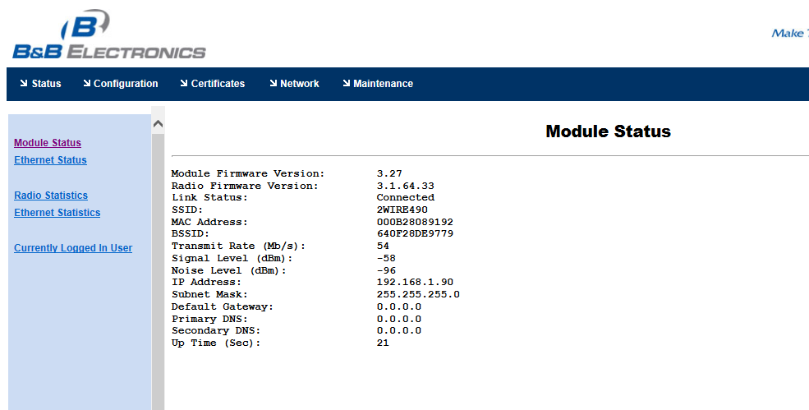
Firmware Updated 3.27

