Slide 1
Pulse Width Modulation
By:
Zak Ahmad
Phuc Dao
Joel Toussaint

Slide 2
Outline
Introduction
PWM Definitions
  Generation
  Types
PWM on the HCS12
Applications
Presented by Zak Ahmad

Slide 3


Introduction
Presented by: Zak Ahmad
Partial Power
Bright Bulb
Dim Bulb
Pulse Width Modulation (PWM) is a technique for delivering partial power to a load via digital means.
Other devices for delivering partial power: potentiometer and rheometer.

Slide 4
Introduction
Presented by: Zak Ahmad
Pulse Width Modulation (PWM) is a method for changing how long a square wave stays “on”.
The on-off behavior changes the average power of the signal.
If signal toggles between on and off quicker than the load, then the load is not affected by the toggling.

Slide 5
Duty Cycle - Introduction
Presented by: Zak Ahmad
The duty cycle (the width of the signal) is modulated.
It is a percentage measurement of how long the signal stays on.
On
Off
V_{H}
Duty Cycle (D)
V_{L}
Period (T)

Slide 6
Duty Cycle - Definition
Presented by: Zak Ahmad
On
Off
Duty Cycle is determined by:
V_{H}
Duty Cycle (D)
V_{L}
Average signal can be found as:
Period (T)
Usually, V_{L} is taken as zero volts for simplicity.

Slide 7
Advantages
Presented by: Zak Ahmad
Average value proportional to duty cycle, D
Low power used in transistors used to switch the signal
Fast switching possible due to MOSFETS and power transistors at speeds in excess of 100 kHz
Digital signal is resistant to noise
Less heat dissipated versus using resistors for intermediate voltage values

Slide 8
Disadvantages
Presented by: Zak Ahmad
Cost
Complexity of circuit
Radio Frequency Interference
Voltage spikes
Electromagnetic noise

Slide 9
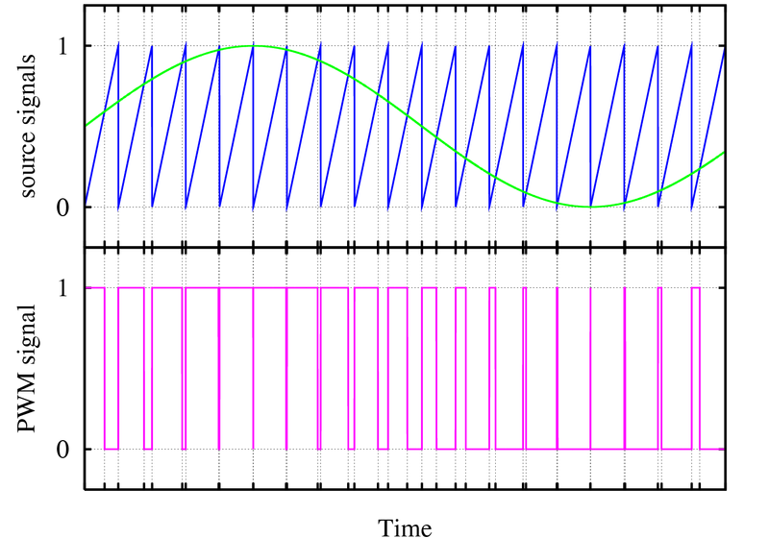
PWM Generation - Analog
Presented by: Zak Ahmad
Intersective Method
When sine is greater than sawtooth PWM is high.
When sine is less than sawtooth PWM is low.
PWM toggles when sine equals sawtooth
3
2
1
4
1
2
3
4

Slide 10
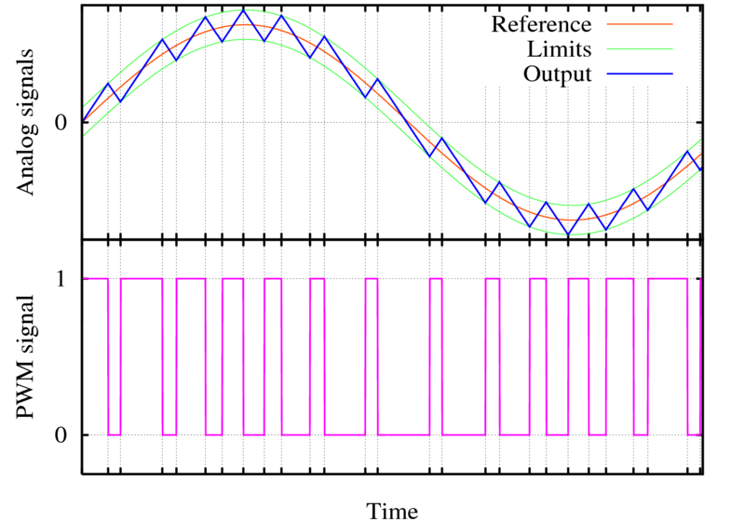
PWM Generation - Digital
Presented by: Zak Ahmad
Delta Method
Output is integrated
Limit signals which are offset from a reference
When output signal reaches limit, PWM state changes

Slide 11
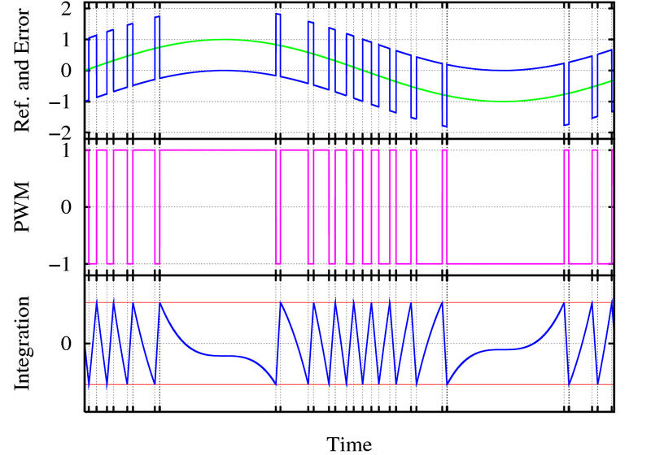
PWM Generation - Digital
Presented by: Zak Ahmad
Delta Sigma Method
Error = Ref – PWM
Error is integrated
When integration signal reaches limit, PWM state changes

Slide 12
Types of PWM – Left Aligned
Presented by: Zak Ahmad
Left edge is fixed, the trailing edge is modulated.
On
Off
On
Off
V_{hi}
V_{hi}
Duty Cycle
~30%
Duty Cycle
~60%
V_{lo}
V_{lo}
Period
Period

Slide 13
Types of PWM – Center Aligned
Presented by: Zak Ahmad
Center of signal is fixed, both edges are modulated
V_{hi}
V_{hi}
Duty Cycle
~30%
Duty Cycle
~60%
V_{lo}
V_{lo}
Period
Period

Slide 14
Choosing PWM Frequency
Presented by: Zak Ahmad
Application dependant.
Not too low:
  Audible frequencies
  Twice the inverse of device time constant
  10 Times higher than control system frequency
Not too high:
  Transistors generate more heat at higher frequencies
  Some loads will not respond at higher frequencies

Slide 15
PWM You Tube Video
Presented by: Zak Ahmad
You Tube search: PWM Tutorial
OR
Click Link

Slide 16
Outline
Introduction
PWM Definitions
  Generation
  Types
PWM on the HCS12
Applications
Presented by Phuc Dao

Slide 17
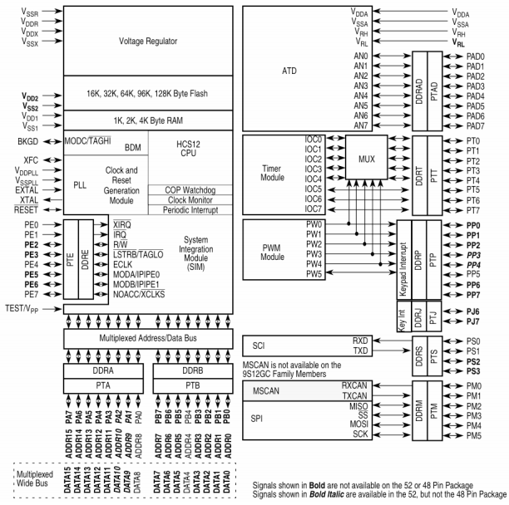
Implementing PWM Using the MC9S12C32
Presented by: Phuc Dao
Dedicated PWM8B6C Chip
6 Independent 8-bit channels
3 Independent 16-bit channels
Signal is outputted through Port P

Slide 18
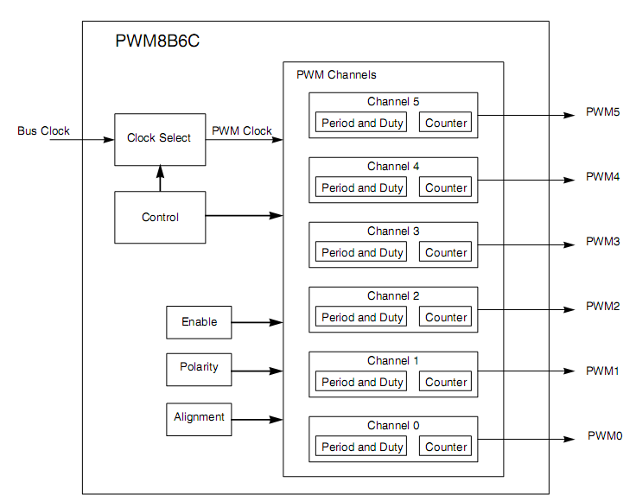
PWM8B6C Module
Presented by: Phuc Dao
Dedicated counter for each channel
Programmable duty cycle and period
Independently adjustable clock, polarity, and alignment

Slide 19
PWM8B6C Module - Other Features
Presented by: Phuc Dao
Four source clocks (A, B, SA, SB) for a wide frequency range
Emergency shutdown
Some changes take a complete cycle to take effect
Modes of Operation:
  Normal: everything is available
  Wait: Low-power consumption and clock disabled
  Freeze: Option to disable input clock
19
Notes:
19

Slide 20
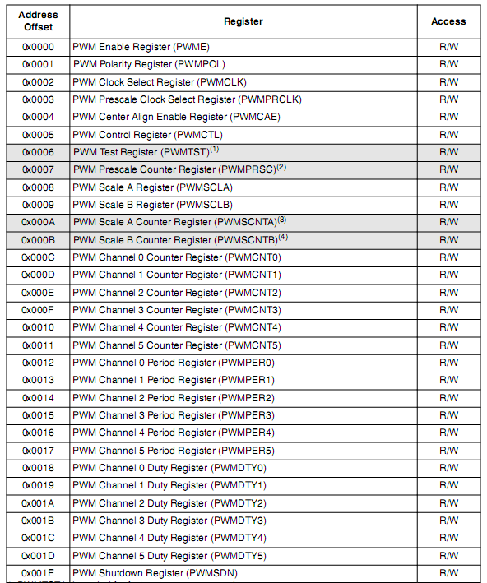
PWM8B6C Memory Map
Presented by: Phuc Dao
Configured through specific registers
Base address is defined at the MCU level
Address offset is defined at the module level
Register address = base address + address offset
Registers are located from $00E0 - $00FF
20
Notes:
20

Slide 21
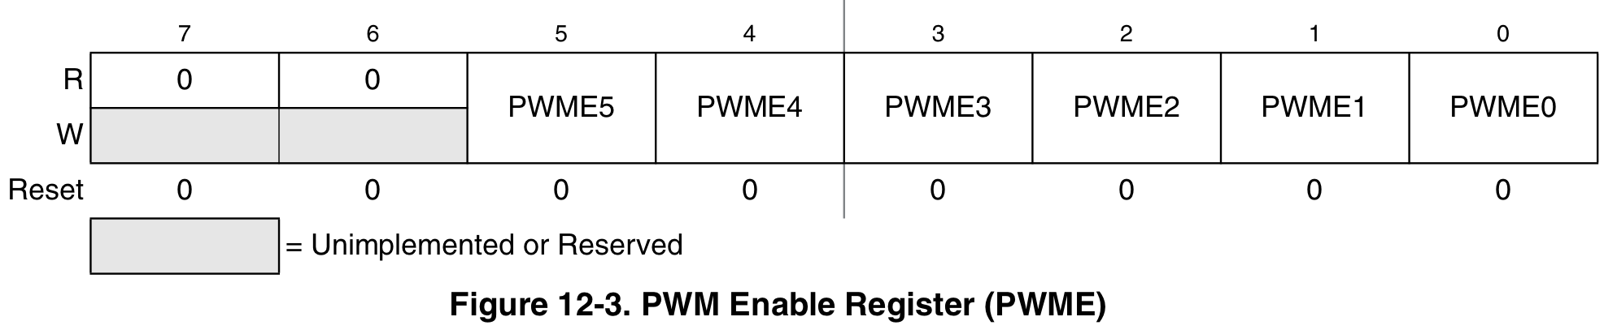
PWM Enable Register (PWME)
Presented by: Phuc Dao
PWME is located at $00E0
Set PWMEx
  0: to disable PWM channel x
  1: to enable PWM channel x
If 16-bit resolution is used, then PWME4/2/0 are disabled
21

Slide 22
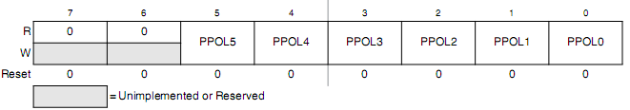
PWM Polarity Register (PWMPOL)
Presented by: Phuc Dao
PWMPOL is located at $00E1
Set PPOLx to
  0: output channel starts low and goes high when duty cycle is reached
  1: output channel starts high and goes low when duty cycle is reached
22

Slide 23
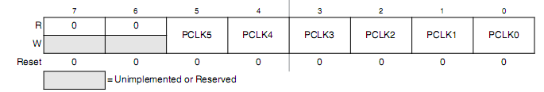
PWM Clock Select Register (PWMCLK)
Presented by: Phuc Dao
PWMCLK is located at $00E2
Set PCLK5, PCLK4, PCLK1, PCLK0 to
  0 to use Clock A
  1 to use Clock SA
Set PCLK3, PCLK2 to
  0 to use Clock B
  1 to use Clock SB
23
Notes:
23

Slide 24
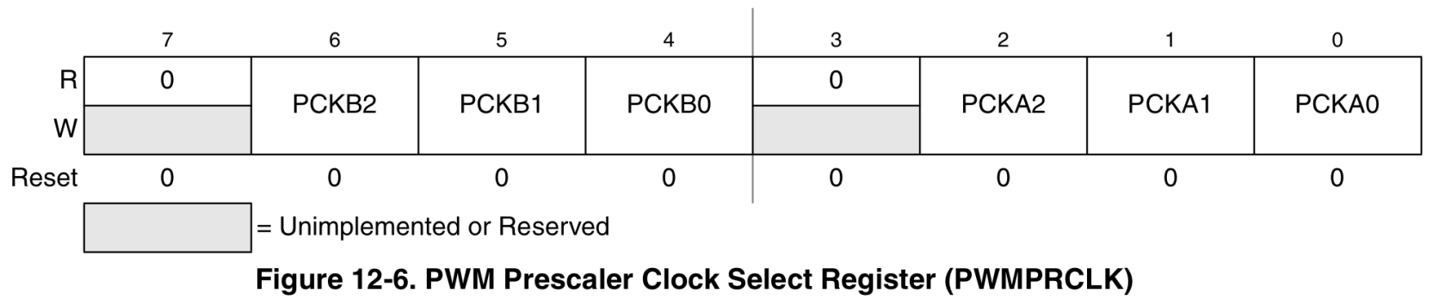
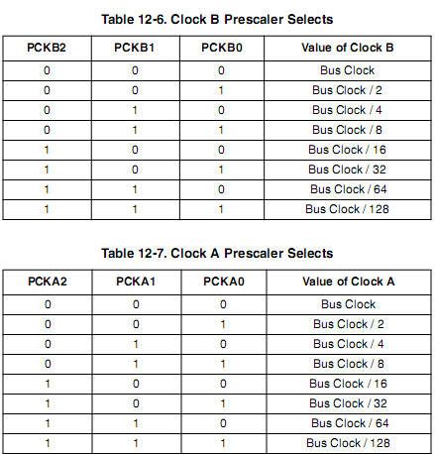
PWM Prescaler Register (PWMPRCLK)
Presented by: Phuc Dao
PWMPRCLK is located at $00E3
Used to prescale clocks A and B
24
Notes:
24

Slide 25

PWM Scale A Register (PWMSCLA)
Presented by: Phuc Dao
PWMSCLA is located at $00E8
Scale value used in scaling Clock A to generate Clock SA
Note: When PWMSCLA = $00, PWMSCLA value is considered a full scale value of 256.
25
Notes:
25

Slide 26
Presented by: Phuc Dao
PWM Scale B Register (PWMSCLB)
PWMSCLB is located at $00E9
Scale value used in scaling Clock B to generate Clock SB
Note: When PWMSCLA = $00, PWMSCLA value is considered a full scale value of 256.
26
Notes:
26

Slide 27
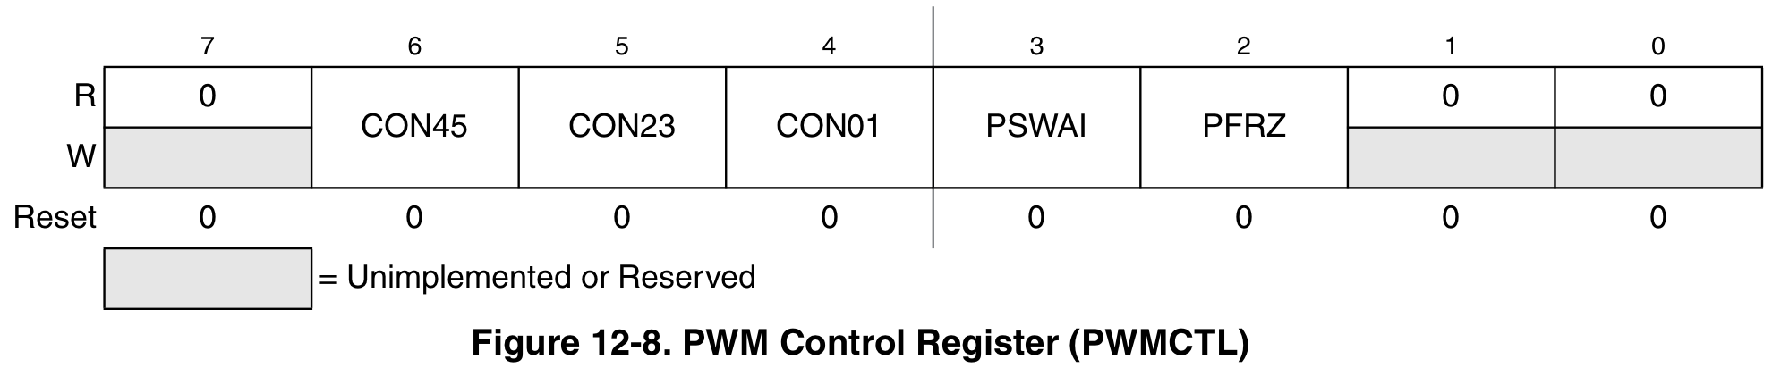
PWM Control Register (PWMCTL)
Presented by: Phuc Dao
PWMCTL is located at $00E5
Set CONxy to
  0: to keep PWM channels separate (8-bit resolution)
  1: to concatenate PWM channels x and y together (16-bit resolution)
Channel y determines the configuration
x becomes the high byte and y becomes the low byte
Bits PSWAI and PFRZ set either wait or freeze mode
Note: change these bits only when the corresponding channels are disabled
27
Notes:
27

Slide 28
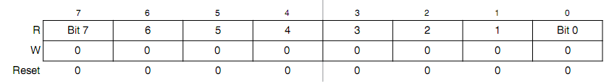
PWM Counter Register (PWMCNTx)
Presented by: Phuc Dao
Total of (6) 8-bit counters located at $00EC - $00F1
One up/down counter per channel
In left aligned mode, the counter counts from 0 to the value in the period register-1. In center aligned mode, the counter counts from zero to the value in the period register-1 and then back down to zero.
Any write to the register causes the value to be reset to #$00 and the counting procedure is restarted.
28
Notes:
28

Slide 29
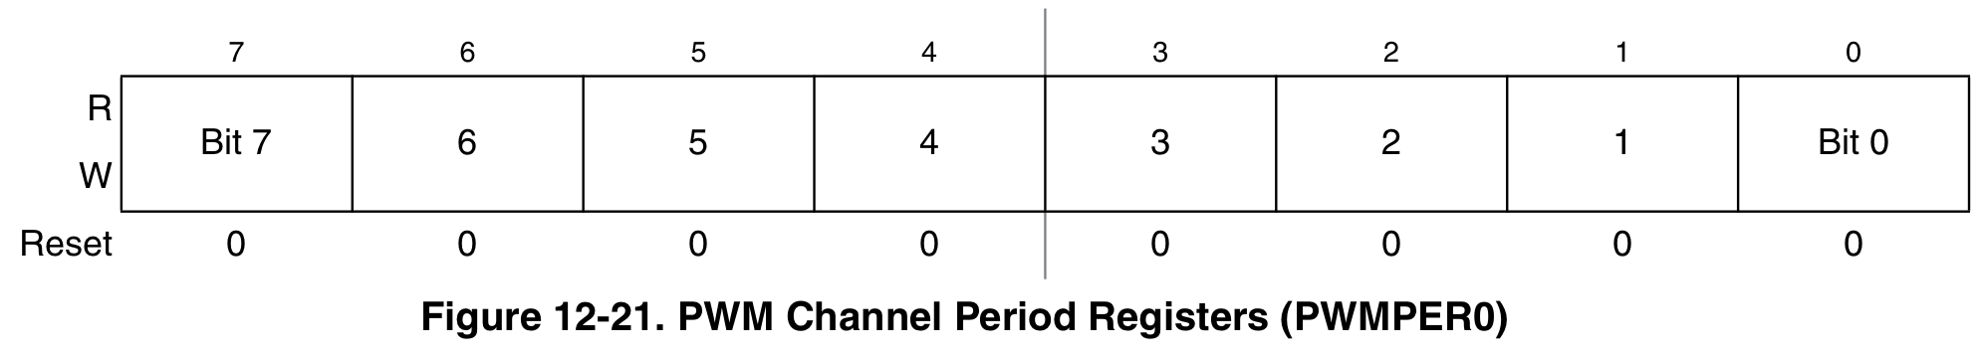
PWM Period Register (PWMPERx)
Presented by: Phuc Dao
(6) Period Registers located at $00F2 - $00F7
Determine the PWM period
Changes occur when:
  Current period ends
  Counter is written to
  Channel is disabled
Left-Aligned:
Center-Aligned:
29
Notes:
29

Slide 30
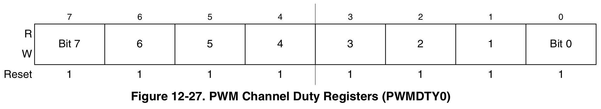
PWM Duty Register (PWMDTYx)
Presented by: Phuc Dao
(6) Duty Registers located at $00F8 - $00FD
Determines the duty of the associated PWM channel
Changes occur when:
  Current period ends
  Counter written to
  Channel is disabled
Polarity = 0:
Polarity = 1:
30
Notes:
30

Slide 31
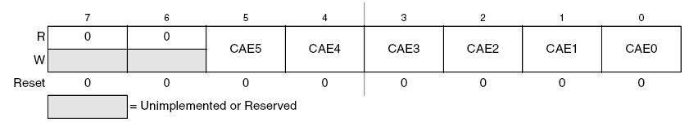
PWM Center Align Register (PWMCAE)
Presented by: Phuc Dao
PWMCAE is located at $00E4
Set CAEx to
  0: for left align output signal
  1: for center align output signal
Note: can only be set when channel is disabled
31
Notes:
31

Slide 32
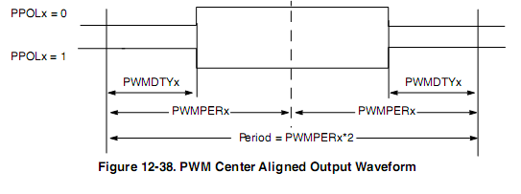
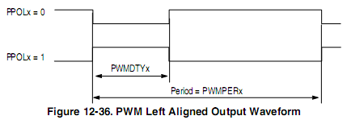
Left vs. Center Aligned
Presented by: Phuc Dao
Signal changes when counter is equal to period register
In the center aligned mode, the PWM counter goes from a down-count to a up-count to down-count, etc.
In the left aligned mode, the PWM counter is a up-counter and rests to zero when it overflows
32

Slide 33
Presented by: Phuc Dao
PWM Resolution
The true resolution depends on the value in PWMPERx even though the PWM module is said to be 8-bit.
The number of distinct duty cycles equals the value stored in PWMPERx.
Maximum number of distinct duty cycles is achieved by writing $FF to the register PWMPERx so that it can represent 256 duty cycle states (00, 01, 02, …, to FF), which corresponds to 2⁸=256 resolution.

Slide 34
Outline
Introduction
PWM Definitions
  Generation
  Types
PWM on the HCS12
Applications
Presented by Joel Toussaint

Slide 35
Applications
Presented by: Joel Toussaint
Telecommunications
DC motors
RC devices
Audio/video effects
Voltage regulation
Use as ADC

Slide 36
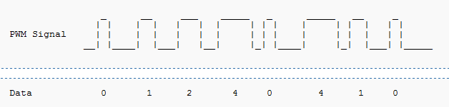
Telecommunications
Presented by: Joel Toussaint
Used in communication since a digital signal is more robust and less vulnerable to noise.
Effective at data transmission over long distance transmission lines
The widths of the pulses correspond to specific data values encoded at one end and decoded at the other.
Pulses of various lengths (the information itself) will be sent at regular intervals (the carrier frequency of the modulation).

Slide 37
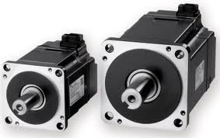
Application to DC Motors
Presented by: Joel Toussaint
Voltage supplied is directly proportional to the duty cycle
Ability to control the speed of the motor via the duty cycle
Example
Can be used in regulating room temperature. A PC can sense the current temperature (using an analog-to-digital converter) and then automatically increase/decrease the fan's speed accordingly.

Slide 38




Presented by: Joel Toussaint
RC devices
Transmitters send PWM signals to the receivers on board of Radio controlled devices for specific control.

Slide 39
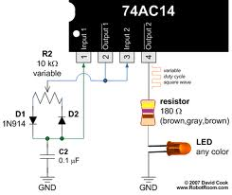
Brightness controlled with a PWM circuit.
Presented by: Joel Toussaint

Slide 40

Video devices
Presented by: Joel Toussaint
PWM dimming provides superior color quality in LED video display
With a 12 bits resolution
the TLC5940 PWM dimming can
provide up to 68.7 million colors
to a pixel.

Slide 41
Audio devices
Used in audio amplifiers to generate output signals for cellphone speakers to high-power stereo systems
Produce less heat than traditional analog amplifiers
Saving energy. Critical for hand held electronics.
Gives a sound effect similar to chorus when used in audio circuit.

Slide 42
Power delivery
Presented by: Joel Toussaint
effective at data transmission over long distance transmission line
Power transfer: PWM used to reduce the total power given to a load without relying on resistive losses

Slide 43
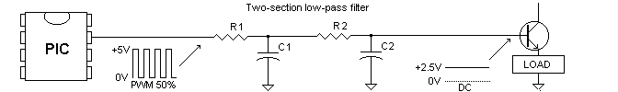
Using PWM to generate an analog voltage level
Presented by: Joel Toussaint
Any shape waveform can be created
PWM frequency should be much higher than the frequency of waveform generated

Slide 44
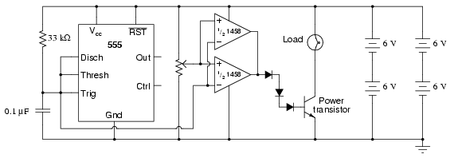
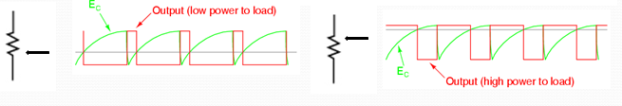
Example of PWM circuit with 555 timer
Presented by: Joel Toussaint

Slide 45
Reference
http://cp.literature.agilent.com/litweb/pdf/5988-9904EN.pdf
http://www.robotroom.com/PWM4.html
MC9S12C Family, MC9S12GC Family Reference Manual, (pp. 347-382)
ME 4447/6405 PWM Student Lectures
www.wikipedia.org
Han-Way Huang, The HCS12/9S12: An Introduction to Software & Hardware Interfacing. Thomson Delmar Learning, United States. 2006.
http://www.pcmag.com/encyclopedia_term/0,2542,t=PWM&i=49992,00.asp
http://www.ece.tamu.edu/~reddy/ee449/notes/pulse.pdf
http://cp.literature.agilent.com/litweb/pdf/5988-9904EN.pdf
http://homepages.which.net/~paul.hills/SpeedControl/SpeedControllersBody.html

