Slide 1
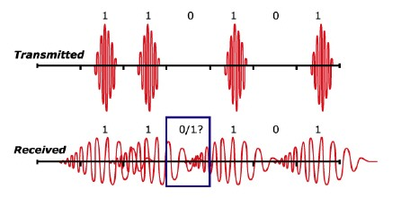
MODULATION
AIDA ESMAEILIAN

Slide 2
MODULATION
Modulation: the process of converting digital data in electronic form to an optical signal that can be transmitted over the fiber.
Demodulation: the process of converting the optical signal back into electronic form and extracting the data that was transmitted.
The ratio of the output powers for the 1 and 0 bits is called the extinction ratio

Slide 3
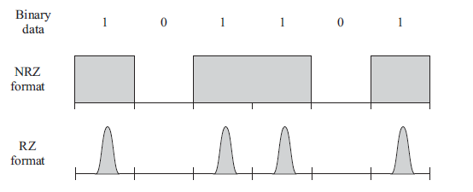
ook
The most commonly used modulation scheme in optical communication is on-off keying (OOK)
Bit rate 1Gb/s => bit interval 1 ns
Bit interval

Slide 4
DIRECT MODULATION
Advantage: simple and inexpensive, no other components are required.
A major advantage of semiconductor lasers → can be directly modulated.
because of the long lifetime of the erbium atoms at the E2 level , erbium lasers cannot be directly modulated even at speeds of a few kilobits per second ➔ require an external modulator
Disadvantage of direct modulation is that the resulting pulses are considerably chirped.
Chirp is a phenomenon wherein the carrier frequency of the transmitted pulse varies with time, and it causes a broadening of the transmitted spectrum.

Slide 5
INDIRECT MODULATION
External modulators in high-speed, dispersion-limited communication systems. (bit rate >= 10 Gb/s)
OOK external modulator is placed in front of a light source and turns the light signal on or off based on the data to be transmitted
External modulators become essential using solitons or return-to-zero (RZ) modulation
practical RZ systems today use a continuous-wave DFB laser followed by a two-stage external modulator

Slide 6
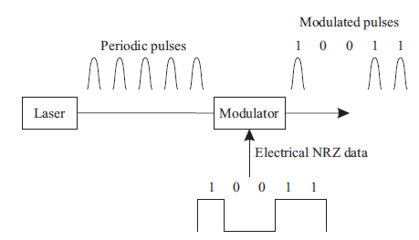
INDIRECT MODULATION

Slide 7
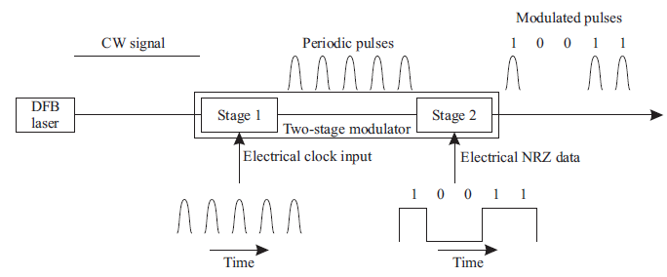
INDIRECT MODULATION

Slide 8
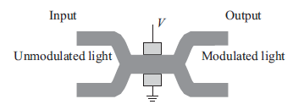
Common external modulators
1- Lithium niobate modulators:
By electro-optic effect, where an applied voltage induces a change in refractive index of the material. As a directional coupler or as a Mach-Zehnder interferometer (MZI)
MZI offers a higher modulation speed for a given drive voltage and provides a higher extinction ratio

Slide 9
MZI
Two titanium-diffused LiNbO3 waveguides form the two arms of a MZ interferometer
In one state, the signals in the two arms of the MZI are in phase and interfere constructively and appear at the output.
In the other state, applying a voltage causes a π phase shift between the two arms of the MZI, leading to destructive interference and no output signal.

Slide 10
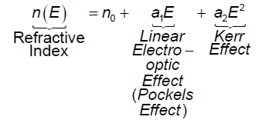
MZI
Because the speed of light is altered by the application of a “control” voltage, electro-optic materials can be described as materials with a voltage-controlled index of refraction.
Index of refraction = speed of light in vacuum / speed of light in material

Slide 11
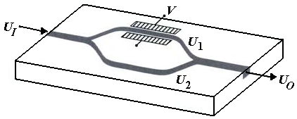
MZI
UI splits into two signals U1 and U2 at the first coupler.
An electro-optic modulator, whose refractive index slightly varies as a function of applying voltage V, is embedded through one path. This affects on the relative phase shift of the two signals at the output couplers, where the two signals recombine.
This variable phase shift changes the output signal UO. Therefore, UO can be varied by the voltage V

Slide 12
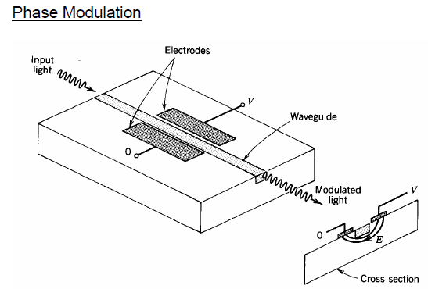

Slide 13
Common external modulators
2- Semiconductor electro-absorption (EA) modulators:
Uses the same material and techniques used to fabricate semiconductor lasers ➔ allows an EA modulator to be integrated along with a DFB laser ➔ a very compact, lower-cost solution
Its bandgap is higher than the photon energy of the incident light ➔allows the light signal to propagate through.
Applying an electric field to the modulator➔shrinking the bandgap of the material ➔ incident photons are absorbed➔Franz-Keldysh effect or the Stark effect
chirp performance of EA is not as good as that of MZI

Slide 14
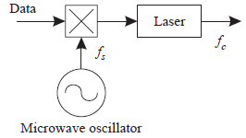
Subcarrier Modulation
The data stream first modulates a microwave carrier, which, in turn, modulates the optical carrier
Main carrier
subcarrier

Slide 15
Optical Coupler
A directional coupler is used to combine and split signals in an optical network
➢ Commonly made by fusing two fibers together in the middle: fused fiber couplers
➢ Also fabricated using waveguides in integrated optics
αP1
P1
(1-α)P2
P2
(1-α)P1
αP2
α: coupling ratio

Slide 16
Optical Coupler
coupler can be
wavelength selective: α depends on the wavelength
widely used to combine signals at 1310 nm and 1550 nm into a single fiber without loss:
1310 nm signal on input1➔is passed through to output 1 1550 nm signal on input2➔is passed through output 1
or wavelength independent (wavelength flat) over a usefully wide range: α is independent of the wavelength
L can be adjusted ➔ such that half the power from each input appears at each output: 3 dB coupler
For monitoring purposes: couplers are called taps, designed typically 0.90–0.95

Slide 17
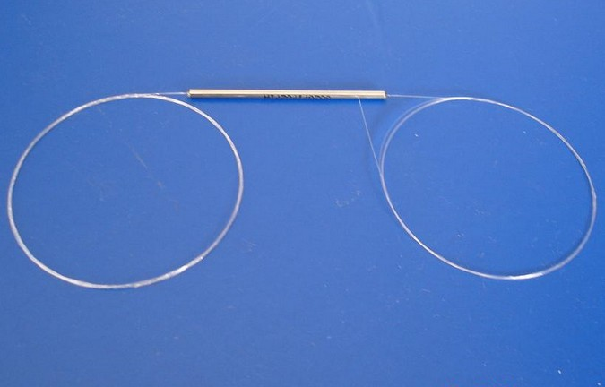
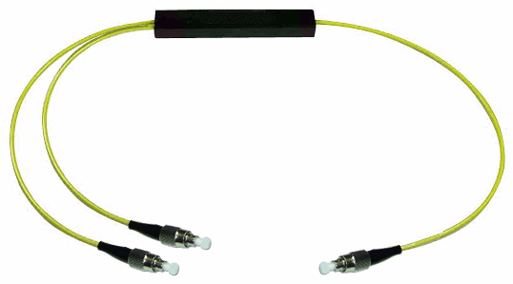
Optical Coupler
Realization on planar waveguides or on optical fibers
Fibers must be longitudinally fused so that the fields from the two branches interfere
The length L of fusion is responsible for the coupling ratio

Slide 18
Isolator
allows transmission in one direction but blocks all transmission in the other direction.
Used at the output of optical amplifiers and lasers primarily to prevent reflections from entering these devices, which would otherwise degrade their performance
Insertion loss: the loss in the forward direction, as small as possible
Isolation: the loss in the reverse direction, as large as possible
Typical insertion loss is around 1 dB, and the isolation is around 40–50 dB

Slide 19
Circulator
Is similar to an isolator, except that it has multiple ports, typically three or four
In a three-port circulator, an input signal on port 1 ➔ sent out on port 2, an input signal on port 2 ➔ sent out on port 3, an input signal on port 3➔sent out on port 1.
Circulators are useful to construct optical add/drop elements

Slide 20
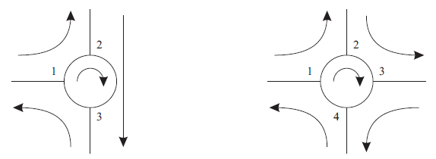
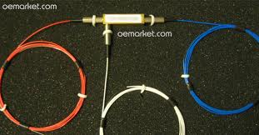
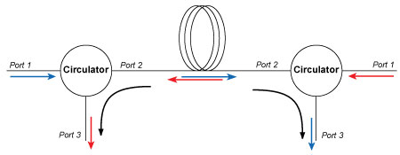
Circulator

Slide 21
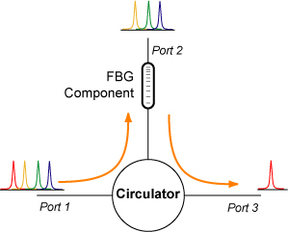
Circulator

