Slide 1
OPTICAL FIBER COMMUNICATION
JITHESH K
ROLL NO 40
S3 EC

Slide 2
Evolution of optical fiber
1880 – Alexander Graham Bell
1930 – Patents on tubing
1950 – Patent for two-layer glass wave-guide
1960 – Laser first used as light source
1965 – High loss of light discovered
1970s – Refining of manufacturing process
1980s – OF technology becomes backbone of long distance telephone networks in NA.

Slide 3
What is optical Fiber?
An optical fiber is a hair thin cylindrical fiber of glass or any transparent dielectric medium.
The fiber which are used for optical communication are wave guides made of transparent dielectrics.
Its function is to guide visible and infrared light over long distances.

Slide 4
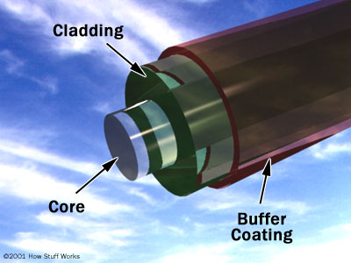
Structure of optical fiber

Slide 5
Core – central tube of very thin size made up of optically transparent dielectric medium and carries the light form transmitter to receiver. The core diameter can vary from about 5um to 100 um.
Cladding – outer optical material surrounding the core having reflecting index lower than core. It helps to keep the light within the core throughout the phenomena of total internal reflection.
Buffer Coating – plastic coating that protects
the fiber made of silicon rubber. The typical diameter of fiber after coating is 250-300 um.

Slide 6
Working principle
Total Internal Reflection
When a ray of light travels from a denser to a rarer medium such that the angle of incidence is greater than the critical angle, the ray reflects back into the same medium this phenomena is called total internal reflection.
In the optical fiber the rays undergo repeated total number of reflections until it emerges out of the other end of the fiber, even if the fiber is bent.

Slide 7
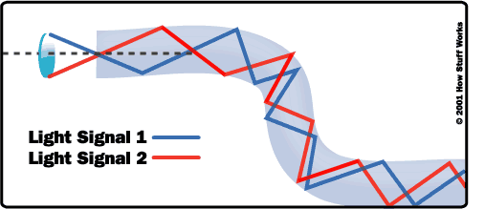
Total internal reflection in optical fiber

Slide 8
Classification of optical fiber
Optical fiber is classified into two categories based on :-
1) The number of modes, and
2) The refractive index

Slide 9
On the basis of number of modes:-
on the basis of number of modes of propagation the optical fiber are classified into two types:
Single mode fiber (SMF) and
Multi-mode fiber (MMF)
Single-mode fibers – in single mode fiber only one mode can propagate through the fiber. This type of fiber has small core diameter(5um) and high cladding diameter(70um) and the difference between the refractive index of core and cladding is very small. There is no dispersion i.e. no degradation of signal during travelling through the fiber.
The light is passed through the single mode fiber through laser diode.

Slide 10
Multi-mode fiber :-
Multi mode fiber allows a large number of modes for the light ray travelling through it.
The core diameter is (40um) and that of cladding is(70um)
The relative refractive index difference is also larger than single mode fiber.
There is signal degradation due to multimode dispersion.
They are not suitable for long distance communication due to large dispersion and attenuation of the signal.

Slide 11
On the basis of Refractive index
There are two types of optical fiber:-
(i) Step-index optical fiber
(ii) Graded-index optical fiber

Slide 12
Step index fiber
The refractive index of core is constant
The refractive index of cladding is also constant
The light rays propagate through it in the form of meridiognal rays which cross the fiber axis during every reflection at the core cladding boundary.

Slide 13
Graded Index fiber
In this type of fiber core has a non uniform refractive index that gradually decrease from the centre towards the core cladding interface.
The cladding has a uniform refractive index.
The light rays propagate through it in the form of skew rays or helical rays. They do not cross the fiber axis at any time.

Slide 14
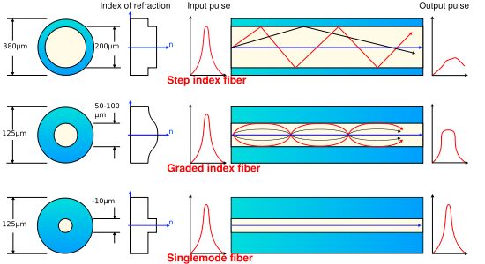

Slide 15
Optical Fiber Communication System
Information source
Electrical source
Optical source
Optical fiber cable
Optical detector
Electrical receive
Destination

Slide 16
Information source- it provides an electrical signal to a transmitter comprising an electrical stage.
Electrical transmitter- It drives an optical source to give an modulation of the light wave carrier.
Optical source- It provides the electrical-optical conversion .It may be a semiconductor laser or an LED.

Slide 17
Optical cable: It serves as transmission medium.
Optical detector: It is responsible for optical to electrical conversion of data and hence responsible for demodulation of the optical carrier. It may be a photodiodes, phototransistor, and photoconductors.
Electrical receiver: It is used for electrical interfacing at the receiver end of the optical link and to perform the signal processing electrically.
Destination: It is the final point at which we receive the information in the form of electrical signal.

Slide 18
Attenuation
Attenuation is a general term that refers to any reduction in the strength of a signal
Attenuation in optical fiber take place due to elements like coupler, splices, connector and fiber itself.
A fiber lower attenuation will allow more power to reach a receiver than with a higher attenuation.
Attenuation may be categorised as –
Intrinsic
Extrinsic

Slide 19
Factor causing attenuation in Fiber
Fig. shows the factor affecting the attenuation in fiber-
Attenuation
Intrinsic
Absorption
Scattering
Extrinsic
Macrobending
Microbending

Slide 20
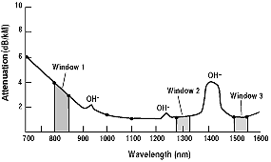
Variation of specific attenuation with wavelength

Slide 21
Attenuation & Wavelength
The specific attenuation ( power loss in dB per unit length ) actually depends on the wavelength of the radiation travelling along the optic fibre
The graph shows minima at 1310nm and 1550nm, which implies that these are desirable wavelengths for optimal transmission
These are infra red wavelengths

Slide 22
Advantage of optical fiber communication
The life of fiber is longer than copper wire
Handling and installation costs of optical fiber is very nominal
It is unaffected with electromagnetic interference
Attenuation in optical fiber is lower than coaxial cable or twisted pair.
There is no necessity of additional equipment for protecting against grounding and voltage problems.
As it does not radiates energy any antenna or detector cannot detects it hence provides signal security

Slide 23
Disadvantage
Highly skilled staff would be required for maintenance
Only point to point working is possible on optical fiber
Precise and costly instruments would be required
Costly if under utilized.
Accept unipolar codes only.
Jointing of fiber and splicing is also time consuming.

Slide 24
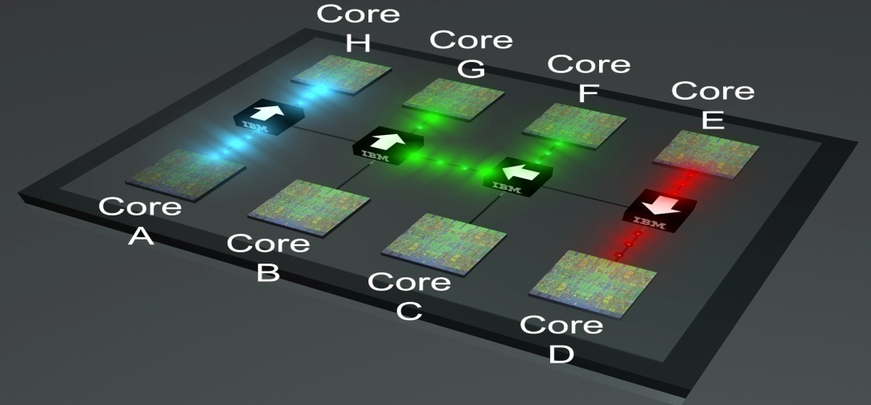
Applications
Optical fiber have wider range of application in almost all field, some are been specified below
In telecommunication field
In space applications
Broadband applications
Computer applications industrial applications
Mining applications
In medical applications
In military applications etc.

Slide 25
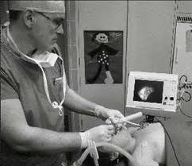
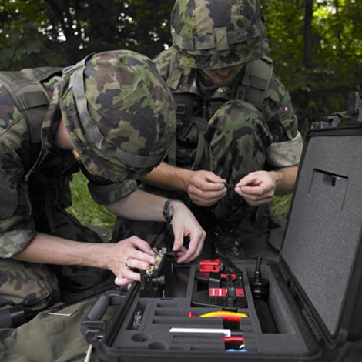
Optical fiber have wider range of application in almost all field, i.e. in medical, electronics, military etc .some are been specified below
Medical
Military
Electronics
IBM microprocessors

Slide 26
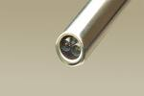
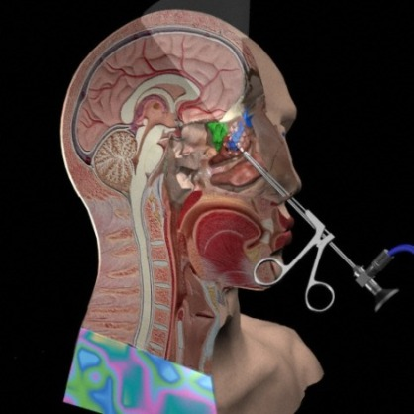
The Endoscope
There are two optical fibres
One for light, to illuminate the inside of the patient
One for a camera to send the images back to the doctor.
Key hole surgery

Slide 27
THANK YOU

