Slide 1
Query processing and optimization
Jose M. Peña
jose.m.pena@liu.se

Slide 2
ER diagram
Relational model
MySQL

Slide 3
Relation schema
Attributes
PNumber | Name | Address | Telephone | E-mail | Age
yymmdd-xxxx
Textual string less than 30 chars
aaaaannn
Textual string less than 30 chars
Positive integer
0<x<150
rrr - nn nn nn
Domain = set of atomic values

Slide 4
Relation
PNumber | Name | Address | Telephone | E-mail | Age
123456-7890 | Anders Andersson | Rydsvägen 1 | 013-11 22 33 | andan111 | 25
112233-4455 | Veronika Pettersson | Alsätersg 2 | 013-22 33 44 | verpe222 | 27
Tuple = list of values in the corresponding domains, or NULL

Slide 5
Key constraints
Relation = set of tuples.
Then, no duplicates are allowed.
Then, every tuple is uniquely identifiable (superkey, candidate key, primary key which are all time-invariant).
PNumber | Name | Address | Telephone | E-mail | Age
123456-7890 | Anders Andersson | Rydsvägen 1 | 013-11 22 33 | andan111 | 25
112233-4455 | Veronika Pettersson | Alsätersg 2 | 013-22 33 44 | verpe222 | 27

Slide 6
Integrity constraints
Entity integrity constraint = no primary key value is NULL.
A set of attributes FK in a relation R1 is a foreign key to another relation R2 with primary key PK if
  domain(FK) = domain(PK), and
  FK in R1 takes value NULL or one of the values of PK in R2.
Referential integrity constraint = conditions (i) and (ii) above hold.

Slide 7
Relational algebra
Relational algebra = language for querying the relational model.
It is a procedural language = how to carry out the query, as opposed to what to retrieve = declarative language, i.e. relational calculus.
Basis for SQL.
Basis for implementation and optimization of queries.

Slide 8
Select
Selects the tuples of a relation satisfying some condition over its attributes.

Slide 9
Example: select
STUDENT:
PNum | Name | Address | TelNr
112233-4455 | Elin | Rydsvägen 1 | 112233
223344-5566 | Nisse | Alsätersgatan 3 | 223344
334455-6677 | Nisse | Rydsvägen 3 | 334455
113322-1122 | Pelle | Rydsvägen 2 | 113322
552233-1144 | Monika | Rydsvägen 4 | 443322
442211-2222 | Patrik | Rydsvägen 6 | 111122
334433-1111 | Camilla | Alsätersgatan 1 | 665544
PNum | Name | Address | TelNr
334455-6677 | Nisse | Rydsvägen 3 | 334455
334433-1111 | Camilla | Alsätersgatan 1 | 665544

Slide 10
Project
Projects a relation over some attributes.
The result must be a relation = duplicates are removed.

Slide 11
Example: project
STUDENT:
PNum | Name | Address | TelNr
112233-4455 | Elin | Rydsvägen 1 | 112233
223344-5566 | Nisse | Alsätersgatan 3 | 223344
334455-6677 | Nisse | Rydsvägen 3 | 334455
PNum | Name
112233-4455 | Elin
223344-5566 | Nisse
334455-6677 | Nisse

Slide 12
Union, intersection and difference
R and S must be compatible, i.e. the same number of attributes and with the same domains.
The result must be a relation = duplicates are removed (union).

Slide 13
Example: Intersection
STUDENT:
PNum | Name | Address | TelNr
112233-4455 | Elin | Rydsvägen 1 | 112233
223344-5566 | Nisse | Alsätersgatan 3 | 223344
334455-6677 | Nisse | Rydsvägen 3 | 334455
EMPLOYEE:
PNum | Name | Office address | TelNr
884455-4455 | Monika | Teknikringen 1 | 111112
223344-5566 | Nisse | Alsätersgatan 3 | 223344
668877-7766 | Patrik | Teknikringen 3 | 332211
PNum | Name | Address | TelNr
223344-5566 | Nisse | Alsätersgatan 3 | 223344

Slide 14
Cartesian product
Name | STATE | Key | City
Los Angeles | Calif | 5 | San Fransisco
Los Angeles | Calif | 7 | Oakland
Los Angeles | Calif | 8 | Boston
Oakland | Calif | 5 | San Fransisco
Oakland | Calif | 7 | Oakland
Oakland | Calif | 8 | Boston
Atlanta | Ga | 5 | San Fransisco
Atlanta | Ga | 7 | Oakland
Atlanta | Ga | 8 | Boston
San Fransisco | Calif | 5 | San Fransisco
San Fransisco | Calif | 7 | Oakland
San Fransisco | Calif | 8 | Boston
Boston | Mass | 5 | San Fransisco
Boston | Mass | 7 | Oakland
Boston | Mass | 8 | Boston
R:
Name | STATE
Los Angeles | Calif
Oakland | Calif
Atlanta | Ga
San Fransisco | Calif
Boston | Mass
S: R x S
Key | City
5 | San Fransisco
7 | Oakland
8 | Boston

Slide 15
Join
Joins two tuples from two relations if they satisfy some condition over their attributes.
Join = Cartesian product followed by selection.
Tuples with NULL in the condition attributes do not appear in the result.
Recall: Join only on foreign key-primary key attributes.
R
S
R.A1=S.B3 AND R.A5<S.A1

Slide 16
Example: join
R:
S:
Name | STATE
Los Angeles | Calif
Oakland | Calif
Atlanta | Ga
San Fransisco | Calif
Boston | Mass
Key | City
5 | San Fransisco
7 | Oakland
8 | Boston
R
S
R.Name=S.City
Name | STATE | Key | City
Oakland | Calif | 7 | Oakland
San Fransisco | Calif | 5 | San Fransisco
Boston | Mass | 8 | Boston

Slide 17
Name | STATE | Key | City
Los Angeles | Calif | 5 | San Fransisco
Los Angeles | Calif | 7 | Oakland
Los Angeles | Calif | 8 | Boston
Oakland | Calif | 5 | San Fransisco
Oakland | Calif | 7 | Oakland
Oakland | Calif | 8 | Boston
Atlanta | Ga | 5 | San Fransisco
Atlanta | Ga | 7 | Oakland
Atlanta | Ga | 8 | Boston
San Fransisco | Calif | 5 | San Fransisco
San Fransisco | Calif | 7 | Oakland
San Fransisco | Calif | 8 | Boston
Boston | Mass | 5 | San Fransisco
Boston | Mass | 7 | Oakland
Boston | Mass | 8 | Boston

Slide 18
Example: join
R:
Name | Area
Los Angeles | 2
Oakland | 9
Atlanta | 7
San Fransisco | 11
Boston | 16
Name | Area | Key | City
Los Angeles | 2 | 5 | San Fransisco
Los Angeles | 2 | 7 | Oakland
Los Angeles | 2 | 8 | Boston
Atlanta | 7 | 7 | Oakland
Atlanta | 7 | 8 | Boston
R
S
S:
R.Area<=S.Key
Key | City
5 | San Fransisco
7 | Oakland
8 | Boston

Slide 19
Name | Area | Key | City
Los Angeles | 2 | 5 | San Fransisco
Los Angeles | 2 | 7 | Oakland
Los Angeles | 2 | 8 | Boston
Oakland | 9 | 5 | San Fransisco
Oakland | 9 | 7 | Oakland
Oakland | 9 | 8 | Boston
Atlanta | 7 | 5 | San Fransisco
Atlanta | 7 | 7 | Oakland
Atlanta | 7 | 8 | Boston
San Fransisco | 11 | 5 | San Fransisco
San Fransisco | 11 | 7 | Oakland
San Fransisco | 11 | 8 | Boston
Boston | 16 | 5 | San Fransisco
Boston | 16 | 7 | Oakland
Boston | 16 | 8 | Boston

Slide 20
Variants of join
Theta join = join.
Equijoin = join with only equality conditions.
Natural join = equijoin in which one of the duplicate attributes is removed (attributes in the conditions must have the same name).
Unless otherwise specified, natural join joins all the attributes with the same name in R and S.
R
*
S
A

Slide 21
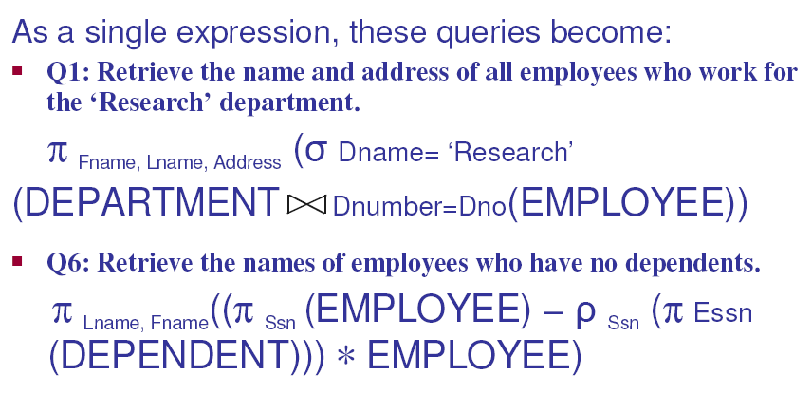
Example

Slide 22
Query trees
Tree that represents a relational algebra expression.
Leaves = base tables.
Internal nodes = relational algebra operators applied to the node’s children.
The tree is executed from leaves to root.
Example: List the last name of the employees born after 1957 who work on a project named ”Aquarius”.
SELECT E.LNAME
FROM EMPLOYEE E, WORKS_ON W, PROJECT P
WHERE P.PNAME = ‘Aquarius’ AND P.PNUMBER = W.PNO AND W.ESSN = E.SSN AND E.BDATE > ‘1957-12-31’
π_{attributes}
Canonial query tree
SELECT attributes
FROM A, B, C
WHERE condition
X
X
C
A B
σ_{condition}
Construct the canonical query tree as follows
Cartesian product of the FROM-tables
Select with WHERE-condition
Project to the SELECT-attributes

Slide 23
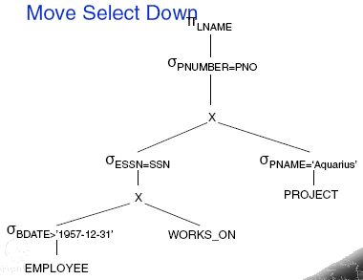
Equivalent query trees

Slide 24
Query processing
Real world
User 4
User 3
Updates
Queries
Answers
User 2
Model
Updates
Queries
Answers
User 1
Updates
Queries
Answers
Updates
Queries
Answers
Processing of
queries and updates
Database
management
system
Access to stored data
Physical
database
Notes:
24

Slide 25
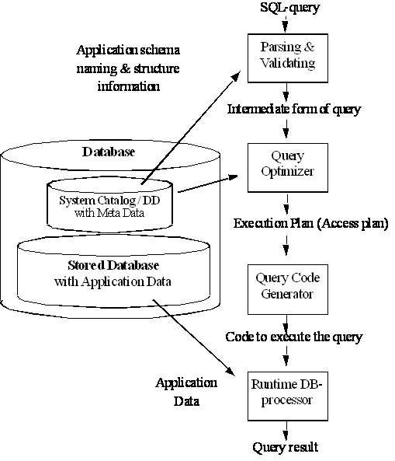
Query processing
StarsIn( movieTitle, movieYear, starName )
MovieStar( name, address, gender, birthdate )
SELECT movieTitle
FROM StarsIn
WHERE starName IN (
SELECT name
FROM MovieStar
WHERE birthdate LIKE ’%1960’);
Canonical query tree
(usually very inefficient)

Slide 26
Parsing and validating
Control of used relations:
  They have to be declared in FROM.
  They must exist in the database.
Control and resolve attributes:
  Attributes must exist in the relations.
Type checking:
  Attributes that are compared must be of the same type.

Slide 27

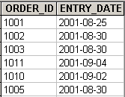

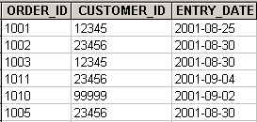
Query optimizer
Heuristic: Use joins instead of cartesian product+selections and do selection and projection as soon as possible, in order to keep the intermediate tables as small as possible, because
  if the tables do not fit in memory, then we need to perform fewer disc accesses,
  if the tables fit in memory, then we use less memory,
  if the tables are distributed, then we reduce communication, and
  if the tables have to be sorted, joined, etc., then we use less computation power

Slide 28
Query optimizer
Fewest tuples ? Smallest size ? Smallest selectivity ? DBMS catalog contains required info.
Heuristic algorithm:
  Break up conjunctive select into cascade.
  Move down select as far as possible in the tree.
  Rearrange select operations: The most restrictive should be executed first.
  Convert Cartesian product followed by selection into join.
  Move down project operations as far as possible in the tree. Create new projections so that only the required attributes are involved in the tree.
  Identify subtrees that can be executed by a single algorithm.

Slide 29
Equivalence rules

Slide 30
Execution plans
Execution plan: Optimized query tree extended with access methods and algorithms to implement the operations.

Slide 31
Query optimizer
Compare the estimate cost estimate of different execution plans and choose the cheapest.
The cost estimate decomposes into the following components.
  Access cost to secondary storage.
    Depends on the access method and file organization. Leading term for large databases.
  Storage cost .
    Storing intermediate results on disk.
  Computation cost.
    In-memory searching, sorting, computation. Leading term for small databases.
  Memory usage cost.
    Memory buffers needed in the server.
  Communication cost.
    Remote connection cost, network transfer cost. Leading term for distributed databases.
The costs above are estimated via the information in the DBMS catalog (e.g. #records, record size, #blocks, primary and secondary access methods, #distinct values, selectivity, etc.).

Slide 32
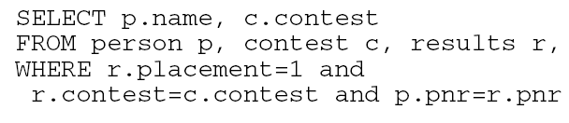
Exercises
True or false ?
Optimize the queries below:

Slide 33
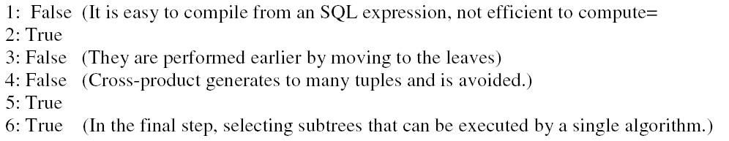
Solutions

Slide 34
Solutions

Slide 35
Solutions

