Slide 1
Home Automation
Thijs Schreijer

Slide 2
Thijs Schreijer
management consultant @ Logica Consulting
dagelijks leven eenvoudiger en efficienter maken
‘targets’; Microsoft Office en Home Automation
Reis belangrijker/leuker dan het doel
Admin van het xPL project
Member of ‘HEMS’ and ‘FriendlyDevice’ workingcommittees @ UPnP forum
Te vinden op http://www.thijsschreijer.nl

Slide 3
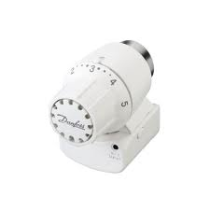
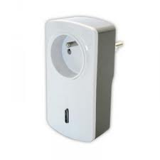
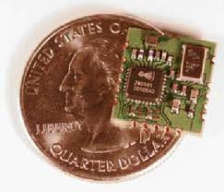
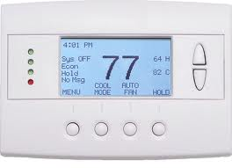
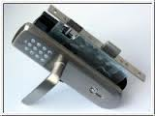
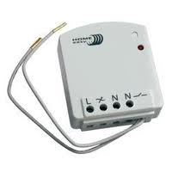
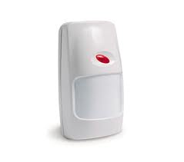
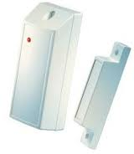
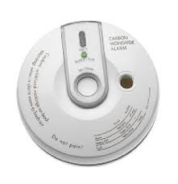

Slide 4
Hardware
Wired
Dedicated
KNX-EIB
PLC
KNX-EIB
X10
Insteon
PowerBus
Wireless
Networked
Zwave
Zigbee
One-way
Klik-aan-klik-uit
HomeEasy
X10 – RF
And many more…

Slide 7
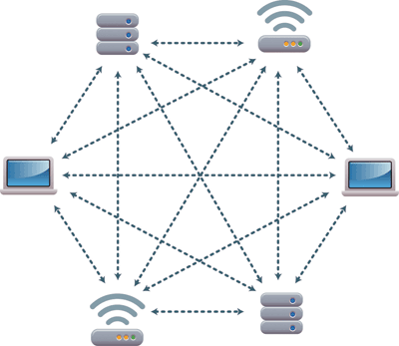

Slide 9
How to control it?

Slide 10
Interoperability
Logic Engine
User interface
Communications
Actor
Sensor

Slide 11
Sad state of affairs
UI
TabletPhone
Browser
HA server
(logic engine + comms + UI)
Driver
Apps
Web
Driver
Driver
Driver
HW 1
HW 2
HW 3

Slide 12
What we need
Protocol
Profiles

Slide 13
xPL is an open protocol intended to permit the control and monitoring of home automation devices
The primary design goal of xPL is to provide a rich set of features and functionality, whilst maintaining an elegant, uncomplicated message structure
The protocol includes complete discovery and auto-configuration capabilities which support a fully “plug-n-play” architecture – essential to ensure a good end-user experience.
xPL benefits from a strongly-specified message structure, required to ensure that xPL-enabled devices from different vendors are able to communicate without the risk of incompatibilities.

Slide 14
xpl-cmnd
{
hop=1
source=xpl-xplhal.myhouse
target=acme-cm12.server
}
x10.basic
{
command=dim
device=a1
level=75
}

Slide 15
Java
Perl
.NET
Lua
C
C++
Python

Slide 16
xPL demo video
DD-WRT router
LuaxPL (netpresence.lua utility)
xPL
Girder

Slide 18
Audio/Video; ABI Research reports
DLNA deployed 250 million devices in 2009
projects the deployment of approximately 1 billion more in 2012
an additional 2 billion in 2014
Several billion routers

Slide 19
characteristics
Controlpoints
Devices
Distributed, auto-discovery
Carry their own description
Wrapper
Based on; ssdp, http, xml, soap, … standards

Slide 20
structure
Device
Services
(evented) statevariables
actions
(embedded) devices

Slide 21
http://opentools.homeip.net/dev-tools-for-upnp

Slide 22
UPnP – Girder demo
MediaPlayer
UPnP
UPnP-2-xPL gateway
xPL
Girder

Slide 23
UPnP gateway/middleware
World…
Gateway
Driver
Driver
Driver
Driver
Driver

Slide 24
Future
Vergrijzing
SmartGrid
HomeManagement

Slide 25
