Slide 1
VOICE CONTROLLED SMART HOME AUTOMATION SYSTEM BASED ON ZIGBEE NETWORK
Engr. Elechi, Promise
And
Onwuka, Charles Chukwuma

Slide 2
Introduction
Wireless Home Automation System is an integrated, easy-to-use home automation system that can be fully operated based on speech commands
It helps one to control household appliances from a centralized control unit
Its a system that can be integrated as a single portable device for controlling household appliances such as lighting, fan, air conditioner, television, security camera, etc.

Slide 3
Review of Related Work
The concept of home automation has been around since the late 1900s [Wikipedia Report]
Sriskanthan, et al. [2002] and Kanma,et al. [2003] implemented a home automation system using Bluetooth that can be accessed remotely through GPRS.
Alheraish, [2004] implemented a home automation system using SMS.
Alkar and Buhur [2005] implemented a home automation system using Internet for enabling remote home access and infrared technology for device communication within the home.
Atukorala, et al. [2009] also implemented a home automation Security System called Smart-Eye using General Packet Radio Service (GPRS).
Muhury and Habib [2012] implemented a DTMF-based home automation system in which the user calls a SIM number assigned to the home and presses the digits on their phone’s keypad to control the home’s devices by generating a DTMF tone.

Slide 4
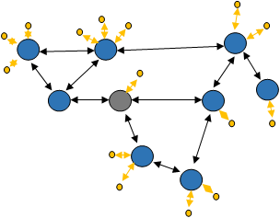
Materials and Method

Slide 5
Materials and Method
+5V POWER
SUPPLY
SPEECH
U
ZIGBEE
MIC
RECOGNITION
A
TRANSCEIVER
UNIT (HM 2007)
R
T
8051
LCD DISPLAY

Slide 6
Materials and Method
U
+5V POWER
SUPPLY
A
R
ZIGBEE
TRANSCEIVER
T
LCD DISPLAY
8051
KITCHEN
LIVING ROOM
BEDROOM
S
SECURITY SYSTEM FOR
MAIN DOOR

Slide 7
Materials and Method
Training Words for Recognition
Press “1” (display will show “01” and the LED will turn OFF) on the keypad
Press the TRAIN key (the LED will turn ON) to place circuit in training mode, for word one.
Say the target word into the onboard microphone (near LED) clearly.
Ensure the circuit signals acceptance of the voice input by blinking the LED OFF then ON. The word (or utterance) is now identified as the “01” word.
If the LED did not flash, start over by pressing “1” and then “TRAIN” key.

Slide 8
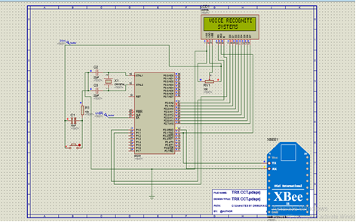
Materials and Method
The circuit was designed using the simulation Proteus software.
The program was written and compiled using Keil IDE and the HEX file was obtained
Using the Proteus 8 software, the hex file was loaded into the microcontroller.
The simulation was started using the “Start” button at the bottom corner of the program interface.

Slide 9
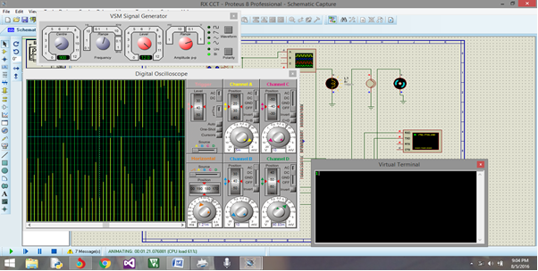
Materials and Method
Launch the VSPD and note the names of the available virtual ports on the software.
Open the Proteus simulation of the transmitter circuit, double click on the Xbee module, click on “properties”, and select any available port. E.g. “COM2”
Repeat step 2 for the receiver circuit but in this case, change the port of the Xbee module to “COM3” (any available port will also work).
Re-launch the VSPD and click on “manage ports”. Under “first port” option, select “COM2” and under the “second port” option, select “COM3”.
Click “Add Pair” and close the software.

Slide 10
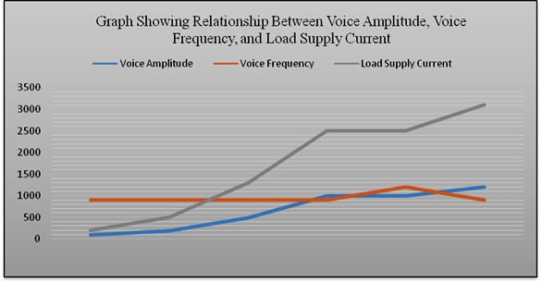
Results

Slide 11
Conclusion
Voice control smart home with ZigBee network can help to minimize wiring complications involved with wired automation and prevents unnecessary movements required to switch ON/OFF appliances.
It provides a much higher operating range when compared to Bluetooth, Wi-Fi and other wireless network protocols.
with the use of ZigBee Home Automation system, considerable amount of power saving is possible, and compatible with future technologies.
It is flexible and can be customized for individual requirements.

