Slide 1
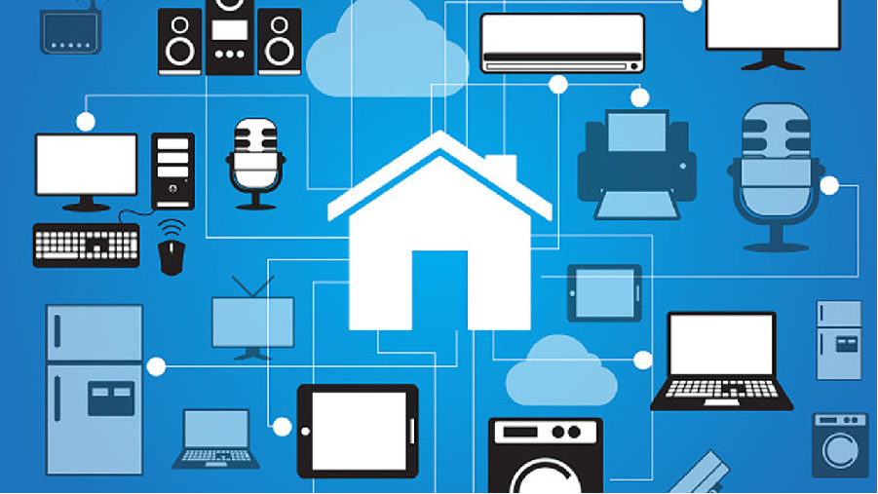
HOME AUTOMATION SYSTEM
Submitted by
Amit Sharma
1310751033
CSE 7th

Slide 2
TRANING COMPLETED FROM
I have completed my training from DELAIN Tech. Hisar. The training was started from 20 June 2016 to 5 August 2016. Thanks to Mr. Sachin Sardana who helps me to complete my training.

Slide 3
CONTENTS
What is this project all about ?
What is my contribution ?
Which technology I've used ?
How it works ?
What are the future scope ?

Slide 4
What is this project all about ?
What if I say “turn on the light(s)”!
What if I say “turn on the T.V.”!
What if I say “open the door”!
What if I say “schedule a meeting with someone/send an email to somebody/make a call to somebody”!
What if, to do something I don’t need to do anything!

Slide 5
What is this project all about ? Cont.
What if all the device in our life could connect to the internet, could communicate to each other, send our information and take our commands.
This is the concept of SMART HOME.
This is the effort which makes our life more easier, more powerful, and time effective.
Apart from this, this project play a key role in the life of those people who are physically disabled.

Slide 6
What is this project all about ? Cont.
Home automation is exactly what it sounds like, automating the ability to control items around the house.
Its simple and relatively inexpensive.

Slide 7
What is my contribution?
I design a program named ’DAVID’.
‘HE’ is responsible for operating all kind of operation, threads and process in a regular flow.
I designed him in such a way that he is not only process commands but also respond accordingly.
He can connect to the internet and will provide us the precise result what we are asking to him.

Slide 8
What is my contribution? Cont.
I spent many hours training him.
The core feature of the programs are as follows:-
Can control the appliances.
Can respond our commands.
Switching ability, voice control to manual control.
Generate error code.
Provides us the temp and weather data.
Sleep and wake mode.

Slide 9
What technology I’ve used ?
There are many languages that can be used to develop such projects, like python, java, VB etc.
But since MS – Visual Basic(.NET Framework) is considered as the one of the powerful and best language in the field of development and deployment, I choose it to make this project go.
Actually I’ve use Visual C# technology which comes under the same framework.

Slide 10
What technology I’ve used ? Cont.
This is simple and easy to use.
Provides various technological features and class libraries.(MFCL)
Powerful tools to build any kind of application.

Slide 11
How it works ?
START
USER VOICE
INPUT
SERVER
USB-to-SERIAL BRIDGE
CONTROLLER
RELAY- SYSTEM

Slide 12
How it works ? Cont.
After initiating the program, user needs to send voice commands to the server.
The microcontroller is connected to the server via USB. On receiving speech commands, server sends commands to the microcontroller over the USB connection.
The microcontroller is directly connected to the relays and it can enable or disable them.
The relays are connected to the electrical system of the building so that they can control the plug points.

Slide 13
What are the future scopes ?
Main enhancement in this project could be as fallows:
By using wireless technology, this project could be wire free.
By uploading this program on a chip, makes it efficient and reliable.
This program can also be uploaded on the server, where it can monitor and report the status, remotely.
Bugs are the main problem in every kind of software system. This has too, so the efficiency can be enhanced by make it bug free.

