Slide 1
Home Automation Console
Publish/Subscribe Server for interoperability and reduction of complexity at end devices

Slide 2
Problem Statement
To achieve interoperability of Home devices by allowing user to customize subscriptions of devices.
The model should not constraint the developer from implementing various sensor network optimizations and provide a consistent API.

Slide 3
Earlier attempts at HAN
Various manufacturers have sold home appliance sets that are hard wired to work together.
These does not allow connectivity with other devices thereby reducing utility.

Slide 4
Related Protocols
Zigbee attempted a standardization of Home Automation devices by providing specifications for all messages that can transmitted
This resulted in 2000+ pages of complex specification that’s needs to implemented by developers on each platform

Slide 5
Our Idea
A Home Automation console which can be wall mounted which is quite similar to a tablet with Android running on it.
It has pub/sub server that gets unprocessed information from publishing sensors.
The user or manufacturer through Android apps can process the information
The user can specify which devices subscribes to which information conditionally.

Slide 6
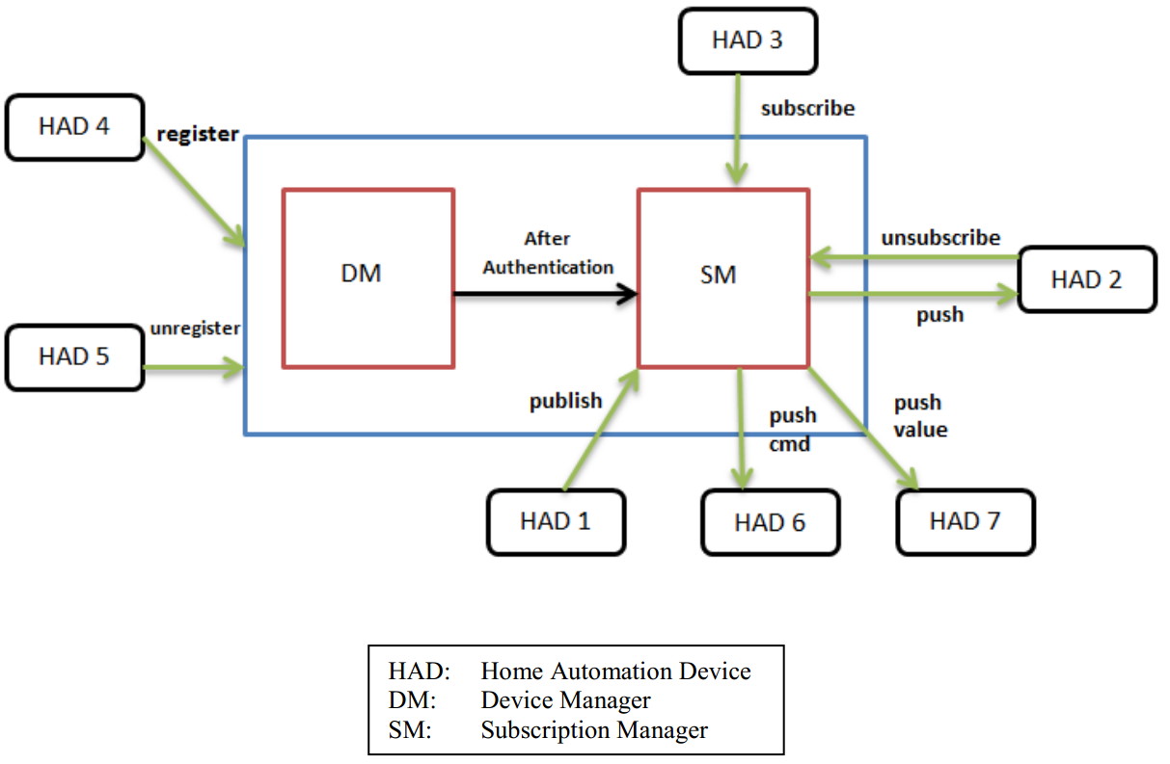

Slide 7
Pub/Sub Algorithm
Each publisher sends all the data it can publish to the HAN Console.
The HAN Console stores mapping of a publisher’s data to a subscriber’s functionality.
The HAN Console processes the publisher’s data according to an expression specific to a subscriber’s functionality and sends it to the subscriber depending on the result

Slide 8
[place holder for screenshots]
[HAN Console]

Slide 9
[place holder for screenshots]
[simulated sensor boards]
[simulated devices]

Slide 10
[place holder for screenshots]
[location based interactive app on user’s mobile]

