Slide 1
The Concept of Transaction Processing
A Transaction: logical unit of database processing that includes one or more access operations (read -retrieval, write - insert or update, delete).
A transaction (set of operations) may be stand-alone specified in a high level language like SQL, or may be embedded within a program.
Transaction boundaries: Begin and End transaction.
An application program may contain several transactions separated by the Begin and End transaction boundaries.

Slide 2
Properties of Transactions
ACID properties:
Atomicity: A transaction is an atomic unit of processing; it is either performed in its entirety or not performed at all.
Consistency preservation: A correct execution of the transaction must take the database from one consistent state to another.
Isolation: A transaction should not make its updates visible to other transactions until it is committed.
Durability or permanency: Once a transaction changes the database and the changes are committed, these changes must never be lost because of subsequent failure.

Slide 3
Basic operations are read and write
read_item(X): Reads a database item named X into a program variable x.
write_item(X): Writes the value of program variable X into the database item named X.
read_item(X) command includes the following steps:
Find the address of the disk block that contains item X.
Copy that disk block into a buffer in main memory (if that disk block is not already in some main memory buffer).
Copy item X from the buffer to the program variable named X.
write_item(X) command includes the following steps:
Find the address of the disk block that contains item X.
Copy that disk block into a buffer in main memory (if that disk block is not already in some main memory buffer).
Copy item X from the program variable named X into its correct location in the buffer.
Store the updated block from the buffer back to disk (either immediately or at some later point in time).

Slide 4
Concurrency control
Single-User System: At most one user at a time can use the system.
Multiuser System: Many users can access the system concurrently.
Concurrency
Interleaved processing: concurrent execution of processes is interleaved in a single CPU
Parallel processing: processes are concurrently executed in multiple CPUs.

Slide 5
Why Concurrency Control is needed:
The Lost Update Problem.
This occurs when two transactions that access the same database items have their operations interleaved in a way that makes the value of some database item incorrect.
The Temporary Update (or Dirty Read) Problem.
This occurs when one transaction updates a database item and then the transaction fails for some reason. The updated item is accessed by another transaction before it is changed back to its original value.
The Incorrect Summary Problem .
If one transaction is calculating an aggregate summary function on a number of records while other transactions are updating some of these records, the aggregate function may calculate some values before they are updated and others after they are updated.

Slide 6
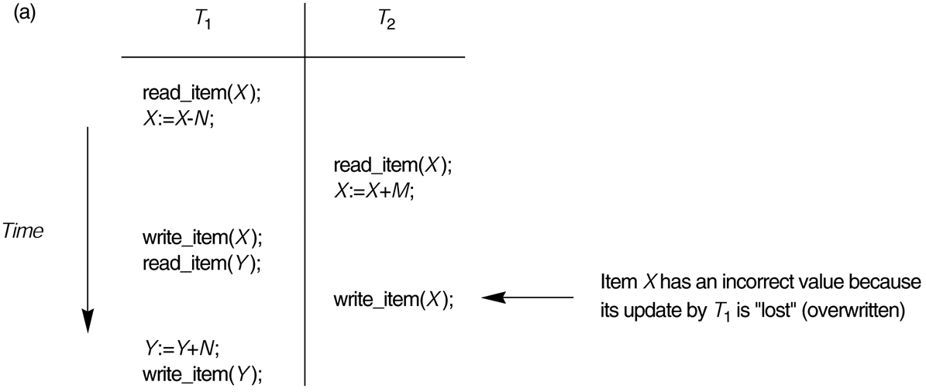
(a) The lost update problem.

Slide 7
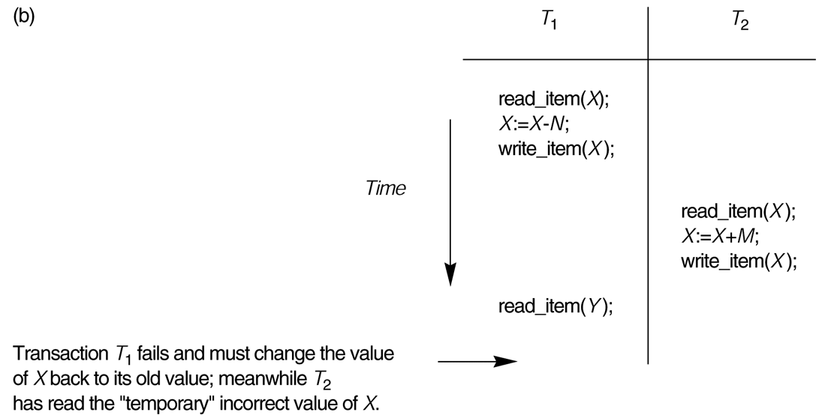
(b) The temporary update problem (Dirty Read) .

Slide 8
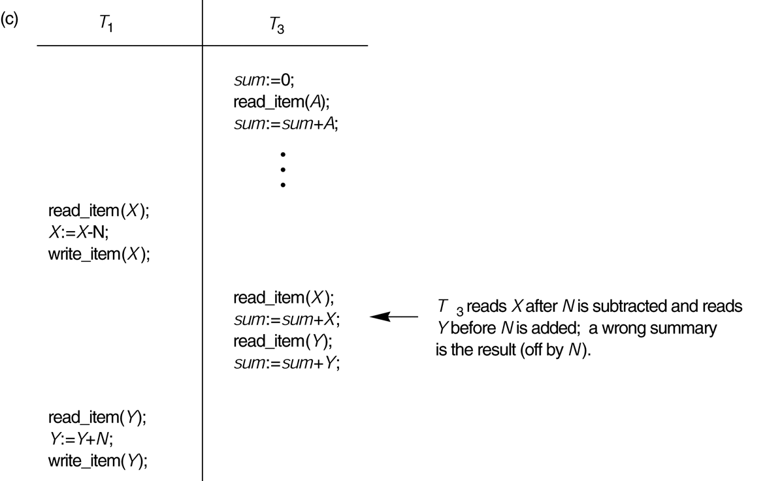
(c) The incorrect summary problem.

Slide 9
Transaction Recovery
Why recovery is needed: (What causes a Transaction to fail)
A computer failure (system crash): A hardware or software error occurs in the computer system during transaction execution.
A transaction or system error : Some operation in the transaction may cause it to fail, such as integer overflow or division by zero. Transaction failure may also occur because of erroneous parameter values or because of a logical programming error. In addition, the user may interrupt the transaction during its execution.
Local errors or exception conditions detected by the transaction:
- certain conditions necessitate cancellation of the transaction. For example, data for the transaction may not be found. A condition, such as insufficient account balance in a banking database.
- a programmed abort in the transaction causes it to fail.
Concurrency control enforcement: The concurrency control method may decide to abort the transaction, to be restarted later, because it violates serializability or because several transactions are in a state of deadlock .
Disk failure: Some disk blocks may lose their data because of a read or write malfunction or because of a disk read/write head crash.
Physical problems : This refers to an endless list of problems that includes power or air-conditioning failure, fire, theft, sabotage, and overwriting disks by mistake.

Slide 10
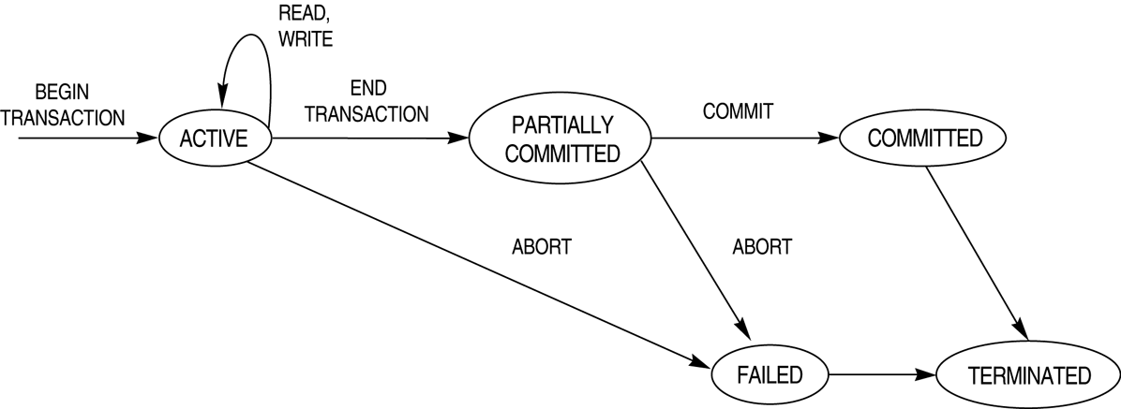
Transaction states.

Slide 11
Transaction and System Concepts
Recovery manager keeps track of the following operations:
begin_transaction:This marks the beginning of transaction execution.
read or write: These specify read or write operations on the database items that are executed as part of a transaction.
end_transaction: This specifies that read and write transaction operations have ended and marks the end limit of transaction execution. At this point it may be necessary to check whether the changes introduced by the transaction can be permanently applied to the database or whether the transaction has to be aborted because it violates concurrency control or for some other reason.
commit_transaction: This signals a successful end of the transaction so that any changes (updates) executed by the transaction can be safely committed to the database and will not be undone.
rollback (or abort): This signals that the transaction has ended unsuccessfully, so that any changes or effects that the transaction may have applied to the database must be undone.

Slide 12
Recovery techniques
Recovery techniques use the following operators:
undo: Similar to rollback except that it applies to a single operation rather than to a whole transaction.
redo: This specifies that certain transaction operations must be redone to ensure that all the operations of a committed transaction have been applied successfully to the database.

Slide 13
The System Log:
The log is kept on disk, so it is not affected by any type of failure except for disk or catastrophic failure. In addition, the log is periodically backed up to archival storage (tape) to guard against such catastrophic failures
Transaction Log
For recovery from any type of failure data values prior to modification (BFIM - BeFore Image) and the new value after modification (AFIM – AFter Image) are required. These values and other information is stored in a sequential file called Transaction log.

Slide 14
Commit Point of a Transaction:
Definition: A transaction T reaches its commit point when all its operations that access the database have been executed successfully and the effect of all the transaction operations on the database has been recorded in the log. Beyond the commit point, the transaction is said to be committed, and its effect is assumed to be permanently recorded in the database. The transaction then writes an entry [commit,T] into the log.
Roll Back of transactions: Needed for transactions that have a [start_transaction,T] entry into the log but no commit entry [commit,T] into the log.
Redoing transactions: Transactions that have written their commit entry in the log must also have recorded all their write operations in the log; otherwise they would not be committed, so their effect on the database can be redone from the log entries.
Force writing a log: before a transaction reaches its commit point, any portion of the log that has not been written to the disk yet must now be written to the disk. This process is called force-writing the log file before committing a transaction.

Slide 15
Transaction Schedules based on Recovery & Serializability
Transaction schedule or history: Is the order of execution of operations from the various transactions
A schedule (or history) S of n transactions T1, T2, ..., Tn :
It is an ordering of the operations of the transactions subject to the constraint that, for each transaction Ti that participates in S, the operations of T1 in S must appear in the same order in which they occur in T1
Recoverable schedule: A schedule S is recoverable if no transaction T in S commits until all transactions T’ that have written an item that T reads have committed.
Serial schedule: A schedule S is serial if, for every transaction T participating in the schedule, all the operations of T are executed consecutively in the schedule. Otherwise, the schedule is called nonserial schedule.
Serializable schedule: A schedule S is serializable if it is equivalent to some serial schedule of the same n transactions.

Slide 16
Transaction Support in SQL
A single SQL statement is always considered to be atomic. Either the statement completes execution without error or it fails and leaves the database unchanged.
With SQL, there is no explicit Begin Transaction statement. Transaction initiation is done implicitly when particular SQL statements are encountered.
Every transaction must have an explicit end statement, which is either a COMMIT or ROLLBACK.

Slide 17
Database Concurrency Control
The Lost Update Problem.
The Temporary Update (or Dirty Read) Problem.
The Incorrect Summary Problem .
1 Purpose of Concurrency Control
To enforce Isolation (through mutual exclusion) among conflicting transactions.
To preserve database consistency through consistency preserving execution of transactions.
To resolve read-write and write-write conflicts.
Example: In concurrent execution environment if T1 conflicts with T2 over a data item A, then the existing concurrency control decides if T1 or T2 should get the A and if the other transaction is rolled-back or waits.

Slide 18
Database Concurrency Control
Two-Phase Locking Techniques
Locking is an operation which secures (a) permission to Read or (b) permission to Write a data item for a transaction. Example: Lock (X). Data item X is locked in behalf of the requesting transaction.
Unlocking is an operation which removes these permissions from the data item. Example: Unlock (X). Data item X is made available to all other transactions.
Lock and Unlock are Atomic operations.

Slide 19
Database Concurrency Control
Two-Phase Locking Techniques: The algorithm
T1 T2 Result
read_lock (Y); read_lock (X); Initial values: X=20; Y=30
read_item (Y); read_item (X); Result of serial execution
unlock (Y); unlock (X); T1 followed by T2
write_lock (X); Write_lock (Y); X=50, Y=80.
read_item (X); read_item (Y); Result of serial execution
X:=X+Y; Y:=X+Y; T2 followed by T1
write_item (X); write_item (Y); X=70, Y=50
unlock (X); unlock (Y);

Slide 20
Database Concurrency Control
Two-Phase Locking Techniques: The algorithm
T1 T2 Result
read_lock (Y); X=50; Y=50
read_item (Y); Nonserializable because it.
unlock (Y); violated two-phase policy.
read_lock (X);
read_item (X);
unlock (X);
write_lock (Y);
read_item (Y);
Y:=X+Y;
write_item (Y);
unlock (Y);
write_lock (X);
read_item (X);
X:=X+Y;
write_item (X);
unlock (X);
Time

Slide 21
Database Concurrency Control
Dealing with Deadlock
Deadlock
T’1 T’2
read_lock (Y); T1 and T2 did follow two-phase
read_item (Y); policy but they are deadlock
read_lock (X);
read_item (Y);
write_lock (X);
(waits for X) write_lock (Y);
(waits for Y)
Deadlock (T’1 and T’2)

Slide 22
Database Concurrency Control (Dealing with Deadlock)
Deadlock prevention
A transaction locks all data items it refers to before it begins execution. This way of locking prevents deadlock since a transaction never waits for a data item. The conservative two-phase locking uses this approach.
Deadlock detection and resolution
The scheduler maintains a wait-for-graph for detecting cycle. If a cycle exists, then one transaction involved in the cycle is selected (victim) and rolled-back. A wait-for-graph is created using the lock table. As soon as a transaction is blocked, it is added to the graph.
Deadlock avoidance
There are many variations of two-phase locking algorithm. Some avoid deadlock by not letting the cycle to complete. That is as soon as the algorithm discovers that blocking a transaction is likely to create a cycle, it rolls back the transaction. Wound-Wait and Wait-Die algorithms use timestamps to avoid deadlocks by rolling-back victim.

Slide 23
Database Concurrency Control
Timestamp based concurrency control algorithm
Timestamp
A monotonically increasing variable (integer) indicating the age of an operation or a transaction. A larger timestamp value indicates a more recent event or operation.
Timestamp based algorithm uses timestamp to serialize the execution of concurrent transactions.

Slide 24
Assignment no. 5
Give a brief comparison between Two-Phase Locking and Timestamp

