Slide 1
Transaction And Concurrency Control
-Bhavya Kilari
Dr. Yanqing Zhang, CSc 8320

Slide 2
PREVIEW
PART I: INTRODUCTION
Transaction Processing System [R. Chow & T. Johnson, 1997]
Serializability [M. Duckett, 1995]
Concurrency Control Protocols
PART II: CURRENT RESEARCH
ZODB[zope cor, Wikipedia, 2009]
Muntiversion Concurrency Control (MVCC)
PART III: FUTURE POTENTIAL
RWC [Andrews,2009]
Dynamic Switching
REFERENCES

Slide 3
Transaction Processing
Motivation : to make use of clean and powerful atomic transaction semantics (ACID Properties)

Slide 4
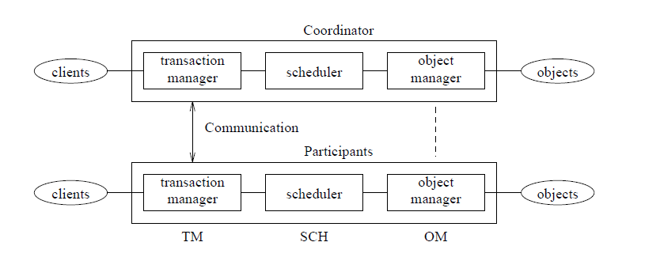
Distributed Transaction Processing System[1]

Slide 5
Atomicity
All or None - Two-Phase Commit
Indivisible – SCH Concurrency Control Protocol
Atomic update – OM Replica Management

Slide 6
Transaction Processing System[1]
Client Process:
Issue a begin transaction
Is at liberty to abort Tr anytime
Issues end transaction
Transaction Manager (TM)
Creates TID and work space
Access request to data object carries TID sent to scheduler
Rejection causes TM to send abort to the client and other TMs
COMMIT must be atomic: two phase commit protocol

Slide 7
Scheduler (SCH)
Chooses a concurrency control protocol to ensure consistency
Inconsistency can be prevented or avoided or consistency can be validated
Object Manager (OM)
Interfacing with underlying file service
Consistency of replicas using replica management protocol
Cache management for efficiency and failure recover for durability.

Slide 8
Serializability
Schedule: set of actions of transactions
Serial Schedule: serial execution of actions of set of transactions
Serializable schedule:
Serializability ensures consistency
Conflicts: write-write, read-write or write-read

Slide 9
Example
Serial schedule : {t1,t2}, {t2,t1} t0 COMMITED
Possible results {C,D} : {80,120}, {120,80}
Operation pairs {1,3} & {2,4} – write-write conflict

Slide 10
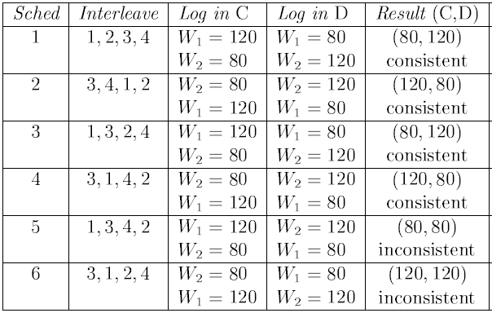

Slide 11
Concurrency Control Protocols[1]
Two-Phase Locking
Timestamp Ordering
Optimistic Concurrency Control

Slide 12
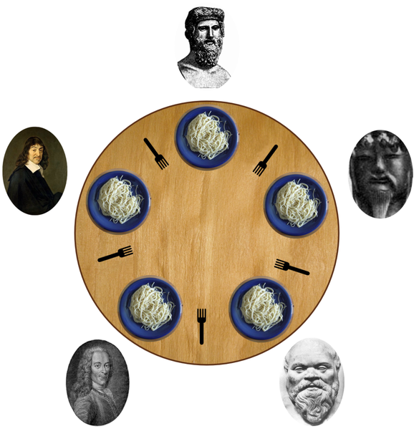
Dining Philosophers Problem[4]
“Common computing problem in concurrency”

Slide 13
Solutions
Waiters Solution
Resource hierarchy solution

Slide 14
Zope Object Database(ZODB) [9,10]
Object-oriented database for transparently and persistently storing objects
Features of the ZODB include: transactions, history/undo, transparently pluggable storage, built-in caching, multiversion concurrency control (MVCC), and scalability across a network (using ZEO).
Speed , ease of use and administration

Slide 15
Multiversion Concurrency Control[2,3]
Each user connected to the database with a snapshot
Changes seen by other users only after the transaction COMMITS
MVCC uses timestamps or increasing transaction IDs to achieve serializability
Microsoft SQL Server,MySQL,Oracle,Sybase SQL etc uses MVCC

Slide 16
Concurrency Control Mechanisms[3]
Basic criteria:
Degree of Concurrency provided
Potential for deadlocks
Level of Consistency guaranteed

Slide 17
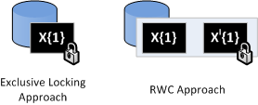
Design Of Concurrency Control Mechanisms-RWC [6]
Read-write-certify (RWC)

Slide 18
FURTHER IMPROVEMENT

Slide 19
New Proposal[5]
Dynamically switching between different types of concurrency control techniques to provide an adaptive access strategy[5]

Slide 20
REVIEW
TPS AND ITS COMPONENTS
SERIALIZABILITY
CONCURRENCY CONTROL
LATEST TECHNIQUES (Zope ODB, MVCC)

Slide 21
REFERENCES
[1]Distributed Operating Systems and Algorithm Analysis, Andy Chow & Theodore Johnson,1997
[2]Wikipedia
[3]Bernstein, Philip A. and Goodman, Nathan (1981), Concurrency Control in Distributed Database Systems, ACM Computing Surveys
[4]Chandy, K.M.; Misra, J. (1984). The Drinking Philosophers Problem. ACM Transactions on Programming Languages and Systems.
[5]http://www.patentstorm.us/patents

Slide 22
[6]http://blogs.cs.st-andrews.ac.uk/angus/2009/09/
[7]A. S. Tanenbaum, “Distributed Operating Systems”,Prentice Hall, pp.22-25,2001.
[8] “The Two-Phase Commit Protocol”, Mike Duckett, http://ei.cs.vt.edu/~cs5204/ sp99/distributedDBMS/duckett/tpcp.html, 4-30-1995.
[9]http://en.wikipedia.org/wiki/Zope_Object_Database
[10] http://www.zope.org/

Slide 23
QUERIES??

