Slide 1
Direction-Adaptive KLT for Image Compression
Vinay Raj Hampapur
Wendy Ni
Stanford University
March 8, 2011

Slide 2
Outline
Motivation
Description of our method
Results and comparisons
Achievements
Future work
Acknowledgement
References

Slide 3
Motivation - I
General transforms
Transform basis pre-defined and independent of image/block content
e.g. DCT, DWT
Karhunen-Loève Transform (KLT)
Pros : maximizes coding gain, de-correlates signal (assuming Gaussian statistics)
Cons : need image statistics a priori
Notes:
KLT calculation : eigen vectors of covariance matrix: Operates on blocks of images . Customizes the basis.
Key idea : Perform compression in transform + quantised plane as opposed to image plane by exploiting statistics

Slide 4
Motivation - II
Directional transforms
Directional Discrete Cosine Transform (DDCT) (Zeng & Fu, 2008)
Exploits directionality in image
Pre-defined basis applied to all images
Others, e.g. Direction Adaptive Partition Block Transform (DA-PBT) (Chang & Girod, 2008)
Notes:
Update DDCT

Slide 5
Overview of Our Method
Direction-adaptive KLT (DA-KLT): getting the best of both worlds
Exploit directionality and KLT
Training KLT
Partition training images into blocks
Classify blocks based on direction
Calculate transform basis for each class
Benchmarking
Directional and non-directional methods

Slide 6
DA-KLT: Training I
Training image set
Training Image Set
Block Classifier
Training
Classified blocks
Basis, PMFs, Huffman table
Class Statistics Calculator
Test Image Set
Compression
Covariance matrices
Coefficients, rates, PSNR, reconstructed images
KLT Basis Calculator
KLT basis function
…

Slide 7
DA-KLT: Training II
KLT basis functions, classified blocks
Training Image Set
Training
KLT
Training data coefficients
Basis, PMFs, Huffman table
Test Image Set
Quantizer
Compression
Quantized coefficients
Coefficients, rates, PSNR, reconstructed images
Coefficient Stats Calculator
Training coefficient PMFs, Huffman table

Slide 8
Block Classification
10 classes
8 directional classes: 0°, ±22.5°, ±45°, ±67.5° and 90°
1 flat class and 1 textured class
Classification techniques
Directional classes: Canny’s edge detection using gradient (Canny, 1986)
Flat class : compare variance to threshold
Textured class: all other blocks

Slide 9
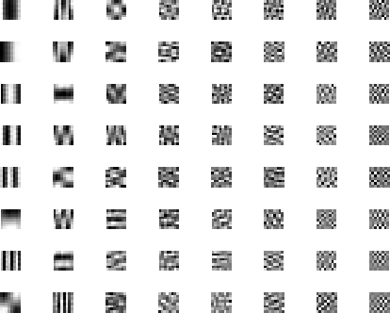
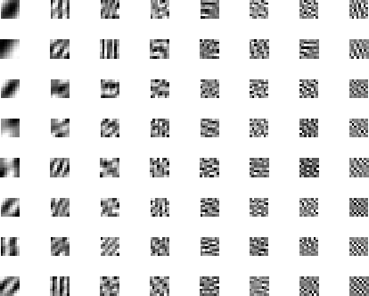
Some KLT Basis Functions
90° directional class
45° directional class
Notes:
Mention block sizes,

Slide 10
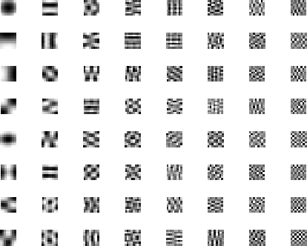
Some KLT Basis Functions
Textured class

Slide 11
DA-KLT: Compression
Test image set
Block Classifier
Training Image Set
Training
Trained KLT basis
Classified blocks
KLT
Basis, PMFs, Huffman table
Coefficients
Test Image Set
Quantizer
Compression
Quant. coefficients
Coefficients, rates, PSNR, reconstructed images
Image Reconstruction
Entropy Calculator
Huffman Encoder
Recon. Images, PSNR
Entropy
Huffman rate
Notes:
Add in Additional inputs to entropy calculator and Huffman encoder

Slide 12
Measure of Performance
PSNR-rate curve
Region of interest: 30-40 dB
Visual quality of reconstructed images
Coding gain
Notes:
Any lower, you don’t want to compress image to that distortion; Any higher you don’t want to look at such high rates. Visual quality also a measure of performance Baboon ‘s texture looks good at pretty low PSNR

Slide 13
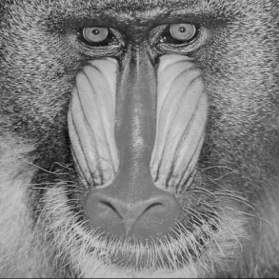
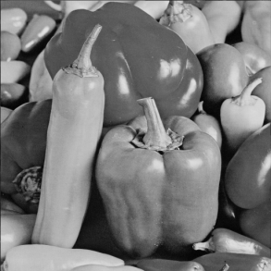
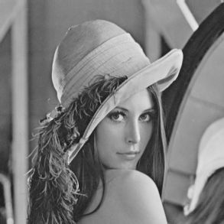
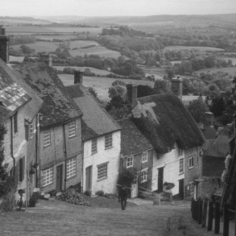
Performance: DA-KLT
Coding gain = 4.79
Coding gain = 52.35
Coding gain = 54.35
Coding gain = 27.32
Block size = 8
Notes:
Slope should be about 6 db: Lena & Mandrill : Similar Blocks -> Similar coefficients -> smaller variances -> Higher coding gain

Slide 14
DA-KLT: Changing Quantization Step
Quantization step = 8; Block size = 8

Slide 15
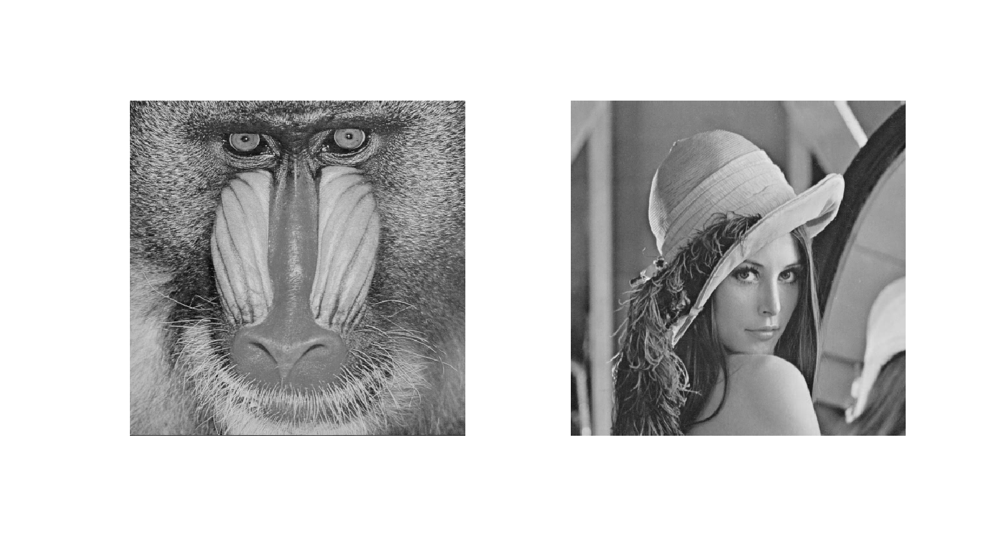
DA-KLT: Changing Quantization Step
Quantization step = 16; Block size = 8

Slide 16
DA-KLT: Changing Quantization Step
Quantization step = 32; Block size = 8

Slide 17
DA-KLT: Changing Quantization Step
Quantization step = 64; Block size = 8
Notes:
Blocking artifacts visual part vs flat part vs high snr

Slide 18
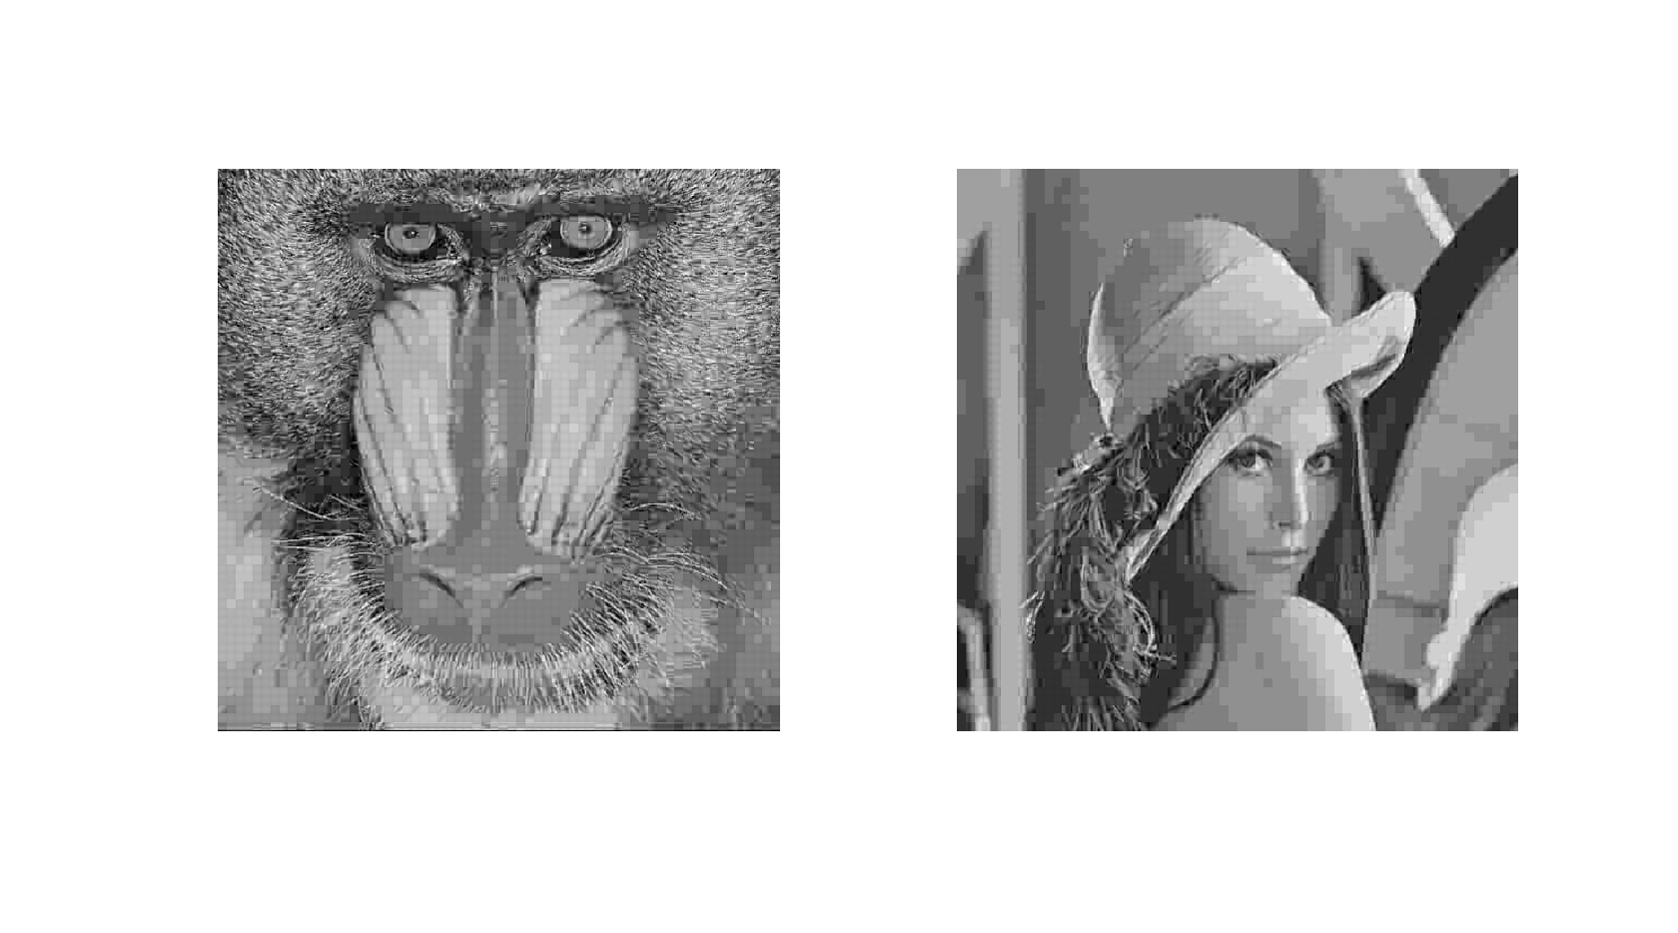
DA-KLT: Changing Quantization Step
Quantization step = 128; Block size = 8

Slide 19
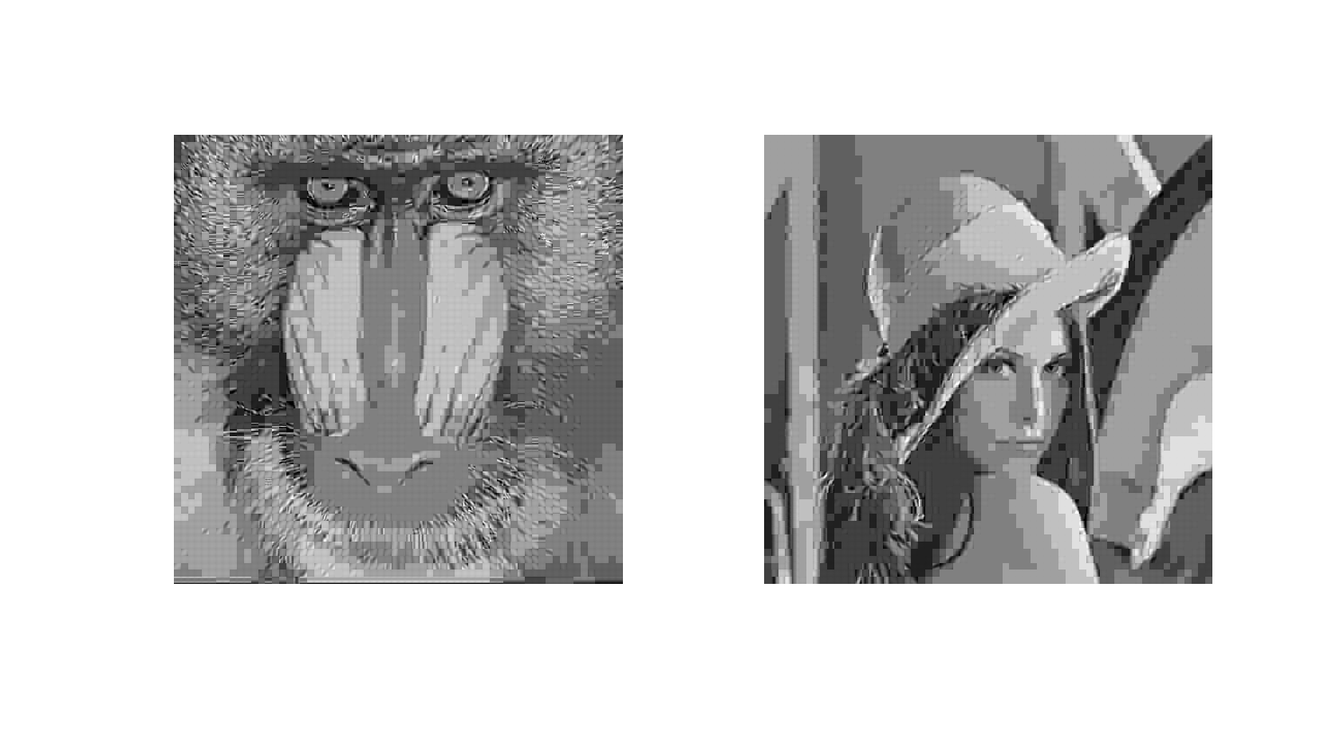
DA-KLT: Changing Quantization Step
Quantization step = 256; Block size = 8

Slide 20
Performance: Principal Component Truncation
Notes:
PCA : For each directional classes, few dominant components along which the energy is concentrated. Completely discard the coefficients associated with least dominant components. Investigate it. Use eigen values to decide which coefficients to keep to keep which percentage of energy

Slide 21
Performance: DA-KLT vs. KLT
Lena: ~1.15dB
Peppers:
~0.85dB
Mandrill: ~1dB
Notes:
Exploits directionality a lot of good stuff came out of it

Slide 22
Performance: DA-KLT vs. DDCT

Slide 23
Achievements I
Implemented DA-KLT and investigated various aspects affecting its performance
Quantization step and block size
Principal component truncation: “ceiling” effect due to limit on energy

Slide 24
Achievements II
Compared against existing techniques
DA-KLT outperforms KLT
DA-KLT does not perform as well as DDCT
However, DA-KLT compression is faster as DDCT employs brute-force block classification
Conclusion:
DA-KLT is a feasible method for exploiting directionality in image using KLT

Slide 25
Suggested Future Work
Use more training images
Estimate source statistics better to improve performance of entropy coder
Check optimality of basis functions
Consider using adaptive block sizes

Slide 26
Acknowledgement
Prof. Bernd Girod
Mina Makar
DDCT code by Chuo-ling Chang

Slide 27
References
[1] B. Zeng and J. Fu, “Directional Discrete Cosine Transforms—A New Framework for Image Coding”, IEEE Transactions on Circuits and Systems for Video Technology, vol. 18, no. 3, pp. 305-313, Mar. 2008. [2] C.-L. Chang and B. Girod, “Direction-Adaptive Partitioned Block Transform for Image Coding”, IEEE International Conference on Image Processing, San Diego, Oct. 2008, pp. 145-148.
[3] J. Canny, “A computational approach to edge detection”, IEEE Transactions on Pattern Analysis and Machine Intelligence, vol. 8 no. 6, Nov. 1986
[4] D. S. Taubman, M. W. Marcellin and M. Rabbani, JPEG2000: Image Compression Fundamentals, Standards and Practice, 2002, Kluwer Academic Publishers, Norwell MA, pp. 151-155

Slide 28
Extra Slides

Slide 29
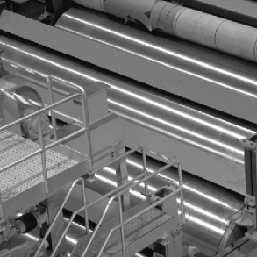
DA-KLT: Coding Gain

Slide 30
DA-KLT: Changing Block Size

Slide 31
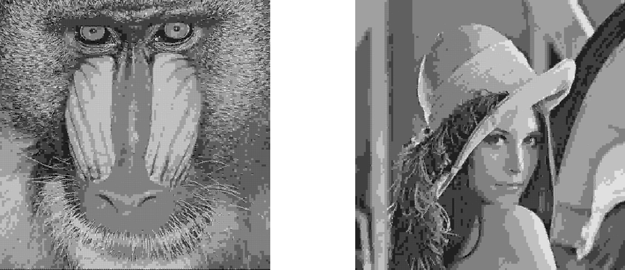
DA-KLT: Changing Block Size
Quantization step = 128; Block size = 4

Slide 32
DA-KLT: Changing Block Size
Quantization step = 128; Block size = 8

Slide 33
DA-KLT: Changing Block Size
Quantization step = 128; Block size = 16

Slide 34
Performance: Huffman Encoder

Slide 35
Performance: DA-KLT vs. DDCT

Slide 36
Performance: DC Separation

Slide 37
DDCT – I
Six of eight directional modes defined in a similar way as was used in H.264, for block size 8x8. (Zeng & Fu, 2008)

Slide 38
DDCT - II
1D DCT along the vertical-right direction (mode 5) followed by 1D DCT, and modified zigzag scanning for encoding of coefficients. (Zeng & Fu, 2008)

