Slide 1
Personal Internet Banking Guide for non-UOB account holder
Guide to pays your children school fees using personal internet banking via Interbank GIRO

Slide 2
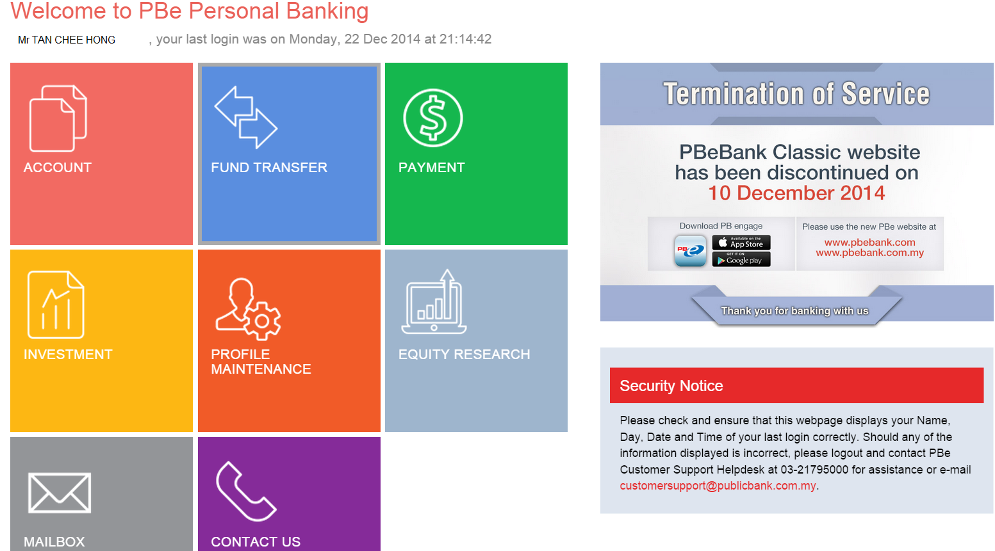
How to perform GIRO via Personal Internet Banking – Example 1 (Non-UOB Account Holder )
Click on Fund Transfer
1

Slide 3
How to perform GIRO via Personal Internet Banking – Example 1 (Non-UOB Account Holder )
Click into other bank account
2

Slide 4
How to perform GIRO via Personal Internet Banking – Example 1 (Non-UOB Account Holder )
Click on To Other Account or To Favourite Account
3
For Favourite Account: Pre-registered
Other Account – Non-registered

Slide 5
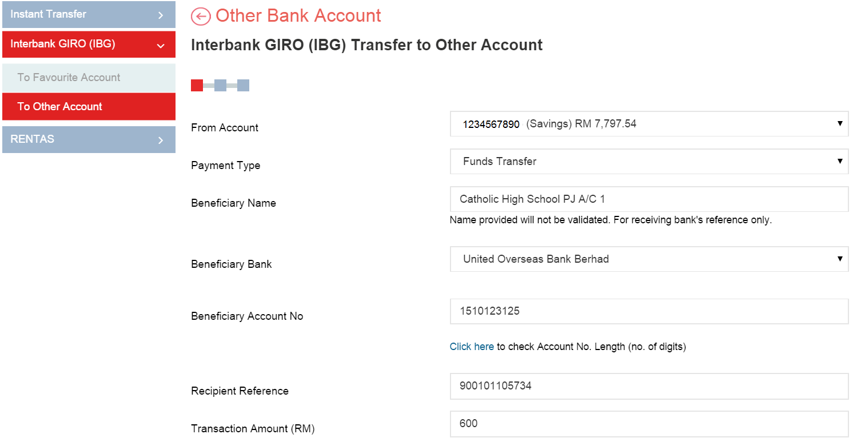
How to perform GIRO via Personal Internet Banking – Example 1 (Non-UOB Account Holder )
Key in beneficiary name, account no, beneficiary bank and amount to be transfer
* Key in your children IC No

Slide 6
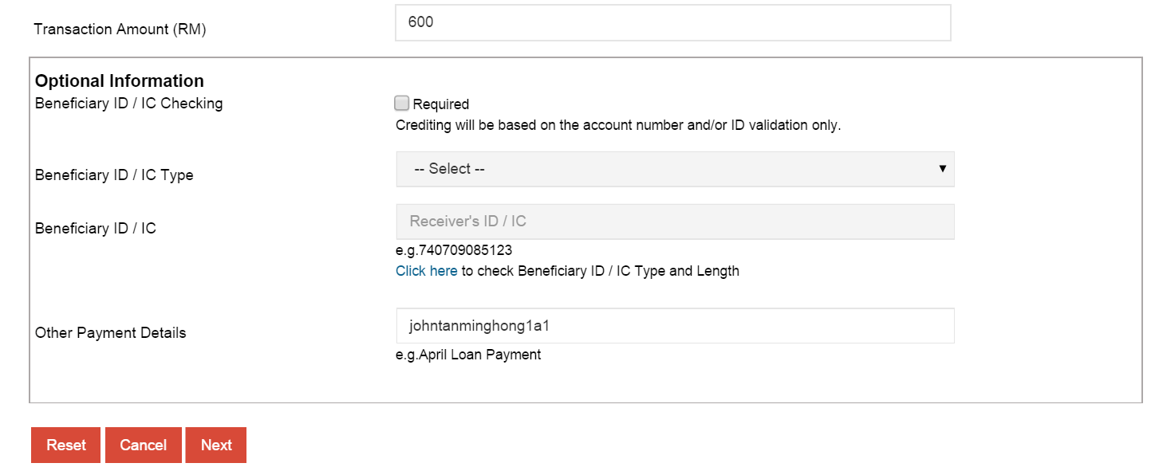
How to perform GIRO via Personal Internet Banking – Example 1 (Non-UOB Account Holder )
*Key in your children full name as per IC and class code
Key in the necessary information and click “next”
4

Slide 7
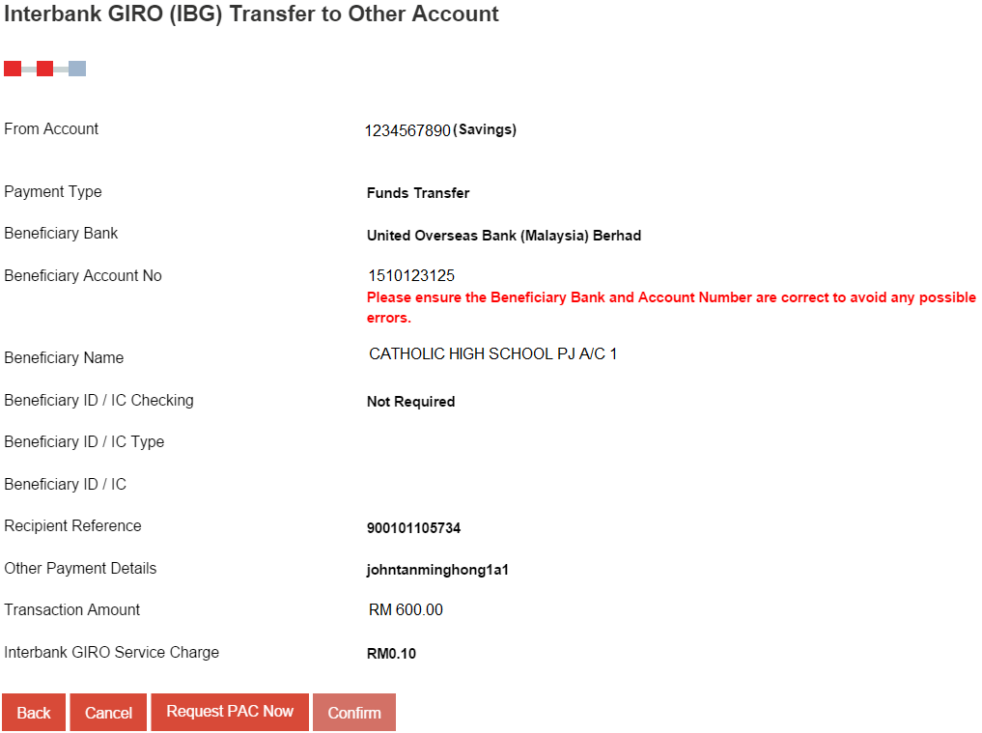
How to perform GIRO via Personal Internet Banking – Example 1 (Non-UOB Account Holder )
Click on "Request PAC Now" button
5

Slide 8
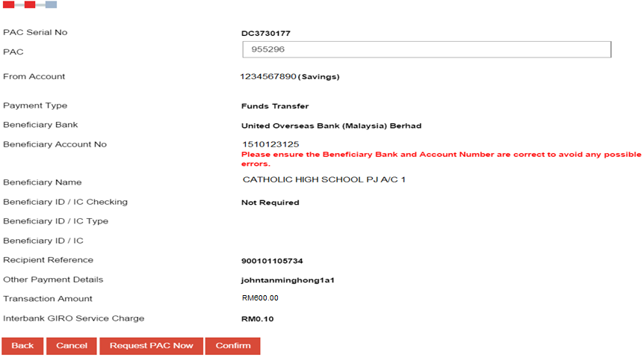
How to perform GIRO via Personal Internet Banking – Example 1 (Non-UOB Account Holder )
Enter PAC
6
Verify details entered and click on Confirm
7

Slide 9
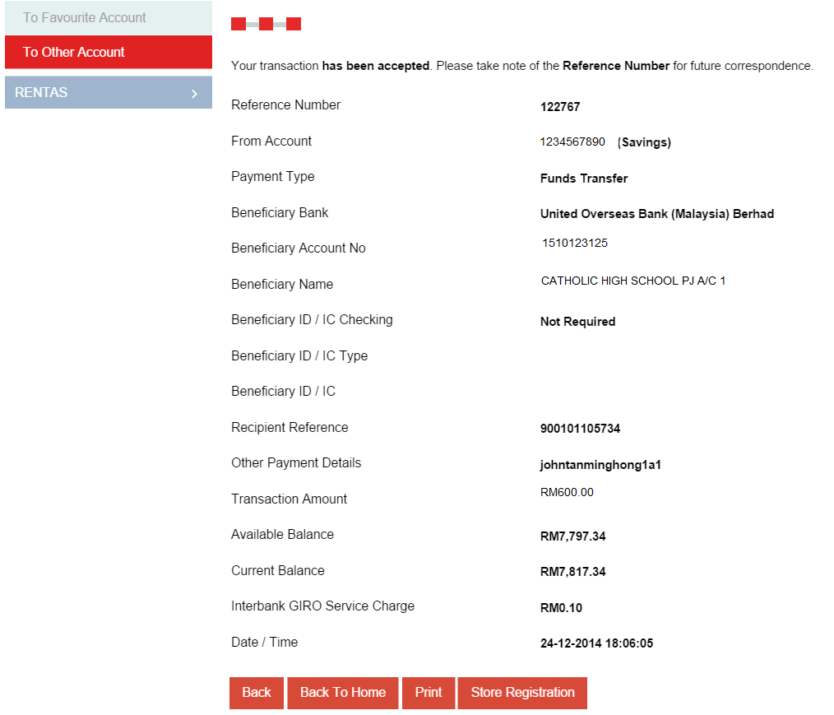
How to perform GIRO via Personal Internet Banking – Example 1 (Non-UOB Account Holder )
Successful Transaction will be provided with reference number

Slide 10
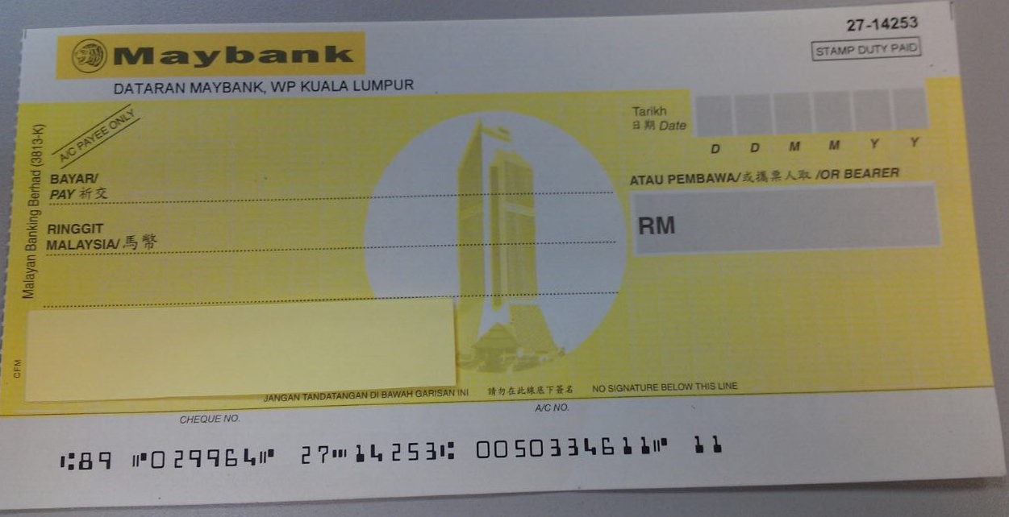
Guide for Parent Paying by Physical Cheque
Fill up necessary information and amount

Slide 11
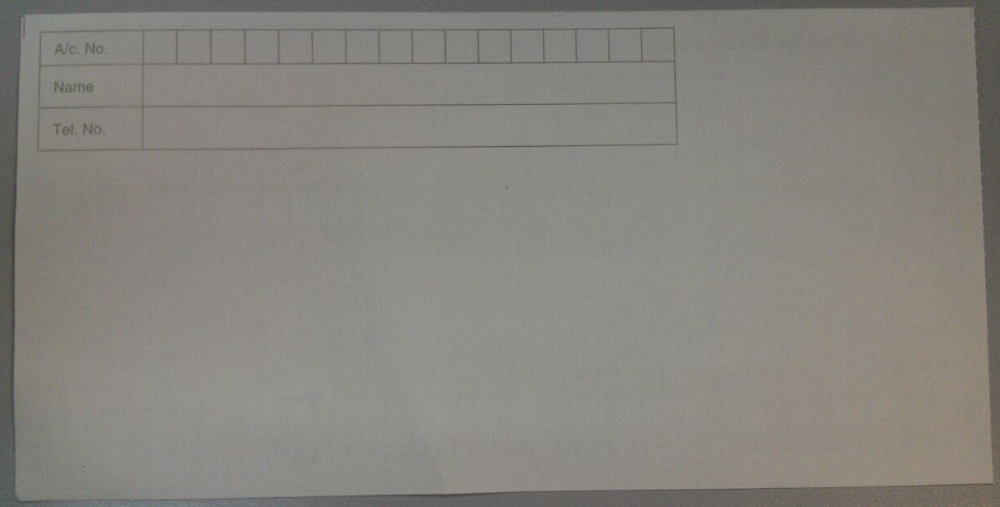
Guide for Parent Paying by Physical Cheque
Fill up Catholic High School Current Account No, Name and Tel No.
Mandatory fill for parent:
Your Children IC No
Your Children Name as per IC and class code
Example:
1. 900101-10-5734
2. John Tan Ming Hong 1A1

