Slide 1
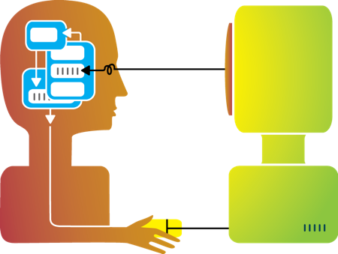
Human computer interaction
Subject : Selected Topics Instructor : Abed Al-Ra’ouf Shtawi

Slide 2
History of hci
Computer-Human Interaction made discretionary hands-on use its focus. CHI grew out of the development of new hardware and programming languages by experienced programmers.
In 1980, the Association for Computing Machinery (ACM) created a "Human Aspects" department for its communications.
As personal computers appeared commercially, ACM formed the Special Interest Group on Computer-Human Interaction (SIGCHI).

Slide 3
Evolution of user interfaces

Slide 4
command line interface

Slide 5
CLI introduction
The CLI gets its name from the fact that it is an interface which contains command lines.
What is Command line interface ? is a user interface to a computer's operating system or an application in which the user responds to a visual prompt by typing in a command on a specified line, receives a response back from the system.

Slide 6
Advantages and disadvantages
Advantages | Disadvantages
This type of interface needs much less memory (RAM) in order to use compared to other types of user interfaces | Commands have to be typed precisely. If there is a spelling error the command will fail
This type of interface does not use as much CPU processing time as others | If you mis-type an instruction, it is often necessary to start from scratch again
A CLI does not require Windows to run | You can't just guess what the instruction might be and you can't just 'have a go'.

Slide 7
Command Line Interface Applications
System administration.
Engineering applications.
Scientific applications.
Ideal for visually impaired users.

Slide 8
Graphical user Interface

Slide 9
Gui introduction
allows the use of icons or other visual indicators to interact with electronic devices, rather than using only text via the command line.
How does GUI works? A GUI uses windows, icons, and menus to carry out commands, such as opening, deleting, and moving files. Although many GUI operating systems are through the use of a mouse, the keyboard can also be utilized by using keyboard shortcuts or arrow keys.

Slide 10
Advantages and disadvantages
Advantages | Disadvantages
This type of user interface is easy to use, especially for a beginner. | GUIs take up a much larger amount of hard disk space than other interfaces.
You do not have to learn complicated commands. | They need significantly more memory (RAM) to run than other interface types.
They let you exchange data between different software applications. | They can be slow for experienced programmers to use. These people often find CLI interfaces faster to use.

Slide 11
Gui Examples
Examples of a GUI operating system
Microsoft Windows.
Apple System 7 and Mac OS.
Chrome OS.
Linux.
Examples of a GUI interface
GNOME.
Any Microsoft program.
Internet browser.

Slide 12
Quick COMPARISON BETWEEN Cli/GUI

Slide 13
Natural user Interface

Slide 14
NUI introduction
Natural user Interface
is a system for human-computer interaction that the user operates through intuitive actions related to natural, everyday human behavior.
How does NUI works?
NUI is powered by touch, by gestures, by sound, by senses. It is our human nature and our inability to learn the delicate nature of human interactions it’s pitfall.

Slide 15
Advantages and disadvantages
Advantages | Disadvantages
The user does not need to be trained in how to use the interface. | Reliability remains an issue - the interface can only respond to commands that have been programmed.
More flexibility than a dialogue interface. | Not widely available as other forms of interface are often superior.
Suitable for physically handicapped people | Highly complex to program and so only warrants this kind of interface where other types of interface are unsuitable.

Slide 16
Natural user Interface Examples
Microsoft’s Kinect.
Google Project Glass.
Leap Motion.
Corning Gorilla glass.

Slide 17
Quick COMPARISON BETWEEN Cli/GUI/NUI

Slide 18
Worked on this Topic
Ahmad Mohammad Al-Bader
201210459
Khalil Mohamed Al-Shekh Hassan
201211121
Malik Ragheb Banat
201210710
Sulieman Mohammad Habahbeh
201211524

Slide 19
References
IT-Tech
Wikipedia
Tech target
How stuff works
Software development
L-info
Computer hope
ITC world
Software quality
Article about history written by Brad A.Myers School of Computer Science Carnegie Mellon University Pittsburgh, PA 15213-3891.

