Slide 1
Introduction to the Semantic Web and Linked Data
Library of Congress
BIBFRAME Pilot Training
for Catalogers
Module 1 - Part 1
The Semantic Web and Linked Data Concepts: A basic overview
Notes:
Welcome to the “The Semantic Web and Linked Data Concepts,” the first part in Module 1 of the Introductory Training to the Semantic Web, Linked Data, and the BIBFRAME Tools workshop developed for LC catalogers who will be participating in the LC BIBFRAME pilot.
The material is based on a wide range of resources and other training material.

Slide 2
Overview
Context
Goals of the presentation
Learning objectives
Outline of the content
Notes:
We’ll first try to put the topic into perspective for the intended audience, LC catalogers.
We’ll give you a brief overview of what is included in the training; discuss what it aims to achieve; then we’ll give you a brief overview of Module 1, Part 1 content so you know what to expect.

Slide 3
LC BIBFRAME Pilot Training for Catalogers
Modules
1: Introduction to the Semantic Web and Linked Data
2: Introduction to the BIBFRAME Tools
3: The BIBFRAME Editor and the LC Pilot

Slide 4
Training modules available at this time
1. Introduction to the Semantic Web and Linked Data
Part 1. SW and LD Concepts
Part 2. Semantic Data Model
2. Introduction to the BIBFRAME Tools
Discussion of Assignments for Module 1

Slide 5
Context
AACR2, RDA, MARC 21 record environment
MARC does not allow a full implementation of RDA
Library data is designed for the use and consumption by humans, but not integrated with the Web
Linked data promise a possibility to increase the visibility and usage of library data on the Web
Notes:
Assumptions:
the attendees have experience in using AACR2, RDA, and MARC 21 for the creation of authority and bibliographic records in library environments and are now involved in LC BIBFRAME Pilot.
the attendees have no computer science or programming background.
the attendees should have a basic understanding of why the Library of Congress decided to “replace MARC as the core vehicle for exchange of bibliographic description” with BIBFRAME, namely:
MARC does not allow a full implementation of RDA
Library data is not integrated with the Web
Linked Data promises a possibility to increase the visibility and usage of library data on the Web

Slide 6
Goals of the presentation
Basic overview of the Semantic Web and Linked Data concepts
Purposes and goals of the Semantic Web
Importance of applying Linked Data principles to library data
A lead in to the next unit on “Semantic Data Model”
Notes:
This presentation attempts to provide a very basic overview of the Semantic Web and Linked Data concepts.
More importantly, this unit aims to help you understand, and focus on the key message in, LC’s efforts in applying Linked Data principles and mechanisms to create another carrier for our library data.
Introduction to terminology, terms, and tools used for Semantic Web applications are covered in more detail in Unit 2.

Slide 7
Learning objectives
Describe the purposes and goals of the Semantic Web and Linked Data
Cite some differences between the Semantic Web and the traditional web
Name some of the datasets provided by LC Linked Data Service
Notes:
At the end of this unit, you should be able to:
Describe the purposes and goals of the Semantic Web and Linked Data and cite some differences between the Semantic Web and the non-Semantic Web environments.
Be aware of LC Linked Data Service* which provides access to commonly found standards and vocabularies promulgated by the Library of Congress. The following are some examples of datasets currently offered as part of this service:
LC Subject Headings
LC Name Authority File
LC Classification
LC Children's Subject Headings
LC Genre/Form Terms
LC Medium of Performance Thesaurus for Music
Thesaurus for Graphic Materials
AFS Ethnographic Thesaurus
Cultural Heritage Organizations
*The Library of Congress Linked Data Service enables both humans and machines to programmatically access authority data at the Library of Congress. This service is influenced by -- and implements – the Linked Data movement's approach of exposing and inter-connecting data on the Web via dereferenceable URIs.

Slide 8
Outline
What is the Semantic Web?
The Basic Idea of Linked Data
Techniques to create the Semantic Web
Examples of Semantic Web applications
Quiz A
Summary and Outlook
Quiz B
Notes:
Here is the outline of what we will discuss in the remaining of the unit.

Slide 9
Tim Berners-Lee describes the Semantic Web
Tim Berners-Lee, James Hendler and Ora Lassila, "The Semantic Web", Scientific American, May 2001, p. 29-37.
Notes:
In 2001, Tim Berners-Lee, James Handler, and Ora Lassila published an article in Scientific American, “The Semantic Web” that describes future scenarios in which the Semantic Web …

Slide 10
The Semantic Web
"The Semantic Web is an extension of the current web in which information is given well-defined meaning, better enabling computers and people to work in cooperation."
Notes:
- “A new form of Web content that is meaningful to computers will unleash a revolution of new possibilities.”
“The Semantic Web will enable machines to comprehend semantic documents and data, not human speech and writings.”
“The explicit representation of the semantics of data, accompanied with domain theories (that is, ontologies ), will enable a Web that provides a qualitatively new level of service.”
Tim Berners-Lee, James Hendler and Ora Lassila, "The Semantic Web", Scientific American, May 2001, p. 29-37.
The Semantic Web is a collaborative effort led by then World Wide Web Consortium (W3C) to provide a framework that allows data to be shared and reused across application, enterprise, and community boundaries.
W3C. What is the Semantic Web? Downloaded February 12, 2014 from http://www.w3.org/2001/sw/

Slide 11
Traditional Web
A collection of linked documents
Data exposed to the Web via HTML, pdf, etc.
Connections between data elements are based on human-readable hyperlinks
Queried by text string matching and relevance ranking algorithms
Notes:
Web 1.0
All the resources we find on the traditional document Web are information resources. There are data posted on Web sites and users simply viewed or downloaded the content.
Darcy DiNucci, an information architecture consultant, coined the term “Web 2.0 In her 1999 article, "Fragmented Future”:
“The Web we know now, which loads into a browser window in essentially static screenfuls, is only an embryo of the Web to come. The first glimmerings of Web 2.0 are beginning to appear, and we are just starting to see how that embryo might develop. The Web will be understood not as screenfuls of text and graphics but as a transport mechanism, the ether through which interactivity happens.”

Slide 12
Web 2.0 and information resources
Everything that lives on the Web is an information resource:
Documents
Images
Audio Files
Video Files
Web 2.0 uses HTTP protocol to retrieve information resources
Notes:
Web 2.0 has greater collaboration among Internet users, content providers and enterprises (Wikis; blogs, social networking sites, etc.)
What Is Web 2.0? [http://www.cbsnews.com/news/what-is-web-20/]

Slide 13
Non-information resources and Web 3.0
All “real-world objects” that exist outside of the Web are non-information resources. Examples of non-information resources are:
People
Places
Abstract Concepts
Relationships
The Semantic Web (Web 3.0) allows the hyper linking between information resources, non-information resources and the relations between them
Notes:
All “real-world objects” that exist outside of the Web are non-information resources (also called
'other resources').
It is important to distinguish, these two types of resources, between the resources found in the current document Web and the real world resources identified in the Linked Data Web.
The Semantic Web uses the HTTP protocol to identify real world, non-information resources and the relationships between resources and non-information resources.
People, places, abstract concepts can be linked to other non-information resources and information resources and the relationships between them.

Slide 14
Sematic Web
Web of linked data
Information from single pages can be found via search engines
Use the Web like a single global database
Allows machines to make logical inferences that have not been explicitly stated by human beings
Complex queries over multiple pages/data sources

Slide 15
Traditional Web vs. Semantic Web
Web of Documents
Web of Data
information resources
links between documents
unstructured data
implicit semantics
for human consumption
“real-world objects”
links between things
structured data
explicit semantics
for machines and human

Slide 16
Goal of the Sematic Web
“The goal of the Semantic Web is to move from a Web of Documents to an open inter-connected Web of Data.”
Notes:
Bauer, Florian and Kaltenböck, Martin. (2012). Linked Open Data: The Essentials. Downloaded December 30, 2014 from: http://www.reeep.org/LOD-the-Essentials.pdf, p.25.

Slide 17
What enables such Web of Data?
Use a set of best practices for publishing and linking structured data on the Web.
Use technologies that are more generic, more flexible which make it easier for data consumers to discover and integrate data from large number of data sources and links
Notes:
Open Linked Data can be used to do the following:
Provide valuable, agreed-upon information in a standard, open format.
Provide mechanisms to link individual schemas and vocabularies in a way so that people can note if their ideas are “similar” and related, even if they are not exactly the same.
Bring all this information to an environment which can be used by most, if not all of us. (Make data available free of proprietary software, single social networks, or web application.)
Bauer, Florian and Kaltenböck, Martin. (2012). Linked Open Data: The Essentials. Downloaded December 30, 2014 from: http://www.reeep.org/LOD-the-Essentials.pdf, p.25.

Slide 18
Linked Data
One practical application of these technologies to real-world data
A style of publishing and interlinking structured data on the Web so that it can be interlinked and become more useful
Builds upon existing well established Web technologies such as HTTP, RDF and URIs
Applying the Linked Data principles to legacy data sources integrates data
Notes:
The term Linked Data was coined by Sir Tim Berners-Lee in his Linked Data Web architecture note [Berners-Lee, T. 2006. Design Issues: Linked Data. Last change: Date: 2007/05/02 14:30:56. http://www.w3.org/DesignIssues/LinkedData.html]. It refers to a style of publishing and interlinking structured data on the Web.
The Wikipedia definition of Linked Data[http://en.wikipedia.org/wiki/Linked_Data
] is, "Linked Data is a term used to describe a method of exposing, sharing, and
connecting data on the Semantic Web. The practice emphasizes Web access to data using existing Web technologies such as URIs and HTTP.“
Linked Data builds upon existing well established HTTP technology. Valuable and good quality data exist in legacy database systems can be exploit to realize a Web of Data.

Slide 19
Linked Data makes the Web a HUGE database
Data is more useful if it links to related data, documents, and descriptions
Data becomes Linked Data when it links to related resources
Notes:
There is a huge volume of data exists on the Web. However, many times the data is buried in in database silos in organizations.
Linked data is about making data available in standard ways so that others can use and link to. This is essential to connect the data we have into a web. It is the unexpected reuse of information which is the value added by the web.

Slide 20
Basics of Linked Data
Use URIs as names for things
Use HTTP URIs so that people can look up those names
When someone looks up a URI, provide useful information, using the standards (RDF*, SPARQL)
Include links to other URIs, so that they can discover more things
➔ Part 2:
“Semantic Data Model”
Notes:
Berners-Lee outlined these four rules of Linked Data in his design issues notes.
These rules are broad guiding principles on how to publish and interlink data in a human and machine readable way by using Semantic Web technologies.
These four principles for Linked Data will be discussed in more detail in Unit 2.

Slide 21
Linked Data 5-star scheme
*
**
***
****
*****
Make your stuff available on the Web
Make it available as structured data
Use non-proprietary formats
Use URIs to identify things, so that people can point at your stuff
Link your data to other data to provide context
Notes:
In 2010 Tim Berners-Lee introduced a 5 star rating to his Linked Data design issues page to encourage data publishers along the road to good Linked Data.
The goal is to encourage data owners to publish their data according to Linked Data principles by asking: Is our linked open data 5 star?
The first star is assigned for the big first step of making the data available on the Web (in whatever format).
All following stars are intended to make the data easier to discover, use, and understand.
The second star is assigned for making the data available in a machine readable, structured way (this can even be an Excel spreadsheet).
The third star is for using non-proprietary formats (e.g., the Open Document Format; ODS instead of XLS).
The fourth star is for using open W3C standards such as RDF to identify resources.
The fifth star is for linking your own data to other datasets.
Again, the motivation here is to have a simple stack of consecutive steps that reward improved access to data by additional stars.
Five Stars of Linked Data Vocabulary Use [http://geog.ucsb.edu/~jano/swj653.pdf]

Slide 22
Linked Data
Machine-actionable data
Describing ➔ identifying
“Record” ➔ Graph
Mapping ➔ linking
String to things
Notes:
“From Strings to Things” Michael Panzer
http://rbms.info/conferences2/preconfdocs/2012/plenary_2_panzer.pdfF

Slide 23
Relationship between Linked Data and the Semantic Web
Semantic Web is a vision of a “Web of Data”
Linked Data is a means to achieve that vision
Semantic Web is What and Linked Data is How

Slide 24
Current state of Linked Data in libraries
Developing use cases
Structuring, cleaning and releasing data
Developing new frameworks and tools
Exploration, prototypes and proofs of concept
Learning!

Slide 25
Example
Notes:
Several of the initiatives that have come out of the OCLC office involve offering OCLC resources as Linked Data. OCLC resources that have been released as Linked Data include the following:
VIAF (Virtual International Authority File)
* FAST (Faceted Application of Subject Terminology) is derived from the Library of Congress Subject Headings (LCSH), FAST (Faceted Application of Subject Terminology)
* Dewey Decimal Classification System

Slide 26
Example

Slide 27
Example

Slide 28
Summary
Basic overview of the Semantic Web and Linked Data concepts
Purposes and goals of the Semantic Web
A lead in to Module 1, part 2 on “Semantic Data Model”

Slide 29
Quiz A

Slide 30
Outlook & Summary
(Understanding MARC Bibliographic -- http://www.loc.gov/marc/umb/)

Slide 31
Change is a continuum
“As library automation technology changes and as cataloging needs change, the MARC 21 formats and related MARC 21 documentation are changing also.”
(Understanding MARC Bibliographic -- http://www.loc.gov/marc/umb/)
Notes:
Change is
“NOT a one-time event.”
“Letting go of “mastery complex,” and embracing perpetual beta.”
“Changes and change management are crucial to success of the modern library”
“Learn from the Past, Prepare for the Future” (OCLC webinar)

Slide 32
Impact
“As computers and technology continue to advance, important issues arise about the quality of library data and computer-based library automation systems. You need to be aware of these issues and their importance to your library.”
(Understanding MARC Bibliographic -- http://www.loc.gov/marc/umb/)
Notes:
How will we be impacted by the change?
What strong effect might we have on this change?

Slide 33
The Semantic Web is …
the Web of Data
Allows machines to “connect the dots”
Provides a common framework to share data on the Web across application boundaries
Notes:
Human can easily “connect the dots” when browsing the Web but machines can’t

Slide 34
Semantic Web approach
Make data easier for machines to find, access and process
Express data and meaning in standard machine readable format
Create relations among resources on the web and interchange those data
Support decentralized definition and management, across the network

Slide 35
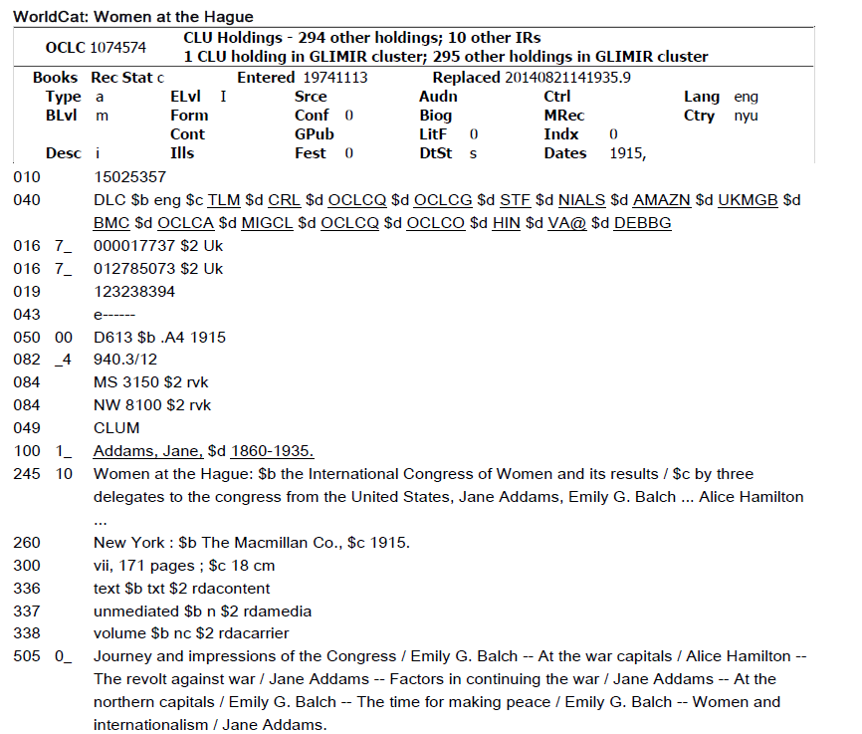
MARC record
Notes:
Information pulled from our MARC records using our OPAC interface is based on this model. This silos our information.

Slide 36
BIBFRAME
Notes:
The Library of Congress is developing BIBFRAME as a general model for expressing and connecting bibliographic data.
It provides an alternative to MARC.

Slide 37
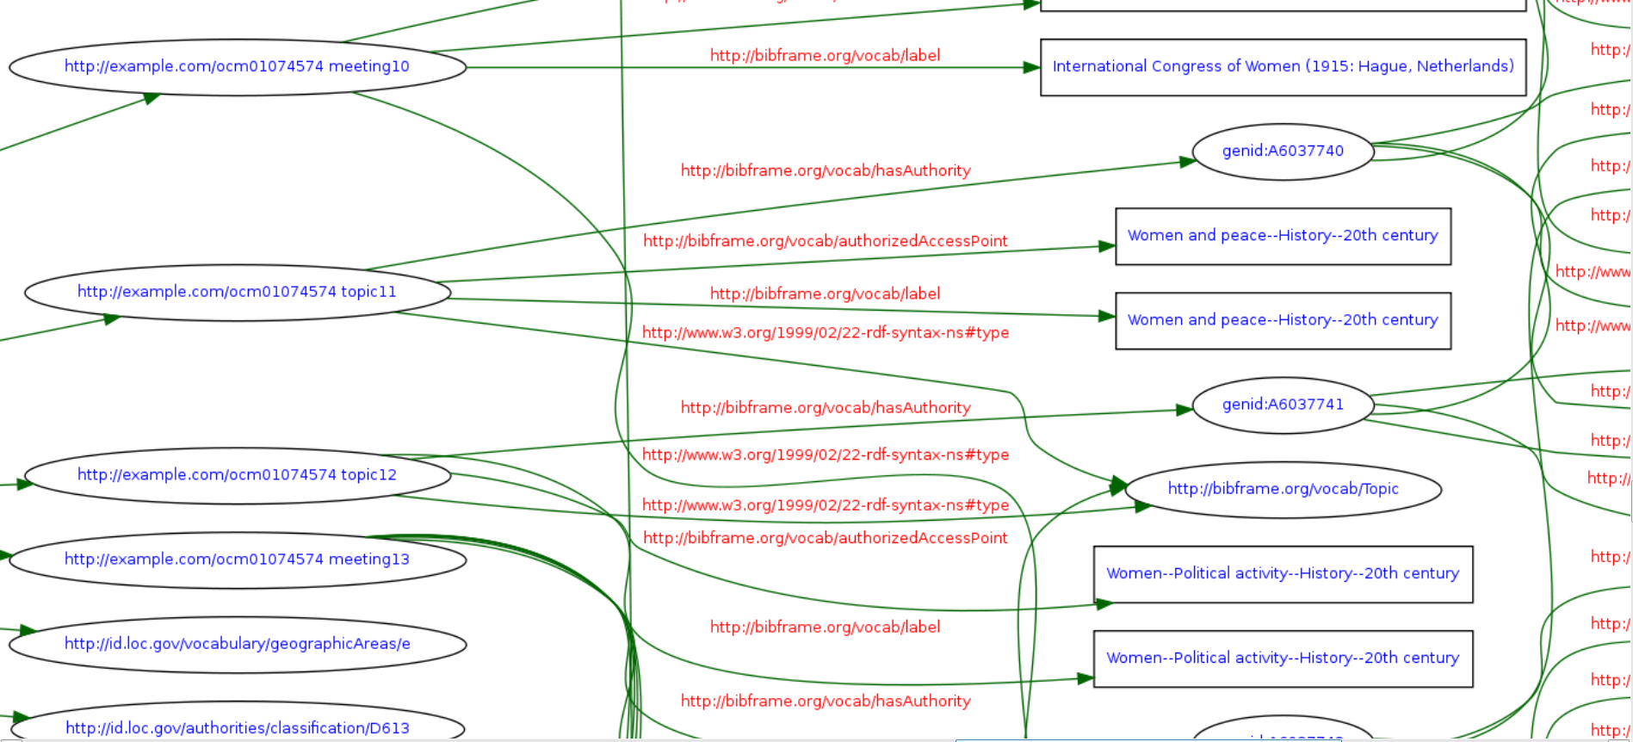
RDF graph of a MARC record
Notes:
What you see on this slide is a small portion of the RDF graph for the MARC record on the previous slide. The record was downloaded from OCLC as a MARC RDF/SML file. The record was converted into a BIBFRAME record using MarcEdit. It was opened in Notepad ++, copied and parsed using an RDF validator which produced the graph.
with an RDF serialization (or format), thereby providing the means to connect bibliographic information to the LOD Cloud.
One way for us to do this is by connecting our records to the global Web of Data.

Slide 38
Summary
Libraries have a huge amount of identifiers
No other community does authorities like we do
We identify, structure, organize data in different ways
With BIBFRAME we can leverage existing Web standards make library content more visible on the Web
Translate MARC skills and practices into a Linked Data context

Slide 39
Quiz B

