Slide 1
Processing Evidence Documents with Semantic Web Technologies
Tod Sedbrook
Richard Newmark
University of Northern Colorado

Slide 2
Processing Evidence Documents with Semantic Web Technologies
Improve healthcare network monitoring
Find ways evidence documents could be augmented with semantic tools to enhance their data and processing visibility
Support explicit business rules that direct exchange processes
Explore an upper level REA ontology
Systematize evidence documents’ contents
Design prototype using embedded semantic rules to reason about updates and resource exchanges

Slide 3
Urgent need for Heath Information Network Monitoring
Currently 4% of U.S. physicians currently use electronic health records,
but failure to make those records interoperable has affected efficiency and patient care.
"We will make the immediate investments necessary to ensure that within five years all of America's medical records are computerized. He said that electronic health records could prevent medical errors, save lives and create hundreds of thousands of jobs.” President Obama

Slide 4
Case Study Background
HIPPA- The Health Insurance Portability Act
$20 billion to modernize health information technology systems
Part of $825 Billion Economic Stimulus Plan
Goal: Improved efficiency in healthcare delivery
Requires standardization and electronic data interchange
Enforcing data integrity, confidentiality and availability
Enforce patient care standards

Slide 5
Technical Safeguards
HIPPA Audit Controls
Section: 164.123(b)
“This standard requires implementing hardware, software and or/procedural controls that record and examines activity in information systems”

Slide 6
Health Information Networks must Demonstrate HIPPA Compliance
U.S Centers for Medicare and Medicaid Services
becoming more aggressive and proactive in auditing HIPPA security compliance
Organizations increasingly need to develop compliance strategy and controls

Slide 7
Modeling with Evidence Documents
HIPPA evidence documents act as
an independent and visual representation that provides a traceable record of commitments and evidence of information exchange and
a data structure that provides information to guide exchange processes that facilitate the transfer of patient rights and resources.

Slide 8
Access control - Controlling system access in accordance with a policy
Establishing and terminating users' access to systems housing electronic patient health information (ePHI) for Specialist Consults

Slide 9
Design Goals
Demonstrate Semantic tools to audit policies for care provider consultations
Auditing of Evidence Documents across heterogeneous care provider organizations

Slide 10
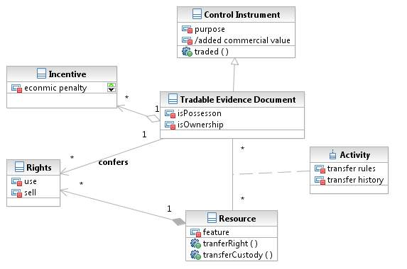
UML Model of Evidence Documents
Tradable Evidence
Documents confers
Right to resources
Notes:
Need help with this figure

Slide 11
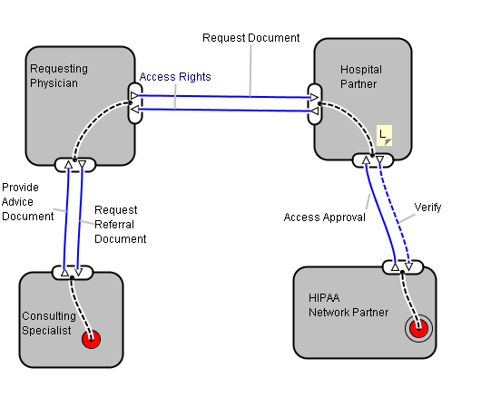
Hospital Liability for non Verification of Patient Referrals
HIPPA regulations
Require hospital partners
To verify access
To referral documents
Notes:
Using e3Value application

Slide 12
REA Policy for Evidence Document Exchange
Automating
Monitoring of REA Policy for Exchange of HIPAA controlled Documents

Slide 13
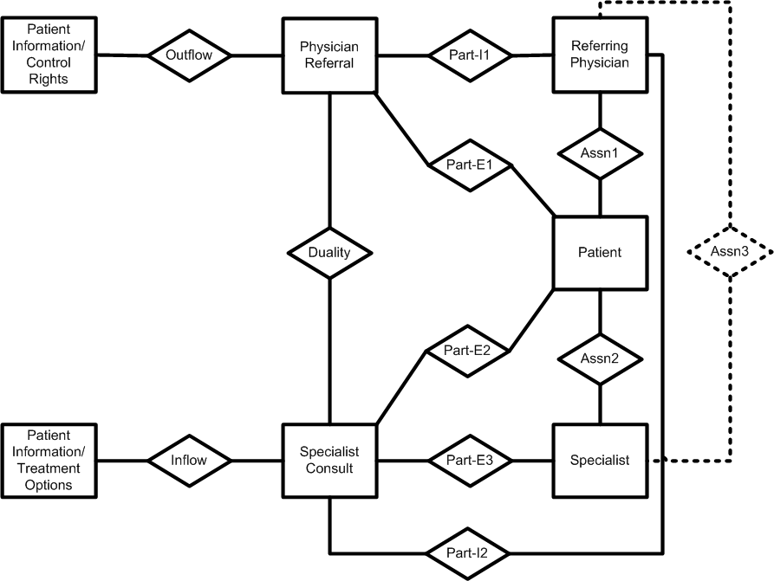
REA Operational Model for referring a patient to a specialist

Slide 14
Use-Case: Policy Level for Referral To A Specialist
Policies 1 and 2. Patient must be eligible and the referring physician must be approved
An eligible patient type has a documented need and has granted approval
An approved referring physician type has primary care responsibility for a patient and is part of a general internist group

Slide 15
Use-Case for Referral (cont)
Policy 3. Select an Approved Specialist Clinician
An approved specialist type has clinical hospital privileges and is part of a specialist group

Slide 16
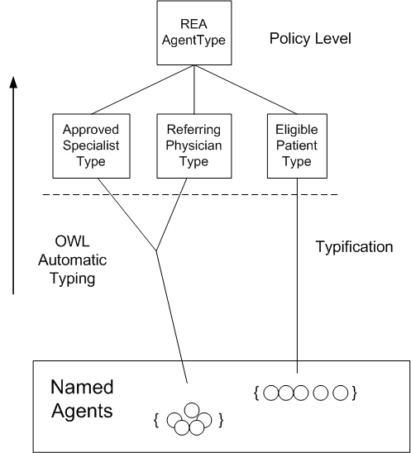
Policy Level Classification
Formalized Policy
Approved Specialist Type:
Anything that has at least one Hospital
Privilege that is clinical and has a least One Role as a Specialist

Slide 17
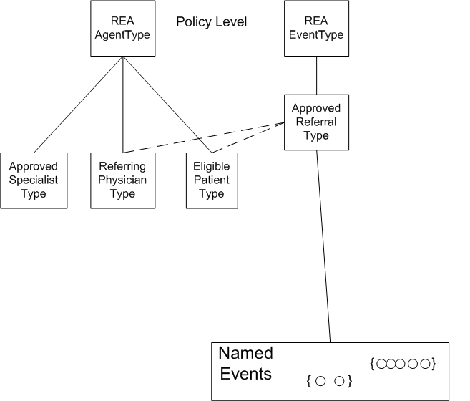
Approved Referral: A Referral that has a least one patient Referral that is an Eligible Patient Type and has at least one clinical approval that is a Referring Clinician Type

Slide 18
HTML + RDFa Markup
Machine Readable Evidence Documents
Health
Information
Network
Consulting Physician Credentials
Patient Referral
Patient Referral
Patient Referral
Referring Physician Credentials

Slide 19
REA Ontology
OWL Inferences
Health Information Ontology
Audit
Compliance
Policy
RDF patient and provider data
Consulting Physician Credentials
Patient Referral
Patient Referral
Patient Referral
Referring Physician Credentials

Slide 20
RDFa Markup embedded in Evidence Documents
Consulting Physician
Provider Name: Dr. Howser
Clinical Authorization: Specialist
Physician Referral Privileges: Clinical Consultant
Human View
<li about= “http://consultation.heathcare.owl#C454 “>
<span rel="rdf:type"
href= http://consultation.heathcare.owl#NamedAgents ></span>
<span rel="hc:has_Consultant_Priviledge"
href= http://consultation.heathcare.owl#Clinical >
</span <span rel="hc:has_Role"
href=“http://consultation.heathcare.owl#Specialist”>
HTML & RDFa Mark-up
<rdf:Description rdf:about="http://consultation.heathcare.owl#C454">
<rdf:type rdf:resource="http://consultation.heathcare.owl#NamedAgents"/>
<hc:has_Consultant_Priviledge rdf:resource="http://consultation.heathcare.owl#Clinical"/>
<hc:has_Role rdf:resource="http://consultation.heathcare.owl#Specialist"/>
</rdf:Description>
Importable RDF
GRDDL of
HTML &RDFa
Transform

Slide 21
Knowledge level OWL descriptions
hc:Approved_Consulting_Clinician
a owl:Class ;
rdfs:subClassOf REAontology:EconomicAgentType ;
owl:equivalentClass
[ a owl:Class ;
owl:intersectionOf ([ a owl:Restriction ;
owl:onProperty hc:has_Hospital_Priviledge ;
owl:someValuesFrom hc:Clinical
] [ a owl:Restriction ;
owl:onProperty hc:has_Role ;
owl:someValuesFrom hc:Specialist
])
] .

Slide 22
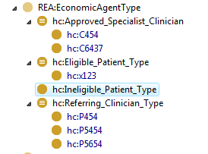
Automated Policy Based Inference Classification into Types
Approved Specialists
Eligible Patients
Referring Clinicians

Slide 23
Higher Level Policy Based Inference
Patient referral
Approved Referral Type
Eligible Patient Type
Inferred
Hc:x123
Hc:x123
Referring Clinicians Type
Clinical Approval
Patient referral
Hc:P123
Clinical Approval
Hc:P123
Approved Referral: Is a Referral that has a least one patient Referral that is an Eligible Patient Type and has at least one clinical approval that is a Referring Clinician Type
Referral Evidence Document

Slide 24
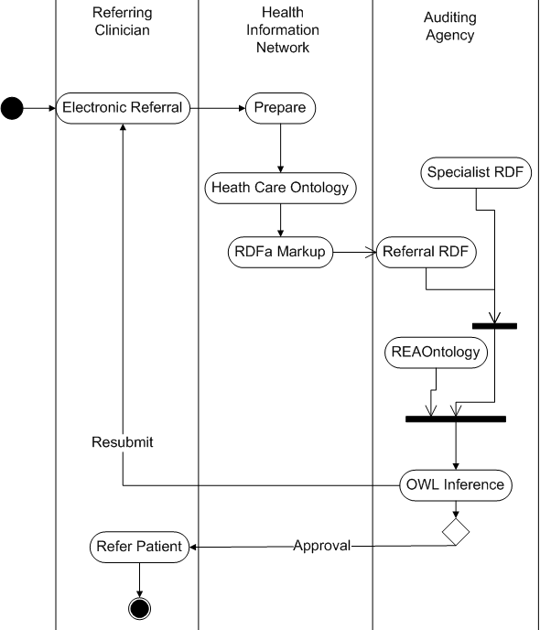
Inference Processes

Slide 25
System Concerns
Evidence Documents:
Assure safety and confidentiality of patient health records
Track and approve policy based access or disclosure of medical records;
Penalty
Patients can recover damages from an entity that improperly used or disclosed personal health information.

