Slide 1
Reinforcement Learning, Dynamic Programming
COSC 878 Doctoral Seminar
Georgetown University
Presenters:
Tavish Vaidya,
Yuankai Zhang
Jan 20, 2014

Slide 2
Introduction
When an infant plays, waves its arms, or looks about, it has no explicit teacher, but it does have a direct sensorimotor connection to its environment
We learn throughout our lives with such interaction
RL is the computational approach to learning from interaction
Goal-directed learning: designs for machines that are effective in solving learning problems of scientific or economic interest, evaluating the designs through mathematical analysis or computational experiments
Computational approach to understanding and automating goal-directed learning and decision-making

Slide 3
Elements of Reinforcement Learning
Policy: Learner’s way of behaving at a given time; mapping from perceived states of the environment to actions to be taken when in those states.
policy can be changed to select another action in future
Reward function: it maps each perceived state (or state-action pair) of the environment to a single number, a reward, indicating the intrinsic desirability of that state; defines what are the good and bad events for the learner.
Aim of learner is to maximize the total reward
Learner can’t change the reward function

Slide 4
Elements of RL
Value function: specifies what is good in the long run
the value of a state is the total amount of reward a learner can expect to accumulate over the future, starting from that state
values indicate the long-term desirability of states after taking into account the states that are likely to follow and the rewards available in those states.
the most important component of almost all reinforcement learning algorithms is a method for efficiently estimating values
Model of the environment: something that mimics the behavior of the environment
Used for planning
any way of deciding on a course of action by considering possible future situations before they are actually experienced

Slide 5
The Reinforcement Learning Problem
Objective:
Describe the reinforcement learning problem
Talk about possible applications that can be framed as reinforcement learning tasks
Mathematically describe the problem
Applicability v/s mathematical tractability tradeoffs and challenges

Slide 6
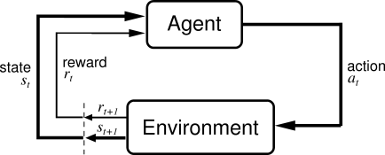
Agent-Environment Interface
Agent: Learner and decision-maker
Environment: Everything agent interacts with, comprising everything outside the agent
Boundary between agent and environment:
anything that cannot be changed arbitrarily by the agent is considered to be outside
convenient to place the boundary of the learning agent not at the limit of its physical body, but at the limit of its control.
And there is task, towards which the agent wants to progress, one instance of reinforcement learning problem
Notes:
Define agent, environment:
Agent: earner and decision-maker
Environment: Everything agent interacts with, comprising everything outside the agent
Boundary between agent and environment:
anything that cannot be changed arbitrarily by the agent is considered to be outside
convenient to place the boundary of the learning agent not at the limit of its physical body, but at the limit of its control.
And there is task, towards which the agent wants to progress, one instance of reinforcement learning problem
How the above figure works?
Each step, agent implements a mapping from states to probabilities of selecting each possible action. mapping is called policy
steps can be anything
States can be representation of anything abstract like emotion:
Actions can also be abstract or something tangible, changing the voltage or have lunch or not
The idea: reinforcement learning framework is a considerable abstraction of the problem of goal-directed learning from interaction.
majority of problems of learning goal-directed behavior can be reduced to three signals passing back and forth between an agent and its environment
choices made by the agent (the actions)
basis on which choices are made (the states)
agent's goal (the rewards)
particular states and actions vary greatly from application to application, and how they are represented is more art than science

Slide 7
Agent-Environment Interface
How the above figure works?
Each step, agent implements a mapping from states to probabilities of selecting each possible action. (Remember policy?)
Time steps can be anything, they need not refer to fixed intervals of real time
can refer to arbitrary successive stages of decision-making and acting
States can be representation of anything abstract like emotion etc.
Actions can also be abstract or tangible, changing the voltage or to have lunch or not
The idea: reinforcement learning framework is a considerable abstraction of the problem of goal-directed learning from interaction
majority of problems of learning goal-directed behavior can be reduced to three signals passing back and forth between an agent and its environment
choices made by the agent (the actions)
basis on which choices are made (the states)
agent's goal (the rewards)
Particular states and actions vary greatly from application to application, and how they are represented is more art than science

Slide 8
Application examples
Air conditioning in a room
States are various temperature and humidity readings
Actions are changing temperatures and activating/stopping cooling/heating function
Rewards: feedback from environment (in this say, human saying “nice job, are you gonna freeze me to death?, perfect!” etc.
Empty soda-can collecting robot
Job is to collect empty soda cans
sensors for detecting cans, an arm and gripper to them up, place them in an onboard bin; runs on a rechargeable battery
Possible actions:
actively search for a can for a certain period of time
remain stationary and wait for someone to bring it a can
head back to its home base to recharge its battery
Rewards:
positive when the robot secures an empty can
large and negative if the battery runs all the way down

Slide 9
Goals and Rewards
Rewards must be provided in such a way that maximizing rewards for the agent will also lead to achievement of the goals
Reward is just a number
e.g. for an empty soda-can collecting robot rewards can be:
reward of 0 most of the time
+1 for each can collected (and confirmed as empty)
-1 if it bumps into someone, non-empty can etc.
Rewards must be set up to truly indicate what we want to be accomplished
Reward signal: tells what is desired from agent and not how to get it
Reward source outside of the agent. Why?
Agent's ultimate goal should be something over which it has imperfect control
Else, it can just arbitrarily say that rewards has been received, without any learning
Notes:
GY: optimize long term reward

Slide 10
Returns in Episodic tasks
Episodic tasks: The agent-environment interaction breaks naturally into subsequences, called episodes
episode ends in a special state called the terminal state, followed by reset to standard starting state or to a sample from a standard distribution of starting states
Such tasks, having episodes, are called episodic tasks.
e.g. plays of a game, trips through a maze, or any sort of repeated interactions.
To maximize the reward is agent’s goal, formally meaning:
maximize the expected return, where the return, R_{t} is defined as some specific function of the reward sequence.
E.g. R_{t} = r_{t+1}+ r_{t+2}+ r_{t+3}+ … + r_{T} where, r_{t+1} , r_{t+2} , r_{t+3} , … denotes the sequence of rewards received after time step t and T is the final time step

Slide 11
Returns in Continuing tasks
Continuing tasks: Agent-environment interaction does not break naturally into identifiable episodes, but goes on continually without limit e.g. a continual process-control task
Such task are called continuing tasks
Final step T = ∞ and return can be infinite
Thus, we need the discounting factor/discount rate 𝛾, such that 0 ≤ 𝛾 ≤ 1
Agent tries to select actions so that the sum of the discounted rewards it receives over the future is maximized, i.e. to maximize expected discounted return
Discount rate determines the present value of future rewards
If 𝛾 = 0, agent cares only about maximizing immediate reward
as 𝛾 -> 1, objective takes future rewards into account more strongly

Slide 12
Unified Notion of Tasks
Problem can be either episodic or continuing but sometimes both.
Representation of both can be combined
considering episode termination to be the entering of a special absorbing state that transitions only to itself and that generates only rewards of zero.
T = ∞ or 𝛾 = 1 but not both simultaneously

Slide 13
Markov Property
Property of environments and their state signals to the agent
“State” refers to whatever information is available to the agent
What information should be provided by state signal?
should have immediate sensations together with the previous state or some other memory of past sensations
more than the immediate sensations, but never more than the complete history of all past sensations
Markov Property: State signal that succeeds in retaining all relevant information is said to be Markov state, or to have the Markov property
A stochastic process has the Markov property if the conditional probability distribution of future states of the process (conditional on both past and present values) depends only upon the present state, not on the sequence of events that preceded it.
Notes:
e.g. we can move our eyes over a scene, with only a tiny spot corresponding to the fovea visible in detail at any one time, yet build up a rich and detailed representation of a scene. Or, more obviously, we can look at an object, then look away, and know that it is still there.
Deduce information from data
state is constructed and maintained on the basis of immediate sensations together with the previous state or some other memory of past sensations.
the state signal should not be expected to inform the agent of everything about the environment, or even everything that would be useful to it in making decisions

Slide 14
Markov Property for RL
Assume finite number of states and reward values
Sum and probabilities rather than integrals and probability densities
Response of environment at time t+1 to action taken at time t :
for all s’, r and all possible values of past events:
For state signal with Markov Property:
for all s’, r, s_{t} and a_{t}
Markov property enables prediction of the next state and expected next reward given the current state and action (and that’s the beauty of it!)
One step dynamics
Notes:
non-Markov, it is still appropriate to think of the state in reinforcement learning as an approximation to a Markov state. Most algorithms do this

Slide 15
Markov Decision Process
RL task satisfying Markov Property is called a Markov decision process (MDP)
Finite MDP
MDP with finite states and action space
Defined by state, action sets and one-step dynamics of the environment

Slide 16
Markov Decision Process (contd.)
In any finite MDP, for any given state s and action a,
the probability of each possible next state s’, called transition probabilities is:
with next state s’, expected value of next reward is:

Slide 17
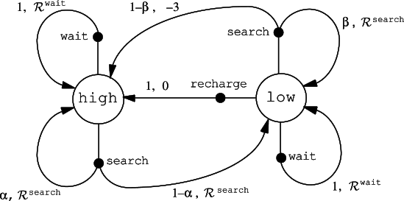
Finite MDP Example
Can-collecting robot example
Notes:
Can-collect robot example, describe it before this and make it a running example

Slide 18
Value functions
Functions of states (or of state-action pairs) that estimate how good it is for the agent to be in a given state (or how good it is to perform a given action in a given state)
“How good” notion is defined in terms of future expected returns, which depends on what action is taken
Value functions are defined with respect to particular policies
Policy: agent's way of behaving at a given time, formally:
Policy 𝜋 is a mapping from each state s ∈ S, and action a ∈ A(s), to the probability 𝜋(s,a) of taking action a when is state s
Value of state s under policy 𝜋 and any time step t, V^{𝜋}(s) is given as:
V^{𝜋} is called the state-value function for policy 𝜋
Notes:
the eq is the expected return when starting in s and following π thereafter
value of the terminal state, if any, is always zero

Slide 19
Value functions
Value of taking action a in state s under a policy 𝜋, Q^{𝜋}(s,a) is:
Q^{𝜋} is the action-value function for policy π
expected return starting from state s, taking action a, and following policy π thereafter

Slide 20
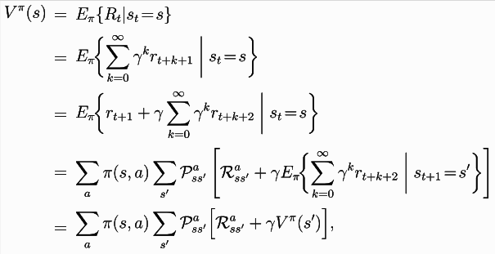
Property of Value functions
Value functions satisfy particular recursive relationships
Averages over all the possibilities, weighting each by its probability of occurring
It states that the value of the start state must equal the (discounted) value of the expected next state, plus the reward expected along the way
Bellman equation
Notes:
actions a taken from A(s), next state s’ are taken from set S or from S⁺ in case of episodic problem
Bellman equation expresses a relationship between the value of a state and the values of its successor states.

Slide 21
Backup diagrams
Diagram relationships that form the basis of the update or backup operations that are at the heart of reinforcement learning methods
Operations transfer value information back to a state (or a state-action pair) from its successor states (or state-action pairs)
Backup diagrams for (a) V^{π} and (b) Q^{π}

Slide 22
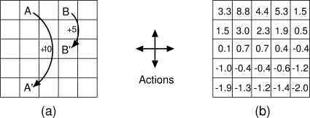
Value functions example
Grid example: (a) exceptional reward dynamics; (b) state-value function for the equiprobable random policy
Notes:
Describe this example properly

Slide 23
Optimal Value Functions
RL task ≈ finding a policy that achieves a lot of reward over the long run
Value functions define a partial ordering over policies.
For MDP we can define optimal policy as:
Policy 𝜋 ≥ 𝜋’ iff V^{𝜋}(s) ≥ V^{𝜋’}(s) for all s ∈ S
There is always at least one policy that is better than or equal to all other policies
All optimal policies (there can be more than 1) can be denoted by π*

Slide 24
Optimal Value Functions (contd.)
All optimal value policies have same optimal state value function, V*, defined as:
for all states s ∈ S
Optimal value policies also have same optimal action-value function, Q*, defined as:
for all states s ∈ S and a ∈ A(s)

Slide 25
Optimal Value Functions (contd.)
Q* can be written in terms of V* as
Why?
V* must satisfy the self-consistency condition given by the Bellman equation for state values
Here, it’s the optimal value function, therefore, V* consistency condition can be written in a special form without reference to any specific policy

Slide 26
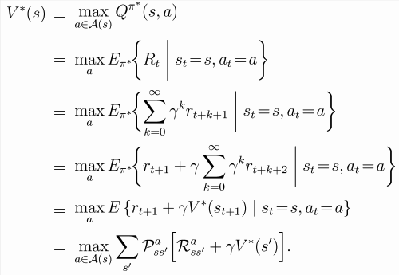
Bellman optimality equation for V*
Intuitively, value of a state under an optimal policy must equal the expected return for the best action from that state

Slide 27
Bellman optimality equation for Q*
Above equation gives the expected return for taking action a in state s and thereafter following an optimal policy

Slide 28
Backup diagrams
Backup diagrams for (a) V* (b) Q*
Arcs represent nodes where agent has to make a choice
Maximum over the choice is taken rather than the expected value given some policy
Under an optimal policy value of state must equal the expected return for the best action from that state
Definition is recursive so the best result rises up

Slide 29
Determining the Optimal Policy
For finite MDP, Bellman optimality equation has a unique solution independent of the policy
Equation can be solved for V* using methods for solving non-linear system of equations if and are known, in principle.
Solve related set of equations for Q*
Determine the policy
For each state s, one or more actions at which the maximum is obtained in the Bellman optimality equation
Any policy that assigns non-zero probability only to these actions is an optimal policy.
Use greedy approach: actions that appear best after a one-step search will be optimal actions
Works because V*, already takes into account the reward consequences of all possible future behavior

Slide 30
Determining the Optimal Policy(contd.)
Using Q*, as it makes choosing optimal actions still easier.
One-step search isn’t required
For state s, agent can find the action that maximizes Q*(s,a)
Action-value function effectively caches the results of all one-step-ahead searches
provides the optimal expected long-term return as a value that is locally and immediately available for each state-action pair
Representing a function of state-action pairs, optimal action-value function allows optimal actions to be selected without knowing anything about the successor states

Slide 31
Optimality and Approximation
In practice, agent rarely learns the optimal policy
Limit on computational resources available to agent
Amount of computation agent can perform in single time step
Memory constraints:
Possible number of states are far more than the number of entries could possibly be in a table while using tabular methods

Slide 32
Optimality and Approximation
Approximation is required in practical cases
Functions must be approximated, using some sort of compact parameterized function representation
But we can do good with useful approximations!
Many states that the agent faces may have a low probability
Spend less resources to approximate actions (suboptimal are OK)
little impact on the amount of reward the agent receives
Online nature of RL allows approximating optimal policies
put more effort into learning to make good decisions for frequently encountered states
less effort for infrequently encountered states

Slide 33
Let discuss some questions!
Is the reinforcement learning framework adequate to usefully represent all goal-directed learning tasks? Can you think of any clear exceptions?
Environment is always changing such that things learnt from experience can’t be applied because the environment has changed.
In standard RL model, there are a discrete Action Space and State Space. Can either or both of them be continuous space? What will happen if the state space becomes continuous?
Yes both can be continuous (Van Hasselt, Hado, and Marco A. Wiering. "Reinforcement learning in continuous action spaces." In Approximate Dynamic Programming and Reinforcement Learning, 2007. ADPRL 2007. IEEE International Symposium on, pp. 272-279. IEEE, 2007.)
You start dealing with partial differentials when state space becomes continuous
What if the state space becomes discrete but with infinite size?
Infinitely many constraints on the model
Sampling a large yet finite set to make the state space finite
Ng, Andrew Y., and Stuart J. Russell. "Algorithms for inverse reinforcement learning." In Icml, pp. 663-670. 2000.

Slide 34
More questions
I saw many places where the reward function is written as R(s,a). So it is a function of state and action. Is this setup universal for RL problems or just for MDP setup? Could Reward function only related to state/action/observation in some RL problems?
Reward function can be defined with respect to a state and action, or observation or just state.
It depends on what notation is being used to describe the model.
For the discount factor gamma, I just wonder, is it possible to choose a value outside of the range [0,1]? Are there situations that fit a model with negative gamma? or a gamma > 1?
Ok it is possible, in theory, purpose of 𝛾 is to discount the value of reward at present, but not change the sense of reward value itself
Practically, negative gamma will have flip the reward
e.g. if reward is +1 and 𝛾 < 0 will cause the agent to stray away from the goal as it gets a positive discounted reward for action that has a negative reward associated with it.
𝛾 > 1, the reward can become infinite, and that is why we use a discounting factor in the first place. Also, to guarantee convergence, 𝛾 may not be greater than 1

Slide 35
Some More!
How to get immediate reward when the future outcome is unknown?
When outcome is unknown, agent's actions do not inuence state transitions, then the problem becomes to maximize the immediate reward as a function of agent’s current state.
REINFORCE Algorithms, class of update rules that perform gradient descent on the expected reward and showed how to integrate these rules with backpropagation
Algorithms mentioned in 6.1.1 Immediate Reward (CRBP, ARC)
One can show that, by iterating this equation, one can predict all future states and expected rewards from knowledge only of the current state as well as would be possible given the complete history up to the current time. Not sure how to predict the history up to the current time? By using HMM?
You don’t predict the history. Say you know the state information at t =0 and move to next state and provide information of state at t =0, thus, you are building the history
As discussed, if states become hidden, there is something more to HMM, i.e. actions and rewards, in case of RL
Notes:
6. CRBP The complementary reinforcement backpropagation algorithm (Ackley & Littman,
1990) (crbp) consists of a feed-forward network mapping an encoding of the state to an
encoding of the action.
ARC The associative reinforcement comparison (arc) algorithm, ahc architecture for the case of boolean actions, consisting of two feed forward network, one learns value of situations, other learns policy. In simplest case, the entire system learns only to optimize immediate reward

Slide 36
Even More Questions!
There is always at least one policy that is better than or equal to all other policies. So is it impossible that one policy is optimal regarding some states, whereas another policy is optimal regarding some other states? (Yifang)
Yes, it is impossible because by definition, a policy π is defined to be better than or equal to a policy π’, if its expected return is greater than or equal to that of π’ for all states.
How is shaping in RL different from supervised learning? It seems like it's cheating the definition by using a roundabout way to impart the same information (Brendan)
Agent is told the immediate reward and the next state, but no information is given about what action it should take in its best interest. This is what it has to learn
In supervised learning, action sequences are not learned, whereas in RL, the agent learns what actions to take by exploration towards a certain goal, exploration being guided by rewards received by the agent.
Adjusting the probability of taking an action given a state can also improve the policy, I think. Seems not covered in Chapter 4? (Yifang)
Yes, covered in chapter 3
Agent can modify the policy but not the rewards
Notes:
MM: supervised learning is a different setting

Slide 37
Even More Questions!
Is there a model of reinforcement learning where the "distance" of the long-run optimality is not fixed? What if you need to want to optimize over a distribution of distances, say 5 6 and 7? (Brad)
The goal is to maximize till the end. So, we should optimize till 7. Agree?
Is it possible to define an optimal policy for a well-behaved infinite MDP? (Brendan)
Yes
Kearns, Michael, Yishay Mansour, and Andrew Y. Ng. "A sparse sampling algorithm for near-optimal planning in large Markov decision processes." Machine Learning 49, no. 2-3 (2002): 193-208.
Sennott, Linn I. "Average cost optimal stationary policies in infinite state Markov decision processes with unbounded costs." Operations Research 37, no. 4 (1989): 626-633.
Why must optimal policies share the same state-value and action-value functions? (Brendan)
Optimal policies are based on values of states V* and values of state-action pairs Q*. If many policies are optimal, they provide the same total reward.
There might be different paths or actions that you can take in a state, but all optimal policies must have those paths. If not, those policies will not be optimal
Formal proof by contradiction

Slide 38
Solving RL problem
Dynamic Programming
mathematically well developed
require complete and accurate model of environment
Monte Carlo Method
don’t require model
not suitable for step-by-step incremental computation
Temporal Difference Learning
don’t require model
fully incremental
more complex to analyze

Slide 39
Dynamic Programming
assume environment is finite MDP
𝓢 and A(s) are finite
dynamics given by transition probabilities and expected immediate rewards
key idea for DP
use of value functions to organize and structure the search for good policies -- how to search
what is a good policy?

Slide 40
Policy Evaluation
Compute state-value function V^{𝜋} for an arbitrary policy 𝜋
Why we want this?
to evaluate the goodness of a policy
better policy -> higher rewards

Slide 41
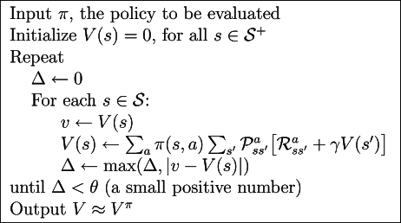
Policy Evaluation
stop if is sufficiently small

Slide 42
Policy Improvement
After evaluating a policy, how to make it better?
What if we take some other action a≠𝜋(s) at state s?
is this greater than V^{𝜋}(s)?
If so, what do we do?

Slide 43
Policy Improvement
we know how to improve over one state s and one action a
how about extend to consider changes at all states and to all possible actions?
selecting at each state the action that appears best according to Q^{𝜋}(s,a)

Slide 44
Policy Iteration
Since we know how to evaluate and improve policies, we can iterate over the processes to find optimal policy
assumption: finite MDP
requires finite iterations to find optimal policy

Slide 45
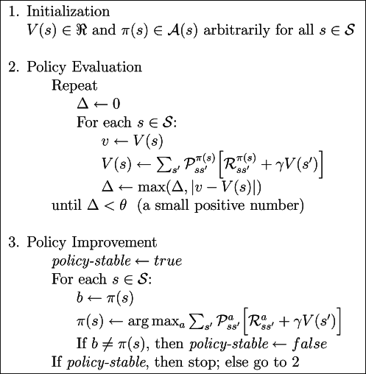
Policy Iteration
Iterate over policies
until some stable
policy reached

Slide 46
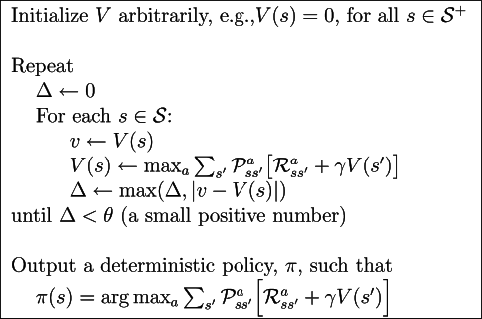
Value Iteration
In Policy Iteration, each iteration involves policy evaluation, which may itself be a protracted iterative computation requiring multiple sweeps through the state set

Slide 47
Asynchronous DP
DP method involves operations over entire state set of the MDP, requires sweeping of entire S
Asynchronous DP are not organized in terms of systematic sweeps of S
makes it easier to intermix computation with real-time interaction
can run an iterative DP algorithm at the same time that an agent is actually experiencing the MDP
agent's experience can be used to determine the states to which the DP algorithm applies its backups
latest value and policy information from the DP algorithm can guide the agent's decision-making

Slide 48
Generalized Policy Iteration
Policy iteration consists of two simultaneous, interacting processes
Policy Evaluation makes the value function consistent with current policy
Policy Improvement makes the policy greedy wrt the current value function
Generalized Policy Iteration (GPI) refers to the general idea of interacting policy evaluation and policy improvement processes
almost all reinforcement learning methods are well described as GPI

Slide 49
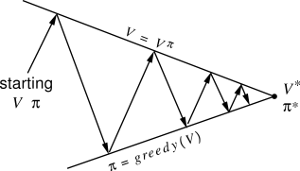
Generalized Policy Iteration
two processes dragging to the same destination, optimality

Slide 50
DP Efficiency
worst case time to find an optimal policy is polynomial in the number of states and actions, if a few technical details ignored
curse of dimensionality
number of states often grows exponentially with number of state variables
inherent difficulties of the problem, not of DP method

Slide 51
Let’s discuss more questions!
According to the RL textbook, DP, Asynchronous DP, Value Iteration, Policy Iteration can be used to solve MDP. How to prove that they will converge to an optimal solution? (Jiyun)
Check this out. http://chercheurs.lille.inria.fr/~ghavamza/RL-EC-Lille/Lecture4-b.pdf
What are the major differences among above four approaches? (Jiyun)
DP: a solution method to solve equations
Asynchronous DP: in-place iterative DP algorithms that are not organized in terms of systematic sweeps of the state set
Policy Iteration: a process that lead to a sequence of monotonically improving policies and value functions
Value Iteration: special case when policy evaluation is stopped after just one sweep
What are these four algorithms' time complexity and space complexity in term of action space size |A| and state space size |S|? Why?(Jiyun)
O(|A||S|²) per iteration for value iteration, O(|A||S|²+|S|³) per iteration for policy iteration, etc; PSPACE
no known tight worst-case bound

Slide 52
Some More Questions
Efficiency comparison between value iteration and policy iteration (Grace)
from the RL book:value iteration is more efficient because value iteration is a special case when policy evaluation is stopped after just one sweep
from the paper: arguments have been put forth to the effect that each approach is better for large problems
From section 4.2, it is unclear why equation 4.9 implies that \pi and \pi\prime are globally optimal and not just locally optimal. Is this a consequence of the markovian nature of the system? (Henry)
we implicitly assume infinite-horizon discounted model, so optimal values are global
if the agent explore enough, it will not stuck in a “bad” state for long
Figure 4.3 shows the pseudo-code of policy improvement. Seems one state can only associate with one action according to the pseudo-code? (Yifang)
the max_{a} in evaluating 𝜋(s) is actually taking all actions possible at state s into consideration

Slide 53
Even More Questions
"an asynchronous algorithm must continue to backup the values of all the states: it can't ignore any state after some point in the computation" - this seems to imply that an asynchronous alg would have to backup all states? or does it just mean that it would *in theory* backup all states if it continued forever? (Brad)
for correctness, all states have to backup. No single state should be missed out.
What does it mean that "In asynchronous DP methods, the evaluation and improvement processes are interleaved at an even finer grain [than one iteration between each policy improvement]" ...? how could it be finer than one iteration? (Brad)
by finer, it means every iteration, the algorithm is more flexible, allowed to make more or less backups to some states

Slide 54
Still More Questions
Does equation 3.10 tell us the number of subproblems is the number of states in a dynamic programming scenario? (Yifang)
from the DP algorithm below, the two summations are taken over all actions possible at state s, and all states these actions lead to, s’

Slide 55
Policy Iteration vs. Value Iteration
Comparing algorithms

Slide 56
Thank you

