Slide 1
Learning In Bayesian Networks

Slide 2
General Learning Problem
Set of random variables X = {X₁, X₂, X₃, X₄, …}
Training set D = {X⁽¹⁾, X⁽²⁾, …, X^{(N)}}
Each observation specifies values of subset of variables
X⁽¹⁾ = {x₁, x₂, ?, x₄, …}
X⁽²⁾ = {x₁, x₂, x₃, x₄, …}
X⁽³⁾ = {?, x₂, x₃, x₄, …}
Goal
Predict joint distribution over some variables given other variables
E.g., P(X₁, X₃ | X₂, X₄)

Slide 3
Classes Of Graphical Model Learning Problems
Network structure known All variables observed
Network structure known Some missing data (or latent variables)
Network structure not known All variables observed
Network structure not known Some missing data (or latent variables)
today and next
class
going to skip (not too relevant for papers we’ll read; see optional readings for more info)

Slide 4
If Network Structure Is Known, The Problem Involves Learning Distributions
The distributions are characterized by parameters 𝝝.
Goal: infer 𝝝 that best explains the data D.
Bayesian methods
Maximum a posteriori
Maximum likelihood
Max. pseudo-likelihood
Moment matching

Slide 5
Learning CPDs When All Variables Are Observed And Network Structure Is Known
Trivial problem if we’re doing Maximum Likelihood estimation
X
Y
P(X)
?
P(X)
?
P(Y)
?
Training Data
Z
X | Y | Z
0 | 0 | 1
0 | 1 | 1
0 | 1 | 0
1 | 1 | 1
1 | 1 | 1
1 | 0 | 0
X | Y | P(Z|X,Y)
0 | 0 | ?
0 | 1 | ?
1 | 0 | ?
1 | 1 | ?
Notes:
Trivial if all you want to do is get ML estimate from data, but why not do the Bayesian thing?
Goal: infer entries in CPTs from the data: INFERENCE PROBLEM

Slide 6
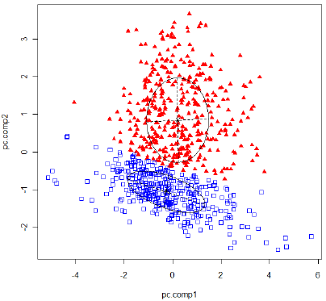
Recasting Learning As Bayesian Inference
We’ve already used Bayesian inference in probabilistic models to compute posteriors on latent (a.k.a. hidden, nonobservable) variables from data.
E.g., Weiss model
Direction of motion
E.g., Gaussian mixture model
To which cluster does each data point belong
Why not treat unknown parameters in the same way?
E.g., Gaussian mixture parameters
E.g., entries in conditional prob. tables

Slide 7
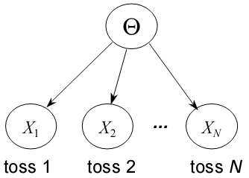
Recasting Learning As Inference
Suppose you have a coin with an unknown bias, θ ≡ P(head).
You flip the coin multiple times and observe the outcome.
From observations, you can infer the bias of the coin
This is learning. This is inference.

Slide 8
Treating Conditional Probabilities As Latent Variables
Graphical model probabilities (priors, conditional distributions) can also be cast as random variables
E.g., Gaussian mixture model
Remove the knowledge “built into” the links (conditional distributions) and into the nodes (prior distributions).
Create new random variables to represent the knowledge
→ Hierarchical Bayesian Inference
𝛼
z
z
λ
z
λ
x
x
x

Slide 9
I’m going to flip a coin, with unknown bias.
Depending on whether it comes up heads or tails,
I will flip one of two other coins, each with an unknown bias.
X: outcome of first flip
Y: outcome of second flip
Slides stolen from David Heckerman tutorial
Notes:
I’m going to flip coin X, with unknown bias. depending on whether it comes up heads or tails, I will flip one of two coins. Call the selected one Y.

Slide 10
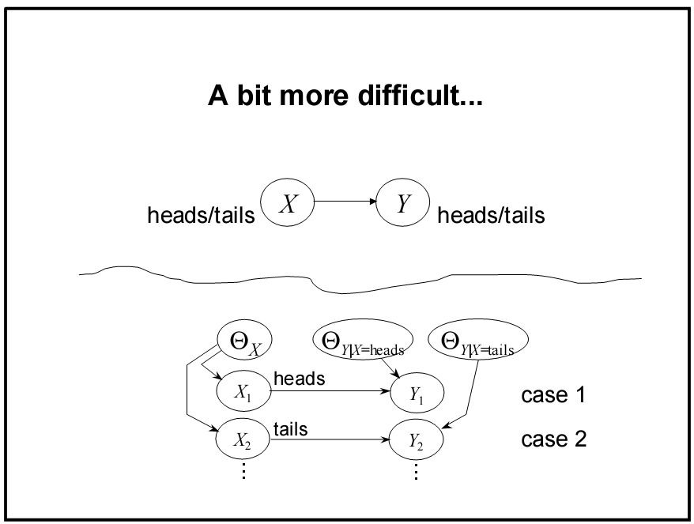
training example 1
training example 2
Notes:
The two cases are different examples (observed values of X, Y)

Slide 11
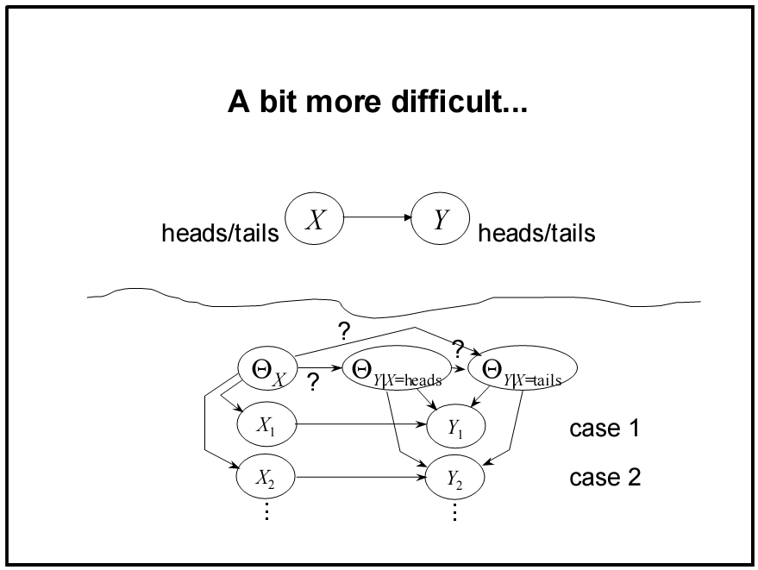
Parameters might not be independent
training example 1
training example 2
Notes:
But the scenario I painted makes them independent

Slide 12
General Approach: Bayesian Learning of Probabilities in a Bayes Net
If network structure S^{h} known and no missing data…
We can express joint distribution over variables X in terms of model parameter vector θ_{s}
Given random sample D = {X⁽¹⁾, X⁽²⁾, …, X^{(N)}}, compute the posterior distribution p(θ_{s} | D, S^{h})
Probabilistic formulation of all supervised and unsupervised learning problems.
Notes:
I is index over nodes

Slide 13
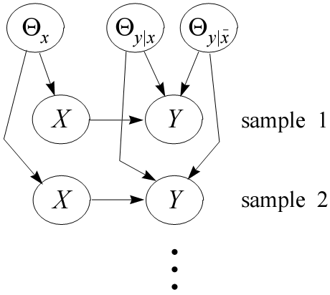
Computing Parameter Posteriors
E.g., net structure X→Y

Slide 14
Computing Parameter Posteriors
Given complete data (all X,Y observed) and no direct dependencies among parameters,
Explanation
Given complete data, each set of parameters is disconnected from each other set of parameters in the graph
parameter
independence
θ_{x}
θ_{x}
θ_{x}
X
Y
θ_{y|x}
D separation
Notes:
Why are THETA(Y|X) and THETA(Y|NOTX) d-separated?

Slide 15
Posterior Predictive Distribution
Given parameter posteriors
What is prediction of next observation X^{(N+1)?}
How can this be used for unsupervised and supervised learning?
What does this formula look like if we’re doing approximate inference by sampling θ_{s} and/or X^{(N+1)?}
What we talked
about the past
three classes
What we just
discussed
Notes:
P(X|theta, D) = P(X|theta)

Slide 16
Prediction Directly From Data
In many cases, prediction can be made without explicitly computing posteriors over parameters
E.g., coin toss example from earlier class
Posterior distribution is
Prediction of next coin outcome
Notes:
Note that we’ve integrated out theta altogether so the parameters are never explicitly represented:

Slide 17
Terminology Digression
Bernoulli : Binomial :: Categorical : Multinomial
single
coin
flip
N flips of coin (e.g., exam score)
single roll of die
N rolls
of die
(e.g., # of each major)

Slide 18
Generalizing To Categorical RVs In Bayes Net
notation change
Variable X_{i} is discrete, with values x_{i}¹, ... x_{i}^{ri}
i: index of categorical RV j: index over configurations of the parents of node i k: index over values of node i
unrestricted distribution: one parameter per probability
X_{a}
X_{b}
X_{i}

Slide 19
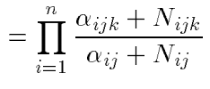
Prediction Directly From Data: Categorical Random Variables
Prior distribution is
Posterior distribution is
Posterior predictive distribution:
I: index over nodes
j: index over values of parents of I
k: index over values of node i
Notes:
Preview of topic modeling

Slide 20
Other Easy Cases
Members of the exponential family
see Barber text 8.5
Linear regression with Gaussian noise
see Barber text 18.1

