Slide 1
Fractal Image Compression
By Cabel Sholdt and Paul Zeman

Slide 2
Overview
Why Fractal Image Compression
Mathematical Background
How does it work?
Examples
Possible Improvements

Slide 3
Why Fractal Image Compression
Different type of compression scheme worth exploring
Takes advantage of similarities within an image
Advanced detail interpolation
High theoretical compression rates
Fast decompression times

Slide 4
Mathematical Background
Started with Michael Barnsley, and refined by A. Jacquin
Try and find a set of transforms that map an image onto itself.
The key is the Collage Theorem
States that if the error difference between the target image and the transformation of that image is less than a certain value the transforms are an equivalent representation of the image.

Slide 5
How does it work?-Encoding
Take a starting image and divide it into small, non-overlapping, square blocks, typically called “parent blocks”.
Divide each parent block into 4 each blocks, or “child blocks.”
Compare each child block against a subset of all possible overlapping blocks of parent block size.
Need to reduce the size of the parent to allow the comparison to work.
Determine which larger block has the lowest difference, according to some measure, between it and the child block.
Calculate a grayscale transform to match intensity levels between large block and child block precisely. Typically an affine transform is used (w*x = a*x + b) to match grayscale levels.
Notes:
Draw Pictures on a board here.

Slide 6
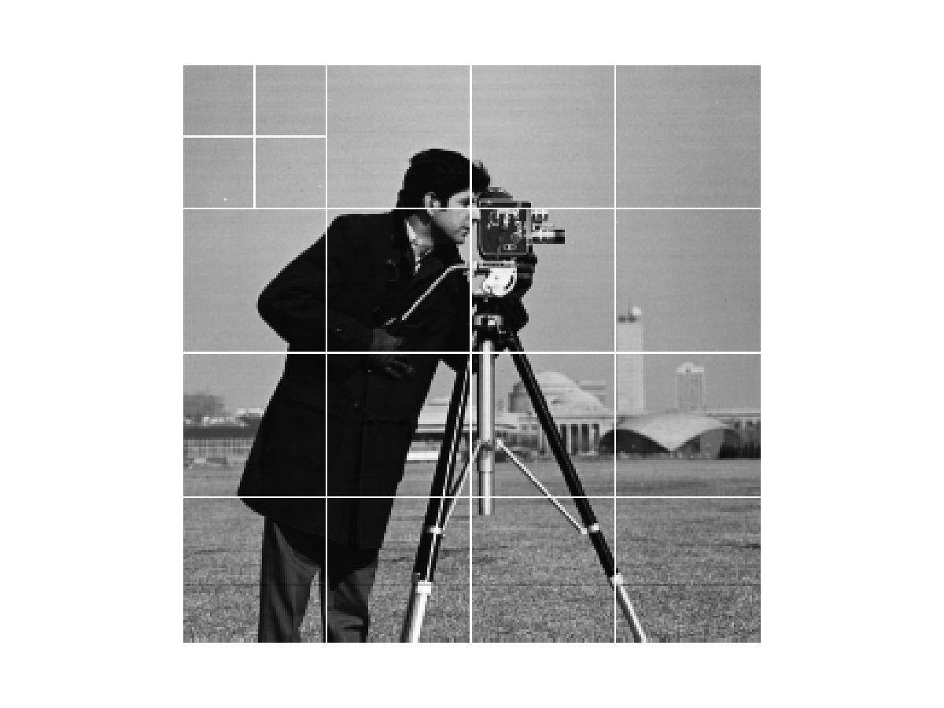
How does it work? – Encoding
Upper left corner child block, very similar to upper right parent block.
Compute affine transform.
Store location of parent block (or transform block), affine transform components, and related child block into a file.
Repeat for each child block.
Lots of comparisons can calculations.
256x256 original image
16x16 sized parent blocks
241*241 = 58,081 block comparisons

Slide 7
How does it work?- Decoding
Read in child block and tranform block position, transform, and size information.
Use any blank starting image of same size as original image
For each child block apply stored transforms against specified transform block
Overwrite child block pixel values with transform block pixel values
Repeat until acceptable image quality is reached.

Slide 8
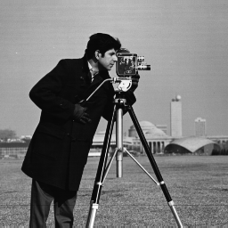
Examples
Original Image
Starting Image for Decoding

Slide 9
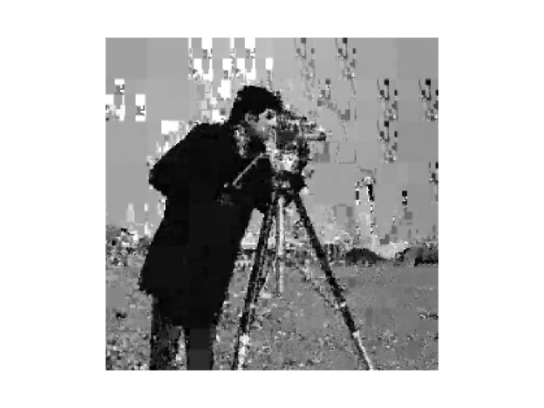
How does it Work? – Decoding
First Iteration
Second Iteration

Slide 10
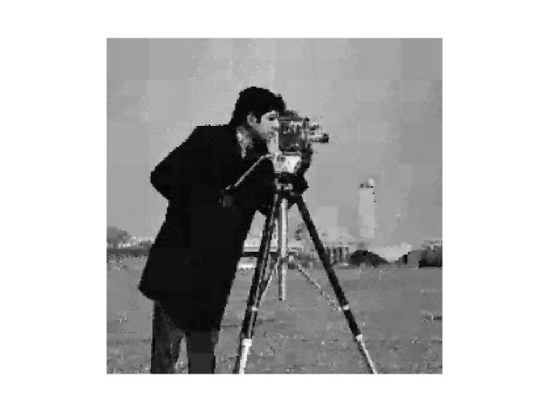
How does it work? - Decoding
Fifth Iteration
Tenth Iteration

Slide 11
Possible Improvments
Greatest weakness is time for encoding
Possible speed ups
Order transform blocks into domains based off of average intensity and variance
Only search through blocks with similar structures
Do not search all possible blocks
Reduce number of child blocks
Quality and Compression Improvements through
Quadtrees or HV Trees
Rotations of Transform Blocks during comparison
Improved grayscale transforms

Slide 12
Questions?

