Slide 1
FRACTAL FUN
Tom Evitts, SU Math Dept.

Slide 2
Characteristics of a Fractal
Geometric Shape
Composed of Self-Similar Parts

Slide 3
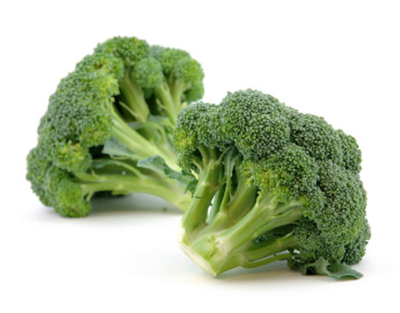
Self-similarity

Slide 4
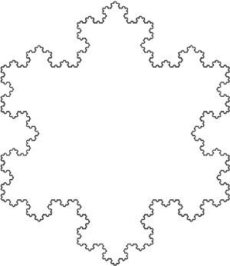
Koch Snowflake 1904

Slide 5
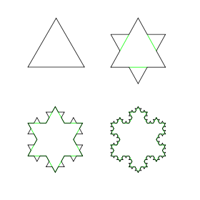
Start with a Triangle….

Slide 6
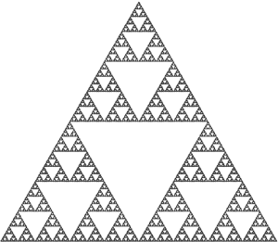
Sierpinski Gasket 1915

Slide 7
Session Themes
Self-similarity
Following directions
Iterative steps
Creative processes
Seeing patterns
Math is more than equations ... Math is fun!

Slide 8
Making a Fractal Cut-out
You need:
Piece of paper
Scissors
Ruler
Fold paper in half (portrait: bottom to top)
fold

Slide 9
Next steps – the iterative sequence
Along the fold, measure in and mark ¼ of the distance from each edge.

Slide 10
Next steps – the iterative sequence
Along the fold, measure in and mark ¼ of the distance from each edge.
From the fold, measure up and mark ½ the distance to the top.

Slide 11
Next steps – the iterative sequence
Use the marks you made to lightly create the lines shown below.
Cut along those lines.

Slide 12
Next steps – the iterative sequence
Carefully fold the flap you have cut up inside the folded paper. If you measured carefully, it should just reach the top edge.
Concealed flap

Slide 13
Time to repeat the steps… with a smaller rectangle
Repeat the iterative sequence (next slide) using the rectangle hiding the concealed flap as the starting object.

Slide 14
Along the fold, measure in and mark ¼ of the distance from each edge.
From the fold, measure up and mark ½ the distance to the top.
Use the marks you made to lightly create the lines shown.
Cut along those lines.

Slide 15
Carefully fold the flap you have cut up inside the folded paper.
Your cutout should look like this:

Slide 16
Seeing Patterns
Unfold and examine your fractal cutout.
What properties do you observe?

Slide 17
Time to cut again (and again)
Repeat the steps with a smaller rectangle.
Can you figure out which one?

Slide 18
Time to cut again (and again)
Repeat the steps with a smaller rectangle.
Can you figure out which one?

Slide 19
More observations?
What patterns are you finding?
Perform another cutting and folding sequence.
What if you could cut and fold “forever?”

Slide 20
Thanks for attending …
Have a great semester!

