Slide 1
Application Controls
Group 3
John Gregory
John Marsh
Gerri Houston
Samantha McNeily

Slide 2
Defining Application Controls
Application controls are those controls that pertain to the scope of individual processes or application systems
They include data edits, separation of business functions, balancing of processing totals, transaction logging, and error reporting

Slide 3
Objectives of Application Controls
Input data is accurate, complete, authorized, and correct
Data is processed in an acceptable time period
Data stored is accurate and complete
Outputs are accurate and complete
A record is maintained to track the process of data from input to storage and the the eventual ouput

Slide 4
Application Controls vs. General Controls
Application controls are those controls that pertain to the scope of individual processes or application systems (specific to a given application)
General controls are controls that apply to all systems components, processes, and data present in an organization or systems environment

Slide 5
Types of Application Controls
Input Controls - check the integrity of data entered into a business application
Processing Controls - ensure processing is complete, accurate, and authorized
Output Controls -compare output results with expected results by checking the output against the input
Management Trial (Audit Trail) Controls - monitors the effectiveness of other controls and identifies errors as close as possible to their sources

Slide 6
Preventive, Detective, and Corrective Controls
Preventive: keep undesirable events from occurring
Detective: should identify expected error types, as well as those that are not expected to occur
Corrective: cause or encourage a desirable event or corrective action to occur after an undesirable event has been detected

Slide 7
Benefits of Relying on Application Controls
Reliability
Once an application control is established, and there is little change to the application, database, or supporting technology, the organization can rely on the application control until a change occurs.
An application control will continue to operate more effectively if the general controls that have a direct impact on its programmatic nature are operating effectively as well. As a result, the auditor will be able to test the control once and not multiple times during the testing period.

Slide 8
Benefits of Relying on Application Controls
Benchmarking
If general controls that are used to monitor program changes, access to programs, and computer operations are effective and continue to be tested on a regular basis, the auditor can conclude that the application control is effective without having to repeat the previous year’s control test.
Auditor should evaluate the appropriate use of benchmarking or an automated control by considering how frequently the application changes. (If application changes frequently, auditor should not rely on benchmarking)

Slide 9
Benefits of Relying on Application Controls
Time and Cost Saving
Application controls generally take less time to test than application controls
Application controls are typically tested one time as long as the general controls are effective

Slide 10
Risk Assessment
Use top-down approach
Determine applications and controls to be reviewed
Determine appropriate tests to be performed
Mapping:
Financial Statement Accounts/Assertions
Business Processes/Units
Risk Identification and Analysis

Slide 11
Risk Assessment Approach
Identify applications, databases, and supporting technology that uses application controls
Define the risk factors associated with each application control
Weigh all risks to determine rankings by importance
Evaluate risk assessment results
Create review plan based on the risk assessment and ranked risk areas

Slide 12
Example of Application Control Risk Assessment

Slide 13
Scoping of Application Controls
Business Process Method
Top-down review approach used to evaluate the application controls present in all the systems that support a particular business process.
Single Application Method
Used to review the application controls within a single application

Slide 14
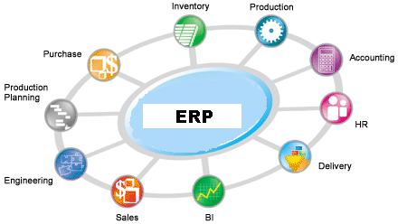
Business Process Method

Slide 15
Application Review Approach
Planning
Create a planning memorandum
All review procedures to be performed
Any computer-assisted tools and techniques used and how they are used
Sample sizes, if applicable
Review items to be selected
Timing of the review

Slide 16
Planning
Detailed Review Program
Meeting with Management
Management’s concerns regarding risks
Previously reported issues
Internal auditing’s risk and control assessment
A summary of the review’s methodology
The review’s scope
How concerns will be communicated
Which managers will be working on the review team
Any Preliminary information needed
The length of the review

Slide 17
Testing Application Controls
Are application controls working?
Substantive testing
Information technology general controls review
Ways to test:
Inspection of system configurations
Inspection or re-performance of reconciliations with supporting details
Re-Performance of the control activity using system data
Inspection of user access listings
Re-Performance of the control activity in a test environment

Slide 18
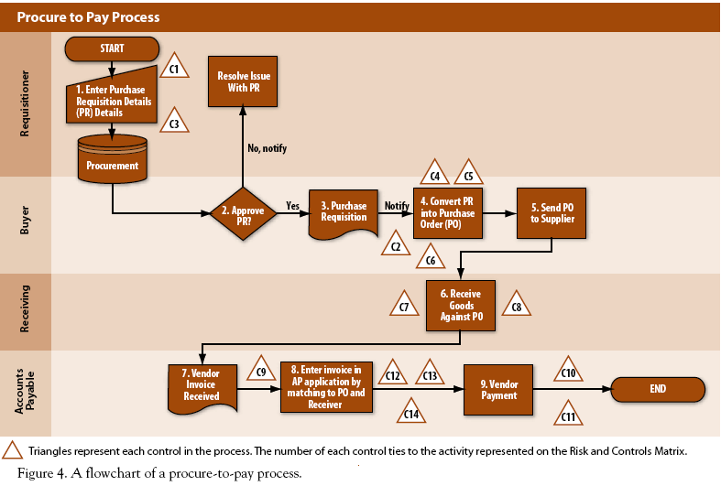
Flowchart-Documentation

Slide 19
Process Narrative-Documentation
1) Procurement
a) Requisitioning
i) When employees need to buy goods or services, they will create a purchase requisition in the procurement application (Control C1). Once the requisition has been created, the buyer will review the purchase requisition for the appropriateness, completeness, and accuracy. Components of the purchase requisition that are reviewed include, but are not limited to, the vendor, item, quantity, and account coding. If the review does not reveal any errors, the buyer will approve the purchase requisition. If the buyer rejects the purchase requisition for any reason, the requisitioner will be notified. Finally, if issues with the original requisition are resolved as required, the buyer will approve the requisition.

Slide 20
Risk and Control Matrix
What to include in a matrix:
Identified risks
Control Objectives
Control Attributes such as control type and frequency
Testing Information

Slide 21
Sources
Auditing Application Controls
Christine Bellino, Jefferson Wells & Steve Hunt; Enterprise Controls Consulting LP
www.theiia.org/download.cfm?file=21838
Information Technology Audits-Application Controls
Xenia, Ley, and Parker

