Slide 1
Particle Swarm Optimization (PSO) Technique and its Variant Binary PSO (BPSO) Presented by: Samia Abid Student: MS(CS)
Supervised by: Dr. Nadeem Javaid
Associate Professor, Department of Computer Science,
COMSATS Institute of Information
Technology, 44000, Islamabad, Pakistan.

Slide 2
Outline
Bio-inspired algorithms
Why bio-inspired techniques.
Taxonomy of bio-inspired techniques.
What is swarm intelligence?
Applications
What is Particle Swarm Optimization (PSO)?
How does it work?
PSO algorithm.
Algorithm example.
Characteristics.
BPSO
How does it work?
Energy optimization by BPSO.

Slide 3
Bio-inspired algorithms
Bio-inspired algorithms are search methods that simulate the natural biological evolution or the behaviour of biological entities [1].
Bio inspired algorithms has a wide range of applications covering all most all areas including:
Computer networks
Security
Robotics
Bio medical engineering
Control systems
Parallel processing
Data mining
Power systems
Production engineering and many more.
[1] Binitha, S., and S. Siva Sathya. "A survey of bio inspired optimization algorithms." International Journal of Soft Computing and Engineering 2, no. 2 (2012): 137-151.

Slide 4
Why Bio-inspired techniques?
Optimization is a commonly encountered mathematical problem in all engineering disciplines. It literally means finding the best possible/desirable solution [1].
Optimization problems are wide ranging and numerous.
Optimization algorithms:
Deterministic
Stochastic in nature
Former methods to solve optimization problems require enormous computational efforts, which tend to fail as the problem size increases.
This is the motivation for employing bio inspired stochastic optimization algorithms as computationally efficient alternatives to deterministic approach.
Notes:
Optimization is a commonly encountered mathematical problem in all engineering disciplines. It literally means finding the best possible/desirable solution.
Optimization problems are wide ranging and numerous, hence methods for solving these problems ought to be, an active research topic.
Optimization algorithms can be either deterministic or stochastic in nature. Former methods to solve optimization problems require enormous computational efforts, which tend to fail as the problem size increases.

Slide 5
Bio-inspired techniques
Bio-inspired techniques
Evolutionary
GA
GP
ES
DE
PFA
Swarm Intelligence
PSO
ACO
ABC
BFA
GSO
FA
SFLA
FSA
Ecological
BBO
AWC
PS2O
Taxonomy of Bio-inspired techniques

Slide 6
Swarm Intelligence (SI)
Algorithms inspired by the collective behavior of social insect colonies and other animal societies are called swarm intelligence algorithms .
The expression was introduced by Gerardo Beni and Jing Wang in 1989, in the context of cellular robotic systems [2].
SI systems are typically made up of a population of simple agents interacting locally with one another and with their environment.
Natural examples:
Ant colonies | Bird flocking | Animal herding
Bacteria growth | Fish schooling.
[2] Yang, Xin-She, Zhihua Cui, Renbin Xiao, Amir Hossein Gandomi, and Mehmet Karamanoglu, eds. Swarm intelligence and bio-inspired computation: theory and applications. Newnes, 2013.

Slide 7
SI Applications
U.S. Military is investigating swarm
techniques for controlling unmanned
vehicles.
Home energy management in
Smart grid.
NASA is investigating the use of
swarm technology for planetary
mapping.

Slide 8
PSO (1/2)
6
First described in 1995 [2].
By James Kennedy and Russel
C. Eberhert.
Inspired by social behavior of
birds and fishes.

Slide 9
PSO (2/2)
7
Combines self-experience with social experience.
Population-based optimization.
Find approximate solutions
of problems.
Easy to implement.
Few parameters to adjust.
[3] Pinto. “The Particle Swarm Optimization algorithm.interne:http://pa
ginas.fe.up.pt/~mac/ensino/docs/DS20102011/Presentations/
PopulationalMetaheuristics/PSO__AndryPinto_InesDomingues_LuisRocha
_HugoAlves_SusanaCruz.pptx,Jun. 27, 2013 [Jan. 31, 2017].

Slide 10
Concept (1/2)
Similarly to genetic algorithm (GA), it is a population-based method.
It represents the state of the algorithm by a population, which is iteratively modified until a termination criterion is satisfied.
Uses a number of particles that make a swarm moving around in the search space looking for the best solution
Each particle in search space adjusts its “flying” according to:
its own flying experience
the flying experience of other particles.

Slide 11
Concept (2/2)
In PSO, each single solution is a "bird" in the search space. We call it "particle".
All the particles have fitness values which are evaluated by the fitness function.
All particles have velocities, which direct the flying of the particles.
The particles fly through the problem space by following the current optimum particles.

Slide 12
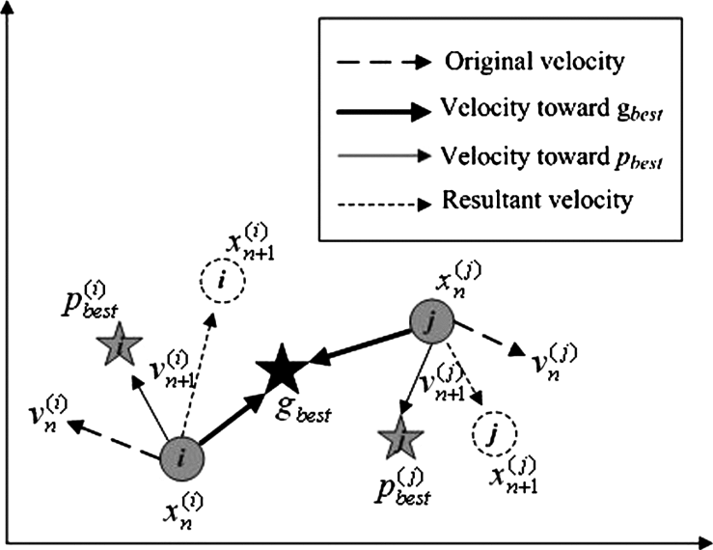
How does it Work? (1/2)
Initialized with a group of random particles [4].
Searches for optimal by updating generations.
Particles move through the solution space, and are evaluated according to some fitness criterion.
In every iteration, each particle is updated by following “best” values.
Pbest
Gbest
[4] Clerc, Maurice. Particle swarm optimization. Vol. 93. John Wiley & Sons, 2010.

Slide 13
How does it Work? (2/2)
Each particle tries to modify its current position and velocity according to the distance between its current position and Pbest, and the distance between its current position and gbest [3].
Update particles’ velocities:
Move particles to their new positions:
Vn+1 | Particle velocity at n+1th iteration | C1 | Acceleration factor related to gbest
C2 | Acceleration factor related to lbest | Rand1 | Random number between 0 and 1
gbest | gbest position of swarm | Pbest | Pbest position of swarm
Pn | Current position of particle

Slide 14
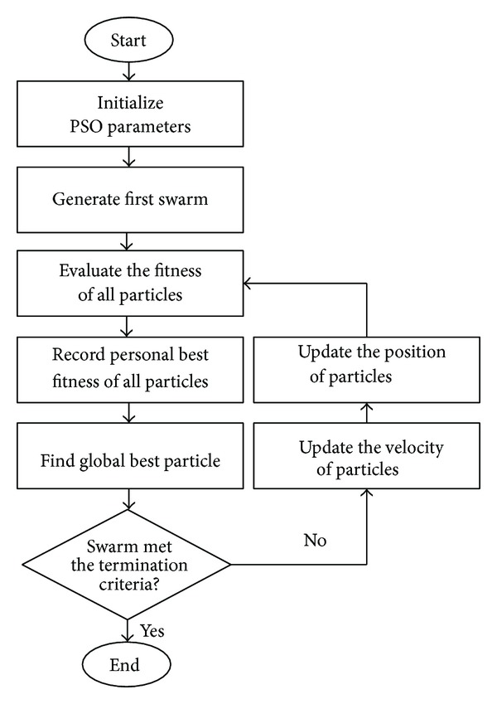
PSO-Algorithm
For each particle
Initialize particle with random number
End
DO
For each particle
Calculate the fitness value
If fitness values at time t is better than the its previous best fitness value (Pbest) at time (t-1)
Set current value as the new Pbest
END
Choose the particle with the best fitness value of all the particles as the gbest
For each particle
Update velocity
Update position
While maximum iterations not reached.

Slide 15
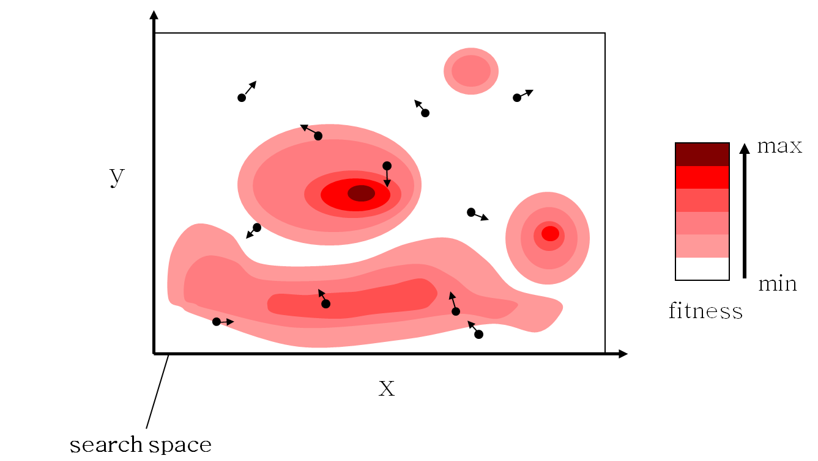
Algorithm-Example (1/8)

Slide 16
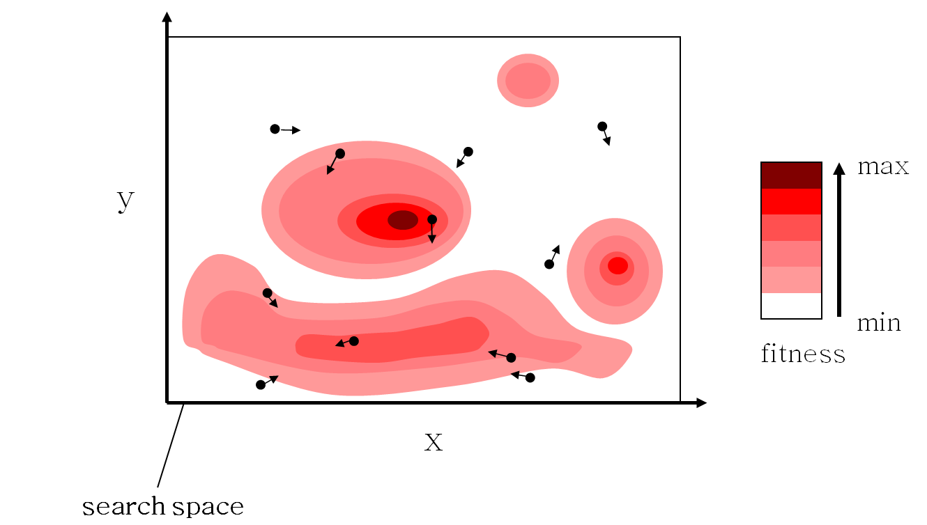
Algorithm-Example (2/8)

Slide 17
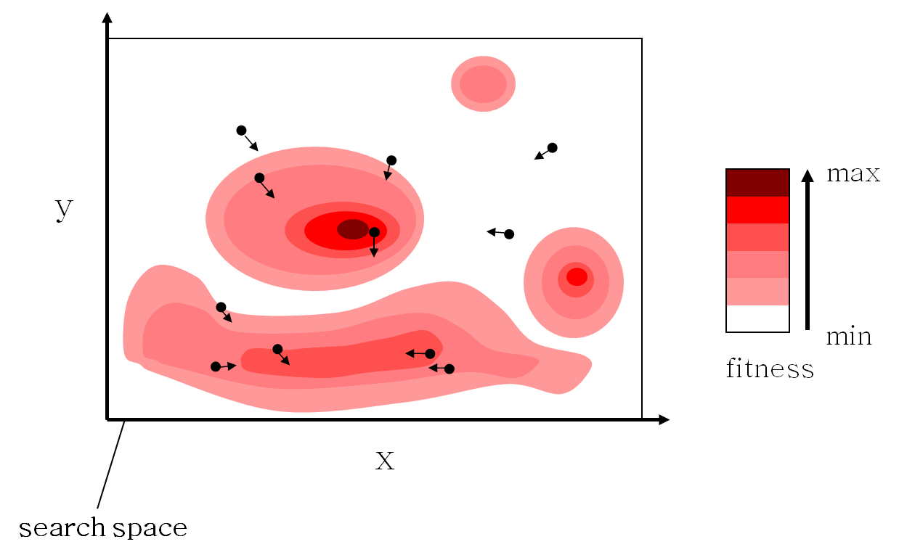
Algorithm-Example (3/8)

Slide 18
Algorithm-Example (4/8)

Slide 19
Algorithm-Example (5/8)

Slide 20
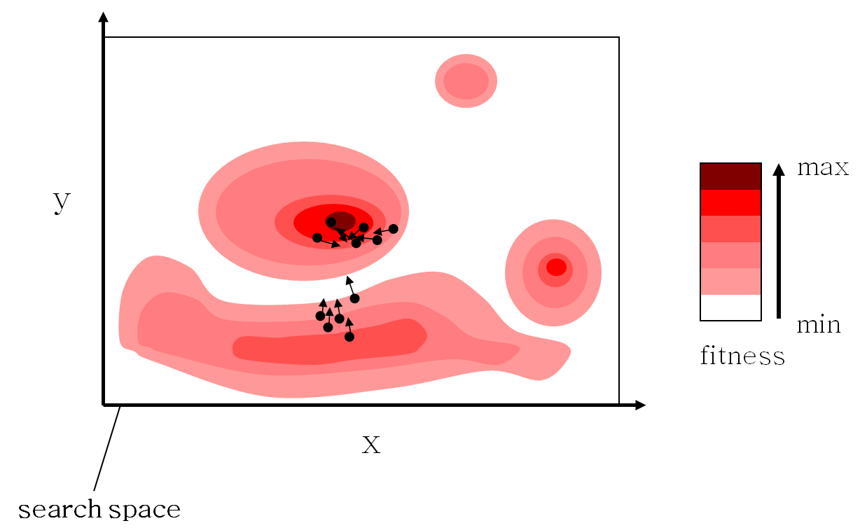
Algorithm-Example (6/8)

Slide 21
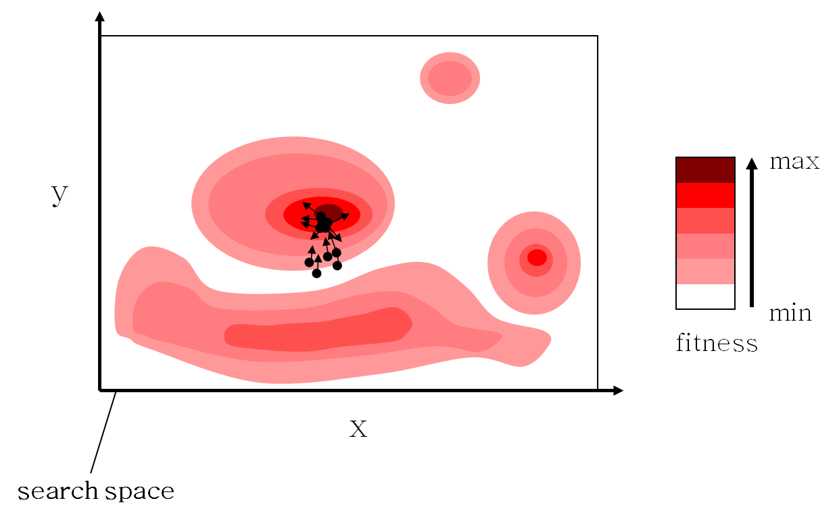
Algorithm-Example (7/8)

Slide 22
Algorithm-Example (8/8)

Slide 23
PSO Characteristics
Pros [5]
Simple implementation
Suitable for concurrent processing
Derivative free
Very few algorithm parameters
Very efficient global search algorithm
Cons [5]
Premature convergence in mid optimum points
Slow convergence in refined search stage (weak local search ability)
[5] Kumar, Ashok, Brajesh Kumar Singh, and B. D. K. Patro. "Particle Swarm Optimization: A Study of Variants and Their Applications." International Journal of Computer Applications 135, no. 5 (2016): 24-30.

Slide 24
BPSO
PSO is a conventional algorithm
Applicable for continuous problems.
However, it cannot be applied to discrete problems directly.
Aiming at the discrete problems, Kennedy and Eberhart extended the PSO to BPSO in 1997 [5]
It is a binary variant of PSO.

Slide 25
How does it work? (1/2)
In BPSO, population has a set of particles.
Each individual particle represents a binary decision.
This decision can be represented by either YES/TRUE=1 or NO/FALSE=0.
All particles represent their positions through binary values which are 0 or 1.
Velocity is restricted within the range {0,1}

Slide 26
How does it work? (2/2)
The velocity vector equation and position vector equation are defined as [5]:
velocity vector equation:
position vector equation:
r is the random number selected from a uniform distribution in [0, 1].

Slide 27
BPSO-Example 1 (1/4)
As an example, let’s say that we are dealing with a population of 5 bit binary particles and a population of 4 particles.
Particle 2
We are updating particle 2 (01011), bit 3(0)
1 | 0 | 1 | 0 | 1
0 | 1 | 0 | 1 | 1
1 | 1 | 1 | 0 | 0
0 | 1 | 1 | 0 | 1

Slide 28
BPSO-Example 1 (2/4)
Furthermore, we will assume that the current velocity of this bit to be a 1 is 0.25.
Furthermore, assume that the best value of this particle (to date) is 00100.
And the best value of the whole population (to date) is 01111.

Slide 29
BPSO-Example 1 (3/4)

Slide 30
BPSO-Example 1 (4/4)
Now, with the value for f, we generate a random number.
If the random number is less than f then bit x becomes a 1 otherwise, it becomes a 0.

Slide 31
Energy Optimization by BPSO (1/10) [6]
No of Homes | 1
No of Appliances | 13
Timeslots | 24 hours.
Appliances | Power Rating (kW/h) | Appliances | Power Rating (kW/h)
Lights | 0.6 | Coffee Maker (CM) | 0.8
Fans | 0.75 | Washing Machine (CM) | 0.78
Clothes Iron | 1.5 | Dish Washer (DW) | 3.60
Microwave Oven | 1.18 | Cloth Dryer (CD) | 4.40
Toaster | 0.5 | Air Conditioner (AC) | 1.44
Refrigerator | 0.73 | Water Heater (WH) | 4.45
Space Heater (SH) | 1.50
[6]. Rahim, Sahar, Nadeem Javaid, Ashfaq Ahmad, Shahid Ahmed Khan, Zahoor Ali Khan, Nabil Alrajeh, and Umar Qasim. "Exploiting heuristic algorithms to efficiently utilize energy management controllers with renewable energy sources." Energy and Buildings 129 (2016): 452-470.

Slide 32
Energy Optimization by BPSO (2/10)
Appliances
LOT cannot be modified
(Not Shiftable)
Lighting Fan, Iron, Microwave over, Toaster, Cofee maker
Shiftable
Washing machine, Dish washer, Clothes dryer
Elastic
Air conditioner, water heater, space heater
Fixed
Can be shifted without altering load profile.
(Uninterruptible)
Can be shifted to a suitable time
(Interruptible)

Slide 33
Energy Optimization by BPSO (3/10)
Parameters of shiftable appliances
Appliances | Start time | End time | Waiting time
Washing machine | 8 | 16 | 5
Dish washer | 7 | 12 | 5
Clothes dryer | 6 | 18 | 5
Parameters of elastic appliances
Appliances | Start time | End time
Air conditioner | 6 | 24
Water heater | 6 | 24
Space heater | 6 | 24

Slide 34
Energy Optimization by BPSO (4/10)
BPSO Parameters
Swarm size | 200
Vmax (maximum velocity) | 4 m/s
Vmin (minimum velocity) | -4 m/s
Max iterations | 600
C1 | 2
C2 | 2

Slide 35
Energy Optimization by BPSO (5/10)
Key terms corresponding to Smart grid optimization
PSO Parameters | Role in HEM | General use
Particle | A timeslot (One possible solution) | Possible solution in search area
swarm | Set of possible solutions | a set of particles
Dimension | Number of appliances | Search area
Fitness function | Designed objective function with constraints | Objective function
Position | Initialize vector for appliances states randomly. | Initialization point in search area
Velocity | Probability of the bit to be 1. (To turn on the appliance.) | Randomly generated
Particle best (Pbest) | Local best values for state array that satisfy objective function . | Evaluated fitness function answer
Global best (Gbest) | Globally best solution that satisfy all constraints (A timeslot) | Evaluated fitness function answer

Slide 36
Energy Optimization by BPSO (6/10)
Step1:
Initialize Particles with random number (randomly generate population)
Set initial position of particles as Pbest.
Code to randomly generate population
for j=1:swarm
for i=1:n
if rand(1)>0.5
X=1;
else
X=0;
end
x1(j,i)=X;
end
end
WM | DW | CD | AC | WH | SP
0 | 1 | 1 | 1 | 1 | 1
1 | 1 | 1 | 0 | 0 | 0
0 | 1 | 1 | 1 | 0 | 0
: : :
0 | 0 | 1 | 0 | 0 | 1

Slide 37
Energy Optimization by BPSO (7/10)
Step 2:
For Each Particle
Calculate the fitness
Fitness Function:
function [FF]=obj(electricity_cost,
power rating,x1,swarm,d)
for i=1:swarm
FF(i,1)=electricity_cost*x1(i,:)';
err=c_electricity_cost*x1(i,:)'-d;
FF(i,1)=FF(i,1)+1000*abs(err);
end
WM | DW | CD | AC |  | WH |  | SP | Fitness
0 | 0 | 1 | 1 |  | 0 |  | 1 | 2.4894
0 | 1 | 1 | 0 |  | 1 |  | 0 | 2.4916
0 | 1 | 1 | 1 |  | 0 |  | 0 | 2.4956
: : :
0 | 1 | 0 |  | 1 |  | 1 | 0 | 2.4888

Slide 38
Energy Optimization by BPSO (8/10)
Step 3:
Choose the Timeslot (solution) with the best fitness value among all possible solutions as the gbest.
0 | 1 | 0 | 1 | 1 | 0
WM | DW | CD | AC |  | WH |  | SP | Fitness
0 | 0 | 1 | 1 |  | 0 |  | 1 | 2.4894
0 | 1 | 1 | 0 |  | 1 |  | 0 | 2.4916
0 | 1 | 1 | 1 |  | 0 |  | 0 | 2.4956
: : :
0 | 1 | 0 |  | 1 |  | 1 | 0 | 2.4888
Gbest solution

Slide 39
Energy Optimization by BPSO (9/10)
Step 4:
For each Particle
Update its velocity.
Update its position.
Step 5:
While maximum iterations not reached.
Note: Repeat this process 24 times to get the most optimal solution for each timeslot.

Slide 40
Energy Optimization by BPSO (10/10)
MATLAB CODE:
for i = 1:swarm
for j = 1:n
v(i,j) = v(i,j)+c1*rand(1)*(pbest(i,j)-x_BP(i,j))+c2*rand(1)*(gbestt_BP(1,j)-x_BP(i,j));
if ( (v(i,j) <= vmax) && (v(i,j)>=vmin) )
v(i,j) = v(i,j);
elseif ( v(i,j) < vmin )
v(i,j) = vmin;
elseif ( v(i,j) > vmax )
v(i,j) = vmax;
end
sig(i,j) = 1/(1+exp(-v(i,j)));
if rand(1) < sig(i,j)
x_BP(i,j) = 1;
else
x_BP(i,j) = 0;
end
end
end
This shows the velocity of the particle should stay in a limit
Apply sigmoidal function on the velocity

Slide 41
Any questions?

