Slide 1

Privacy by Design
2014-04-24

Slide 2

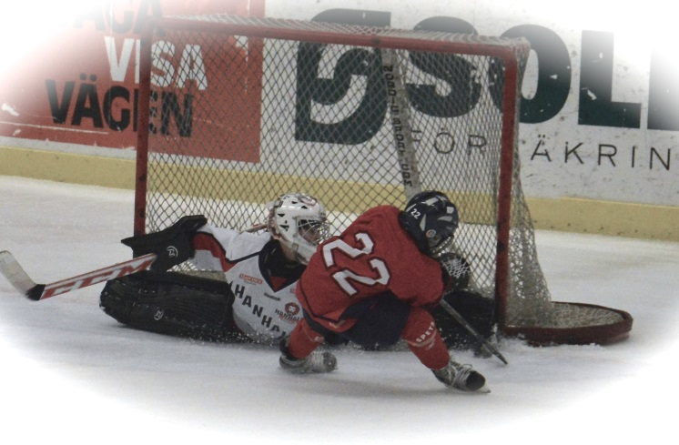
Jan Wellergård
Personal Data Representative (sv. Personuppgiftsombud / Data Protection Officer for TeliaSonera’s Swedish entities (2005)
Security Director for IT Support System in Group Technology
Board Member of Forum för Dataskydd
Security Consultant (97-00)
  Telia.se

Slide 3
Agenda
Putting Privacy by Design into context
Walk-through of the 7 principles of Privacy by Design
  Relate to law/regulation
  Some lessons learned
Q&A

Slide 4
Impact of failing to protect Personal Data
Survey done by Askus and Handelshögskolan looking at the reaction from shareholders, customers and the public to certain practises seen as ethical or unethical. They also measured the effect of mitigating actions
  10.000 answers
  Result was a risk index from -100 to +100 showing the potential effect for reputation
Child labour gave a risk index of:
  Positive communication (PR) increase of 17
  Concrete action (on site), increase of 29
Resell or transfer of customer data gave a risk index of:
  Positive communication (PR), no increase
  Concrete actions, no increase
  Consent, increase of 28
-70
-68
http://www.aftonbladet.se/debatt/article17642749.ab
http://www.crossnet.se/iva/20131119NR_1500/index.html
Notes:
Showed a significant difference of views between senior management and public

Slide 5

What does this mean?
Reduce the risk and impact of failing to protect data
  Minimize the volume of data
    don’t process data not needed
    remove unneeded data
  Make processing secure
    Implementing “adequate” security measures
    Don’t forget manual processes
Put the user in the drivers seat
  Let user feel that he/she is in control of its personal data
  Inform the user
This needs to be considered throughout the system lifecycle, starting from the business case, via acquisition / development, go-live (start collection of data), change management and decommission.
=> Privacy By Design

Slide 6
Current laws
Data Protection Directive 95/46/EC
  Personuppgiftslagen (PuL) (SFS 1998:204)
  Lov om behandling av personopplysninger
  Personuppgiftslag (22.4.1999/523)
  Etc.
Directive on Privacy and Electronic Communication (2002/58/EC)
Data Retention Directive (2006/24/EC)
Telecoms Package and Cookie directive 2009/136/EC
Freedom of Information (“Offentlighetsprincipen”)
Specific laws on certain registers or processing
In order to comply, one needs a systematic approach throughout the system lifecycle.
=> Privacy By Design

Slide 7

Some terms used in Data Protection
Processing (of personal data) – All actions made on data (collecting, updating, disclosing, deletion)
Subject – A registered person
Controller - The legal entity responsible for the processing
Processor – The legal entity processing data on behalf of the Controller (outsourcing partner)

Slide 8
8 Principles (UK–act)
Personal data shall be processed fairly and lawfully and, in particular, shall not be processed unless
  have legitimate grounds
  have no adverse effects
  being transparent of what you are to do with the data
Personal data shall be obtained only for one or more specified and lawful purposes, and shall not be further processed in any manner incompatible with that purpose or those purposes.
Personal data shall be adequate, relevant and not excessive in relation to the purpose or purposes for which they are processed.
Personal data shall be accurate and, where necessary, kept up to date.
Personal data processed for any purpose or purposes shall not be kept for longer than is necessary for that purpose or those purposes.
Personal data shall be processed in accordance with the rights of data subjects under this Act.
Appropriate technical and organisational measures shall be taken against unauthorised or unlawful processing of personal data and against accidental loss or destruction of, or damage to, personal data.
Personal data shall not be transferred to a country or territory outside the European Economic Area unless that country or territory ensures an adequate level of protection for the rights and freedoms of data subjects in relation to the processing of personal data.

Slide 9

7 Foundational Principles
PbD
Ann Cavoukian, Ph.D - Information & Privacy
Commissioner Ontario, Canada
http://www.privacybydesign.ca
1. Proactive not Reactive; Preventative not Remedial.
2. Privacy as the Default Setting
3. Privacy Embedded into Design
4. Full Functionality — Positive-Sum, not Zero-Sum
5. End-to-End Security — Full Lifecycle Protection
6. Visibility and Transparency — Keep it Open
7. Respect for User Privacy — Keep it User-Centric

Slide 10
1. Proactive not Reactive; Preventative not Remedial
Clear boundaries
  Privacy Policy (what is our view of Privacy?)
  Legal/Regulatory requirements
  Best practices (look at other EU/EES countries)
Privacy Impact Assessment (PIA)
  GDPR (Data protection impact assessment) on PIAs
  Regulation from PTS
Notes:
More on PIAs
Putting the risk of the subject in focus not the risks of the company
Detailed information mapping
What data is to be processed, How will data be collected, How will it be processed?
Flow of data? Disclosures?
Security and quality measures in place?
Relevant legislation (legal requirements) and internal policies
Assess risks, decide, monitor
Integrate PIA with “normal” Risk Management in projects / maintenance

Slide 11

2. Privacy as the Default Setting
Users get the maximum privacy at start, no configuration needed
  Default rules! (People are lazy ; Complicated to set the correct parameters)
  Users ”opt-in” to share data or to allow processing of data
  Conflict of the business benefit of processing data and privacy (marketing etc)

Slide 12
3. Privacy Embedded into Design
Minimize the personal data used
  Use other, less sensitive data (if possible), aggregate-delete
  Avoid sensitive data such as personal number/SSN
Cater for Subject Access Requests
Metadata (browser fingerprints)
  Can be more sensitive than content
  Loss of metadata (when can we delete, obsolete data)
User customization how personal data is used
Use defined values instead of free-text fields (avoiding less appropriate data to be entered, and quality issues).
How do we inform the customer and how do we get consent?

Slide 13

4. Full Functionality — Positive-Sum, not Zero-Sum
By being more creative, one can find measures to reduce the privacy risks
  Functional/system domains
  Go strictly for the objective
    Automated License Plate Recognition
Examples of risks
  Metadata like Audit logs (dual use)
  Systems are by default very
  capable (risk of misuse)
Notes:
We don’t choose between functionality or Privacy ; Security or Privacy
Metadata like Audit logs (dual use)
+ Prohibits misuse of data of the subject, monitoring of the system
- Tracks the employees (performance measurement)

Slide 14

5. End-to-End Security — Full Lifecycle Protection
Strong access management procedures
  Only grant access to those who need – review
  Tailor Access Control profiles to the tasks of the user
Encryption in transit and at rest
Purge/Culling/Deletion of personal data
  Clear understanding of the purpose of the system
  Removal/Deletion/Archiving
    Deletion vs. Anonymization
    Using PII as keys (like customer ID) in the DB
    How much data do we need to remove?
Having control over changes (scope creep)
Notes:
Always base the security on a risk assessment and/or PIA
Look at local guidance of your Data Protection Authority

Slide 15





6. Visibility and Transparency — Keep it Open
Publish (or be open) with PIAs
Openness on what we do with the data (Privacy Policy, www.telia.se/sakerhet - Plain English
  What data to we have, what do we do with it, etc?
  Legal requirement!
Independent Audits & Certifications

Slide 16

7. Respect for User Privacy — Keep it User-Centric
  Connect with usability. The system is usable when the user gets control over its personal data.
    User friendly options
    Good oversight
      Google Dashboard https://www.google.com/settings/datatools
      Yahoo! Privacy Centre
  Automate Subject Request Access
    Facebook Archive Dump
    Google
  Federated user management (sharing data with other application)
    Facebook Apps
  Risk of “Consent fatigue”

Slide 17

Questions?

Slide 18
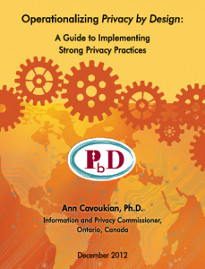

More reading
http://www.privacybydesign.ca/content/uploads/2013/01/operationalizing-pbd-guide.pdf
http://www.datainspektionen.se/lagar-och-regler/personuppgiftslagen/inbyggd-integritet-privacy-by-design/

Slide 19
Links if you have a lot of time on your hands
http://ico.org.uk/for_organisations/data_protection/topic_guides/privacy_by_design
http://www.iva.se/press/Aktuellt/Hog-moral-kan-bli-svensk-konkurrensfordel/
http://www.slideshare.net/IVA1919/reputational-risks#
http://cyberlaw.stanford.edu/wiki/index.php/PET

Slide 20



Contact
Visit us on www.dpforum.se or e-mail info@dpforum.se
Forum för dataskydd is also present on;
DPForumSwe
Forum för Dataskydd
jan_wellergard
http://www.linkedin.com/in/jankw

