Slide 1
Social Network Analysis
Eytan Adar
590AI
Some content from Lada Adamic

Slide 2
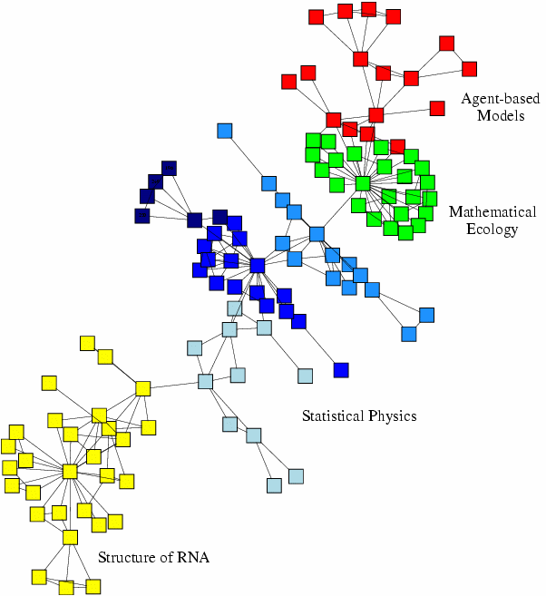

Slide 3
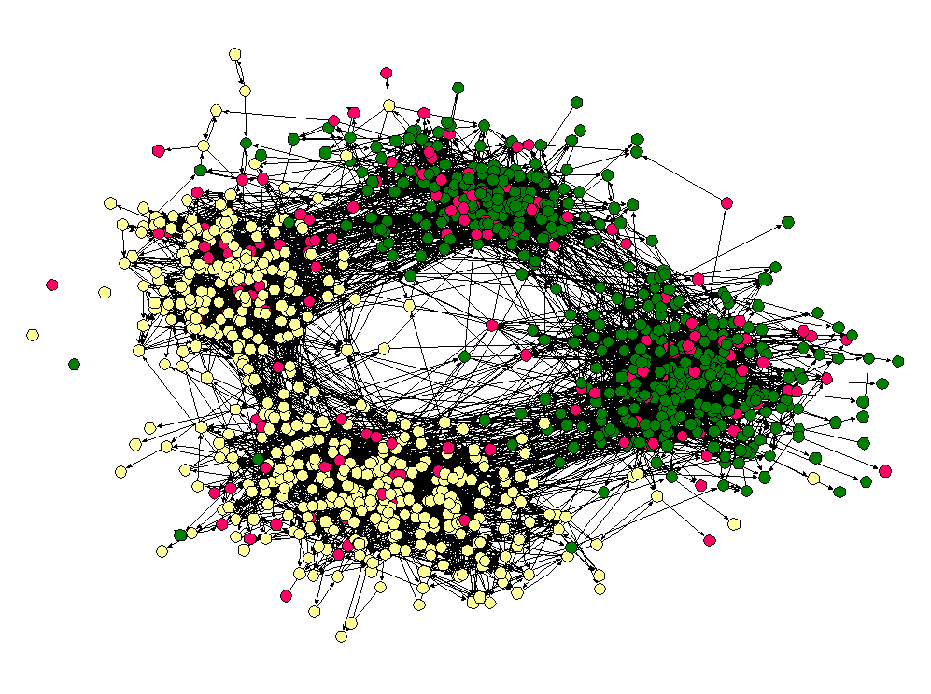

Slide 4
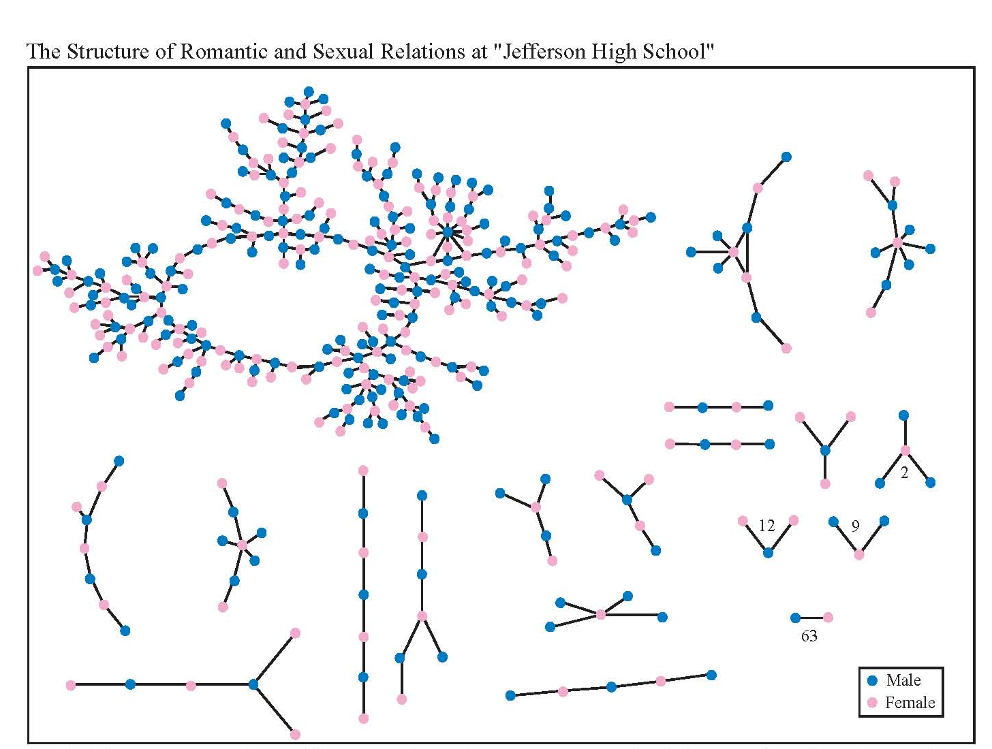

Slide 5
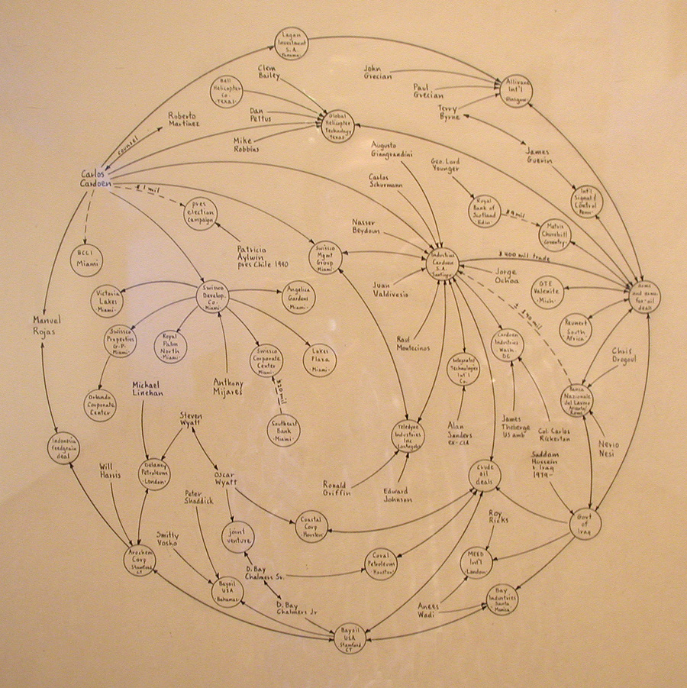

Slide 6
Vocabulary Lesson
Relational Tie
Actor
parentOf
supervisorOf
reallyHates (+/-)
…
Person
Group
Event
…
Dyad
Relation: collection of ties of a specific type (every parentOf tie)

Slide 7
Vocabulary Lesson
If A likes B and B likes C then A likes C (transitivity)
If A likes B and C likes B then A likes C
…
Triad

Slide 8
Vocabulary Lesson
Social Network
One mode

Slide 9
Vocabulary Lesson
Social Network
Two mode

Slide 10
Vocabulary Lesson
Ego-Centered Network
ego
(egonet)

Slide 11
Describing Networks
Graph theoretic
  Nodes/edges, what you’d expect
Sociometric
  Sociomatrix (2D matrix representation)
  Sociogram (the adjacency matrix)
Algebraic
  n_{i} → n_{j}
  Also what you’d expect
Basically complimentary

Slide 12
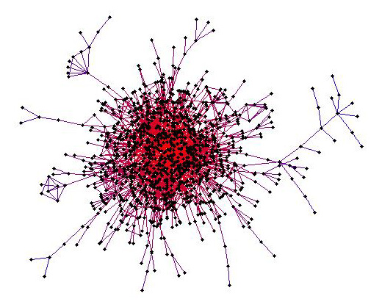
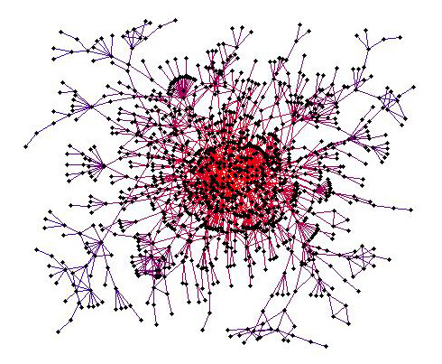
Describing Networks
MIT
Stanford

Slide 13
Describing Networks
Geodesic
  shortest_path(n,m)
Diameter
  max(geodesic(n,m)) n,m actors in graph
Density
  Number of existing edges / All possible edges
Degree distribution

Slide 14
Types of Networks/Models
A few quick examples
  Erdős–Rényi
    G(n,M): randomly draw M edges between n nodes
    Does not really model the real world
      Average connectivity on nodes conserved

Slide 15
Types of Networks/Models
A few quick examples
  Erdős–Rényi
  Small World
    Watts-Strogatz
    Kleinberg lattice model

Slide 16
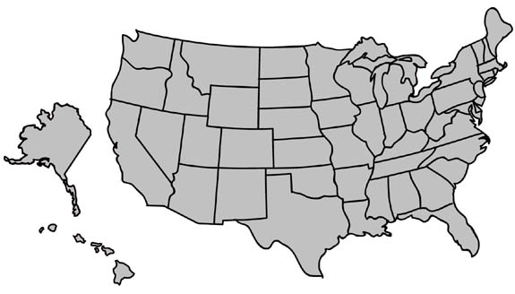
Small world experiments then
MA
NE
Milgram’s experiment (1960’s):
Given a target individual and a particular property, pass the message to a person you correspond with who is “closest” to the target.

Slide 17
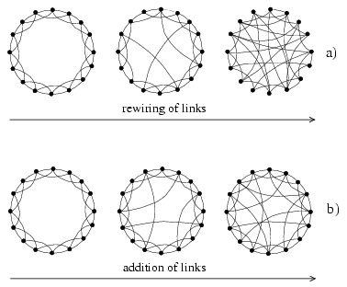
Watts-Strogatz Ring Lattice Rewiring
Select a fraction p of edges
Reposition on of their endpoints
Add a fraction p of additional edges leaving underlying lattice intact
As in many network generating algorithms
  Disallow self-edges
  Disallow multiple edges

Slide 18
Geographical search
MA
NE

Slide 19
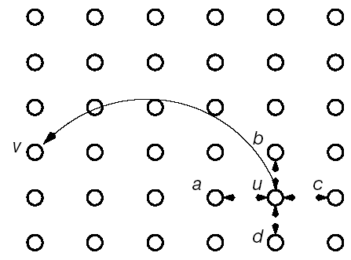
Kleinberg Lattice Model
nodes are placed on a lattice and
connect to nearest neighbors
additional links placed with p_{uv} ~
Kleinberg, ‘The Small World Phenomenon, An Algorithmic Perspective’
(Nature 2000)

Slide 21
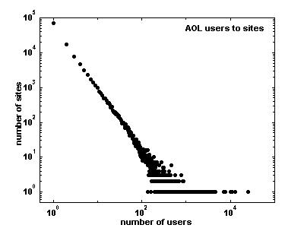
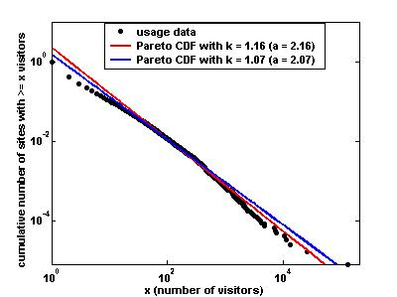
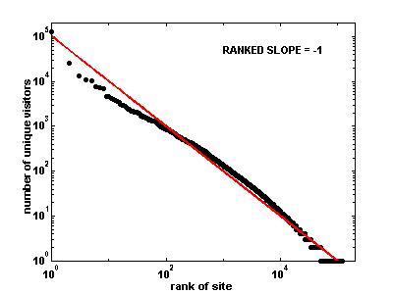
A little more on degree distribution
Power-laws, zipf, etc.
Distribution of users among web sites
CDF of users to sites
Sites ranked by popularity

Slide 22
A little more on degree distribution
Pareto/Power-law
  Pareto: CDF P[X > x] ~ x^{-k}
  Power-law: PDF P[X = x] ~ x^{-(k+1)} = x^{-a}
  Some recent debate (Aaron Clauset)
    http://arxiv.org/abs/0706.1062
Zipf
  Frequency versus rank y ~ r^{-b} (small b)
More info:
  Zipf, Power-laws, and Pareto – a ranking tutorial (http://www.hpl.hp.com/research/idl/papers/ranking/ranking.html)

Slide 23
Types of Networks/Models
A few quick examples
  Erdős–Rényi
  Small World
    Watts-Strogatz
    Kleinberg lattice model
  Preferential Attachment
    Generally attributed to Barabási & Albert

Slide 24
Basic BA-model
Very simple algorithm to implement
  start with an initial set of m₀ fully connected nodes
    e.g. m₀ = 3
  now add new vertices one by one, each one with exactly m edges
  each new edge connects to an existing vertex in proportion to the number of edges that vertex already has → preferential attachment

Slide 25
Properties of the BA graph
The distribution is scale free with exponent α = 3 P(k) = 2 m²/k³
The graph is connected
  Every new vertex is born with a link or several links (depending on whether m = 1 or m > 1)
  It then connects to an ‘older’ vertex, which itself connected to another vertex when it was introduced
  And we started from a connected core
The older are richer
  Nodes accumulate links as time goes on, which gives older nodes an advantage since newer nodes are going to attach preferentially – and older nodes have a higher degree to tempt them with than some new kid on the block

Slide 26
Common Tasks
Measuring “importance”
  Centrality, prestige
Link prediction
Diffusion modeling
  Epidemiological
Clustering
  Blockmodeling, Girvan-Newman
Structure analysis
  Motifs, Isomorphisms, etc.
Visualization/Privacy/etc.

Slide 27
Data Collection / Cleaning
Analysis

Slide 28
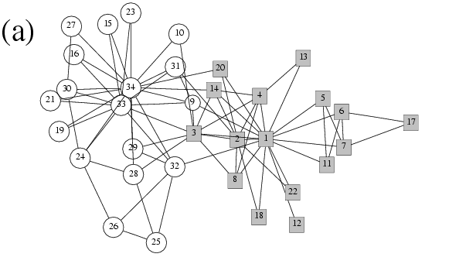
Past

Slide 29
Data Collection / Cleaning
Small datasets
Pretty explicit connections
Analysis
Understand the properties
Past

Slide 30
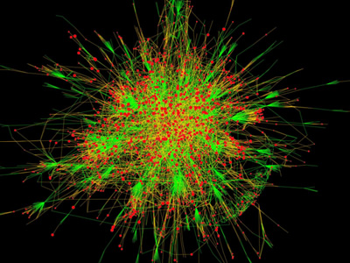
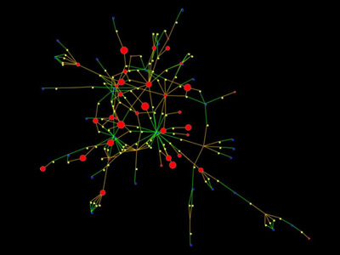
Present

Slide 31
Data Collection / Cleaning
Large datasets
Entity resolution
Implicit connections
Analysis
Understand the properties
Present

Slide 32
Common Tasks
Measuring “importance”
  Centrality, prestige (incoming links)
Link prediction
Diffusion modeling
  Epidemiological
Clustering
  Blockmodeling, Girvan-Newman
Structure analysis
  Motifs, Isomorphisms, etc.
Visualization/Privacy/etc.

Slide 33
Centrality Measures
Degree centrality
  Edges per node (the more, the more important the node)
Closeness centrality
  How close the node is to every other node
Betweenness centrality
  How many shortest paths go through the edge node (communication metaphor)
Information centrality
  All paths to other nodes weighted by path length
Bibliometric + Internet style
  PageRank

Slide 34
Tie Strength
Strength of Weak Ties (Granovetter)
  Granovetter: How often did you see the contact that helped you find the job prior to the job search
    16.7 % often (at least once a week)
    55.6% occasionally (more than once a year but less than twice a week)
    27.8% rarely – once a year or less
  Weak ties will tend to have different information than we and our close contacts do
weak ties will tend to have high
beweenness and low transitivity

Slide 35
Common Tasks
Measuring “importance”
  Centrality, prestige (incoming links)
Link prediction
Diffusion modeling
  Epidemiological
Clustering
  Blockmodeling, Girvan-Newman
Structure analysis
  Motifs, Isomorphisms, etc.
Visualization/Privacy/etc.

Slide 36
Link Prediction
?

Slide 37
Link Prediction in Social Net Data
We know things about structure
  Homophily = like likes like or bird of a feather flock together or similar people group together
  Mutuality
  Triad closure
Various measures that try to use this

Slide 38
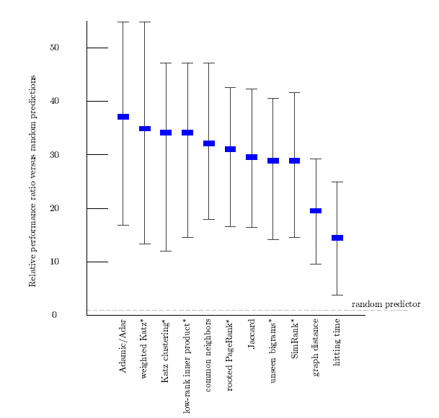
Link Prediction
Simple metrics
  Only take into account graph properties
Γ(x) = neighbors of x
Originally: 1 / log(frequency(z))
Liben-Nowell, Kleinberg (CIKM’03)

Slide 39
Link Prediction
Simple metrics
  Only take into account graph properties
Paths of length l (generally 1) from x to y
weighted variant is the number of times the two collaborated
Liben-Nowell, Kleinberg (CIKM’03)

Slide 40
Link Prediction in Relational Data
We know things about structure
  Homophily = like likes like or bird of a feather flock together or similar people group together
  Mutuality
  Triad closure
Slightly more interesting problem if we have relational data on actors and ties
  Move beyond structure

Slide 41
Relationship & Link Prediction
advisorOf?
Employee /contractor
Salary
Time at company
…

Slide 42
Link/Label Prediction in Relational Data
Koller and co.
  Relational Bayesian Networks
  Relational Markov Networks
    Structure (subgraph templates/cliques)
      Similar context
      Transitivity
Getoor and co.
  Relationship Identification for Social Network Discovery
    Diehl/Namata/Getoor AAAI’07
  Enron data
    Traffic statistics and content to find supervisory relationships?
  Traffic/Text based
  Not really identification, more like ranking

Slide 43
Common Tasks
Measuring “importance”
  Centrality, prestige (incoming links)
Link prediction
Diffusion modeling
  Epidemiological
Clustering
  Blockmodeling, Girvan-Newman
Structure analysis
  Motifs, Isomorphisms, etc.
Visualization/Privacy/etc.

Slide 44
Epidemiological
Viruses
  Biological, computational
  STDs, needle sharing, etc.
  Mark Handcock at UW
Blog networks
  Applying SIR models (Info Diffusion Through Blogspace, Gruhl et al.)
    Induce transmission graph, cascade models, simulation
  Link prediction (Tracking Information Epidemics in Blogspace, Adar et al.)
    Find repeated “likely” infections
  Outbreak detection (Cost-effective Outbreak Detection in Networks, Leskovec et al.)
    Submodularity

Slide 45
Common Tasks
Measuring “importance”
  Centrality, prestige (incoming links)
Link prediction
Diffusion modeling
  Epidemiological
Clustering
  Blockmodeling, Girvan-Newman
Structure analysis
  Motifs, Isomorphisms, etc.
Visualization/Privacy/etc.

Slide 46
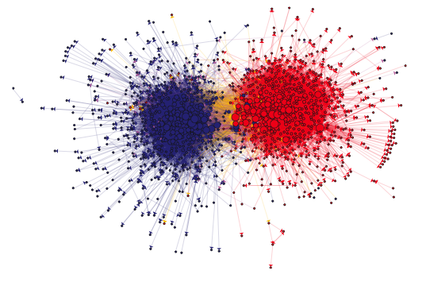

Slide 47
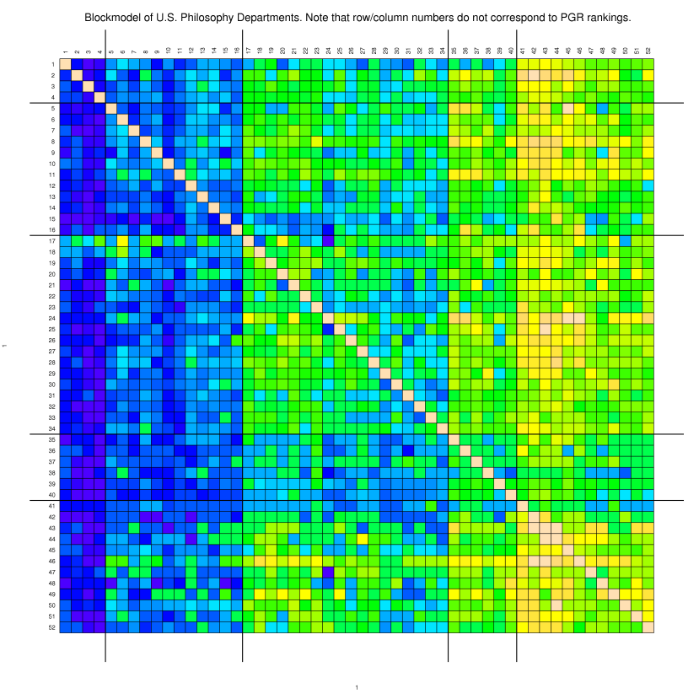

Slide 49
Blockmodels
Actors are portioned into positions
  Rearrange rows/columns
The sociomatrix is then reduced to a smaller image
Hierarchical clustering
  Various distance metrics
    Euclidean, CONvergence of CORrelation (CONCOR)
Various “fit” metrics

Slide 51
Girvan-Newman Algorithm
Split on shortest paths (“weak ties”)
Calculate betweenness on all edges
Remove highest betweenness edge
Recalculate
Goto 1

Slide 52
Other solutions
Min-cut based
“Voltage” based
Hierarchical schemes

Slide 53
Common Tasks
Measuring “importance”
  Centrality, prestige (incoming links)
Link prediction
Diffusion modeling
  Epidemiological
Clustering
  Blockmodeling, Girvan-Newman
Structure analysis
  Motifs, Isomorphisms, etc.
Visualization/Privacy/etc.

Slide 55
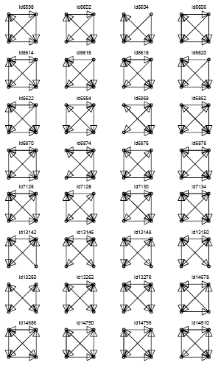

Slide 56
Network motif detection
How many more motifs of a certain type exist over a random network
Started in biological networks
  http://www.weizmann.ac.il/mcb/UriAlon/

Slide 57
Basic idea
construct many random graphs with the same number of nodes and edges (same node degree distribution?)
count the number of motifs in those graphs
calculate the Z score: the probability that the given number of motifs in the real world network could have occurred by chance

Slide 59
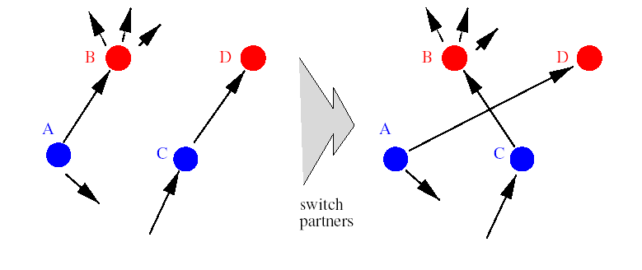
Generating random graphs
Many models don’t preserve the desired features
Have to be careful how we generate

Slide 60
Other Structural Analysis
sisterOf
daughterOf
nieceOf
Find all

Slide 61
Common Tasks
Measuring “importance”
  Centrality, prestige (incoming links)
Link prediction
Diffusion modeling
  Epidemiological
Clustering
  Blockmodeling, Girvan-Newman
Structure analysis
  Motifs, Isomorphisms, etc.
Visualization/Privacy/etc.

Slide 62
Privacy
Emerging interest in anonymizing networks
  Lars Backstrom (WWW’07) demonstrated one of the first attacks
How to remove labels while preserving graph properties?
  While ensuring that labels cannot be reapplied

Slide 63
Network attacks
Terrorist networks
  How to attack them
  How they might attack us
Carley at CMU

Slide 64
Software
Pajek
  http://vlado.fmf.uni-lj.si/pub/networks/pajek/
UCINET
  http://www.analytictech.com/
KrackPlot
  http://www.andrew.cmu.edu/user/krack/krackplot.shtml
GUESS
  http://www.graphexploration.org
Etc.

Slide 65
Books/Journals/Conferences
Social Networks/Phs. Rev
Social Network Analysis (Wasserman + Faust)
The Development of Social Network Analysis (Freeman)
Linked (Barabsi)
Six Degrees (Watts)
Sunbelt/ICWSM/KDD/CIKM/NIPS

Slide 66
Questions?

Slide 67
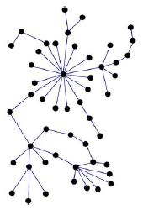
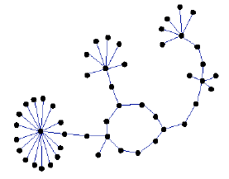
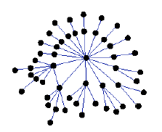
Assortativity
Social networks are assortative:
  the gregarious people associate with other gregarious people
  the loners associate with other loners
The Internet is disassorative:
Disassortative:
hubs are in the periphery
Assortative:
hubs connect to hubs
Random

