Slide 1
Data Management
Module 1
Introduction

Slide 2

Topics
What is data management?
Why is data management important?
What is the data life cycle?

Slide 3
Learning Objectives
After completing this lesson, the participant will be able to:
  Define data management
  Describe the importance of data management
  Describe the benefits of good data management
  Describe the costs of poor data management
  Identify Federal policies governing data management
  Identify components of the data life cycle

Slide 4
Data management – what is it?
Data management is a broad catch-all term used by different people in different contexts. It can be used to describe a variety of activities such as:
  Data storage,
  Data curation,
  Data preservation,
  Database design,
  Data modeling and more
Sometimes it can be used to refer to data management policy and sometimes to the practice of data management.
Slide credit: Australian National Data Service
Notes:
3

Slide 5

Data management for the researcher
All those activities which a researcher can undertake
  to organize and manage their data
  to facilitate their own research, and
  to provide a foundation for the
  longer-term sustainability of the data
Slide credit: Australian National Data Service
Notes:
4

Slide 6
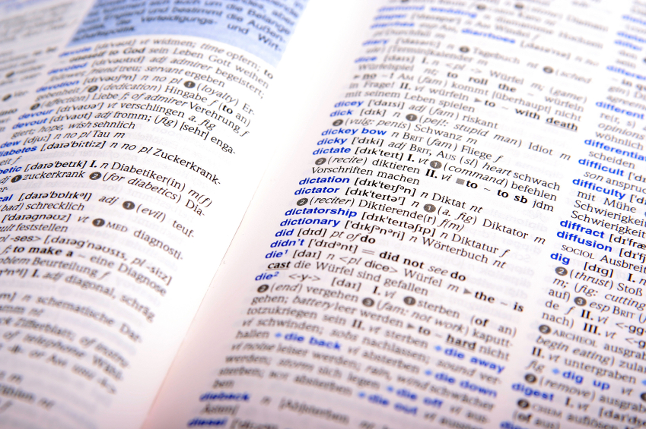

Data management defined
“The business function that develops and executes plans, policies, practices and projects that acquire, control, protect, deliver and enhance the value of data and information.”
Source: DAMA Dictionary of Data Management, 1st Ed.

Slide 7
Why is Data Management Important?
Expands value of data from original purpose
Allows discovery and integration of data
Avoids duplication of effort
Increases visibility in scientific/public arena
Allows new science collaborations
Allows rapid response to unexpected events
Assists in historical & long-term analyses
Avoids costs associated with poor data management

Slide 8
Benefits of Good Data Management Practices
Short-term
Spend less time doing data management and more time doing research
Easier to prepare and use data for yourself
Collaborators can readily understand and use data files
Long-term (data publication)
Scientists outside your project can find, understand, and use your data to address broad questions
You get credit for archived data products and their use in other papers
Sponsors protect their investment
Slide credit: Bob Cook,
Oak Ridge National Laboratory
Notes:
From Module 6, Best Practices for Preserving Data

Slide 9

Costs of Poor Data Management
According to Larry English, poor data quality can cost companies 15% to 25% of their operating budget
What would a 15% cost reduction be worth to the USGS?
Slide modified from Tom Chatfield, BLM
Notes:
Cost of Bad Data
Larry P. English is the president and principal of Information Impact International, Inc. He is an internationally recognized speaker, teacher, consultant, and author in information and knowledge management, and information quality improvement. He has provided consulting and education in more than 30 countries on five continents. Larry was featured as one of the "21 Voices for the 21st Century" in Quality Progress. DAMA awarded him the 1998 “Individual Achievement Award” for his contributions to the field of information resource management. He has chaired 19 Information Quality Conferences in the US and Europe and is a co-founder of the International Association for Information and Data Quality (IAIDQ).
These figures are based upon surveys conducted by his organization to various industries and commercial organizations.

Slide 10
Poor Data Management Makes Headlines
“MEDICARE PAYMENT ERRORS NEAR $20B”
(USA Today, December 2004)
“AUDIT: JUSTICE STATS ON ANTI-TERROR CASES FLAWED” (Associated Press, February 2007)
“OOPS! TECH ERROR WIPES OUT ALASKA INFO” (Associated Press, March 2007)
Slide credit: Tom Chatfield, BLM
Notes:
Data Costs
Certainly the Department of Interior has its own examples of news items involving data credibility but consider some of these recent headlines affecting agencies and organizations. Data quality is not limited to any one organization. These examples show costs (in terms of money lost) due to a lack of data quality control.
“MEDICARE PAYMENT ERRORS NEAR $20B” (CNN) December 2004
Miscoding and Billing Errors from Doctors and Hospitals totaled $20,000,000,000 in FY 2003 (9.3% error rate) . The error rate measured claims that were paid despite being medically unnecessary, inadequately documented or improperly coded. In some instances, Medicare asked health care providers for medical records to back up their claims and got no response. The survey did not document instances of alleged fraud. This error rate actually was an improvement over the previous fiscal year (9.8% error rate).
“AUDIT: JUSTICE STATS ON ANTI-TERROR CASES FLAWED” (AP) February 2007)
The Justice Department Inspector General found only two sets of data out of 26 concerning terrorism attacks were accurate. The Justice Department uses these statistics to argue for their budget. The Inspector General said the data “appear to be the result of decentralized and haphazard methods of collections … and do not appear to be intentional.”
“OOPS! TECH ERROR WIPES OUT Alaska Info” (AP) March 2007
A technician managed to delete the data and backup for the $38 billion Alaska oil revenue fund – money received by residents of the State. Correcting the errors cost the State an additional $220,700 (which of course was taken off the receipts to Alaska residents.)

Slide 11

Case Study 1
In May 2006, a VA employee was blamed for the theft of 26.5 million Social Security numbers after he took home sensitive data and his home was burglarized.
The VA sent letters to every living veteran and some of their spouses with the bad news.
The stolen data included names, Social Security numbers, dates of birth and numerical disability ratings.
According to the VA, no medical records or financial information had been compromised.
Slide credit: Tom Chatfield, BLM
Notes:
A VA employee took files home as part of department work on a data collation project to simplify some VA processes. Subsequently, someone broke into the employee’s home and stole the data. The career employee, a data analyst, was not authorized to take the files home. The employee had authority to access the information for his job but did not follow procedures to safeguard the data.
The information was a list of all veterans who served in the military and were discharged since 1975. The veterans’ personal information that was compromised included names, Social Security numbers and dates of birth. The data contained no medical or financial information, but there may be disability numerical rankings. The laptop computer which contained the data was later recovered. It appeared that the data had not been accessed.
Just a few days after suspects were arrested in the above case, another computer with veterans' personal information was missing. This time, information on as many as 38,000 living and deceased veterans was on a desktop computer, which was lost by outside contractor.
Included on the computer were veterans' names, addresses, Social Security Numbers, dates of birth, insurance carriers and billing information, dates of military service, and claims data, which may include some medical information.
Only veterans who received treatment in the past four years at the two VA medical centers in Philadelphia and Pittsburgh were impacted by the theft. The agency estimated that records on the computer include information on about 5,000 patients treated at the Philadelphia facility, 11,000 at Pittsburgh, and about 2,000 deceased patients. The computer may also have contained information on another 20,000 people who received care through the Pittsburgh medical center.

Slide 12
Case Study 2
A wildlife biologist for a small field office was the in-house GIS expert and provided support for all the staff’s GIS needs. However, the data was stored on her own workstation. When the biologist relocated to another office, no one understood how the data was stored or managed.
Solution: A state office GIS specialist retrieved the workstation and sifted through files trying to salvage relevant data.
Cost: 1 work month ($4,000) plus the
value of data that was not recovered
Slide credit: Tom Chatfield, BLM
Notes:
Note: The situation could have been worse because the data was not being backed up as it would have been if stored on a server.

Slide 13
Data Management Policies
Federal
DOI
USGS
Legislation Concerning Data
Information Quality Act
Clinger-Cohen Act
Paperwork Reduction Act
Computer Matching & Personal Privacy Act
Government Performance & Results Act
Government Paperwork Elimination Act
Privacy Act
Freedom of Information Act
Executive Order 12906 (Geospatial Data)
DOI and USGS are mandated to perform data management functions by Federal legislation and Executive Orders.
Notes:
Guidelines governing data management are set forth by policies and activities at the Federal, DOI, and USGS levels. There may also be guidelines established at science centers and within programs.
DOI and USGS are mandated to perform data management functions by Federal legislation and Executive Orders.
Section 515 of The Treasury & General Government Appropriations Act for FY 2001
(Information Quality Act) allows the public to examine and challenge the data
disseminated by the BLM and provides review procedures for those challenges. More
detail on this Act will be provided later in the course
• Clinger-Cohen Act (a.k.a. IT Management Reform Act) established the position of Chief
Information Officer to oversee information quality and IT implementation. It mandates that
agencies develop Enterprise-wide information architectures to improve business
performance and data portability
• Paperwork Reduction Act of 1995 (44 USC 301-3520) provides the basis for managing
information as a resource. It mandates that agencies take steps to improve their data
quality and data sharing capabilities
• Computer Matching and Personal Privacy Act expands the Privacy Act guarantees to
ensure that privacy violations do not occur when databases are combined or integrated

Slide 14
The Data Life Cycle
Assure
Preserve
Discover
Integrate
Analyze
Collect
Describe
Deposit
  The Data Life Cycle is a continuum of data development, manipulation, management, and storage stages.
Notes:
The Data Life Cycle is a continuum of data development, manipulation, management, and storage stages.
During the life cycle of data, data will go through the process of collection, quality assurance, description, deposition into a database,
preservation of the data via its deposition, potential discovery by other scientists,
integration of multiple sets of data, and finally analysis of the integrated datasets.

Slide 15
Before Data Analysis
Collection: manual,
instrument, web
Assurance: quality
control
Describe: metadata
generation
Assure
Preserve
Discover
Integrate
Analyze
Collect
Describe
Deposit
Notes:
Before Data Analysis the researcher is involved in the first three stages of the Data Life Cycle. The first stage involves the collecting of data. The second stage is assurance, followed by describe. Each of these stages will be defined in more detail in the following slides.
Assurance: checking for erroneous points, outliers or mistakes (see other best practices module)
Describe: metadata generation
-documenting data origins, creating proper headings and descriptors (see other best practices module)

Slide 16

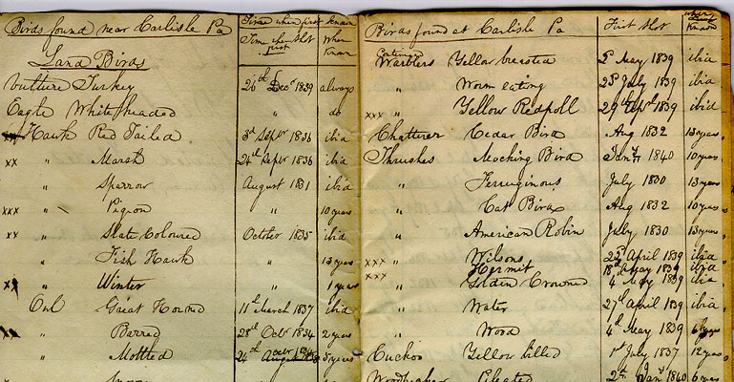
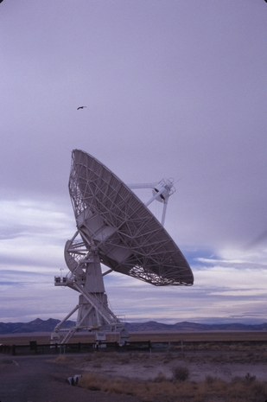
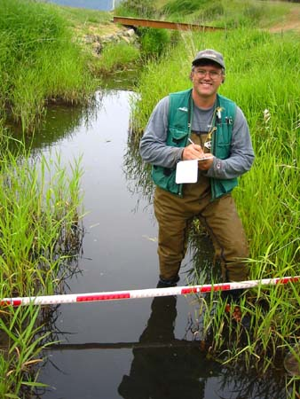
The Data Life Cycle: Collect
Notes:
In the collection stage of the Data Life Cycle the researcher may be involved in manual data collection through recording observations in a notebook, taking measurements, etc. which are eventually put into a computer program or a database (examples include Excel or a geodatabase). This data may also be collected via instruments that will produce data outputs, for example .csv. Collections of data may also come from web sources, databases, and other distributed data.

Slide 17
The Data Life Cycle: Assure
A researcher creates strategies for preventing errors to be present in a dataset
Quality assurance involves implementing measures that will ensure the quality of data before collection
Quality control involves monitoring and maintaining the quality of data throughout the study
Notes:
A researcher creates strategies for preventing errors to be present in a dataset
Quality assurance involves implementing measures that will ensure the quality of data before collection
Quality control involves monitoring and maintaining the quality of data throughout the study

Slide 18
The Data Life Cycle: Describe
“Describe data” can occur at any stage of the data lifecycle
Create metadata records to describe a dataset, including how it was collected and definitions used – this will document critical provenance information.
Operational metadata can capture and describe computing processes.
Adhere to organizational policies and procedures for ongoing collection management, including de-accessioning of data as appropriate.
Notes:
“Describe data” can occur at any stage of the data lifecycle
Create metadata records to describe a dataset, including how it was collected and definitions used – this will document critical provenance information.
Operational metadata can capture and describe computing processes.
Adhere to organizational policies and procedures for ongoing collection management, including de-accessioning of data as appropriate.

Slide 19
The Data Life Cycle: Deposit
Deposit data in appropriate repositories so that research can be discovered.
Depositing data maximizes potential for re-use, ensures preservation, and provides access to users over time.
Assure
Preserve
Discover
Integrate
Analyze
Collect
Describe
Deposit
Notes:
Deposit data in appropriate repositories so that research can be discovered.
Depositing data maximizes potential for re-use, ensures preservation, and provides access to users over time.

Slide 20
The Data Life Cycle: Protect and Preserve
Preserving and protecting data includes:
  saving data in proper formats that will ensure longevity of use
  Protecting data by keeping multiple copies in several locations
Assure
Preserve
Discover
Integrate
Analyze
Collect
Describe
Deposit
Notes:
Preserving and protecting data includes:
saving data in proper formats that will ensure longevity of use
Protecting data by keeping multiple copies in several locations

Slide 21
The Data Life Cycle: Discover
Discover data for use in new research
Access data through repositories, metadata clearinghouses, and data centers
Discover other research in a particular field, new processes, and new methodologies
Assure
Preserve
Discover
Integrate
Analyze
Collect
Describe
Deposit
Notes:
Discover data for use in new research
Access data through repositories, metadata clearinghouses, and data centers
Discover other research in a particular field, new processes, and new methodologies

Slide 22
The Data Life Cycle: Integrate
Integrate data with other related datasets
Use existing standards when integrating data (e.g. metadata, ontologies, semantic frameworks, and knowledge representation strategies).
Support community-based efforts for data interoperability
Assure
Preserve
Discover
Integrate
Analyze
Collect
Describe
Deposit
Notes:
Integrate data with other related datasets
Use existing standards when integrating data (e.g. ontologies, semantic frameworks, and knowledge representation strategies).
Support community-based efforts for data interoperability

Slide 23
The Data Life Cycle: Analyze
Data analysis produces scientific conclusions and results
Visualize the data to better understand and interpret
Discover trends
Assure
Preserve
Discover
Integrate
Analyze
Collect
Describe
Deposit
Notes:
Data analysis produces scientific conclusions and results
Visualize the data to better understand and interpret
Discover trends

Slide 24
Data Life Cycle Management
Data Life Cycle Management (DLM) is a policy-based approach to managing the flow of data through an information system life cycle: from creation and initial storage to long term preservation.
Federal guidance on the data life cycle is provided by OMB Circular A-16 Supplemental Guidance
Notes:
Data Life Cycle management (DLM) is a policy-based approach to managing the flow of an information system's data throughout its life cycle: from creation and initial storage to long term preservation.
You can learn more about Data Life Cycle management in Module 10 in this series.

Slide 25
Summary
Each phase of the Data Life Cycle indicates places in which data should be actively managed
The Data Life Cycle is a continuum of data development, manipulation, management, and storage stages
DLM or Data Life Cycle Management is an approach to manage the flow of information at each of the Data Life Cycle stages
Notes:
In summary, we learned that each phase of the Data Life Cycle indicates places in which data should be actively managed.
The Data Life Cycle is a continuum of data development, manipulation, management, and storage stages
Lastly, DLM or Data Life Cycle Management is an approach to manage the flow of information and data wherever they may appear in the Data Life Cycle.
.

Slide 26
References
National Science Foundation
http://searchstorage.techtarget.com/definition/data-life-cycle-management
http://libraries.mit.edu/guides/subjects/data-management/cycle.html
https://www.dataone.org/
OMB Circular A-16 Supplemental Guidance - http://www.whitehouse.gov/sites/default/files/omb/memoranda/2011/m11-03.pdf

Slide 27


What did you learn?
START QUIZ

Slide 28
1. Which of the following best defines the Data Life Cycle?
  The Data Life Cycle is a continuum of collecting data.
The Data Life Cycle is a continuum of data management.
  The Data Life Cycle is a continuum of data development, manipulation, management, and storage stages.
  The Data Life Cycle is a continuum of data collection and analysis.

Slide 29
Think about this …
You might want to review this section.
Return

Slide 30
Excellent!
Proceed to the next question
Next

Slide 31
2. Before analyzing data, one is involved in the process or processes of_________ .
  Collection
  Assurance
  Description
  All the above

Slide 32
Think about this …
You might want to review this section
Return

Slide 33
Excellent!
Proceed to the next question
Next

Slide 34
3. The deposit stage in the Data Life Cycle provides systems, tools, procedures, and capacity for _________________
  efficient data and metadata deposition by authors and others.
efficient data collection
  efficient quality control
  efficient preservation

Slide 35
Think about this …
You might want to review this section
Return

Slide 36
Excellent!
Proceed to the next question
Next

Slide 37
4. Data discovery can best be defined as which of the following:
  New data that has been entered into a repository and is based on new research
  The process of providing access of data to specialist and non-specialist users through the use of systems, tools, and other methods of dissemination
  The process of accessingdata through repositories, metadata clearinghouses, and data centers
  Process of presenting data through various visualization tools to enhance user understanding of the data.

Slide 38
Think about this …
You might want to review this section
Return

Slide 39
Excellent!
Proceed to the next question
Next

Slide 40
5. Each phase of the Data Life Cycle defines how data should be actively_______________ .
Stored
Developed
Managed
Manipulated
All of the Above

Slide 41
Think about this …
You might want to review this section
Return

Slide 42
Excellent!
Please proceed to the next slide
Next

Slide 43
6. ____________is a policy-based approach to managing the flow of an information system's data throughout its life cycle.
Storage
Analysis
Data Life Cycle Management (DLM)
Collection

Slide 44
Think about this …
You might want to review this section
Return

Slide 45
Excellent!
You have completed this learning module.
Next

Slide 46

Before you go . . .
We want to hear from you! CLICK the arrow to take our short survey.

