Slide 1
Fault Tolerance in Distributed Systems
Jyoti Islam
Nagi Reddy Gatla
Venkatesh Javvaji

Slide 2
Overview
Distributed System
Fault Tolerance
Handling Byzantine Failures
High Availability in Peer-to-Peer Systems
Current Research Focus
Future Research

Slide 3
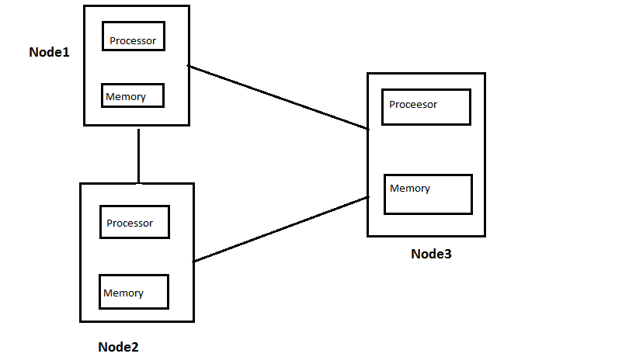
What is a Distributed System
Collection of independent computers that appear to its users as a single coherent system.
Every system has its own memory and its own set of resources.
They can share some common peripheral devices such as a printer.
Systems are organized in such a manner so as to hide their existence from the end user.
Message passing or RPC technique through communication technology such as TCP/IP.
Notes:
In the early days of computing, Centralized systems were in use.
Due to the gradual development in the field of networks and micro-electronics, centralized systems lost their ways to Interconnected-multiprocessor systems.

Slide 4
Fault Tolerance
Ability of a system to continue functioning in the event of a partial failure.
Though the system continues to function but overall performance may get affected.
Distributed systems are made up of a large number of components, developing a system which is hundred percent fault tolerant is practically very challenging.
Two main reasons for the occurrence of a fault
Node failure -Hardware or software failure.
Malicious Error-Caused by unauthorized Access.

Slide 5
Advantages of Fault Tolerance
Fault Tolerance is needed in order to provide 3 main feature to distributed systems.
1)Reliability-Focuses on a continuous service with out any interruptions.
2)Availability - Concerned with read readiness of the system.
3)Security-Prevents any unauthorized access.
Examples-Patient Monitoring systems, flight control systems, Banking Services etc.

Slide 6
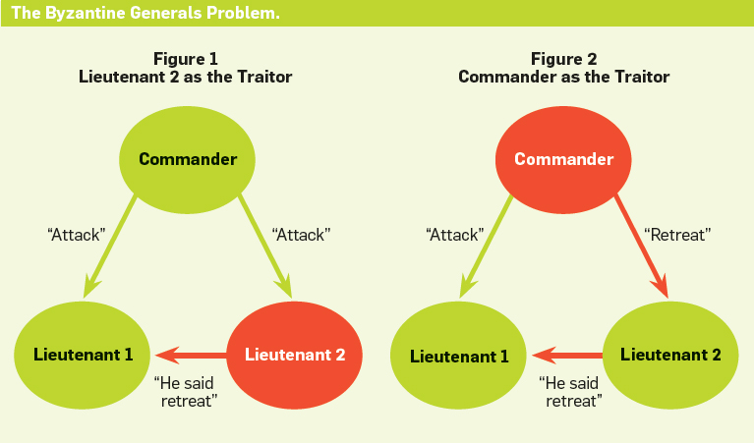
Byzantine failure
Byzantine fault
Any fault presenting different symptoms to different observers
Byzantine failure
The loss of a system service due to a Byzantine fault in systems that require consensus.
Notes:
Ch-8 has detail description, covered by

Slide 7
Handling Byzantine Failures
To deploy active replication:
Constructing a collection of finite state machines.
To have the non-faulty processes in this collection execute operations in the same order.
Assuming that at most k processes fail at once
A client sends an operation to the entire group.
And accepts an answer that is returned by at least k +] different processes.

Slide 8
Handling Byzantine Failures (cont.)
The difficult part in achieving this protection is
to ensure that non-faulty processes execute all operations in the same order.
To assign a coordinator that simply serializes all operations.
By attaching a sequence number to each request.
But the coordinator may fail.
Sequence numbers are handed out one after the other.
A gap, or a timeout for an operation may indicate that something is wrong.

Slide 9
Quorum Mechanism
To ensure requests can be correctly ordered, a quorum mechanism is used:
A process receives a request to execute operation 0 with number n in view v.
It sends this to all other processes.
Waits until it has received a confirmation from at least 2k others that have seen the same request.
In this way, we obtain a quorum of size 2k + 1 for the request.
Such a confirmation is called a quorum certificate.
Notes:
it tells us that a sufficiently large number of processes have stored the
same request and that it is thus safe to proceed.

Slide 10
Different phases in Byzantine fault tolerance
Different phases in Byzantine fault tolerance

Slide 11
Different phases in Byzantine fault tolerance
During the first phase, a client sends a request to the entire server group.
Once the master has received the request, it multicasts a sequence number in a pre-prepare phase so that the associated operation will be properly ordered.
At that point the slave replicas need to ensure that the master's sequence number is accepted by a quorum, provided that each of them accepts the master's proposal.

Slide 12
Different phases in Byzantine fault tolerance
If a slave accepts the proposed sequence number, it multicasts this acceptance to the others.
During the commit phase, agreement has been reached and all processes inform each other and execute the operation, after which the client can finally see the result.

Slide 13
Why Commit Phase is needed?
Within the same view, after the prepare phase all processes agree on the same ordering of requests.
If there was a need to change to a new view:
Different processes may have the same sequence number for different operations which were assigned in different views.

Slide 14
Why Commit Phase is needed?
So we need the commit phase:
In which each process now tells the others :
It has stored the request in its local log, and for the current view.
If there is a need to recover from a crash:
A process will know exactly which sequence number had been assigned, and during which view.

Slide 15
Why Commit Phase is needed?
A committed operation can be executed as soon as:
A non-faulty process has seen the same 2k commit messages (and they should match its own intentions).
They have a quorum of 2k + 1 for executing the operation.
Pending operations with lower sequence numbers should be executed first.
Notes:
Changing to a new view essentially follows the view changes for virtual synchrony
as described in Chap. 8. In this case, a process needs to send information
on the pre-prepared messages that it knows of, as well as the received prepared
messages from the previous view

Slide 16
High Availability in Peer-to-Peer Systems
It would seem that by simply replicating files availability is easy to guarantee.
But unavailability of nodes is so high that this simple reasoning no longer holds.
The key solution to high availability is redundancy.
Two different methods to realize redundancy: replication and erasure coding.

Slide 17
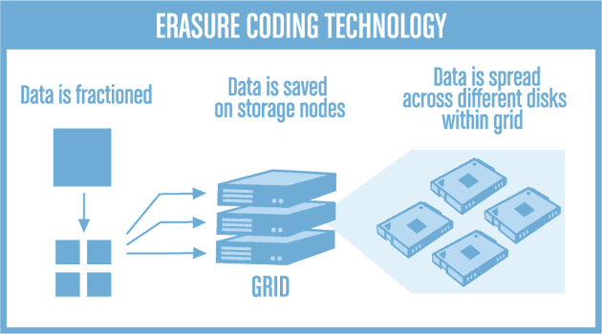
Erasure coding (EC)
A method of data protection.
Data is broken into fragments, expanded and encoded with redundant data pieces.
Stored across a set of different locations or storage media.

Slide 18
Erasure coding (EC)
Erasure coding requires less redundancy than simply replicating files.
In peer-to-peer networks in which nodes regularly come and go:
Replicating files for increasing availability is less efficient from a storage perspective than using erasure coding techniques.

Slide 19
Research Paper: Containing Byzantine Failures with Control Zones

Slide 20
Introduction
In this paper, they considered the problem of reliably broadcasting messages in a network where some nodes are likely to fail.
They considered the most general failure model: the Byzantine model, where the failing nodes have an arbitrary behavior, and may actively try to destabilize the network.
In this paper, it proposes a new broadcast protocol adapted to such networks. This protocol is based on interconnected subsets called control zones, that filter the diffusion of false messages.
This paper gives a methodology to determine a set of nodes that always communicate reliably, depending on the placement of Byzantine nodes.

Slide 21
Related Works
Many Byzantine-robust protocols are based on cryptography the nodes use digital signatures to authenticate the sender across multiple hops.
However, if Byzantine nodes are to be considered in the strong sense, we must assume that they are omniscient and know any cryptographic secret.
Yet, the most important point is that cryptography requires some degree of trusted infrastructure to initially distributes public and private keys: therefore, if this initial infrastructure fails, the whole network fails.
Yet, we want to design a totally decentralized solution, where any element can fail independently without compromising the whole system.
Space local algorithms try to contain the fault as close to its source as possible. This is only applicable to the problems where the information from distant nodes is unimportant
There are several other solutions formed on the premise of known topology and synchronous network.

Slide 22
Paper’s Contribution
In this paper, the paper tries to trade the perfectly reliable communication between correct nodes for the ability to support low-connectivity communication graphs with many Byzantine nodes.
The paper proposes a new broadcast protocol based on control zones and authorizations. Intuitively, control zones act as filters in the network: they limit the diffusion of Byzantine messages.
The paper’s theoretical results enable us to determine, for a given network, a given set of Byzantine nodes and a given setting of the protocol, whether two given nodes can communicate reliably or not. We then use this result to perform a statistical evaluation of our protocol, and show that it significantly outperforms previous solutions.

Slide 23
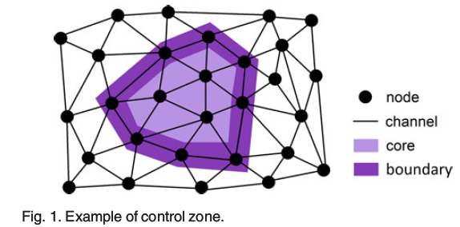
MODEL AND PROTOCOL
Terminology:
Node Cut: Let S and X be two sets of nodes. We say that X is a node cut isolating S if any path connecting a node in S and a node q in S contains at least one node of X.
Control Zone: A control zone is a tuple (Core; Boundary) of disjoint, connected node sets, such that Boundary is a node-cut isolating Core from the rest of the network.

Slide 24
Preliminaries
Each node should know which control zone does it belong to and also know the neighbors which belongs to the core of this control zone, Z.
Message Transmission:
A given node p sends a message containing the tuple (p;m0) to its neighbors, the neighbors of p send (p;m0) to their neighbors, and so forth, until every node receives (p;m0). Then the entire network knows that p broadcast m0.
A Byzantine node can send (p;m1), with m1 != m0, to make the network believe that p broadcast m1.
To limit the action of Byzantine nodes, we define a set of control zones. A control zone is defined by:
Its core, an arbitrary set of nodes.
Its boundary, a node-cut isolating the core from the rest of the network.
The important point is that messages must pass through the boundary to access the core.

Slide 25
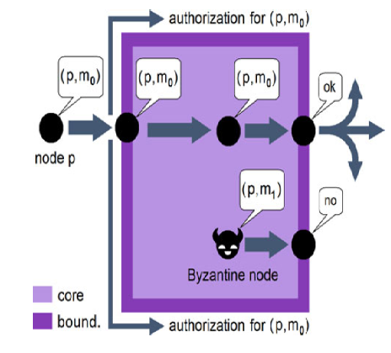
Protocol Idea
Main Idea of protocol:
When a message enters the core of a control zone, an authorization is broadcast on its boundary. This message, unlike standard messages, is not affected by other control zones.
When the same message wants to exit the core, this authorization is required.
This mechanism does not disturb the broadcasting of correct messages.
This mechanism does not disturb the broadcasting of correct messages.

Slide 26
Contd..
Suppose that a Byzantine node is in the core of the control zone, and sends a false message (p;m1), whereas p is not in the core of the control zone. Then, this message never gets the authorization to exit the core, as it never entered it.
The underlying intuition is to define a lot of control zones on the network, intersecting each other, in order to minimize the broadcasting of Byzantine messages.

Slide 27
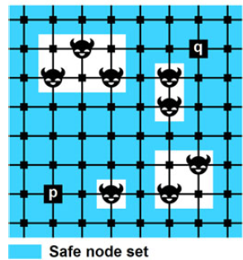
Results
For a given number nB of randomly distributed Byzantine failures, we would like to evaluate the probability P(nB) that two correct nodes communicate reliably. For this purpose, we use a Monte-Carlo method:
In this paper it generates a large number of random placements of nB Byzantine nodes.
For each placement, they randomly choose two correct nodes, and check if they communicate reliably. If they do, the simulation is a success.
On a large number of simulations, the fraction of successes approaches P(nB).

Slide 28
Discussion
So we can conclude that in this paper, they proposed a Byzantine-resilient broadcast protocol adapted to sparsely connected networks. They gave a methodology to determine a reliable set of nodes, and experimentally showed the efficiency of this solution.

Slide 29
Current Research Focus
Current Research is focused on investigating strategies for using replication to design and implement highly reliable peer-to-peer systems and how those strategies can be influenced by application characteristics and host availability.
Researchers are exploring replication strategy design tradeoffs along several interdependent axes:
Application characteristics
Replica placement
Replication granularity

Slide 30
Application characteristics:
Two key properties of peer-to-peer applications that impact the use of replication are object sizes and timeliness of object download.
First, larger objects take longer to replicate and naturally motivate the use of block-level replication. However, when conventional blocking is used for large objects, the reliability of the system depends on large number of hosts being available at the same time.
As a result, the availability of an object is inversely related to its size: the larger the object, the worse the availability.
Second, the relationship between when data is requested and the time at which it must be delivered.

Slide 31
Replica Placement:
peer-to-peer systems should not ignore the availability characteristics of the underlying workstations and networks on which they are implemented. In particular, systems should recognize that there is wide variability in the availability of hosts in the system.
Given such a wide variability, the system should not place replicas blindly: more replicas are required when placing on hosts with low availability, and fewer on highly available hosts.
Replica Granularity:
Whole-file replication allows simple and low-overhead implementations of naming and lookup, while block-level replication allows increased performance through parallel downloads and better balancing of large file objects. Finally, block-level erasure coding can enhance overall availability while providing the flexibility of block-level replication and, surprisingly, the minimal state requirements of whole-file designs.

Slide 32
Future Research
Researchers are comparing the use of whole object and blocking replication, and pursuing the use of erasure codes with blocking replication as a novel technique for achieving high reliability even for systems primarily composed of hosts with poor availability. In addition, they are investigating how application properties such as object size, timeliness of delivery, workload properties such as object popularity, and network properties such as host availability should influence replication strategies.

Slide 33
References
Castro, Miguel, and Barbara Liskov. "Practical Byzantine fault tolerance and proactive recovery." ACM Transactions on Computer Systems (TOCS) 20.4 (2002): 398-461.
Replication Strategies for Highly Available Peer-to-Peer Storage; Ranjita Bhagwan, David Moore, Stefan Savage, and Geoffrey M. Voelker
Containing Byzantine Failures with Control Zones; Alexandre Maurer and Sebastien Tixeuil; IEEE TRANSACTIONS ON PARALLEL AND DISTRIBUTED SYSTEMS, VOL. 26, NO. 2, FEBRUARY 2015

