Slide 1
Radar Remote Sensing
RADAR => RAdio Detection And Ranging

Slide 2
Radar Remote Sensing
Active remote sensing system using 1 cm to 1m wavelengths (microwaves).

Slide 3
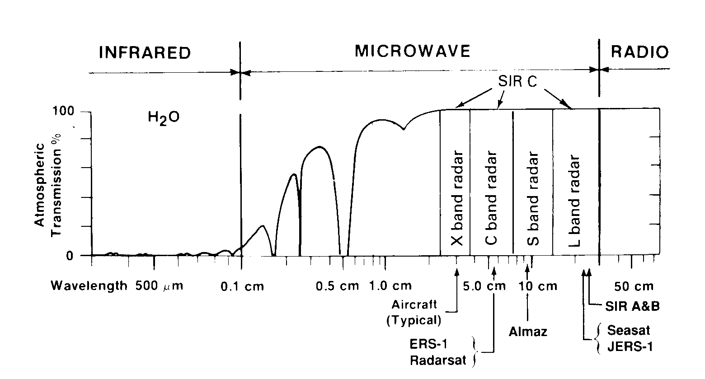
Microwave Atmospheric Window

Slide 4
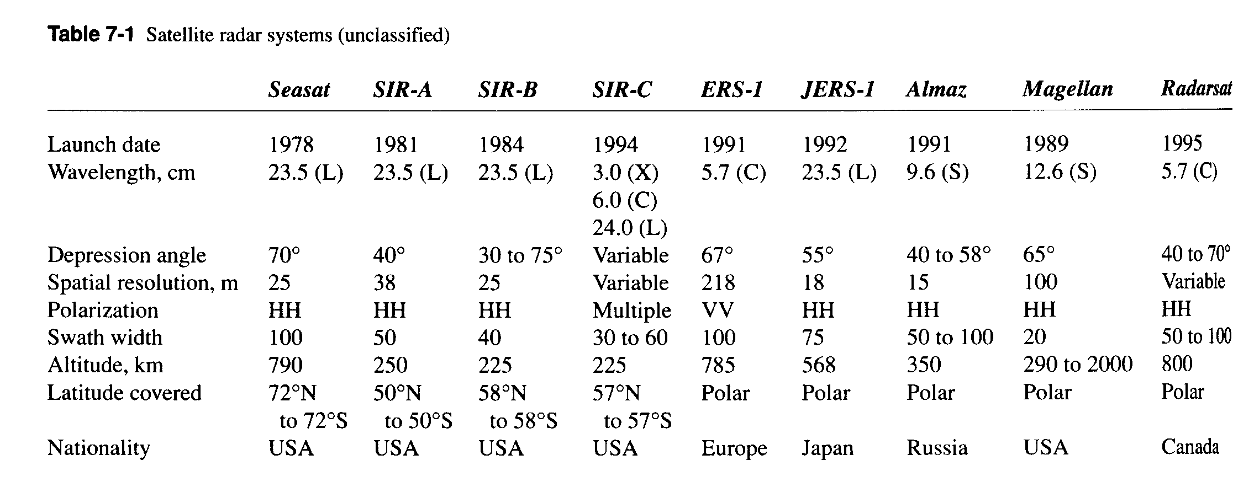
Radar Systems
AIRSAR - Flies in DC-8 with C, L, and P bands
SRTM (Shuttle Radar Topography Mission)
- X-band and C-band radar

Slide 5
Radar Applications
Radar imaging
  Measure returned energy flux
  Return controlled by dielectric constant (index of refraction) of materials, roughness of surface at wavelength scale, and slopes
Radar altimetry
  Measure round trip travel time to determine distance between antenna and surface
Radar interferometry
  Broadcast from one antenna and receive at another antenna with known distance between them
  Phase difference for two antennas used to determine topography.

Slide 6
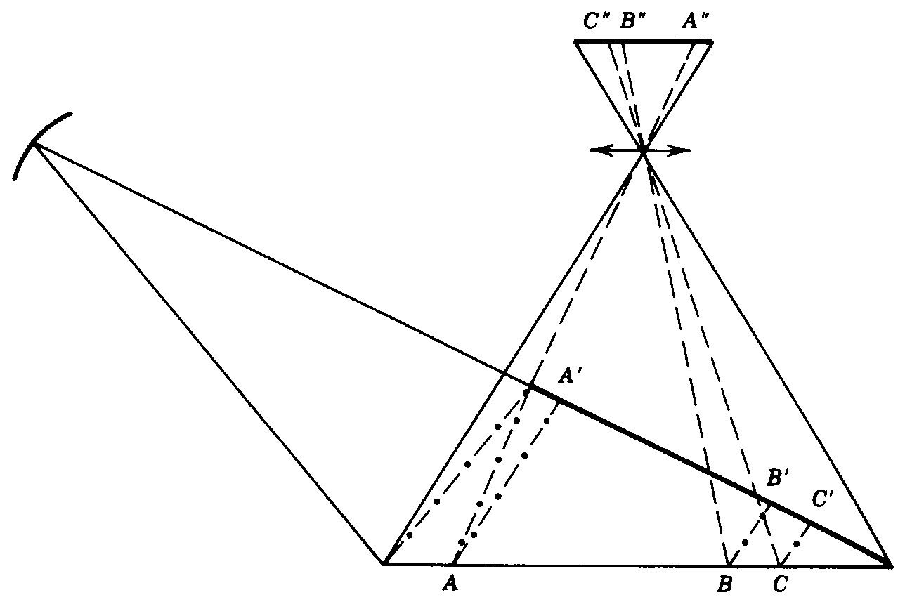
Characteristics of Radar Images
SLAR - Side-Looking Airborne Radar
SAR - Synthetic Aperture Radar (also side-looking)
Side-looking characteristics induce some geometric effects quite distinct from framing cameras.

Slide 7
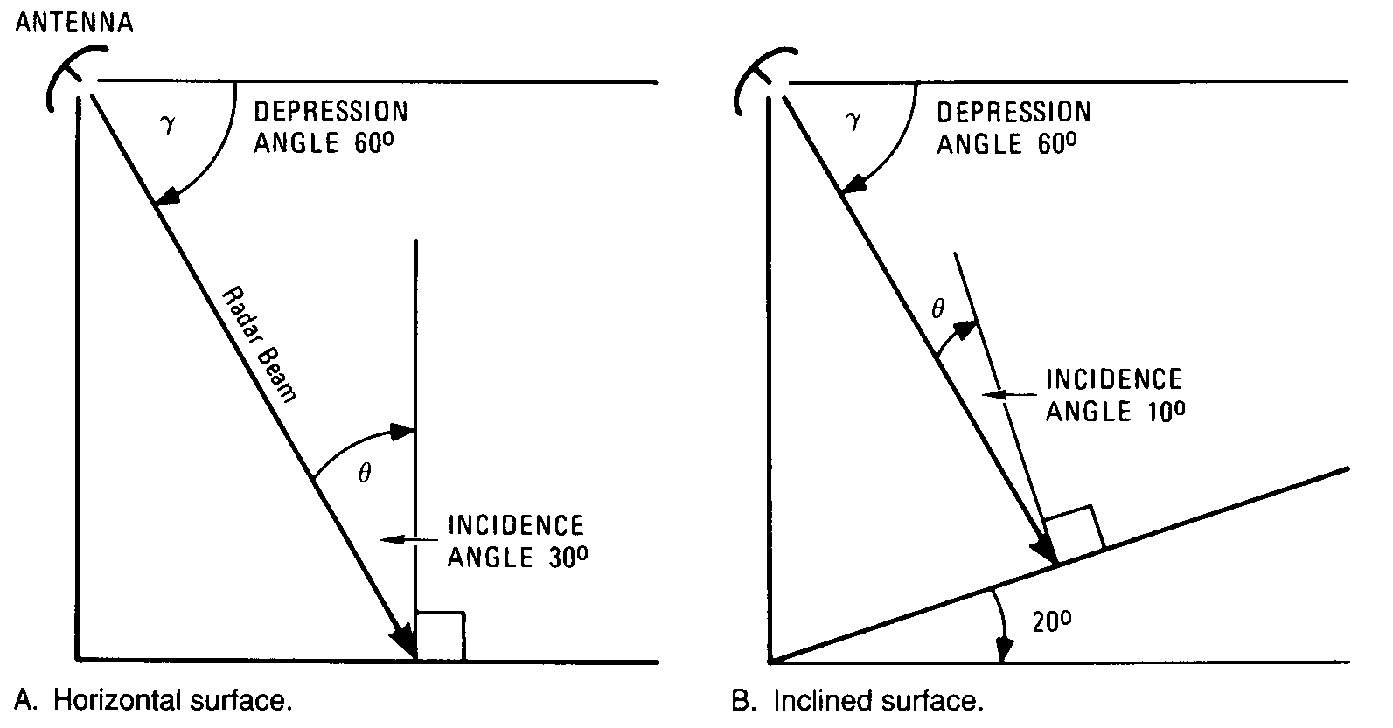
Depression and Incidence Angle

Slide 8
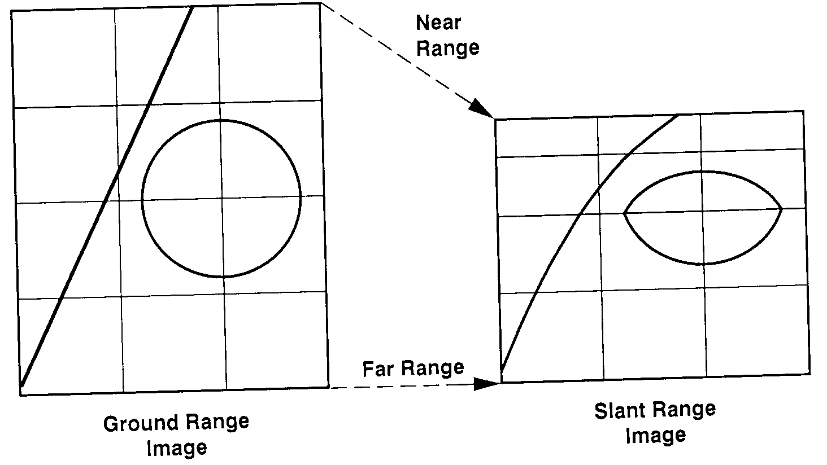
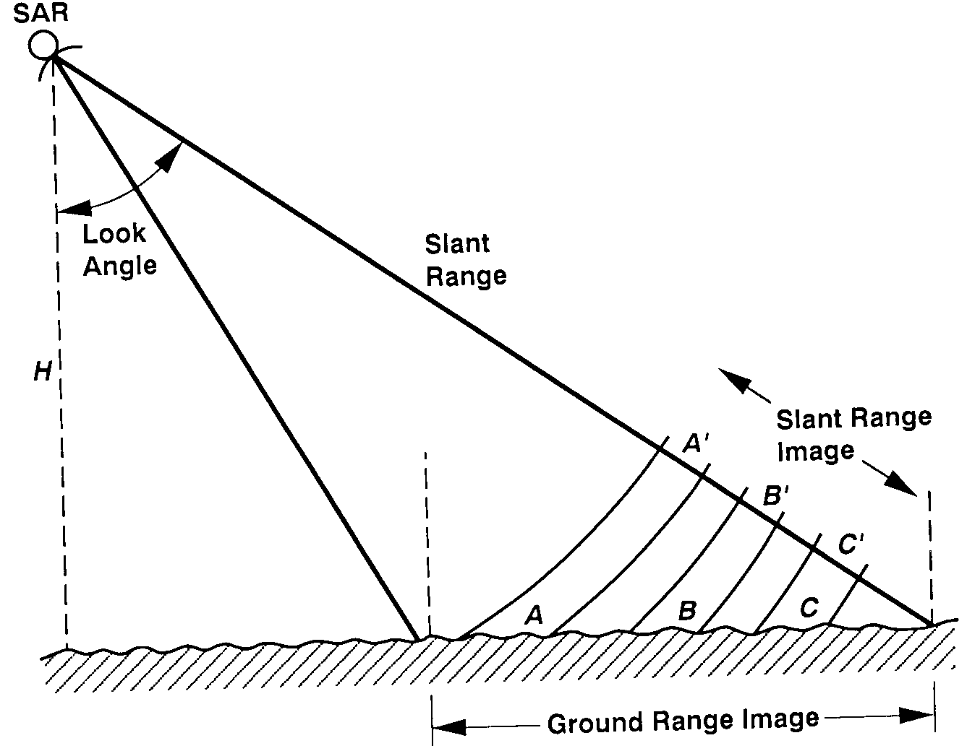
Characteristics of Radar Images
Radar records strength of returned signal and round trip travel time to determine pixel brightness and location of pixel perpendicular to flight direction, respectively.

Slide 9
Radar Remote Sensing
Radar Image Characteristics
  Shadows
  Foreshortening
  Layover
  Relief Displacement
Radar Spatial Resolution
  Cross Track or Range Resolution
  Along Track Resolution
    SLAR
    SAR

Slide 10
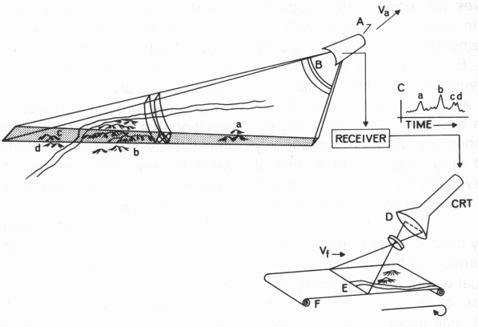
Radar Image Characteristics
For side-looking radar systems, position within an image line is determined by travel time of radar beam.
Multiple image lines are created by forward motion of aircraft or satellite.

Slide 11
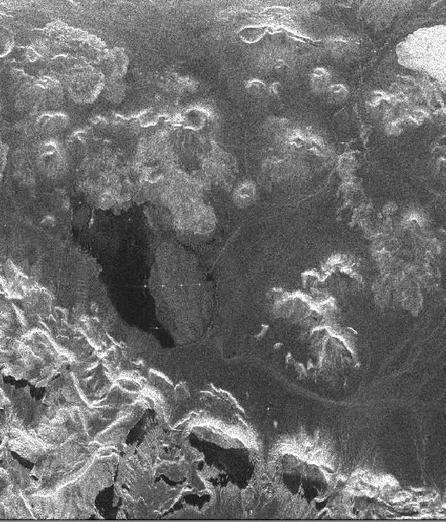
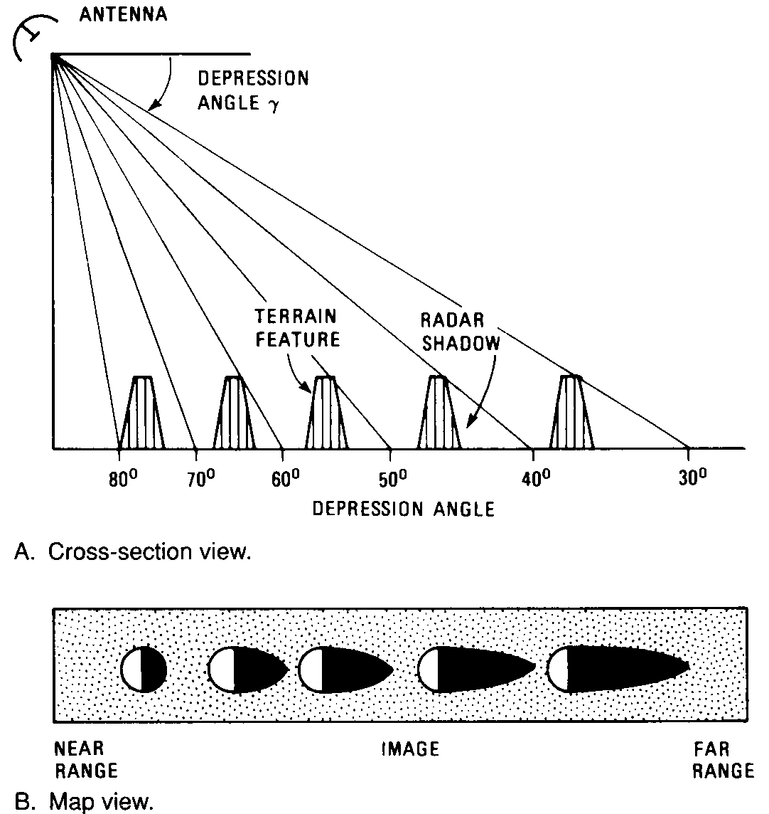
Radar Shadows
Radar shadows occur when slopes are not seen by radar beam. That is, when slope angle is greater than the depression angle.
Shadow lengths get longer behind obstacles as depression angle gets smaller.

Slide 12
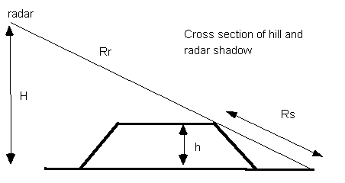
Radar Shadows
For simple terrain (flat with bumps), shadows can be used to get heights.
See diagram below. H = aircraft altitude, h = feature height,
R_{r} = slant range to far end of shadow, R_{s} = slant range length of shadow.
Distances measured on slant range image.

Slide 13
Slant Range and Ground Range Images

Slide 14
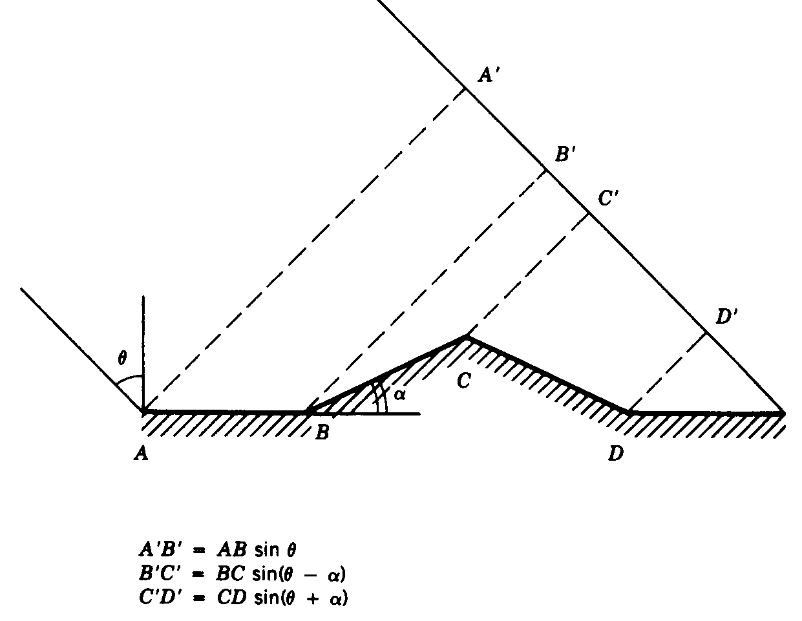
Foreshortening
Given that range determines cross-track pixel location, there is geometric foreshortening.
Cross-track length of feature determines how long it remains in radar illumination.
If surface slope is normal to wave front, then slope appears as a point in output image.
Foreshortening is one reason
why radar is side-looking.
Features directly beneath
aircraft would have same
return times and
thus show as single point.

Slide 15
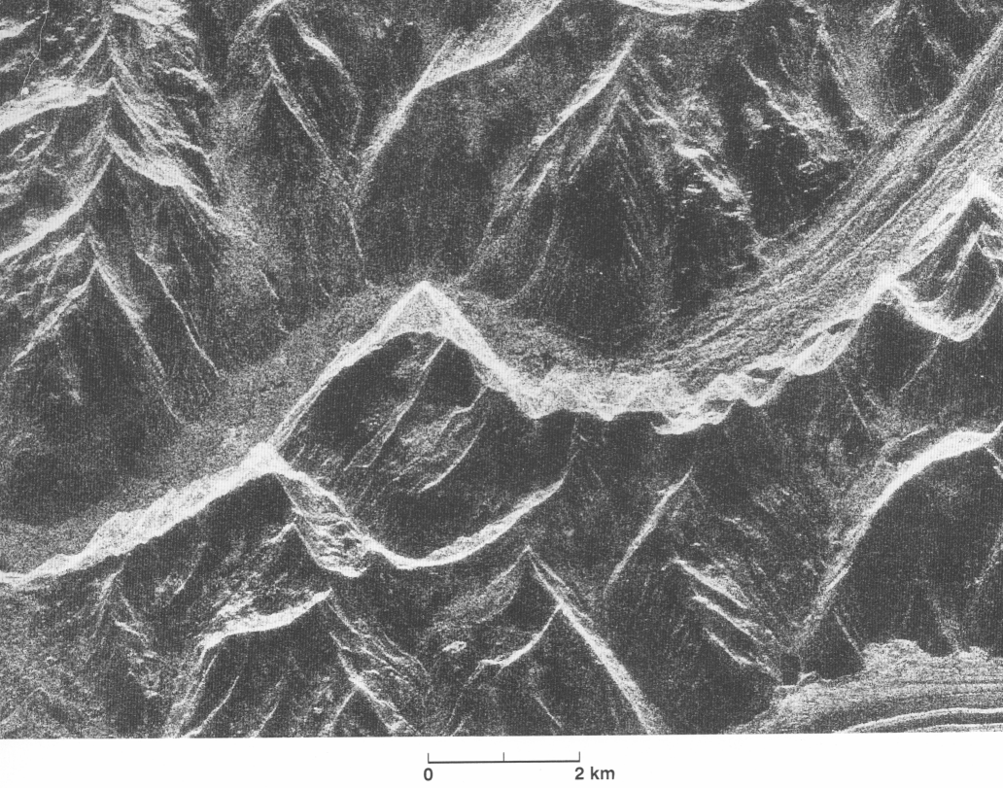
Foreshortening Example
Seasat image of Alaska. Radar illumination is from the top.

Slide 16
Foreshortening
Surfaces seen with largest depression angles (closest to antenna) will have greatest amount of foreshortening.
Foreshortening decreases as the depression angle decreases (i.e., further from antenna) for a given surface slope.
Example of foreshortening for slopes of 15º from horizontal.

Slide 17
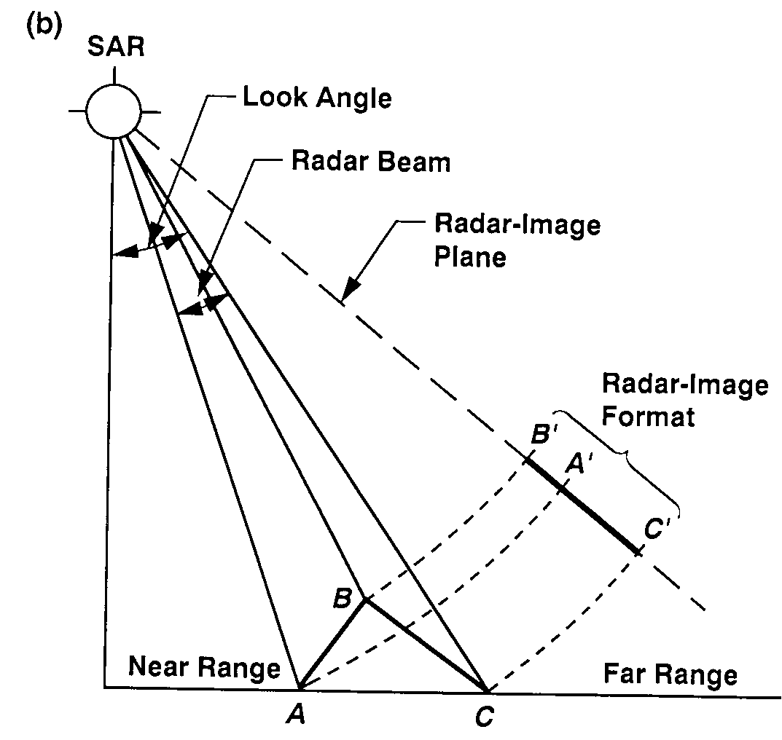
Layover in Radar Images
Layover occurs when slopes are steep that for return from top of slope is received before the return from the bottom of slope.
Object appears to be "laying over" on its side in the radar image.
Layover increases as depression angle increases.

Slide 18
Layover Example
Seasat image of Alaska. Radar illumination is from the top.

Slide 19
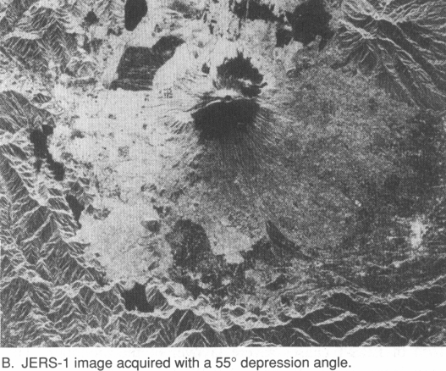
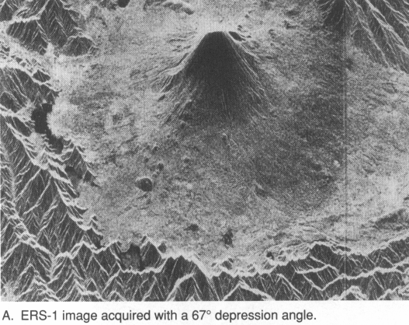
Layover Example
Mount Fujiyama, Japan. Radar illumination from the top.

Slide 20
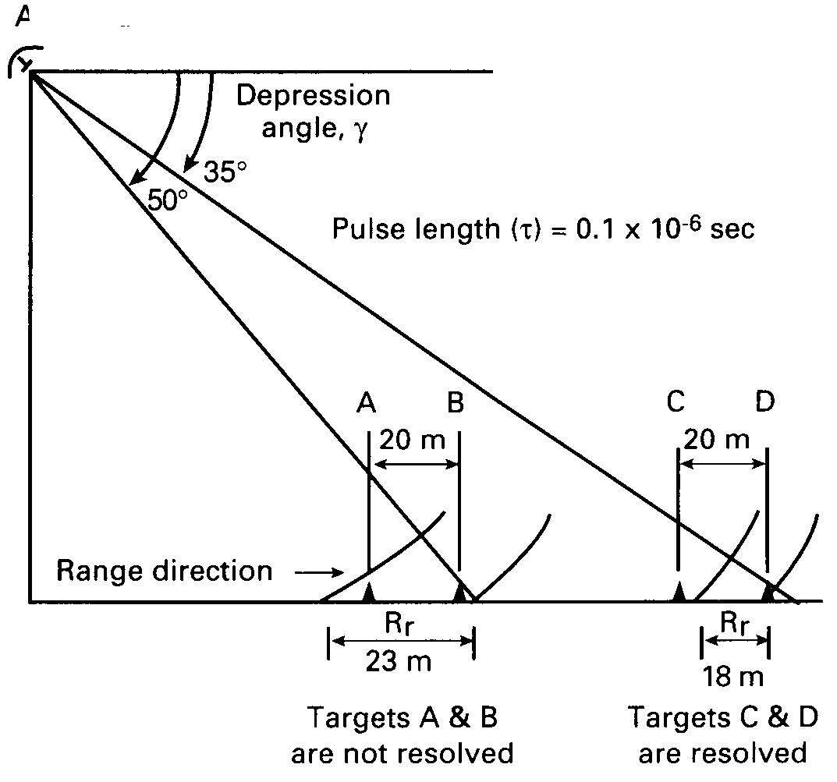
Radar Image Spatial Resolution
Separate values of resolution for the along-track and cross-track directions.
Consider cross-track or range resolution.
Range resolution dependent on pulse length, τ, and on depression angle, β. Not dependent on antenna altitude.
Two features will be resolved in the range direction if their return pulses do not arrive back at the antenna at the same time.

Slide 21
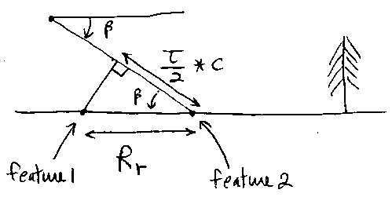
Range Resolution
Pulse length in distance is τ∗c.
Assume that features are separated in
range direction if horizontal separation
(R_{r}⁾,is greater than (τ∗c)/2.
From the triangle in diagram, we can
derive range resolution (R_{r}).
As pulse length and depression angle
decrease, the range resolution gets smaller.
Better resolution further from the antenna.
As depression angle increase for points closer
to the antenna, range resolution is worse.
Another reason why radar can not image directly
beneath the antenna.

Slide 22
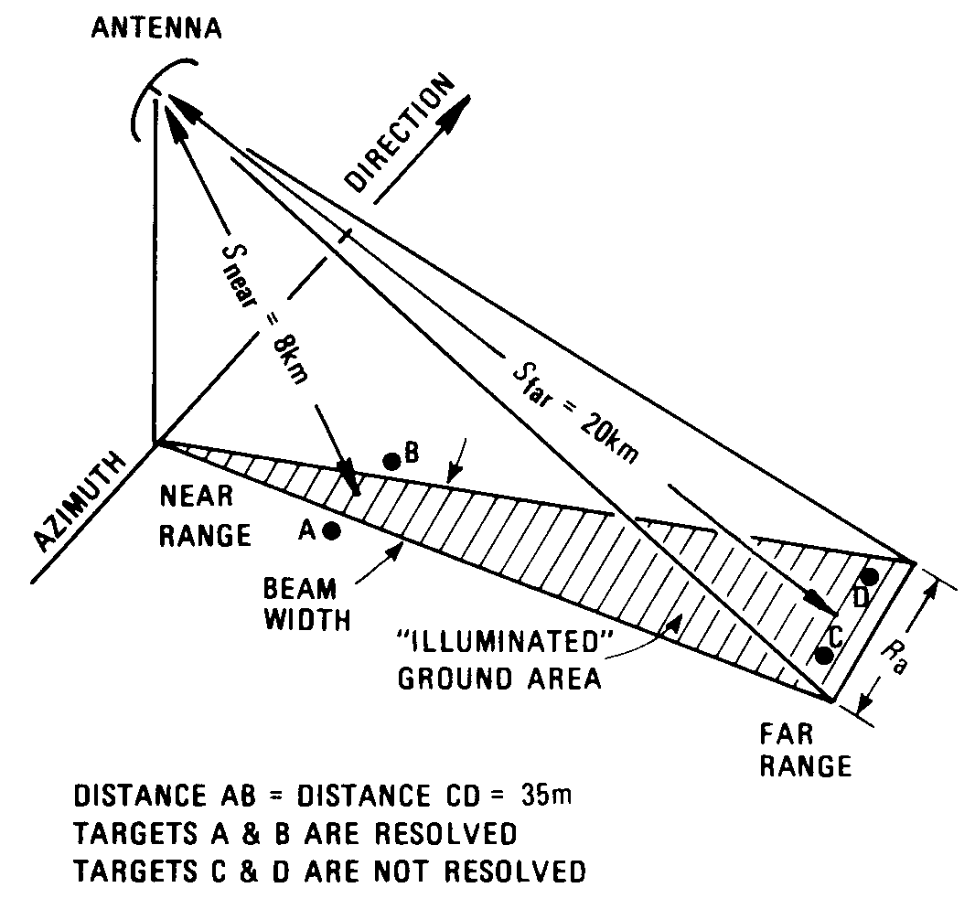
Along-Track Resolution
Along-track resolution in independent of the range resolution.
For simple SLAR system, the along-track cell size (R_{a})is dependent on beam width projected onto the ground. Beam width and thus along-track resolution becomes wider for distances further from the antenna.
Where S is slant range, λ is radar
wavelength, and D is antenna width.
Equation is derived from fact that beam
width is proportional to λ/D.
For SAR systems, a longer antenna
is synthesized for greater slant ranges
to maintain a constant along-track
resolution.

