Slide 1
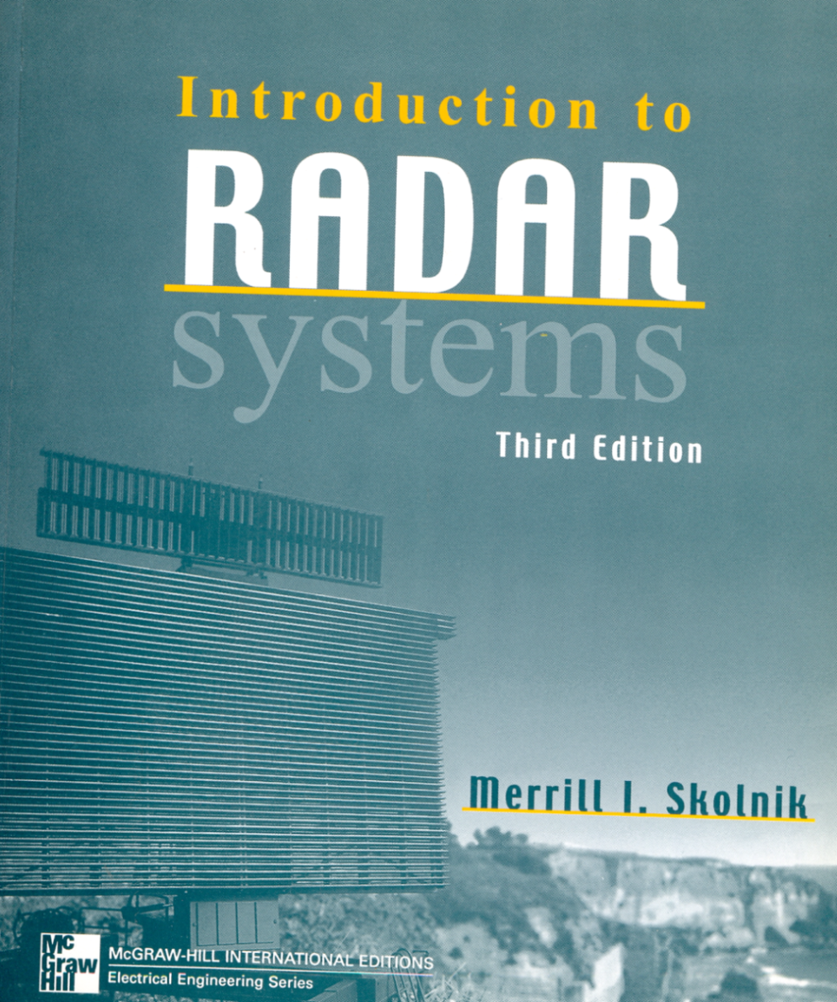
Third Edition By : Merrill I. Skolnik
INTRODUCTION TO RADAR SYSTEMS
Second Edition By : Merrill I. Skolnik

Slide 2
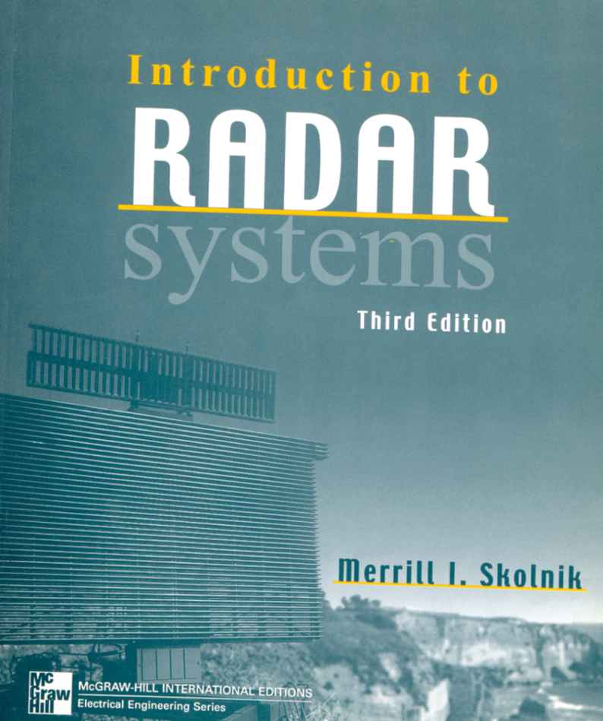
Third Edition By : Merrill I. Skolnik
INTRODUCTION TO RADAR SYSTEMS
Chapter 1:
A Introduction to Radar

Slide 3
Contents
Chapter 1: An Introduction to Radar
Chapter 2: The Radar Equation
Chapter 3: MTI and Pulse Doppler Radar
Chapter 4: Tracking Radar
Chapter 5: Detection of Signals in Noise
Chapter 6: Information from radar Signals
Chapter 7: Radar Clutter
Chapter 8: Propagation of Radar Waves
Chapter 9: The Radar Antenna
Chapter 10: Radar Transmitters
Chapter 11: Radar Receiver

Slide 4
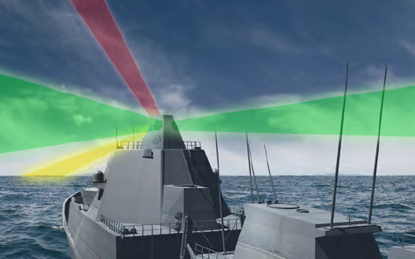
What is the Radar?

Slide 5
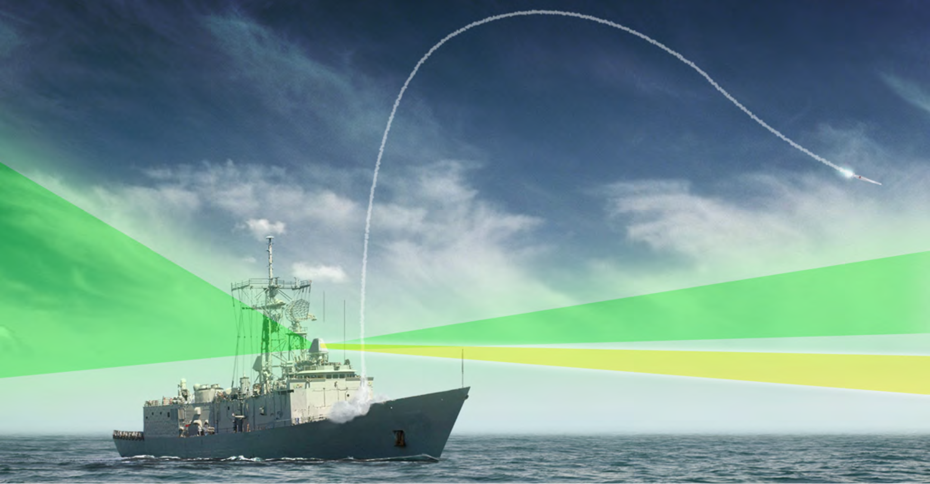
What is the Radar?

Slide 6
What is the Radar?

Slide 7
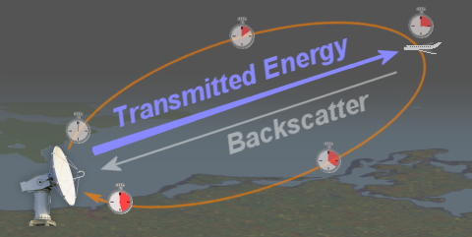
What is the Radar?

Slide 8
Radar Advantages
Cloud and smoke penetration.
Night vision.
Forest canopy penetration and canopy structure.
Complements visible/infrared sensors (sensitive to terrain features and moisture).
Good for discrimination of terrain structure (roughness) and drainage patterns.
Radar Disadvantages
Interpretation requires knowledge of radar interaction with surfaces.
Speckle (dark and bright pixels) limits interpretation.
Satellite systems are not yet multispectral and multi polarization (usually one band/one polarization) on most satellite platforms (limits forest canopy information).
Not good for discrimination and mapping of different vegetation types except at very general levels.
Data analysis can be hindered in steep topography and rough terrain due to extreme layover effects.

Slide 9
Review of Common Radar Types
CW
Simple Pulsed Range Radar
Pulse Doppler
Pulse Compression (Chirp and Phase Coded)
Frequency Agile
MTI (Coherent and Coherent-on-Receiver)
Mono-pulse
Phased Array
SAR
Bi-static Radars
Instrumentation
Multimode
Other (MLS, ILS, TACAN)

Slide 10
History of the radar
Before World War II: A simple radar by several country is proposed and applied.
After World War II: the radar technology grew rapidly.
Use of Doppler effect in MTI (moving target indicator).
Use of High power stable amplifier such as klystron, TWT and solid state amplifier instead of the magnetron tube.
Use of mono-pulse radar for better accuracy.
Use of pulse compression technique to achieve the range resolution.
Use of Synthetic aperture radar (SAR) for imaging of ground surfaces.
Development of Airborne radar.
Phase array Antenna for electronically scan of environments without mechanical movement of the antenna.
Use of HF over-the-Horizon radars to detect aircraft to almost 2000 nmi.
Use of radar technology to recognize target by extraction of its information.
radar to gather weather information, wind speed and direction.
Use of digital signal processing to develop radar.

Slide 11
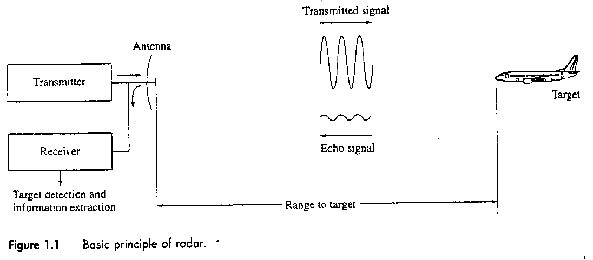
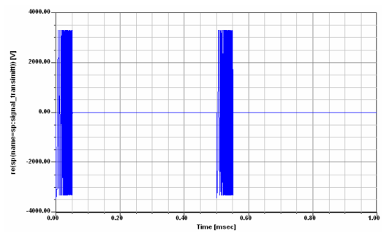
The Principle of the Radar
For example :

Slide 12
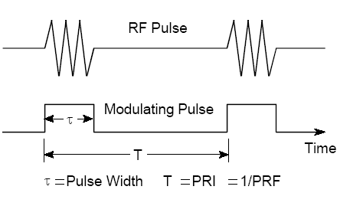
Typical Radar Waveform
PRI (Pulse Repetition Interval)
PRF (Pulse Repetition Frequency)
P_{t} is Peak Power
P_{av} is Average Power
for example:

Slide 13
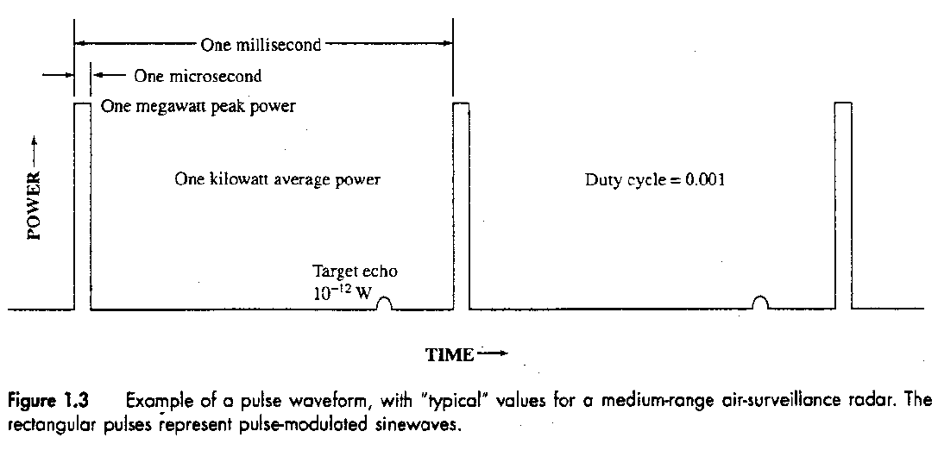
Typical Radar Waveform
Target echo is : Watts = dBm

Slide 14
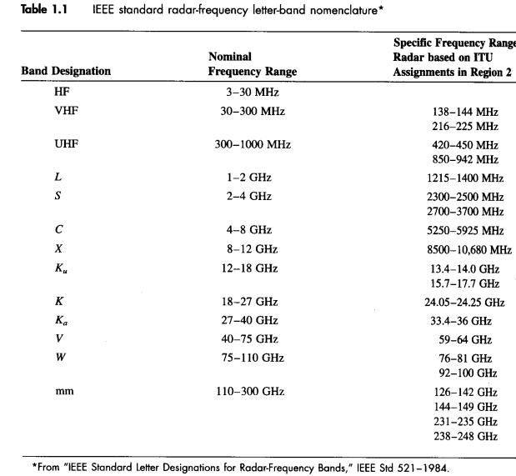
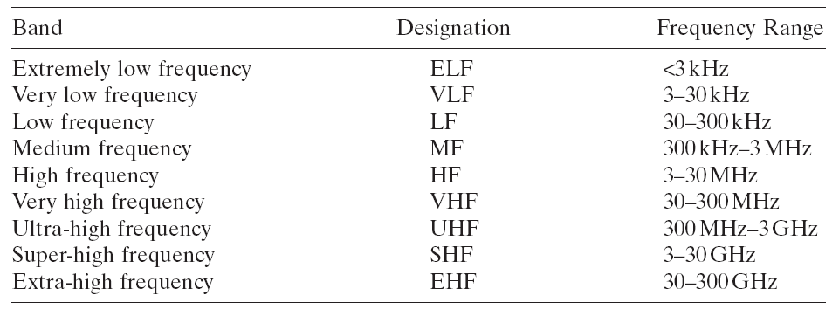
IEEE Standard Radar Frequencies

Slide 15
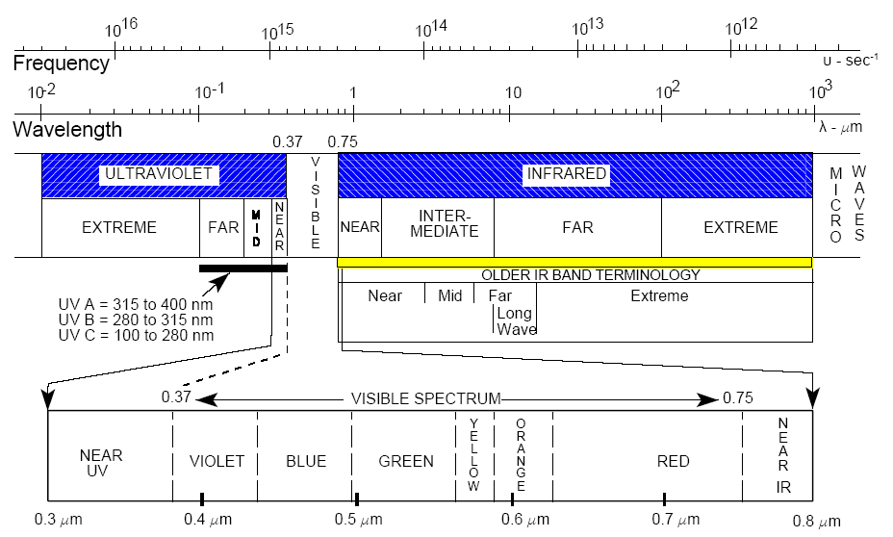
Optical Region

Slide 16
Radar Block Diagram

Slide 17
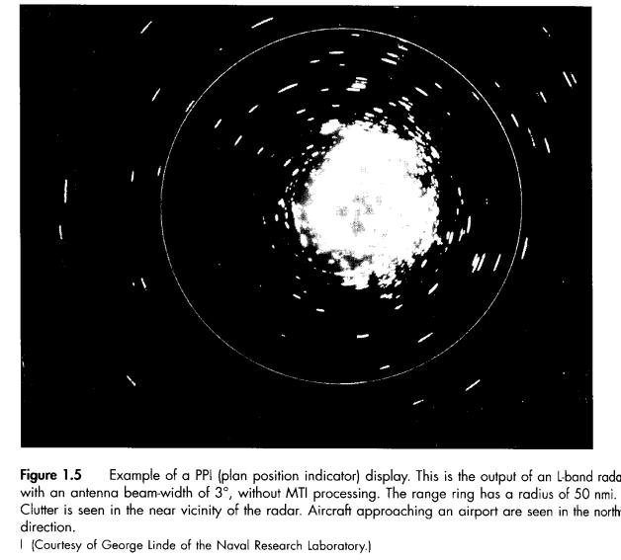
Plan Position Indicator (PPI) Display

Slide 18
Antenna Pattern
Beam width =
D is Horizontal or Vertical dimension of antenna
For example :

Slide 19
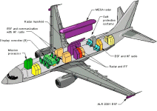
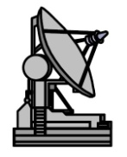
The Radar Equation
Target
is transmitter
is receiver
is gain of antenna
is effective aperture of antenna
is peak power
is radar cross section
is distance (range) of target from radar

Slide 20
Example :
P 1.2 A ground-based air-surveillance radar operate at frequency of 1300MHz (L-Band). Its maximum range is 200nmi (1 nautical mile equal 1852meter) for the detection of a target with a radar cross section of 1m². its antenna 12 m wide by 4 m high, and the antenna aperture efficiency is 0.65. the minimum detectable signal is 10⁻¹³ watts. Determine the following:
Antenna effective aperture and gain?
Peak transmitter power?
Pulse repetition frequency (PRF) to achieve a maximum unambiguous range of 200 nmi?
Average transmitter power , if the pulse width is 2 micro sec?
Duty cycle?
Horizontal and vertical beam width?

Slide 21
Solution :

Slide 22
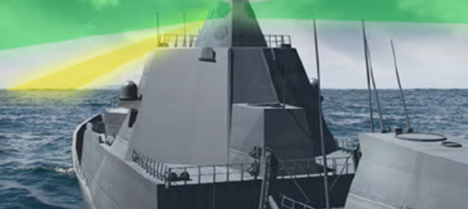
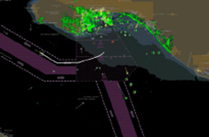
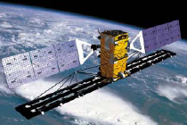
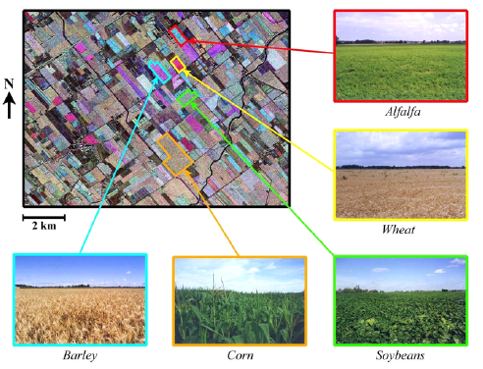
Applications of the Radar
Military Applications
Space Systems
Airborne Applications
Maritime Applications
Surveillance
Search and Track
Fire Control
Navigation
Missile Guidance
Proximity Fuses
Altimeter
Terrain Avoidance
Weather Mapping
Civil Applications
Space Systems
Air Transport and Navigation Applications
Maritime Applications
Industry Applications. Speed and distance measurements
Oil and Gas Exploration
The movement of insects and birds.

Slide 23
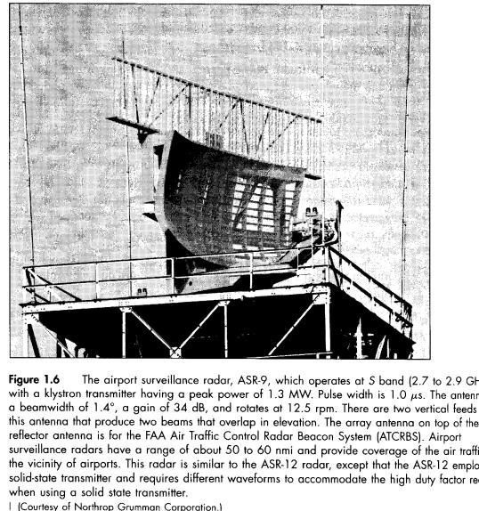
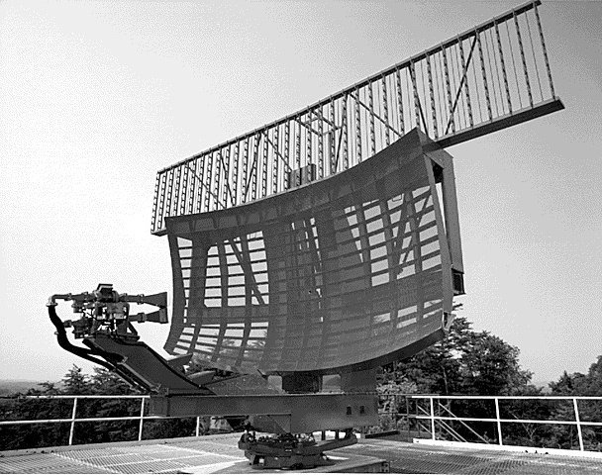

Slide 24
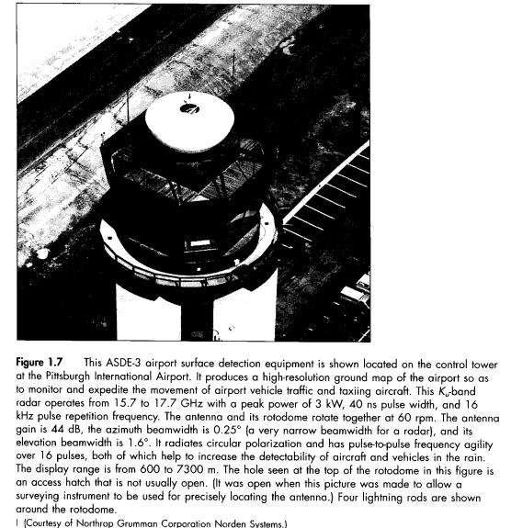
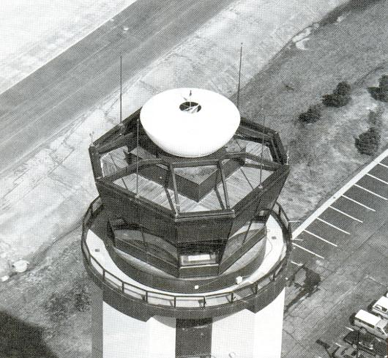

Slide 25
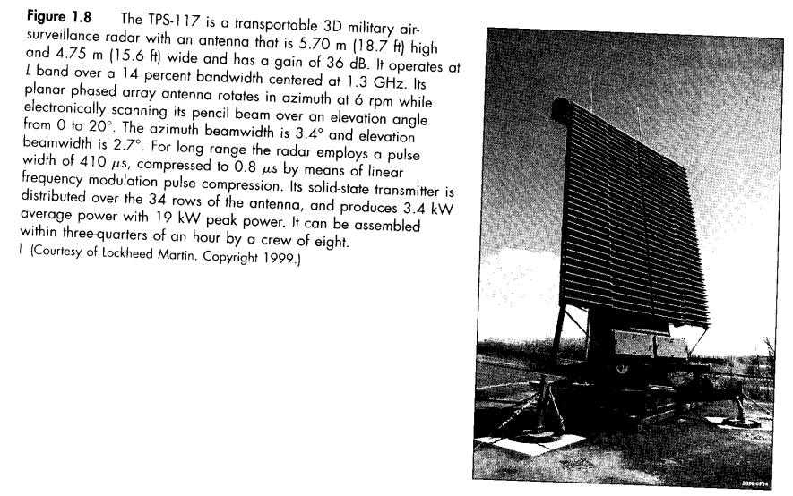
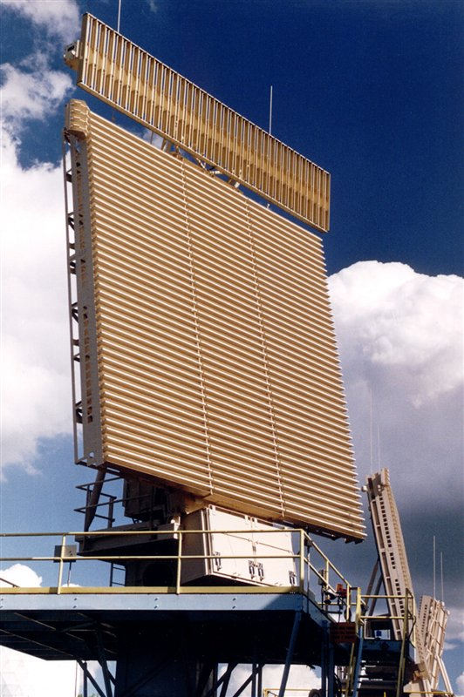

Slide 26
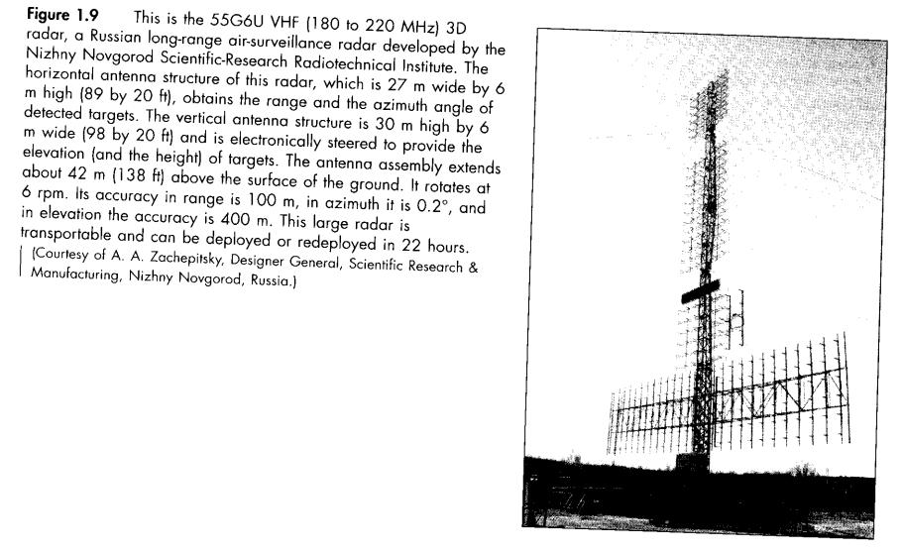
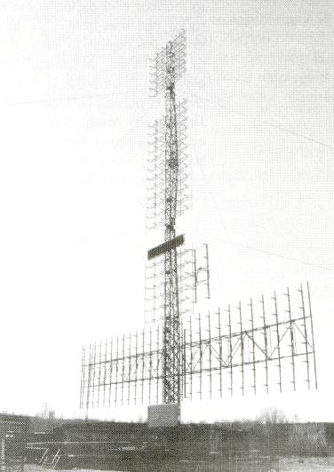

Slide 27
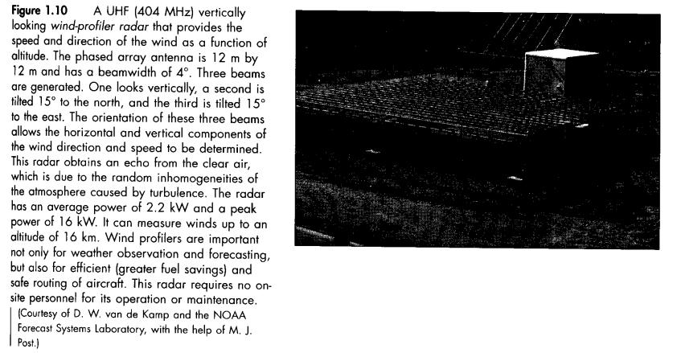
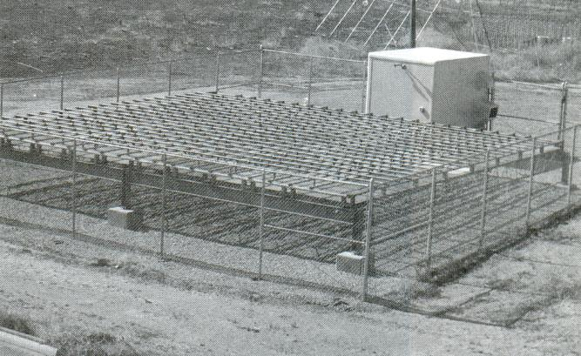

Slide 28
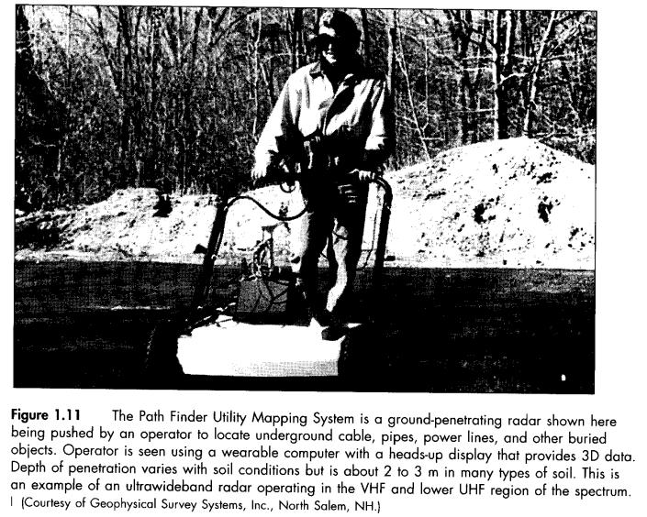
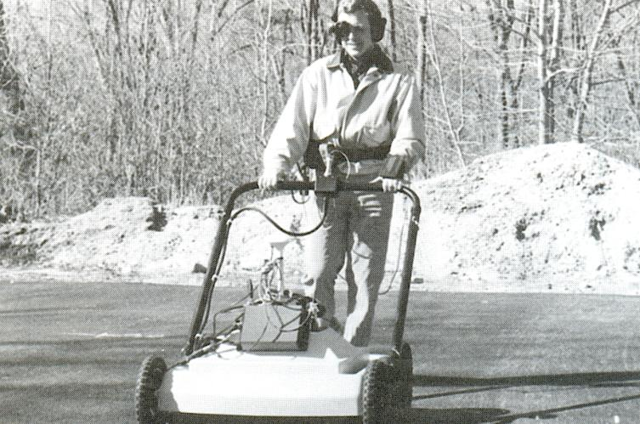

Slide 29
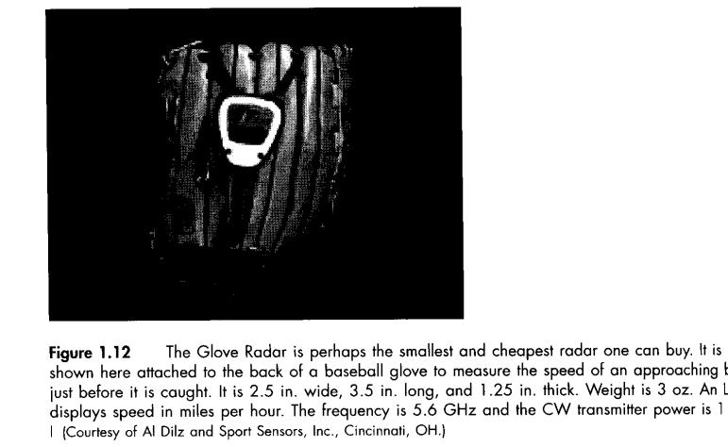
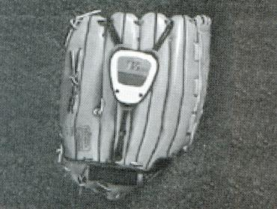

Slide 30
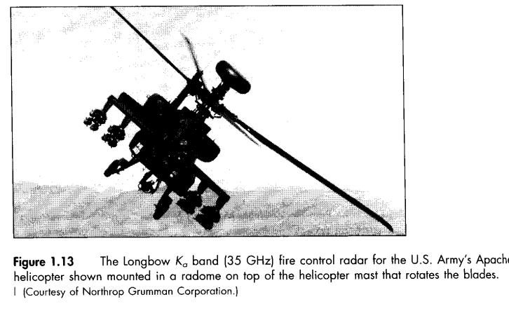
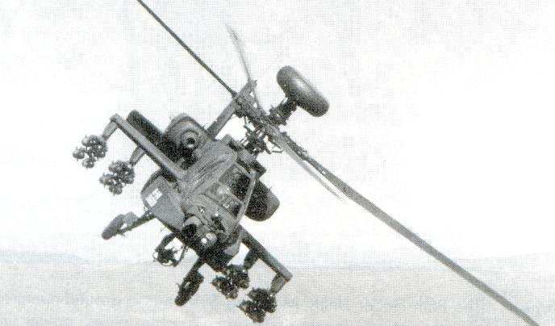

Slide 31
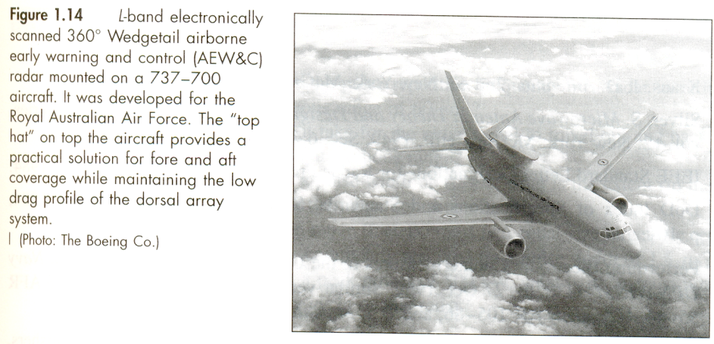

Slide 32
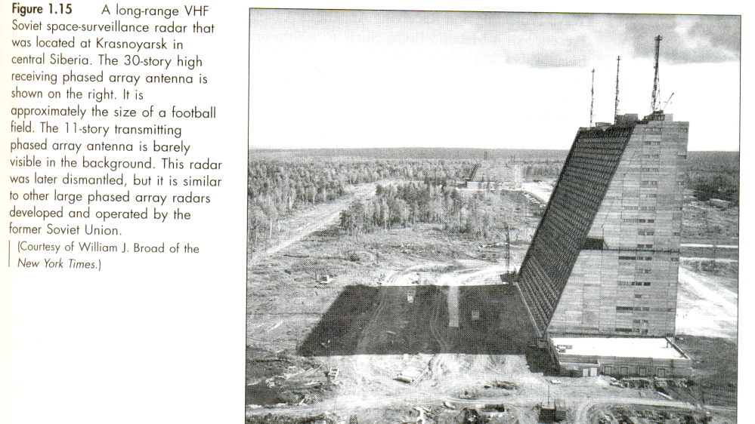

Slide 33
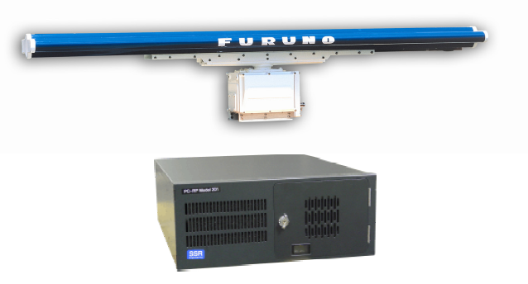
High Resolution Radars

Slide 34
New Radar systems
Enhanced Meteorological Radars. [Nexrad, Terminal Doppler Weather Radar, Wind profiler, TRMM satellite weather radar and airborne wind-shear detection radar]
Planetary Explorations. [ Magellan for Venus, Cassini for Titan, a moon of Saturn]
Interferomectic Synthetic Aperture Radar (SAR) for 3D images.
Inverse Synthetic Aperture Radar (ISAR).
Ground Penetration Radar (GPR).
Serial production of phased array radars. [Patriod, Aegis, Pave Paws, B-1B bomber]
Active aperture phased arrays.
Ballistic missile defense radars. [GBR and Arrow]
HF over the horizon radars. [ROTHR and Jindalee]
Battlefield surveillance. [JSTARS]
Radars for remote sensing of the environments.
Improved air-traffic control radars.
New multifunction airborne military fighter/attack radars.

Slide 35
