Slide 1
Radar Summary Chart
(A 20 minute rant on THE most useless way of accessing radar data)
by
Dr. Bradley Muller

Slide 2
The Radar Summary chart—an outmoded way of looking at radar data.
It is a computer-generated mosaic of radar echo intensity contours based on the Radar Weather Reports (SD/ROB) text product.
Produced hourly showing precipitation types, cell movements, maximum echo tops, locations of line echoes and remarks (p. 5-50, Aviation Weather Services).
The Radar Weather Reports (SD/ROB) product is described on p. 3-45 of Aviation Weather Services.

Slide 3
The bad news: no human intervention!
**Here is what the government publication, Aviation Weather Services has to say about the Radar Weather Reports product: "This is a textual product derived from the WSR-88D NEXRAD radar without human intervention. The resolution of this textual product is very coarse, up to 80 minutes old, and should only be used if no other radar information is unavailable. [emphasis added]"**
By extension, I would say that the radar summary chart should only be used in the absence of other, better radar information.
**However, the FAA still tests you on the radar summary chart, which is derived from this product!!**

Slide 4
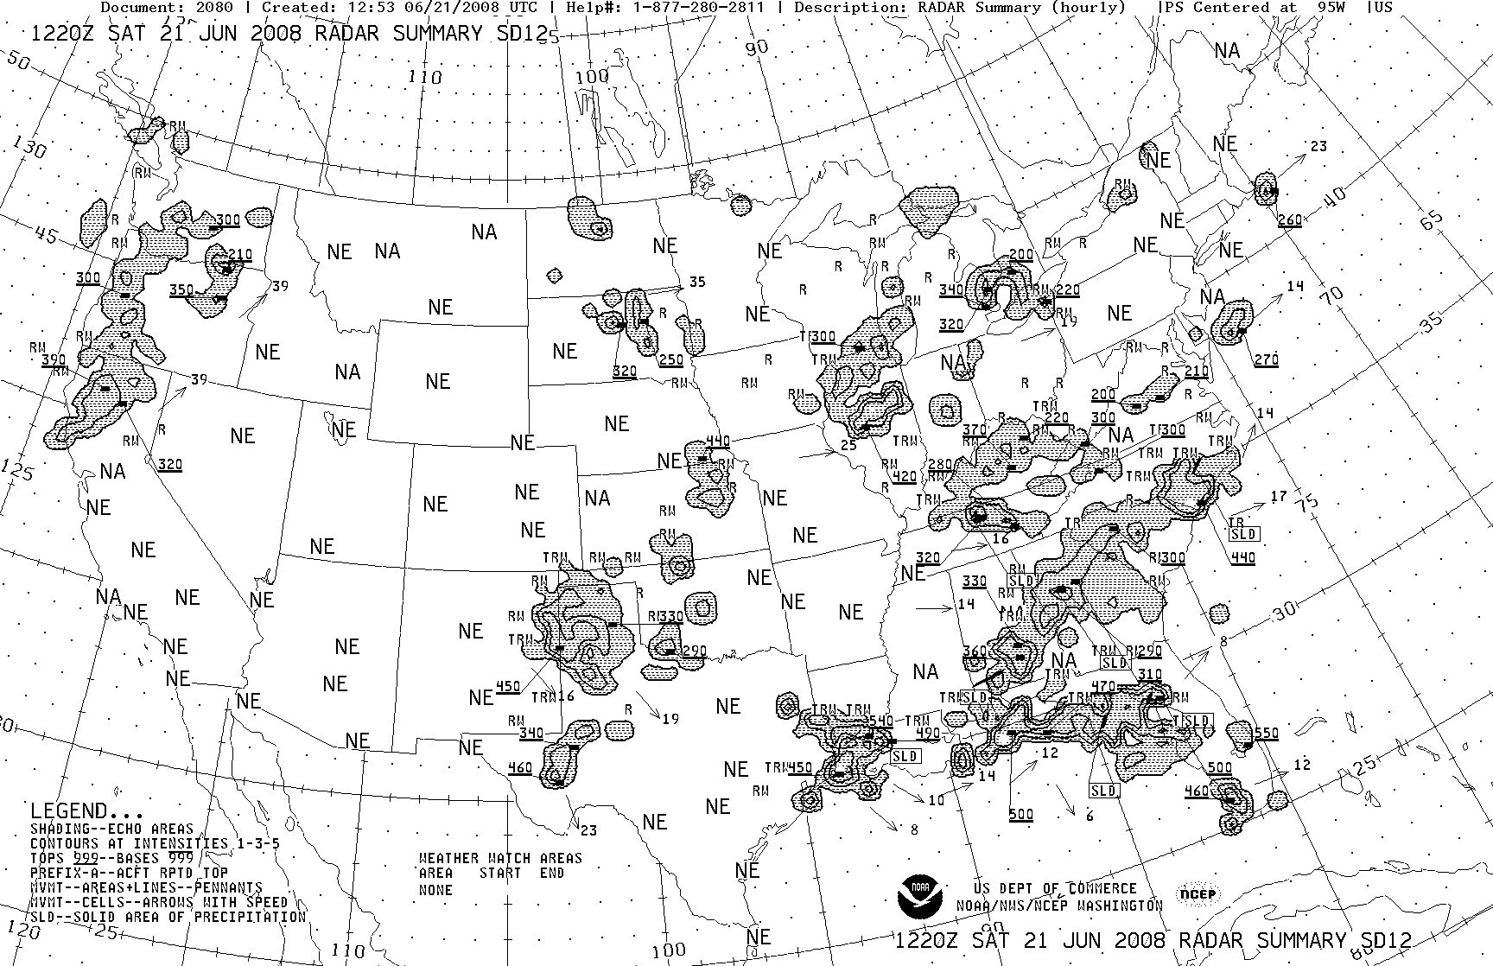
Radar Summary Chart
Issued hourly
Provides echo tops, echo strength, and cell movement

Slide 5
Radar Summary Chart
NE = No echo
NA = Not available – big difference!
OM = Out for Maintenance
1st Contour – Level 1-2 radar return
2nd Contour – Level 3-4 radar return
3rd Contour – Level >5 radar return
R = Rain
RW = Rain Showers
TRW = Thunderstorms/rain showers
Underlined numbers – echo tops (100s of feet)
Arrows/numbers –direction and speed (kts)

Slide 6
Radar Summary Chart

Slide 7
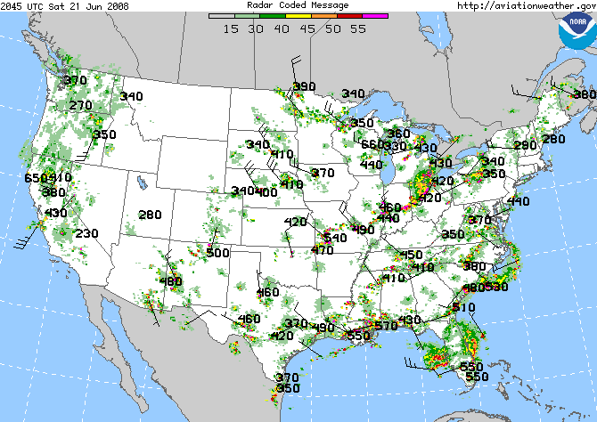
Radar Coded Message
Similar to Radar Summary but color-coded and updated half-hourly
Numbers indicate echo tops, wind barbs represent cell movement

Slide 8
Why I hate the Radar Summary Chart—and you should too!

Slide 10
Ground clutter and terrain—not precip.!

Slide 11
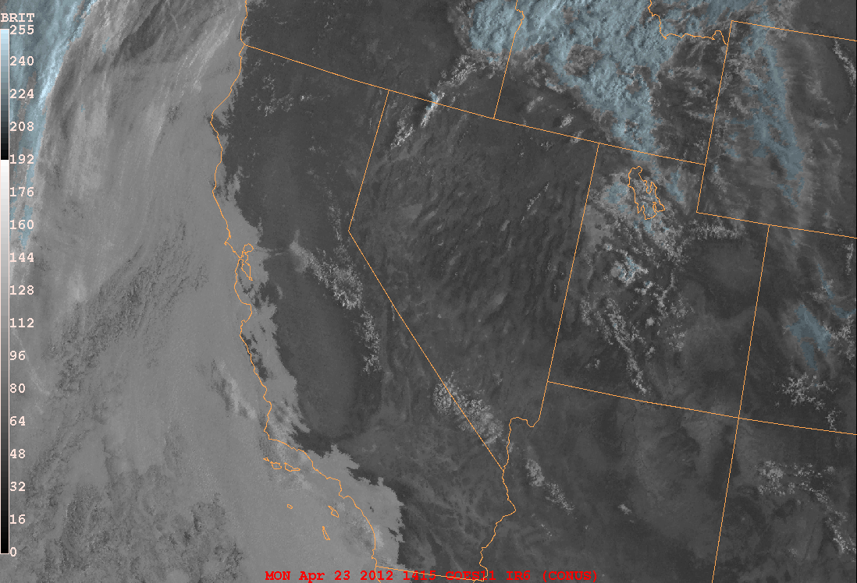
Mosher’s “Day/Night Vis” at 1400z: Fog/stratus/DZ along coast.
Snow, a few Cu in the mountains.
Sacramento Valley: No clouds and no precipitation!

Slide 12
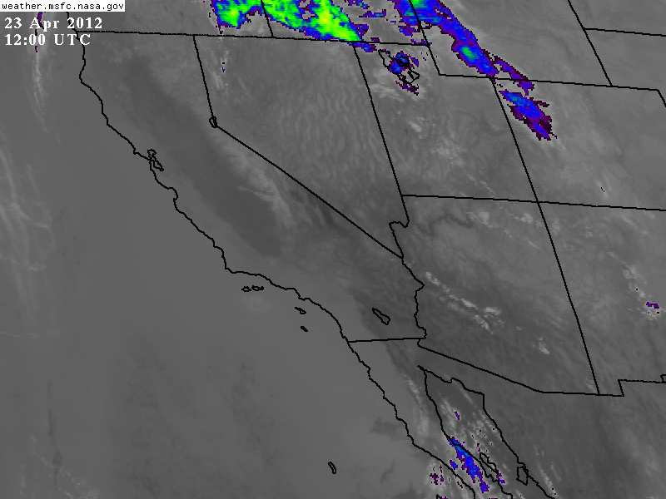
GOES IR Image—no rainclouds over AZ or CA!

Slide 13
Radar Coded Messages for same time shows no precip. in CA and AZ.

Slide 14
But wait…it gets worse…

Slide 15
Thunderstorms in the Sothern California desert?

Slide 16
Yuma, AZ radar.

Slide 17
Hanford, CA radar.

Slide 18
Edwards Air Force Base radar.

Slide 19
GOES VIS Satellite 1530z.

Slide 20
“No human intervention” leads to thundershowers with 39,000 ft tops being reported based on ground clutter and anomalous propagation!
That’s why I hate the Radar Summary Chart—and you should too!!

