Slide 1
Virtualization Attacks
Undetectable Bluepill

Slide 2
Virtualization and its Attacks
What is Virtualization?
What makes it possible?
How does it affect security?
Blue Pill Attacks
Conclusion
Questions

Slide 3
What’s Virtualization?
Software or Hardware Assisted
Emulates guest operating systems or systems
Can be used to:
Run alternate OS’s
Provide a security layer to the main system
Ex. Run risky processes in a virtual honeypot
Duplicate environments
Run servers
Etc…

Slide 4
What’s the Difference?
Software Virtualization
Hardware Virtualization
Emulates Guest Code
Binary translation of critical commands
Not full virtualization
Commonly used
VMWare, Parallels, etc.
AMD-V / Intel VT-x
Code isn’t emulated
Allows full virtualization
Very efficient code execution
Increasingly popular

Slide 5
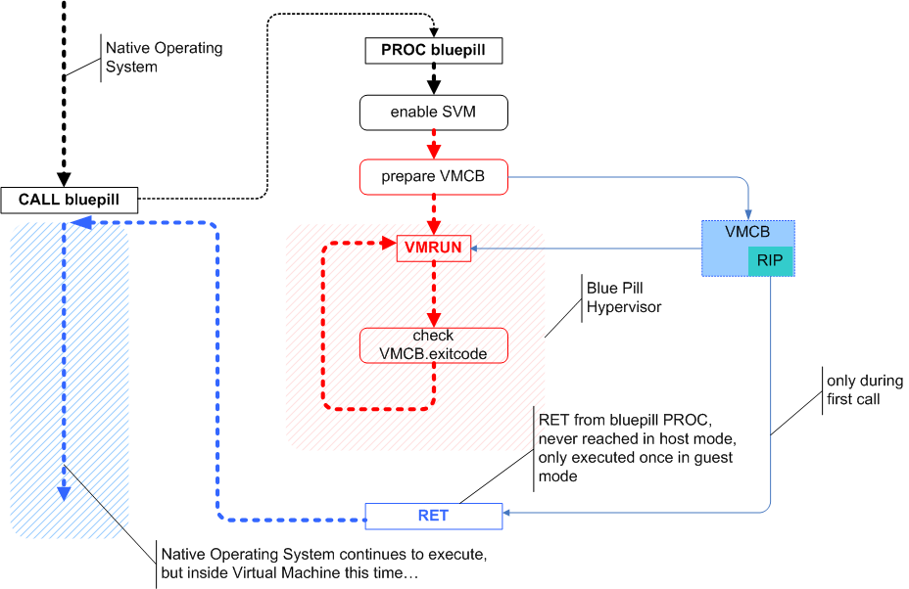
What are the implications?
BLUE Pill (© COSEINC Research, Advanced )Malware Labs, 2006)

Slide 6
Bluepill exists outside the matrix…
System itself is virtualized
Control over ‘interesting’ events
Heuristic scans
Infected Kernel Detection
Etc.
Hardware doesn’t need to be virtualized
No detectable performance penalty
Undetectable?

Slide 7
Virtualization Detection (Redpill)
Code exists claiming to detect Bluepill infections
Timing attack based algorithms
Register Location Detection (Modified under VM)
Only Detects Virtualization, not BluePill Malware!!!!
Variety of programs use virtualization = huge number of false positives (not every VM is a bluepill infection)
Many Redpill designs are processor model specific, subject to large error rates
Inaccurate, difficult to trust!

Slide 8
Is there any good news?
Basic Rootkits / kernel malware are still effective
No need to implement high level virtualization attacks
Not all public machines are hardware virtualization capable, less reward.
Will be most effective with the rise of virtualization implementation (servers, A/V, etc.) which are still a few years out
A few years to prepare

Slide 9
Conclusion
Hardware Virtualization
Virtualization Attacks
Detection
Questions?

