Slide 1
Home Intrusion Detection System
Andre, Irena, Priyanka, Wileen

Slide 2
Intrusion Detection
Based on ubiquitous computing
can occur using any device, in any location, in any format
Our system is designed to be:
lightweight
portable
mobile

Slide 3
Hardware
Raspberry Pi
Raspberry Pi camera
Logitech Quickcam (for audio)
Edimax USB wireless adapter

Slide 4
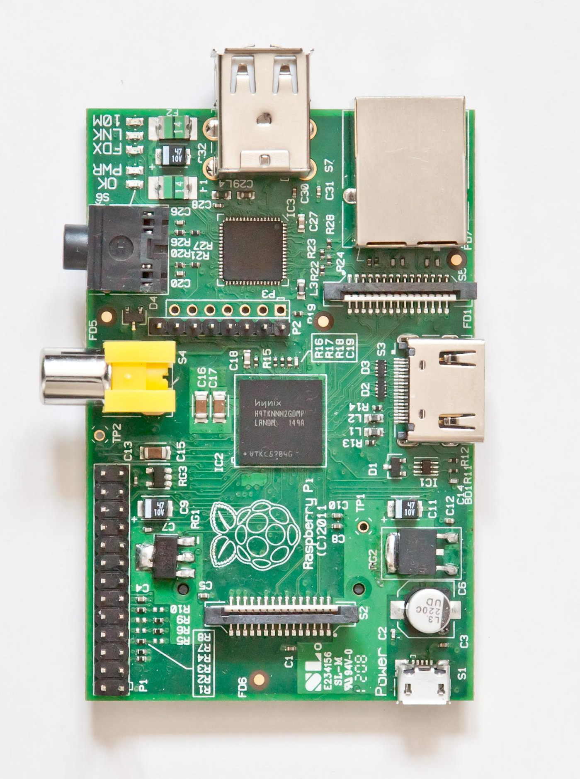
Raspberry Pi
Credit card sized, single-board computer
700 MHz ARM processor
Uses SD card for booting and storage
Runs Raspbian, a Debian-based OS
HDMI, 2xUSB, audio out, composite video, Ethernet

Slide 5
What Can It Do
Detect motion and capture video or take a snapshot
Upload to Google Drive to view online
Capture audio and upload
Alert owner through email and/or text message
Controls accessible through web server running on Raspberry Pi

Slide 6
Software
Most code is in Python
Google Speech API used for audio
Motion used used for motion detection
Detects number of changed pixels

Slide 7
Future
Add facial recognition feature
Improve voice recognition
Make more features available through web server

