Slide 1
Vehicular Ad-Hoc Networks

Slide 2
overview
Motivation
Ongoing research on VANETs
Introduction
Objectives
Applications
Possible attacks
Conclusion

Slide 3
Motivation
Safety and transport efficiency
  Congestion costs the U.S. economy over $100 billion per year.
  Vehicle occupancy has dropped 7% in the last two decades.
  In Europe around 40,000 people die and more than 1.5 millions are injured every year on the roads
  Traffic jams generate a tremendous waste of time and of fuel

Slide 4
Ongoing research on VANETs
» USA:
– Vehicle Safety Communications Consortium (VSCC)
http://www-nrd.nhtsa.dot.gov/pdf/nrd-12/CAMP3/pages/VSCC.htm/
– DSRC/WAVE Technology
http://www.leearmstrong.com/DSRC/DSRCHomeset.htm/ (all info, up to date)
http://grouper.ieee.org/groups/scc32/dsrc/index.html/ (standardization)
» Europe:
– Car to Car Communication Consortium
http://www.car-to-car.org/
– PReVENT
http://www.prevent-ip.org/
– CarTalk
http://www.cartalk2000.net/
– Network on Wheels (Germany)
http://www.network-on-wheels.de/
» Japan:
– ITS Japan
http://www.its-ip.org/

Slide 5
INTRODUCTION
Ad-Hoc Network:
  A network with minimal or no infrastructure
  It is a temporary network composed of mobile terminals fitted with a relay function.
  Self-organizing
  Mobile nodes act as network router
  mobile nodes provides not only function for information transmission and reception but also function for information relay.

Slide 6
INTRODUCTION
What is VANET?
It is special form of MANET and it provides
• Vehicle-to-vehicle communications
• Vehicle-to-infrastructure communications
  Uses equipped vehicles as the network nodes
  Nodes move at will relative to each other but within the constraints of the road infrastructure

Slide 7
VANET

Slide 8
OBJECTIVES
VANETs promises safer roads, assures less or no accidents.

Slide 9
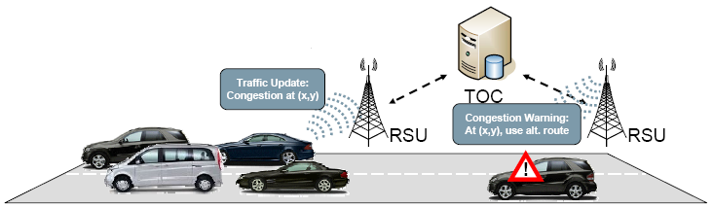
More efficient driving
By letting the driver know about the traffic.

Slide 10
More fun and entertainment

Slide 11
Smart vehicle

Slide 12
Smart vehicle
EDR –
  Used in vehicles to register all important parameters, such as velocity, acceleration, etc. especially during abnormal situations (accidents)
Forward radar –
  Used to detect any forward obstacles as far as 200 meters
Positioning System –
  Used to locate vehicles
  Accuracy can be improved by knowledge of road topology
Computing platform –
  Inputs from various components are used to generate useful information

Slide 13
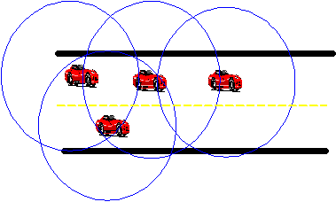
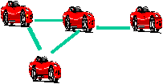
Message propagates to destination using a number of intermediate links

Slide 14
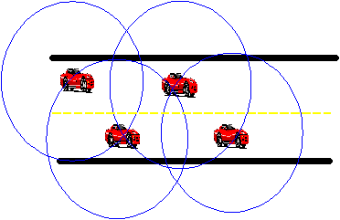

If vehicle mobility causes links to break, message rerouted using a different path

Slide 15
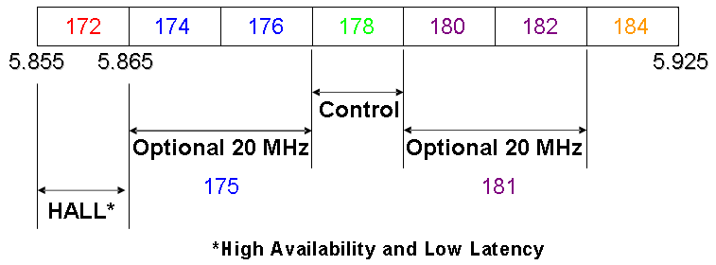
Dedicated Short Range Communications (DSRC)
DSRC operates at 5.9 GHz

Slide 16
DSRC – Operating Characteristics
IEEE 802.11p protocol (802.11a modification for VC)
Maximum range: 1000 m
Vehicle speeds up to 100 mph
Low latency: 50 ms
Application priority: 8 levels
Channel 172: vehicle safety only

Slide 17
How does DSRC work?
Road-Side Unit (RSU)
  Announces to OBUs 10 times per second applications it supports on which channel
On-Board Unit (OBU)
  Listens on Channel 172
  Executes safety applications first
  Then switches channels
  Executes non-safety applications
  Returns to Channel 172 and listens

Slide 18
Differences from manet
Limited Redundancy
  The redundancy in MANETs is critical to providing additional bandwidth
  In VANETs the redundancy is limited both in time and in function
Rapid Topology Changes
  High relative speed of vehicles => short link life
large scale – potentially billion

Slide 19
VANET applications
Safety alerts
  Requirement: Bounded latency
  Primary Issue: Broadcast storm
Congestion warning
  Requirement: Message persistence
  Primary Issue: Disconnected network
Infotainment
  Requirement: End-to-end connectivity
  Primary Issue: Disconnection due to high mobility

Slide 20
Application-1 : Congestion Detection
Vehicles detect congestion when:
  # Vehicles > Threshold 1
  Speed < Threshold 2
Relay congestion information
  Hop-by-hop message forwarding
  Other vehicles can choose alternate routes

Slide 21
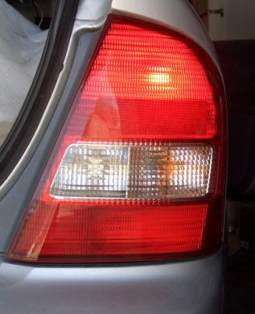
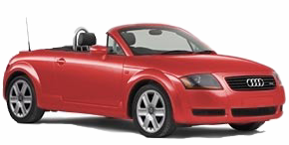
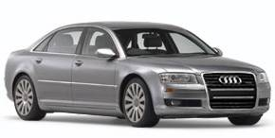
Application-2 : Deceleration Warning
Prevent pile-ups when a vehicle decelerates rapidly

Slide 22
ADVERSARIES
A realistic assessment of the vehicular environment suggests the following classes of adversaries
Greedy drivers
Snoops.
Pranksters.
Malicious Attackers.

Slide 23
Attackers
Insider or outsider
  Insider – valid user
  Outsider – Intruder, limited attack options
Malicious or rational
  Malicious – No personal benefit, intends to harm other users
  Rational – seeks personal benefits, more predictable attack
Active or passive
  Active: Generates packets, participates in the network
  Passive: Eavesdrop, track users

Slide 24
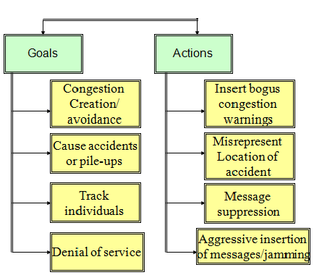
attacks
Security Attacks

Slide 25
Attacks
Basic attacks
  Bogus information
  Cheating with sensor information
  ID disclosure
  Denial of service
Sophisticated attacks
  Hidden vehicle
  Tunnel attack

Slide 26
Bogus information attack

Slide 27
Hidden vehicle attack

Slide 28
Tunnel attack

Slide 29
conclusion
In VANETs, vehicles are mobile nodes which communicate with each other and also with Road side unit(RSU).
Provides many useful applications such as traffic optimization, payment services, location-based services, infotainment.
We have analyzed the threat, general classification of attacks, posed on the vehicular networks.

Slide 30
Thank you

