Slide 1
MOBILE AD-HOC NETWORKS
BY
Vivek vardhan reddy tatikonda

Slide 2
Introduction
Mobile Ad Hoc Network (MANET) is a completely wireless connectivity through the nodes constructed by the actions of the network.

Slide 3
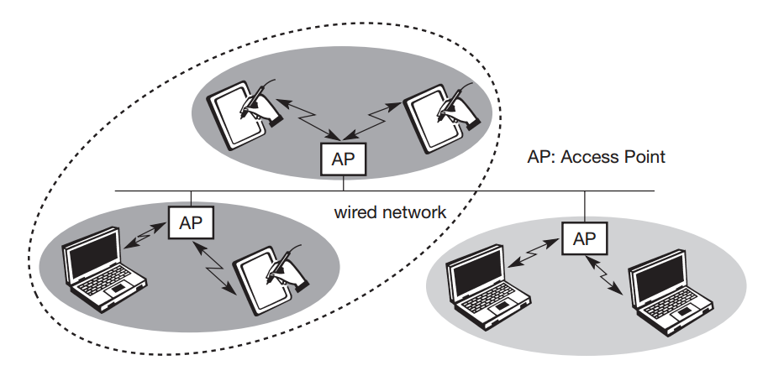
Wireless Networks
There are two types of Wireless Networks:
Infrastructure Network:
Infrastructure networks not only provide access to other networks, but also include forwarding functions, medium access control etc.
Source: https://sgar91.files.wordpress.com/2011/10/mobile_communications_schiller_2e.pdf.

Slide 4
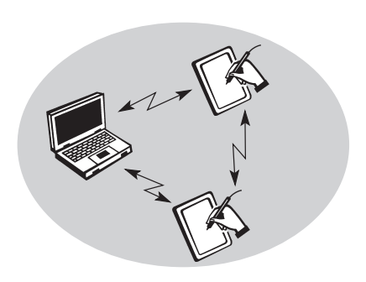
AD-HOC NETWORK:
Ad-hoc wireless networks, however, do not need any infrastructure to work. Each node can communicate directly with other nodes, so no access point controlling medium access is necessary.
Source: https://sgar91.files.wordpress.com/2011/10/mobile_communications_schiller_2e.pdf.

Slide 5
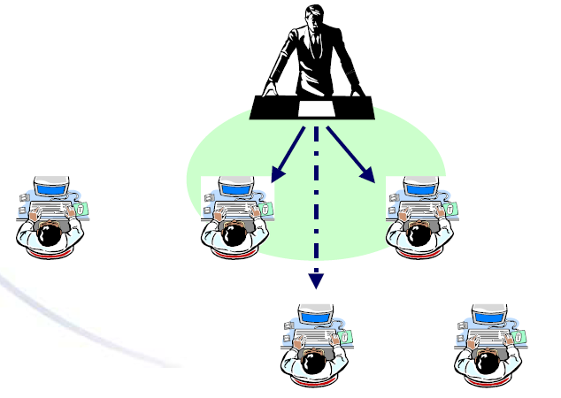
Single Hop AD-HOC
Source: http://ae.hc.cust.edu.tw/new_website/attachments/article/146/Lecture%2014.ppt

Slide 6
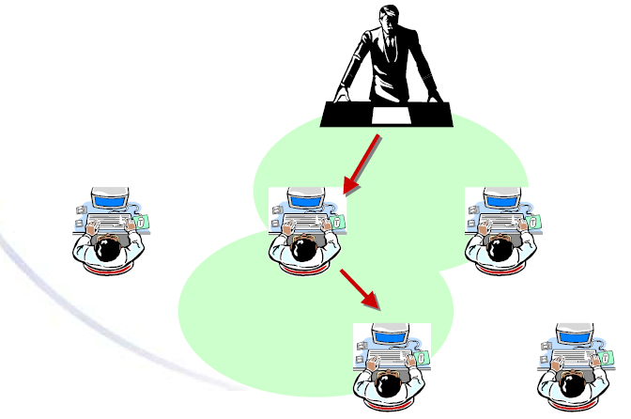
Multi-Hop AD-HOC
Source: http://ae.hc.cust.edu.tw/new_website/attachments/article/146/Lecture%2014.ppt

Slide 7
MANET = Mobile Ad Hoc Networks
A set of mobile hosts, each with a transceiver.
no base stations; no fixed network infrastructure.
multi-hop communication.
needs a routing protocol which can handle changing topology.

Slide 8
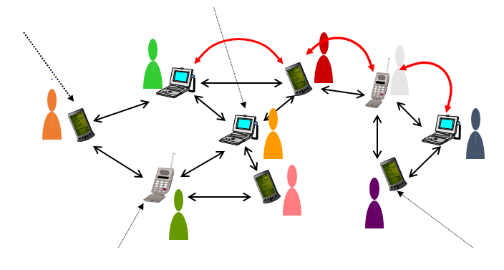
Representation Of MANET
8
Source: http://ae.hc.cust.edu.tw/new_website/attachments/article/146/Lecture%2014.ppt

Slide 9
The fundamentals for the Mobile Ad Hoc Networks
Dynamic topologies.
Bandwidth-constrained.
Energy-constrained operation.
Limited physical security.

Slide 10
Applications of Ad-hoc Networks
Military battlefield.
Commercial sector.
Local level.
Personal Area Network (PAN).

Slide 11
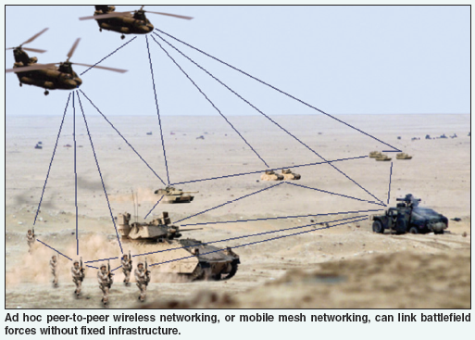
Military Battlefield.
Source: http://ae.hc.cust.edu.tw/new_website/attachments/article/146/Lecture%2014.ppt

Slide 12
THANK YOU

