Slide 1
Text Mining
Principles of Data Mining
Published by Springer-Verlag. 2007

Slide 2
Representing Text Documents for Data Mining
bag-of-words representation Example： (1) Tony likes to watch movies. John likes movies too. (2) Tony also likes to watch football games. Based on these two text documents, a list is constructed as follows： {“Tony”,”likes”,”to”,”watch”,”movies”,”also”,”football”, ”games”,”John”,”too”}
local dictionary
global dictionary

Slide 3
Stop Words and Stemming
stop words：common words that are likely to be useless for classiﬁcation. ex：‘a’, ‘an’, ‘the’, ‘is’, ‘I’, ‘you’ and ‘of’.
stemming：this is based on the words in documents often have many morphological variants. ex：computing, computer, computation, computational etc. might be stemmed to ‘comput’.

Slide 4
Representing Text Documents: Constructing a Vector Space Model
the total number of features is N , the terms in some arbitrary order as $t_{1}$, $t_{2}$, ..., $t_{N}$. The ith document as an ordered set of N values, which we will call an N-dimensional vector and write as ($X_{i1}$, $X_{i2}$, ... , $X_{iN}$). The complete set of vectors for all documents is called a vector space model(VSM).
In general we can say that value $X_{ij}$ is a weight measuring the importance of the jth term tj in the ith document.

Slide 5
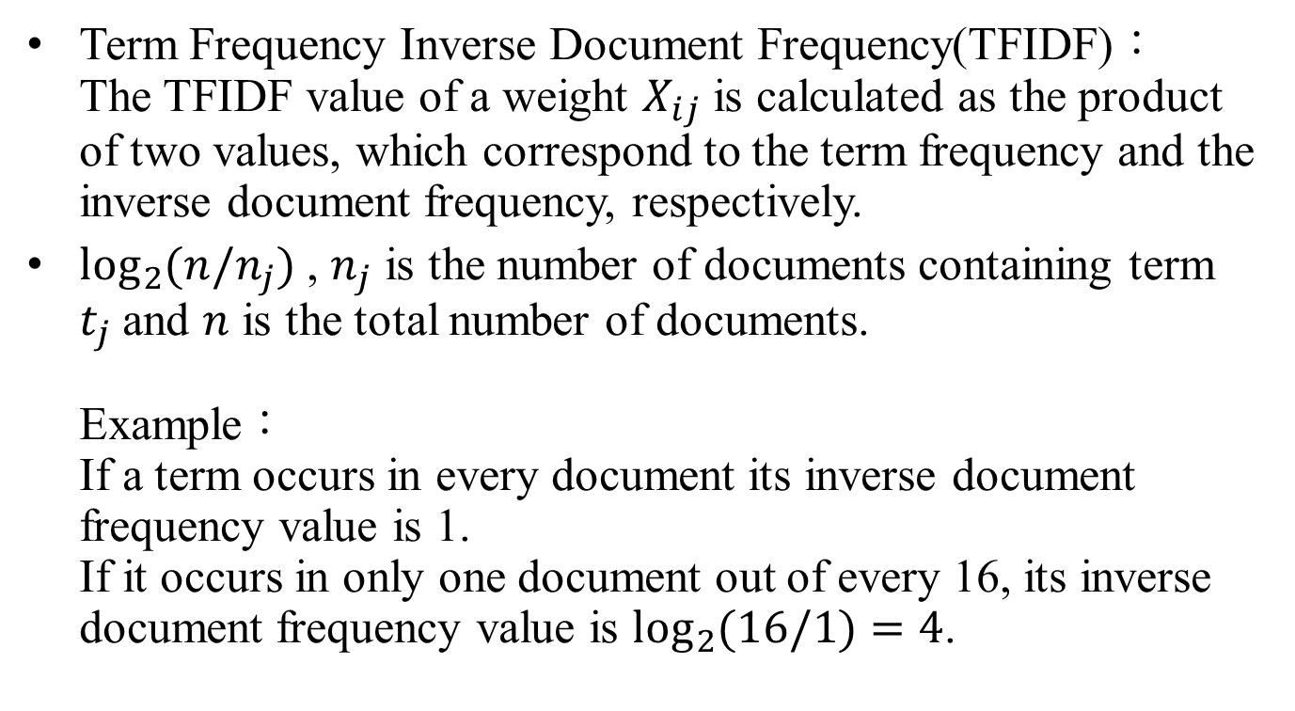
Representing Text Documents: Constructing a Vector Space Model
Term Frequency Inverse Document Frequency(TFIDF)： The TFIDF value of a weight $X_{ij}$ is calculated as the product of two values, which correspond to the term frequency and the inverse document frequency, respectively.
$\log_{2}{(n/n_{j})}$ , $n_{j}$ is the number of documents containing term $t_{j}$and $n$ is the total number of documents. Example： If a term occurs in every document its inverse document frequency value is 1. If it occurs in only one document out of every 16, its inverse document frequency value is $\log_{2}{(16/1)}=4$.

Slide 6
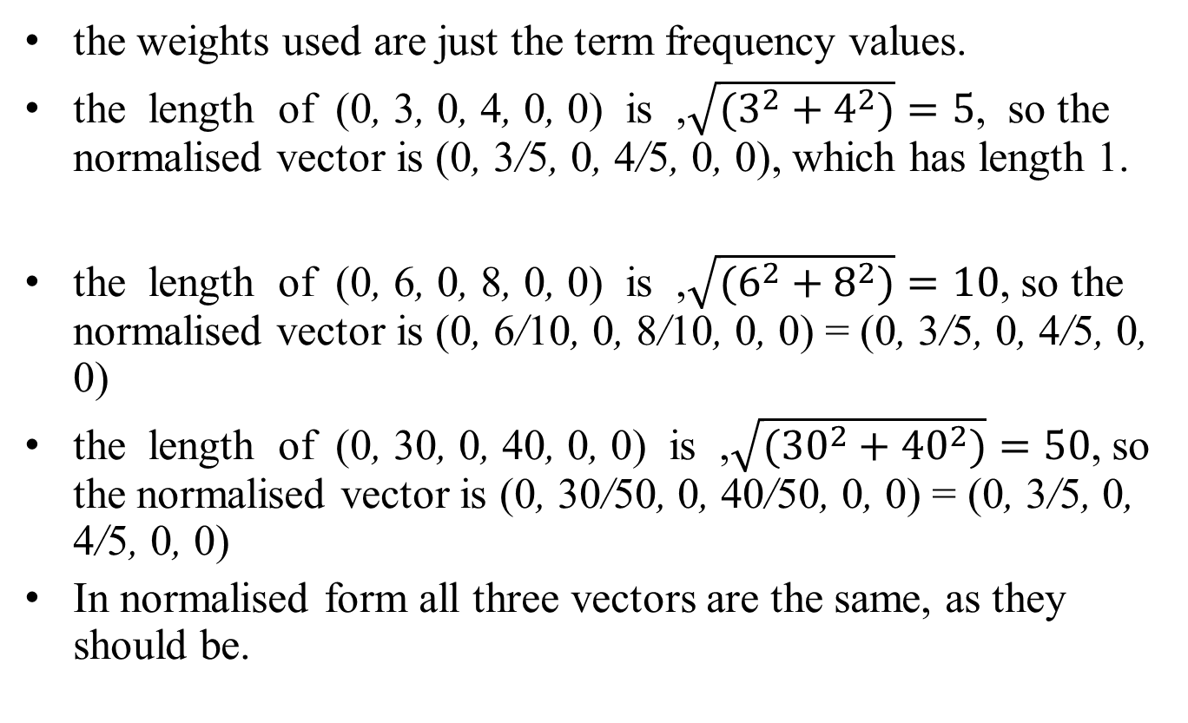
Normalising the Weights
the weights used are just the term frequency values.
the length of (0, 3, 0, 4, 0, 0) is ,$\sqrt{(3^{2}+4^{2})}=5$, so the normalised vector is (0, 3/5, 0, 4/5, 0, 0), which has length 1.
the length of (0, 6, 0, 8, 0, 0) is ,$\sqrt{(6^{2}+8^{2})}=10$, so the normalised vector is (0, 6/10, 0, 8/10, 0, 0) = (0, 3/5, 0, 4/5, 0, 0)
the length of (0, 30, 0, 40, 0, 0) is ,$\sqrt{({30}^{2}+{40}^{2})}=50$, so the normalised vector is (0, 30/50, 0, 40/50, 0, 0) = (0, 3/5, 0, 4/5, 0, 0)
In normalised form all three vectors are the same, as they should be.

Slide 7
Measuring the Distance Between Two Vectors
We deﬁne the dot product of two unit vectors of the same dimension to be the sum of the products of the corresponding pairs of values. Example： If we take the two unnormalised vectors (6, 4, 0, 2, 1) and (5, 7, 6, 0, 2), normalising them to unit length converts the values to (0.79, 0.53, 0, 0.26, 0.13) and (0.47, 0.66, 0.56, 0, 0.19). The dot product is now 0.79 $×$ 0.47 + 0.53 $×$ 0.66 + 0 $×$ 0.56 + 0.26 $×$ 0 + 0.13 $×$ 0.19 = 0.74 approximately. So a measure of the distance between the two values, which is 1 − 0.74 = 0.26.

Slide 8
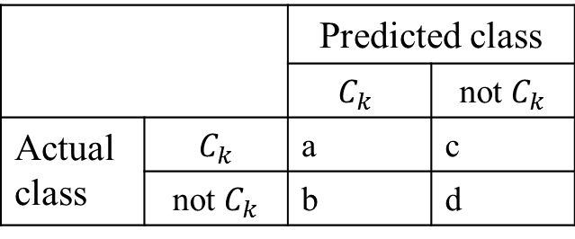
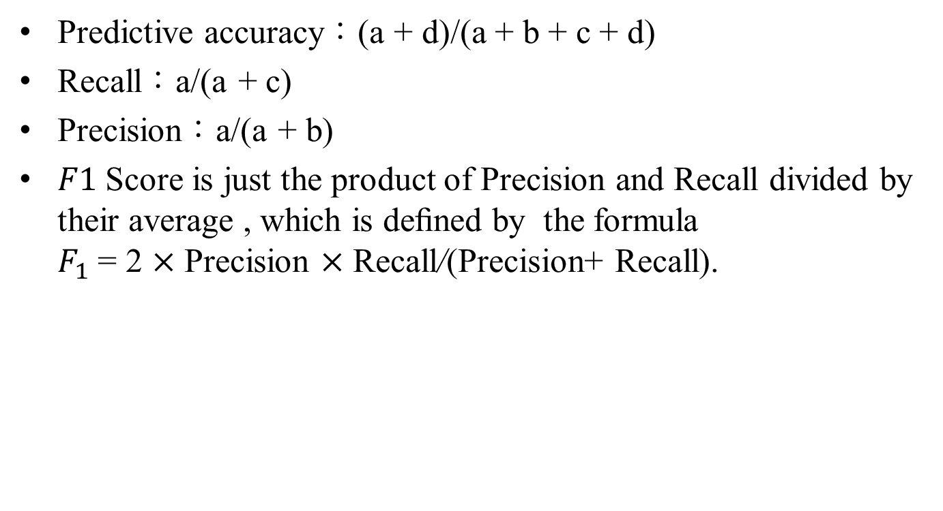
Measuring the Performance of a Text Classiﬁer
Predictive accuracy：(a + d)/(a + b + c + d)
Recall：a/(a + c)
Precision：a/(a + b)
$F1$ Score is just the product of Precision and Recall divided by their average , which is deﬁned by the formula $F_{1}$ = 2 $×$ Precision $×$ Recall/(Precision+ Recall).
 |  | Predicted class
 |  | $$C_{k}$$ | not $C_{k}$
Actual class | $$C_{k}$$ | a | c
 | not $C_{k}$ | b | d

Slide 9
Hypertext Categorisation
The automatic classiﬁcation of web pages, i.e. HTML ﬁles, is usually known as Hypertext Categorisation (or Hypertext Classiﬁcation).

Slide 10
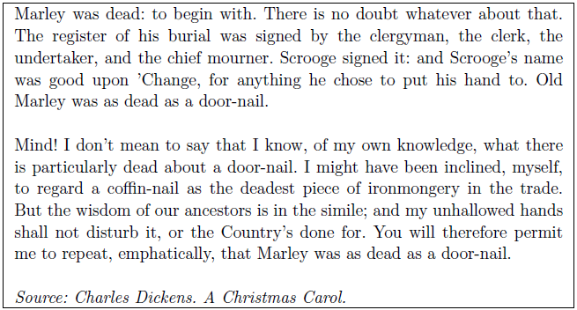
Hypertext Classiﬁcation versus Text Classiﬁcation
Text Classiﬁcation： In text classiﬁcation the words that the human reader sees are very similar to the data provided to the classiﬁcation program.

Slide 11
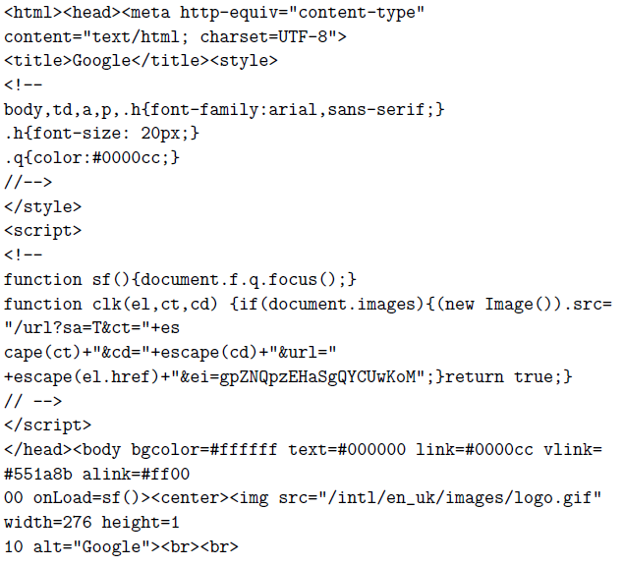
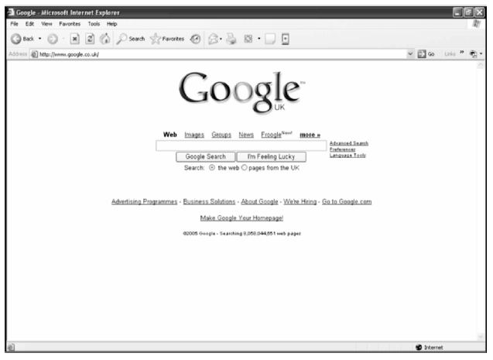
Hypertext Classiﬁcation versus Text Classiﬁcation
Hypertext Classiﬁcation：

