Slide 1
Local Binary Patterns And It’s Variants For Face Recognition
K.Meena, Dr.A.Suruliandi
IEEE-International Conference on Recent Trends in Information Technology, ICRTIT 2011 MIT, Anna University, Chennai. June 3-5, 2011
Report Date: 2011/12/23
Reporter: MING-RU ZHAN(詹明儒)

Slide 2
Outline
Introduction
Texture Models
Local binary pattern(LBP)
Multivariate Local binary pattern(MLBP)
Center Symmetric Local binary pattern(CS-LBP)
Local binary pattern variance(LBPV)
Classification Principle
Experiments
Conclusion

Slide 3
Introduction(1/2)
Facial recognition plays a vital rule in human computer interaction.
This skill quite robust, despite large changes in the visual stimulus due to viewing conditions.
The Local Binary Pattern aim of texture classification.
The Local Binary Patter method is computationally simple and rotation invariant method.

Slide 4
Introduction(2/2)
Face image is divided into several regions and LBP is applied and features are extracted over the region.
MLBP is widely used for image classification and segmentation.
CS- LBP has several advantages such as tolerance to illumination changes, robustness on flat image areas and computational efficiency.
LBPV is the local contrast information into one dimensional LBP histogram.

Slide 5
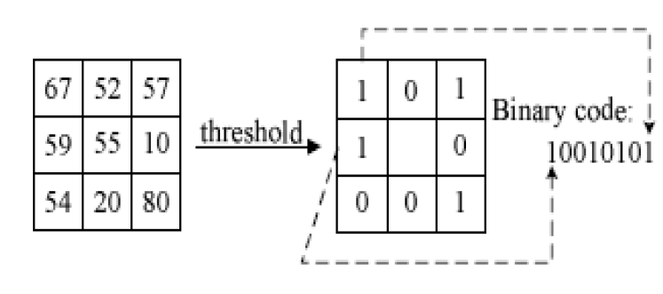
Texture Models-Local binary pattern(LBP)(1/2)
LBP of a pixel is formed by threshold the 3X3 neighborhood of each pixel value with the center pixel’s value.
Figure 1. Illustration of Basic LBP operator

Slide 6
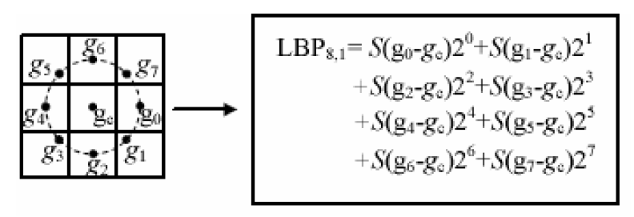
Texture Models-Local binary pattern(LBP)(2/2)
Figure 2. The LBP operator of a pixel’s circular neighborhoods
(1)

Slide 7
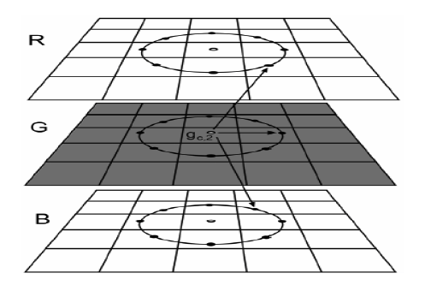
Texture Models-Multivariate Local binary pattern(MLBP)
Figure 3. MLBP texture measure describes
spatial relations within a band and between bands
(2)
Notes:
Waste times

Slide 8
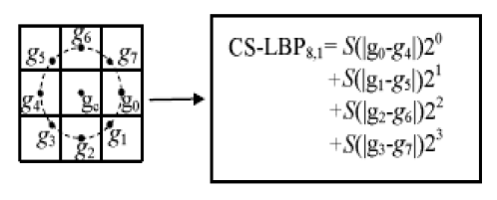
Texture Models-Center Symmetric Local binary pattern(CS-LBP)
It also reduces the computational complexity when compared with LBP.
Figure 4. CS-LBP feature for a neighborhood of 8 pixel
(3)

Slide 9
Texture Models-Local binary pattern variance(LBPV)
(4)
(5)
Notes:
影像局部空間結構與對比度來截取影像的紋理特徵，

Slide 10
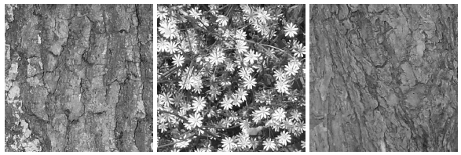
Classification principle
Training
In the training phase, using the proposed feature extraction algorithm.
Texture Similarity
Figure 5. Texture
(6)

Slide 11
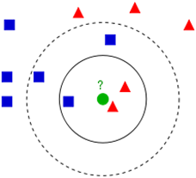
Classification principle
Classification
In the texture classification phase, author used K-Nearest Neighbor(KNN) classification algorithm
Figure 6. Example of k-NN classification
Notes:
K-NN 第k位最接近的鄰居

Slide 12
Experiments- Experimental Data
Figure 7. Sample Images from JAFFE Female database
Figure 8. Samples from the CMU-PIE face database.
Figure 9. Samples from the FRGC Version2 face database.

Slide 13
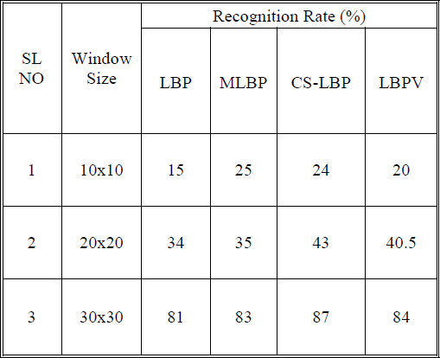
Experiments- Experimental comparisons on JAFFE Female database
Table 1. Recognition Rate For Different Window Size

Slide 14
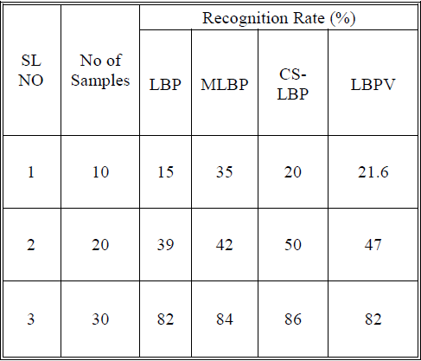
Experiments- Experimental comparisons on JAFFE Female database
Table 2. RECOGNITION RATE FOR DIFFERENT NUMBER OF SAMPLES

Slide 15
Conclusion
In this paper LBP and its modified models CS-LBP, MLBP and LBPV were analyzed.
CS-LBP provide good recognition rate than other methods and also it consumes less computational time.

Slide 16
Personal Remark
Author used one image as a sample training image, maybe to cause inaccuracy .
In this paper, the function define is unclear, just like parameter not prior define.
Notes:
準確率有待商榷

