Slide 1
DATA MINING WITH CLUSTERING
Suresh Merugu, IITR

Slide 2
Overview
Definition of Clustering
Existing Clustering Methods
Clustering Examples
Classification
Classification Examples

Slide 3
Definition
Cluster: A collection of data objects
  Similar to one another within the same cluster
  Dissimilar to the objects in other clusters
Cluster Analysis
  Finding similarities between data according to the characteristics found in the data and grouping similar data objects into clusters
Unsupervised learning: No predefined classes
Typical Applications
  As a stand-alone tool to get insight into data distribution
  As a Preprocessing step for other algorithms

Slide 4


Raw Data
Clustering Algorithm
Clusters of Data

Slide 5
Why clustering?
A few good reasons ...
    Simplifications
    Pattern detection
    Useful in data concept construction
    Unsupervised learning process

Slide 6
Where to use Clustering?
Data Mining
Information Retrieval
Text Mining
Web Analysis
Marketing
Medical Diagnostic

Slide 7
Examples of Clustering Applications
Marketing: Help marketers discover distinct groups in their customer bases, and then use this knowledge to develop targeted marketing programs
Land Use: Identification of areas of similar land use in an earth observation database
City-Planning: Identifying groups of houses according to their house type, value, and geographical location
Earth-Quake Studies: Observed earth quake epicenters should be clustered along continent faults
Climate: understanding earth climate, find patterns of atmospheric and ocean

Slide 8
Quality: What Is Good Clustering?
A good clustering method will produce high quality clusters with
  high intra-class similarity
  low inter-class similarity
The quality of a clustering result depends on both the similarity measure used by the method and its implementation
The quality of a clustering method is also measured by its ability to discover some or all of the hidden patterns

Slide 9
Basic Steps to Develop a Clustering Task
Feature selection
  Select info concerning the task of interest
  Minimal information redundancy
Proximity measure
  Similarity of two feature vectors
Clustering criterion
  Expressed via a cost function or some rules
Clustering algorithms
  Choice of algorithms
Validation of the results
  Validation test (also, clustering tendency test)
Interpretation of the results
  Integration with applications

Slide 10
Which method should I use?
Type of attributes in data
Scalability to larger dataset
Ability to work with irregular data
Time cost
Complexity
Data order dependency
Result presentation

Slide 11
Major Existing Clustering Methods
Distance-based
Hierarchical
Partitioning
Probabilistic

Slide 12
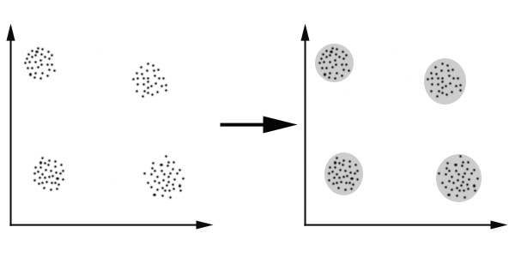
Distance Based Method
In this case we easily identify the 4 clusters into which the data can be divided; the similarity criterion is distance:
Two or more objects belong to the same cluster if they are “close” according to a given distance. This is called distance–based clustering.

Slide 13
Hierarchical Clustering
Agglomerative (bottom up)
Start with 1 point (singleton)
Recursively add two or more appropriate clusters
Stop when k number of clusters is achieved.
Divisive (top down)
Start with a big cluster
Recursively divide into smaller clusters
Stop when k number of clusters is achieved.

Slide 14
Agglomerative (Bottom Up)
Divisive (Top Down)

Slide 15
CURE: Another Hierarchical Approach
Uses a number of points to represent a cluster
Representative points are found by selecting a constant number of points from a cluster and then “shrinking” them toward the center of the cluster
Cluster similarity is the similarity of the closest pair of representative points from different clusters.
Shrinking representative points toward the center helps avoid problems with noise and outliers.
CURE is better able to handle clusters of arbitrary shapes and sizes.
×
×

Slide 16
General Steps of Hierarchical Clustering
Given a set of N items to be clustered, and an N*N distance (or similarity) matrix, the basic process of hierarchical clustering (defined by S.C. Johnson in 1967) is this:
Start by assigning each item to a cluster, so that if you have N items, you now have N clusters, each containing just one item.
Let the distances (similarities) between the clusters the same as the distances (similarities) between the items they contain.
Find the closest (most similar) pair of clusters and merge them into a single cluster, so that now you have one cluster less.
Compute distances (similarities) between the new cluster and each of the old clusters.
Repeat steps 2 and 3 until all items are clustered into K number of clusters

Slide 17
Hierarchical Clustering

Slide 18
Feature Reduction
The feature reduction can be achieved either through feature selection and feature extraction through a number of mathematical tools.
Feature Selection
Selecting few original bands from the whole datasets by some mathematical modeling.
Feature extraction
Projecting the original data set onto adequate sub-spaces.

Slide 19
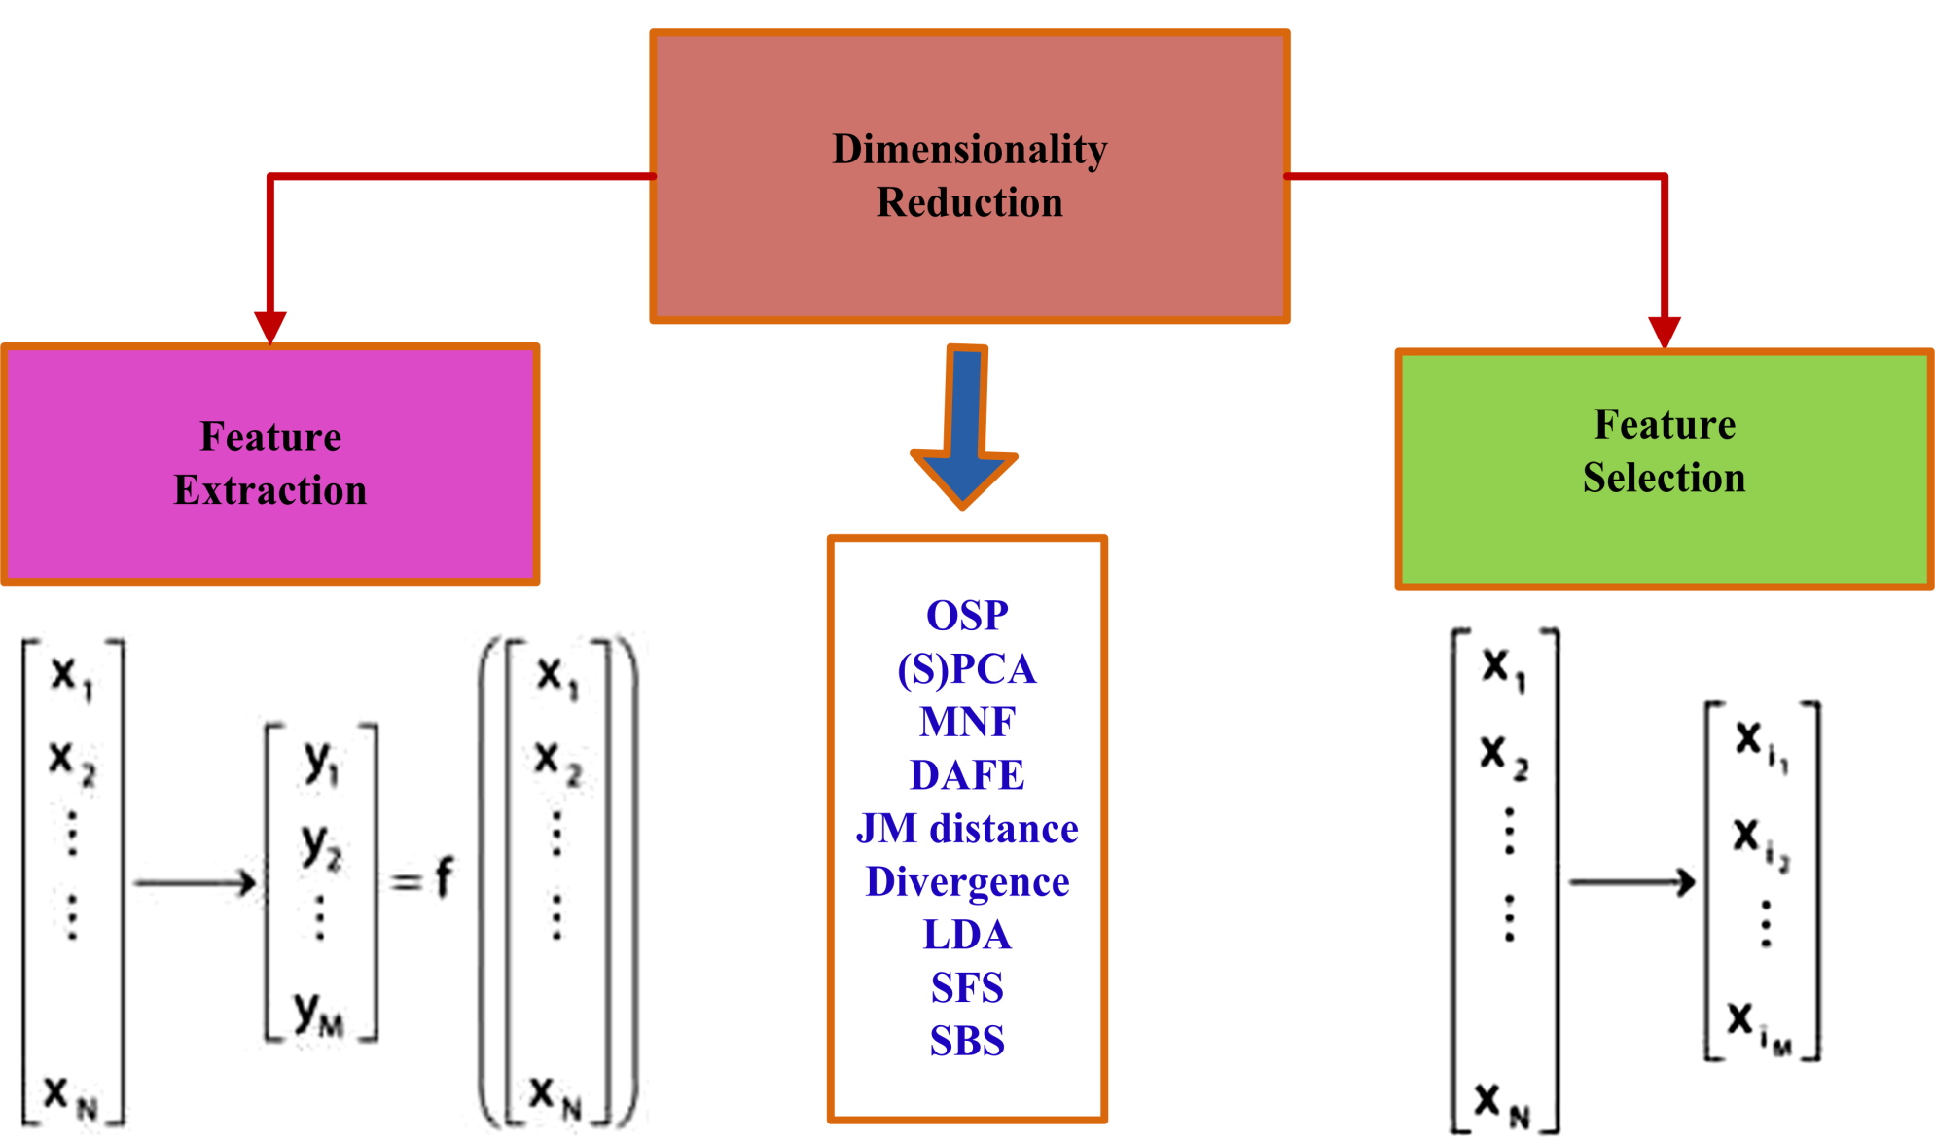
Feature Reduction

Slide 20
Partitioning Clustering
Divide data into proper subset
Recursively go through each subset and relocate points between clusters (opposite to visit-once approach in Hierarchical approach)
    This recursive relocation= higher quality cluster

Slide 21
Probabilistic Clustering
Data are picked from mixture of probability distribution.
Use the mean, variance of each distribution as parameters for cluster
Single cluster membership

Slide 22
Clustering ALGORITHMS
K-means and the Self Organising Maps
Clustering Algorithm
Today several different unsupervised classification algorithms are commonly used in remotely sensed data.
The two most frequently used algorithms are the K-mean and the ISODATA clustering algorithm.
Both of these algorithms are iterative procedures.

Slide 23
Cont…
In general, both of them assign first an arbitrary initial cluster vector.
The second step classifies each pixel to the closest cluster.
In the third step the new cluster mean vectors are calculated based on all the pixels in one cluster.
The second and third steps are repeated until the "change" between the iteration is small.
The "change" can be defined in several different ways, either by measuring the distances the mean cluster vector have changed from one iteration to another or by the percentage of pixels that have changed between iterations.

Slide 24
Cont…
The ISODATA algorithm has some further refinements by splitting and merging of clusters (JENSEN, 1996).
The ISODATA algorithm is similar to the k-means algorithm with the distinct difference that the ISODATA algorithm allows for different number of clusters while the k-means assumes that the number of clusters is known a priori.
K-means (just as the ISODATA algorithm) is very sensitive to initial starting values.

Slide 25
How ISODATA works
Cluster centers are randomly placed and pixels are assigned based on the shortest distance to center method
2) The standard deviation within each cluster, and the
distance between cluster centers is calculated
    Clusters are split if one or more standard deviation
    is greater than the user-defined threshold
    Clusters are merged if the distance between them
    is less than the user-defined threshold
A second iteration is performed with the new cluster
centers

Slide 26
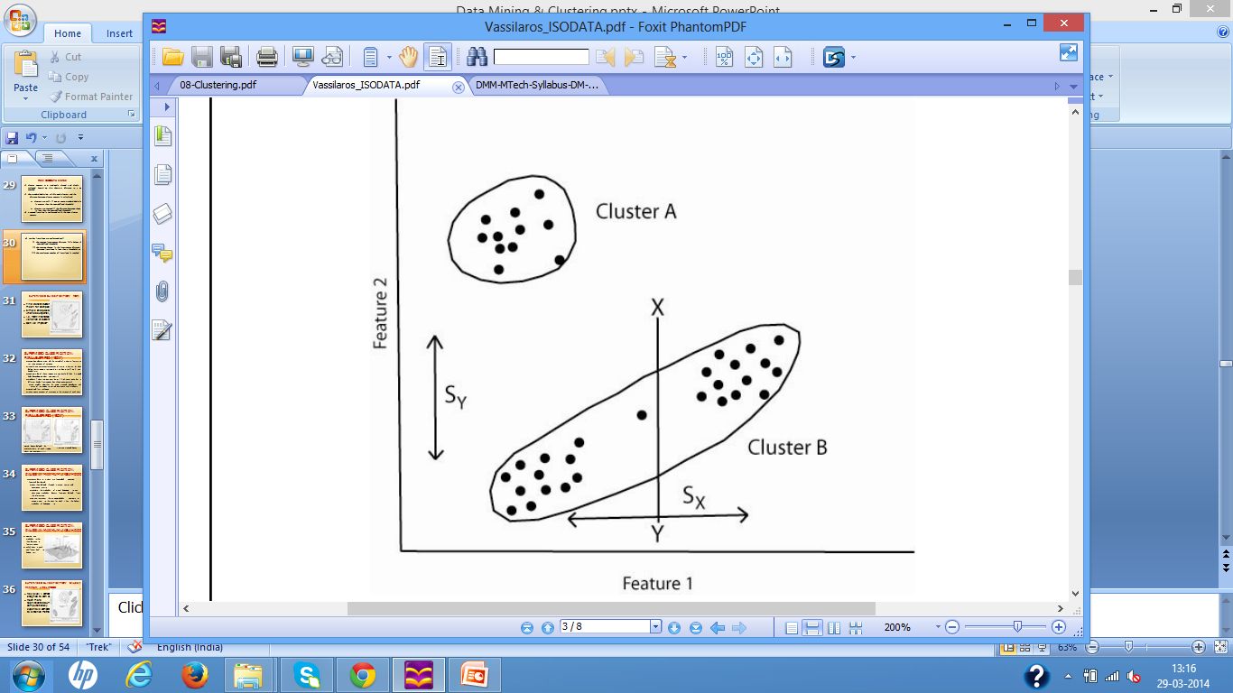
Cont…
4) Further iterations are performed until:
    i) The average inter-center distance falls below the
    user-defined threshold,
    ii) The average change in the inter-center distance
    between iterations is less than a threshold, or
    iii) The maximum number of iterations is reached

Slide 27
K-means (unsupervised)
A set number of cluster centers are positioned randomly through the spectral space.
Pixels are assigned to their nearest cluster.
The mean location is re-calculated for each cluster.
Repeat 2 and 3 until movement of cluster centres is below threshold.
Assign class types to spectral clusters.

Slide 28
Example OF k-means
1. First iteration. The cluster centers are set at random. Pixels will be assigned to the nearest center.
2. Second iteration. The centers move to the mean-center of all pixels in this cluster.
3. N^{th} iteration.
The centers have stabilized.

Slide 29
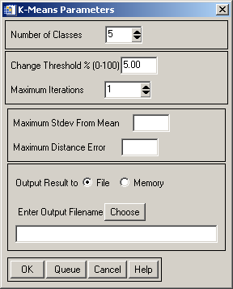

Slide 30
Example OF ISODATA
1. Data is Clustered but blue cluster is very stretched in band 1.
2.Cyan and green clusters only have 2 or less pixels. So they will be Removed.
3. Either assign outliers to nearest cluster, or mark as unclassified.

Slide 31
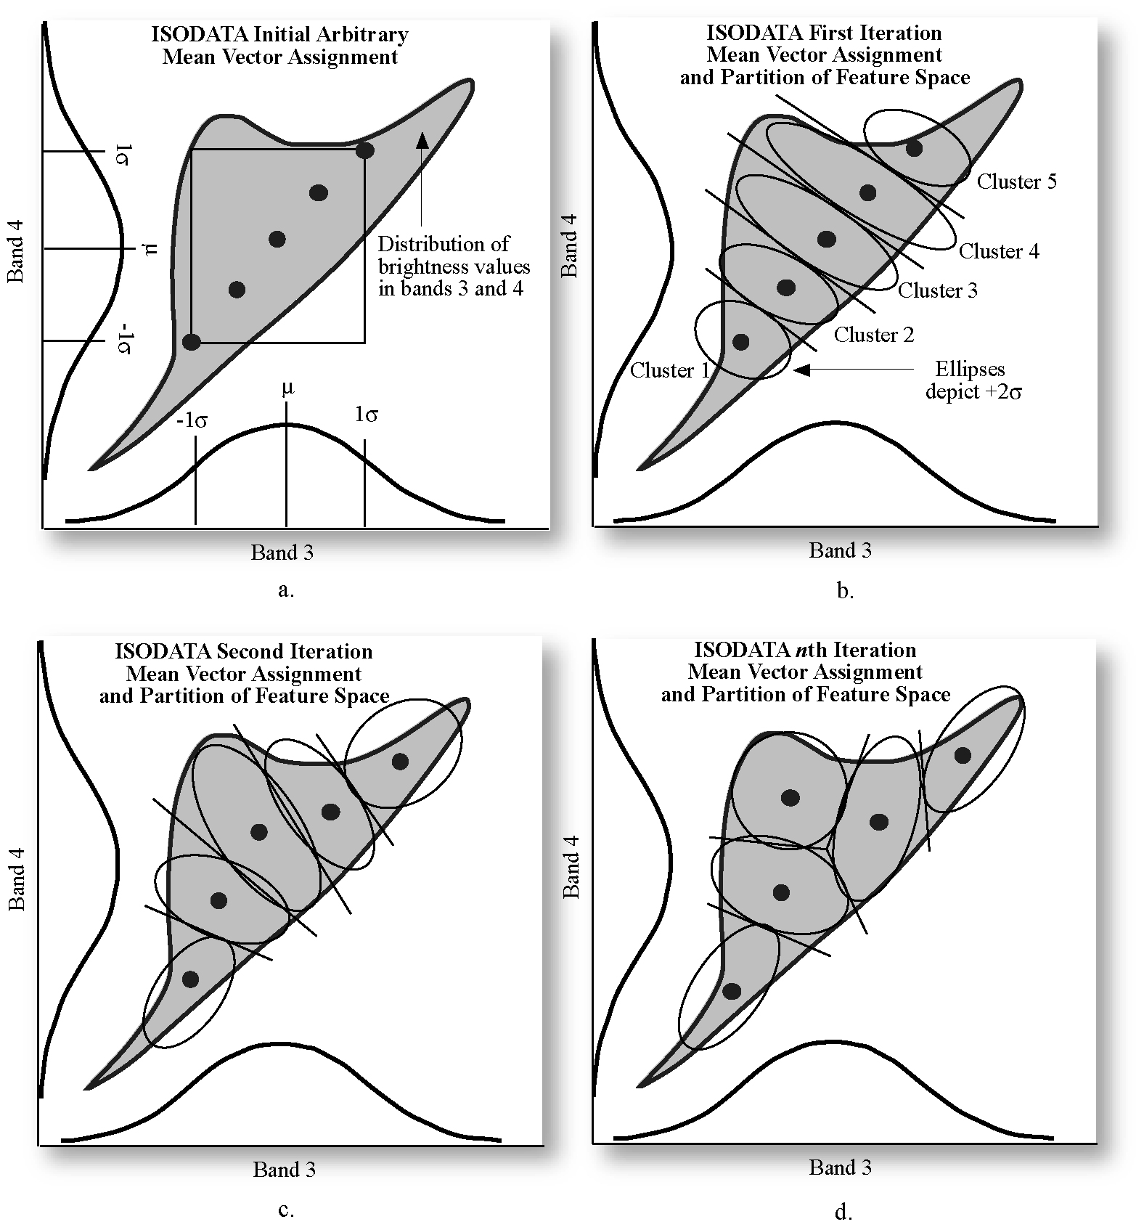

Slide 32
ISODATA: Initial Cluster Values (properties)
Number of Classes
Maximum Iterations
Pixel change threshold (0 - 100%) (The change threshold is used to end the iterative process when the number of pixels in each class changes by less than the threshold. The classification will end when either this threshold is met or the maximum number of iterations has been reached)
Initializing from statistics (Erdas) or from input (ENVI) (the initial values to put in for ENVI are minimum no. of pixel in class, maximum class stdv, minimum class distance, maximum no. merge pairs)

Slide 33
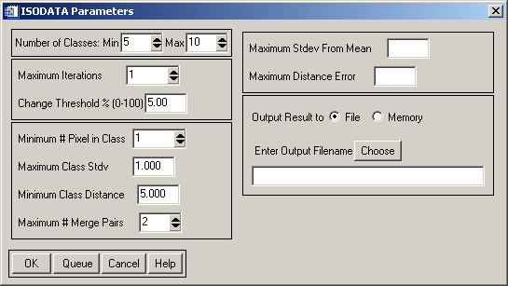
Maximum Class Stdv (in pixel value). If the stdv of a class is larger than this threshold then the class is split into two classes.
Minimum class distance (in pixel value) between class means. If the distance between two class means is less than the minimum value entered, then ENVI merges the classes.
Optional Maximum stdv from mean (1 to 3σ) and maximum distance error (in pixel value). If any of these two setup, some pixels might not be classified.

Slide 34
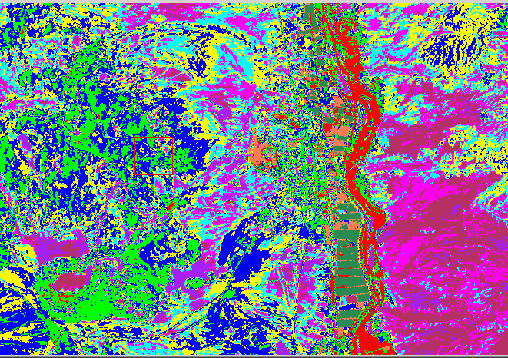
5-10 classes, 8 iterations, 5 for change threshold, (MinP 5, MaxSD 1, MinD 5, MMP 2)
(Suresh Merugu, 2012)

Slide 35
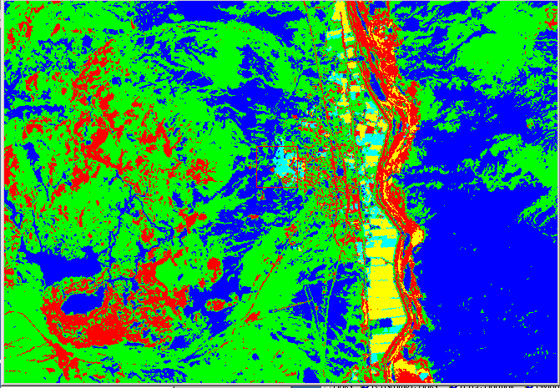
1-5 classes, 11 iterations, 5 for change threshold, (MinP 5, MaxSD 1, MinD 5, MMP 2)
(Suresh Merugu, 2012)

Slide 36
5 classes
10 classes
(Suresh Merugu, 2012)

Slide 37
ADVANTAGES & DISADVANTAGES
Advantages
  Requires no prior knowledge of the region
  Human error is minimized
  Unique classes are recognized as distinct units
  Disadvantages
  Classes do not necessarily match informational categories of interest
  Limited control of classes and identities
  Spectral properties of classes can change with time.
  Distance Measures are used to group or cluster brightness values together.
  Euclidean distance between points in space is a common way to calculate closeness.

Slide 38
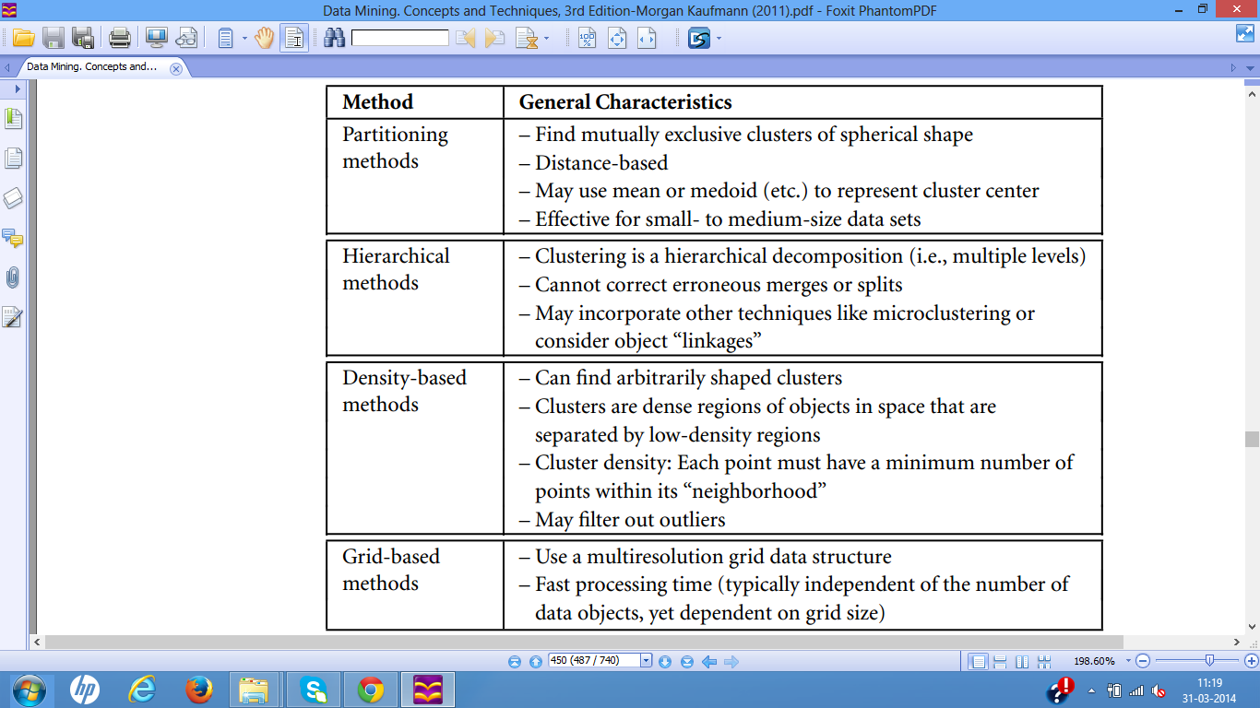
Overview of clustering methods

Slide 39
K-mean algorithm
It accepts the number of clusters to group data into, and the dataset to cluster as input values.
2. It then creates the first K initial clusters (K= number of clusters needed) from the dataset by choosing K rows of data randomly from the dataset.
For Example, if there are 10,000 rows of data in the dataset and 3 clusters need to be formed, then the first K=3 initial clusters will be created by selecting 3 records randomly from the dataset as the initial clusters. Each of the 3 initial clusters formed will have just one row of data.

Slide 40
Cont…
  The K-Means algorithm calculates the Arithmetic Mean of each cluster formed in the dataset. The Arithmetic Mean of a cluster is the mean of all the individual records in the cluster. In each of the first K initial clusters, there is only one record. The Arithmetic Mean of a cluster with one record is the set of values that make up that record.
  For Example if the dataset we are discussing is a set of Height, Weight and Age measurements for students in a University, where a record P in the dataset S is represented by a Height, Weight and Age measurement, then P = {Age, Height, Weight).
  Then a record containing the measurements of a student John, would be represented as John = {20, 170, 80} where John's Age = 20 years, Height = 1.70 metres and Weight = 80 Pounds. Since there is only one record in each initial cluster then the Arithmetic Mean of a cluster with only the record for John as a member = {20, 170, 80}.

Slide 41
Cont…
Next, K-Means assigns each record in the dataset to only one of the initial clusters. Each record is assigned to the nearest cluster (the cluster which it is most similar to) using a measure of distance or similarity like the Euclidean Distance Measure or Manhattan/City-Block Distance Measure.
5. K-Means re-assigns each record in the dataset to the most similar cluster and re-calculates the arithmetic mean of all the clusters in the dataset. The arithmetic mean of a cluster is the arithmetic mean of all the records in that cluster.
For Example, if a cluster contains two records where the record of the set of measurements for John = {20, 170, 80} and Henry = {30, 160, 120}, then the arithmetic mean P_{mean} is represented as P_{mean}= {Age_{mean}, Height_{mean}, Weight_{mean}). Age_{mean}= (20 + 30)/2, Height_{mean}= (170 + 160)/2 and Weight_{mean}= (80 + 120)/2.
The arithmetic mean of this cluster = {25, 165, 100}. This new arithmetic mean becomes the center of this new cluster. Following the same procedure, new cluster centers are formed for all the existing clusters.

Slide 42
Cont…
K-Means re-assigns each record in the dataset to only one of the new clusters formed. A record or data point is assigned to the nearest cluster (the cluster which it is most similar to) using a measure of distance or similarity.
The preceding steps are repeated until stable clusters are formed and the K-Means clustering procedure is completed.
Stable clusters are formed when new iterations or repetitions of the K-Means clustering algorithm does not create new clusters as the cluster center or Arithmetic Mean of each cluster formed is the same as the old cluster center.
There are different techniques for determining when a stable cluster is formed or when the k-means clustering algorithm procedure is completed.

Slide 43
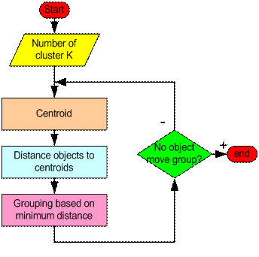
How “K-Mean” Clustering algorithm works?

Slide 44
Cont…
Step 1: Begin with a decision on the value of k = number
of clusters .
Step 2: Put any initial partition that classifies the data into
k clusters. You may assign the training samples
randomly, or systematically as the following:
    1. Take the first k training sample as single-element
    clusters
    2. Assign each of the remaining (N-k) training sample
    to the cluster with the nearest centroid. After each
    assignment, recompute the centroid of the gaining
    cluster.

Slide 45
Cont…
Step 3: Take each sample in sequence and compute its
distance from the centroid of each of the clusters.
If a sample is not currently in the cluster with the
closest centroid, switch this sample to that cluster
and update the centroid of the cluster gaining the
new sample and the cluster losing the sample.
Step 4: Repeat step 3 until convergence is achieved, that is
until a pass through the training sample causes no
new assignments.

Slide 46
A Simple example showing the implementation of k-means algorithm (using K=2)

Slide 47
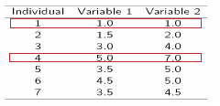
Cont…
Step 1:
Initialization: Randomly we choose following two centroids
(k=2) for two clusters.
In this case the 2 centroid are: m1=(1.0,1.0)
and m2=(5.0,7.0).

Slide 48



Cont…
Step 2:
Thus, we obtain two clusters Containing:{1,2,3}and{4,5,6,7}.
Their new centroids are:

Slide 49
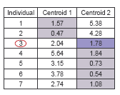
Cont…
Step 3:
Now using these centroids we compute the Euclidean distance of each object, as shown in table.
Therefore, the new clusters are: {1,2} and {3,4,5,6,7}
Next centroids are: m1=(1.25,1.5) and
m2 = (3.9,5.1)

Slide 50
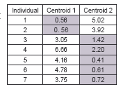
Cont…
Step 4 :
The clusters obtained are:
{1,2} and {3,4,5,6,7}
Therefore, there is no change in the cluster.
Thus, the algorithm comes to a halt here and final result consist of 2 clusters {1,2} and {3,4,5,6,7}.

Slide 51
PLOT

Slide 52
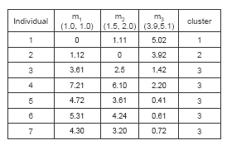
(with K=3)
Cont…
Step 1
Step 2

Slide 53
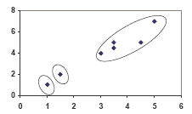
PLOT

Slide 54
Thank You
Suresh Merugu, IITR

