Slide 1
Graphing Linear and Nonlinear Systems
A-CED.2 Create equations in two or more variables to represent relationships between quantities; graph equations on coordinate axes with labels and scales.
A-REI.11 Explain why the x-coordinates of the points where the graphs of the equations y = f(x) and
y = g(x) intersect are the solutions of the equation f(x) = g(x); find the solutions approximately, e.g., using technology to graph the functions, make tables of values, or find successive approximations. Include cases where f(x) and/or g(x) are linear, polynomial, rational, absolute value, exponential, and logarithmic functions.

Slide 2
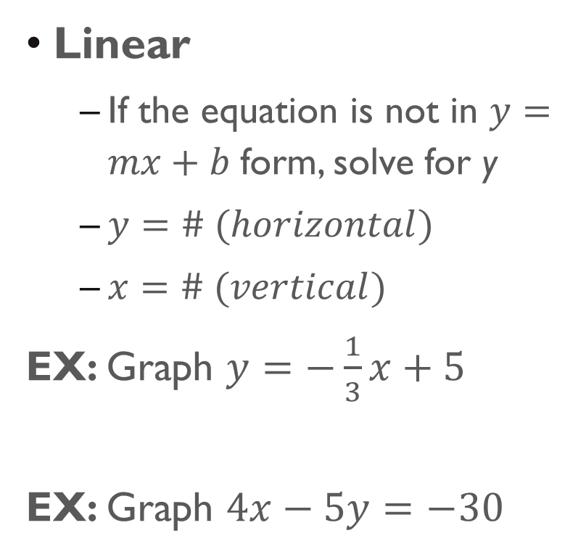
Types of equations
Linear
If the equation is not in $y=mx+b$form, solve for y
$y=\# (horizontal)$
$x=\# (vertical)$
EX: Graph $y=−\frac{1}{3}x+5$
EX: Graph $4x−5y=−30$
Nonlinear
Absolute Value
Square Root
Quadratic
Circle
Logarithmic
Exponential
Polynomial

Slide 3
Steps for Calculator
Type equation into y =
Press GRAPH to view the graph
Press 2ND GRAPH to view the table of points
Plot points on a graph

Slide 4
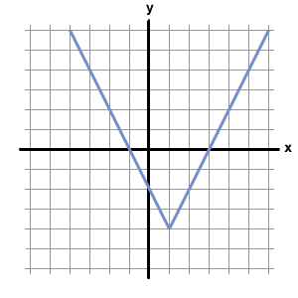
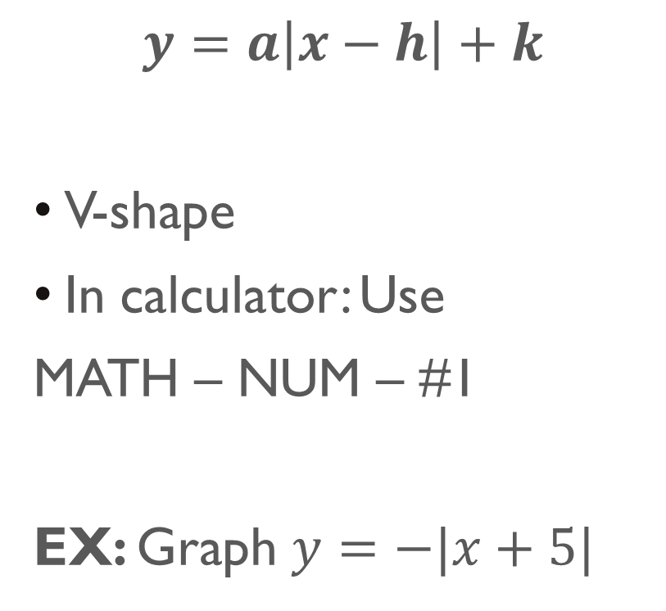
Absolute Value
$$y=a\left|x−h\right|+k$$
V-shape
In calculator: Use
MATH – NUM – #1
EX: Graph $y=−|x+5|$

Slide 5
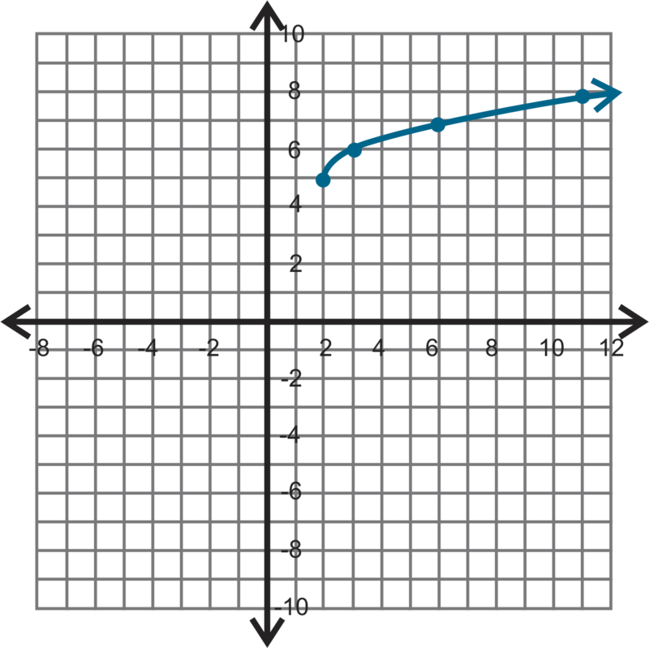
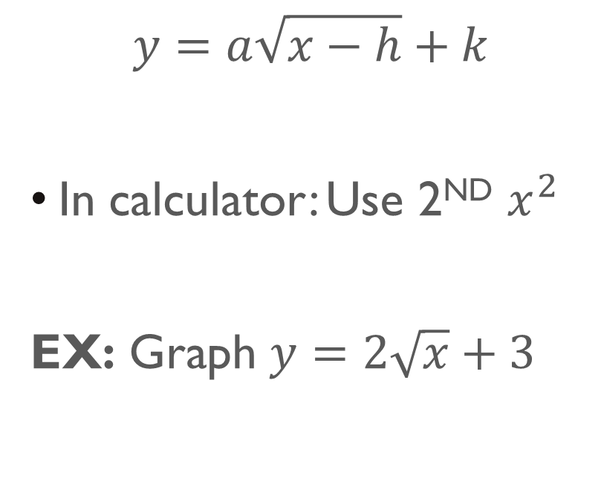
Square root
$$y=a\sqrt{x−h}+k$$
In calculator: Use 2ND $x^{2}$
EX: Graph $y=2\sqrt{x}+3$

Slide 6
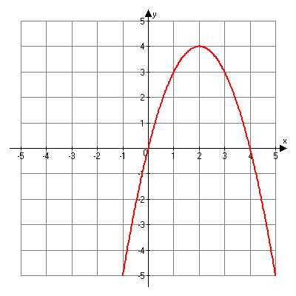
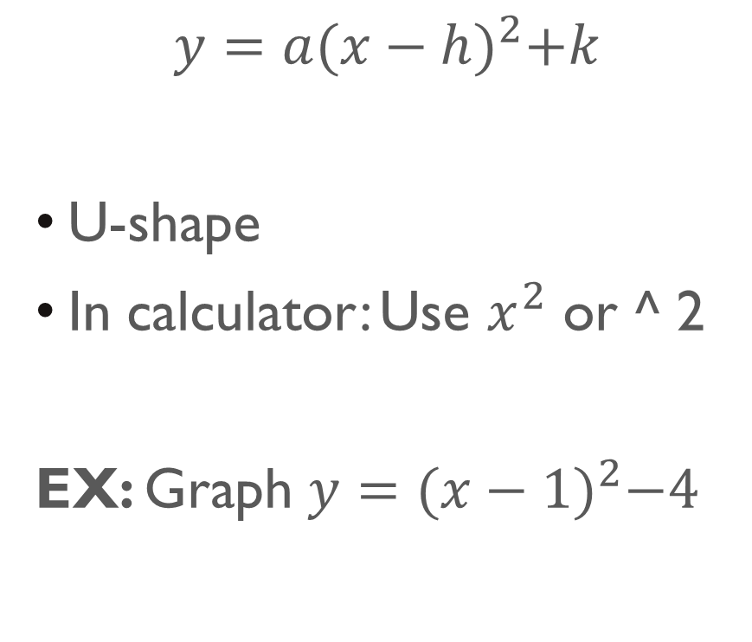
Quadratic
$$y=a{(x−h)}^{2}+k$$
U-shape
In calculator: Use $x^{2}$ or ^ 2
EX: Graph $y={(x−1)}^{2}−4$

Slide 7
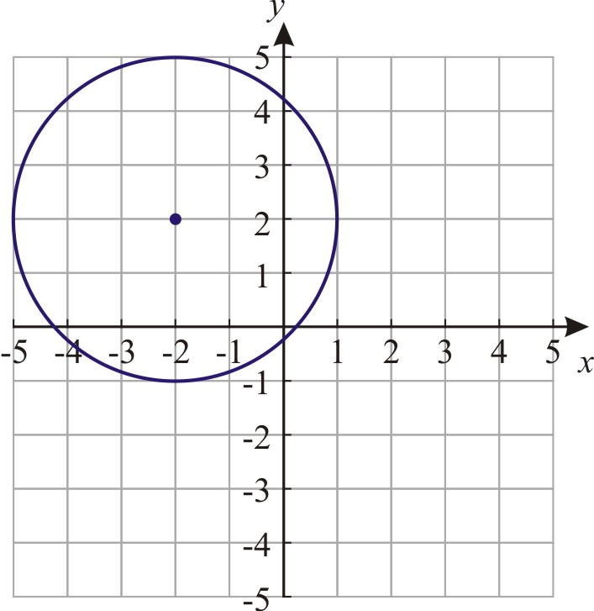
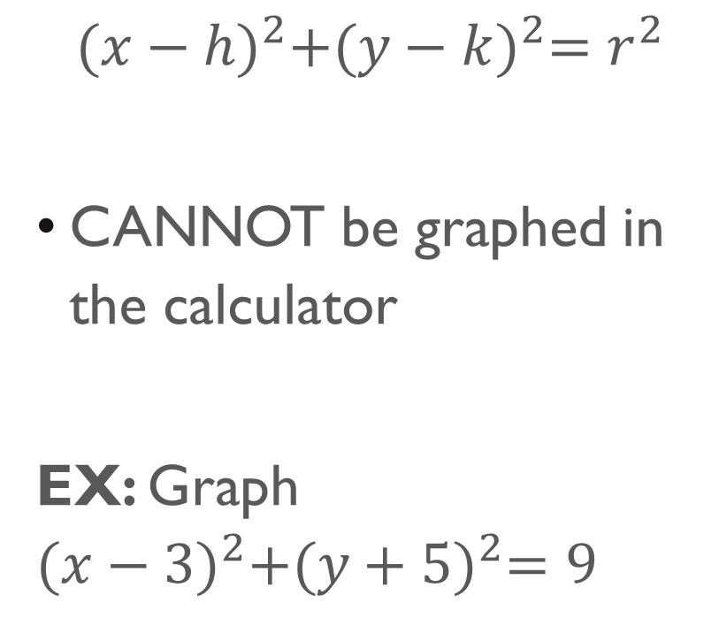
Circle
$${(x−h)}^{2}+{(y−k)}^{2}=r^{2}$$
CANNOT be graphed in the calculator
EX: Graph ${(x−3)}^{2}+{(y+5)}^{2}=9$

Slide 8
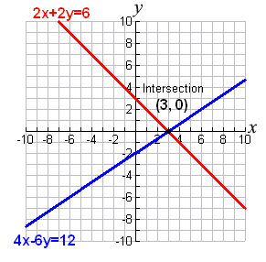
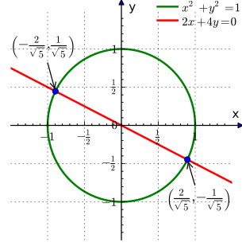
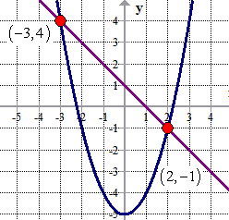
Graphing Systems of equations
Solution to a system is the point where the two equations intersect
If the equations do NOT intersect, there is no solution

Slide 9
Examples
Graph each of the following and find the solution to the system of equations.
1. $\left\{\begin{aligned}y=−\frac{3}{2}x−7 \\ −2x+y=0\end{aligned}\right.$ 3. $\left\{\begin{aligned}y=2\sqrt{x+5}−3 \\ 3x+4y=−16\end{aligned}\right.$
2. $\left\{\begin{aligned}x=1 \\ {(x+3)}^{2}+{(y+1)}^{2}=16\end{aligned}\right.$ 4. $\left\{\begin{aligned}y=\left|x\right|−1 \\ y={(x+2)}^{2}−1\end{aligned}\right.$

Slide 10
Finding Intersection in Calculator
Type one equation into y1 and the other equation into y2
GRAPH
2ND TRACE #5
Move the blinking cursor to the intersection using left and right arrow keys
Press ENTER 3 times

Slide 11

Examples
5. $\left\{\begin{aligned}y=\frac{3}{4}x+5 \\ 4x−y=1\end{aligned}\right.$ 7. $\left\{\begin{aligned}y=2{(x−3)}^{2} \\ y=\sqrt{x}+5\end{aligned}\right.$
6. $\left\{\begin{aligned}y=−3\left|x\right|+4 \\ y=−1\end{aligned}\right.$ 8. $\left\{\begin{aligned}y=−{\left(x+2\right)}^{2}−5 \\ y=\frac{4}{5}x+2\end{aligned}\right.$

