Slide 1
Applying Genetic Algorithms to Decision Making in Autonomic Computing Systems
Authors:
Andres J. Ramirez, David B. Knoester, Betty H.C. Cheng, Philip K. McKinley
Michigan State University
Presented By:
Shivashis Saha
University of Nebraska-Lincoln

Slide 2
Outline
Introduction
Background
Remote Mirroring
Genetic Algorithm
Proposed Approach
Plato Design
Fitness Function
Case Study
Conclusion

Slide 3
Introduction
Autonomic Computing System
What is it?
Self-configurable
Anticipated execution vs Dynamic reconfiguration
Three key components:
Monitoring
Decision making
Reconfiguration

Slide 4
Introduction
Reconfiguration
Rule based decision making
Utility based decision making
Self adapt to scenarios considered at design time
Evolutionary computations
Limited to specific set of reconfiguration strategies

Slide 5
Contributions
Plato – GA based decision making process
Reconfiguration plans for changing requirements and environmental conditions
No need to plan in advance
Dynamic reconfiguration of an overlay network
Distributing data to a collection of remote data mirrors
Design Objectives:
Minimize cost
Maximize data reliability
Maximize network performance

Slide 6
Remote Mirroring
Copies of important data are stored at one or more secondary locations
Tradeoff between better performance with lower cost against greater potential for data loss
Design choices
Type of links
Throughput, latency, loss rate
Remote mirroring protocols
Synchronous vs Asynchronous

Slide 7
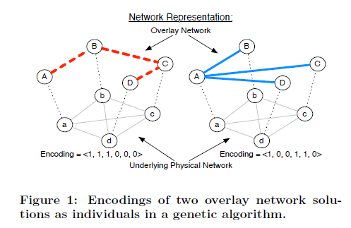
Genetic Algorithm
Chromosomes
<AB, BC, CD, AD, AC, BD>

Slide 8
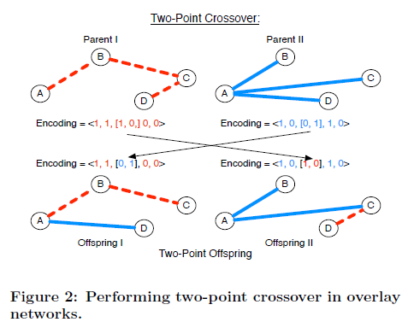
Genetic Algorithm
Crossover
One-point vs Two-point

Slide 9
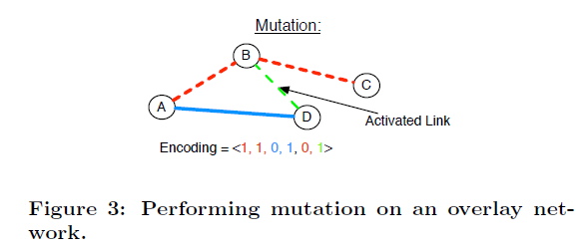
Genetic Algorithm
Mutation

Slide 10
Genetic Algorithm
Summarize the entire approach:
Generate initial population
Use crossover and mutation to generate new generation
Evaluate the offspring
Survival of the fittest
Go to step 2; Terminate when desired value achieved or the algorithm converged

Slide 11
Proposed Approach
Input: A network of remote data mirrors
Output: Construct an overlay network
Data can be distributed to all the nodes
Network must remain connected
Never exceed monetary budget
Minimize bandwidth for diffusing data

Slide 12
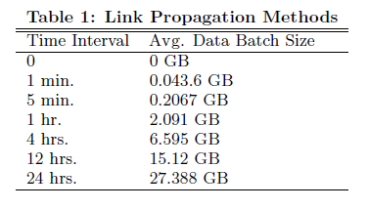
Plato Design
Chromosome encodes a complete network
Link
active or inactive
Associated with seven propagation method
There are 7^{n(n-1)/2}*2^{n(n-1)/2} possible link configurations

Slide 13
Fitness Function
Network’s fitness in terms of cost
Network’s fitness in terms of performance
Network’s fitness in terms of reliability

Slide 14
Fitness Function
Operational costs incurred by all active links
Maximum amount of money allocated for the network

Slide 15
Fitness Function
Average latency over all active links
Largest measured latency in the underlying network
Total bandwidth in the overlay network
Total effective bandwidth in the overlay network after data has been coalesced
Limit on the best value achieved in terms of bandwidth reduction

Slide 16
Fitness Function
Number of active links used
Maximum number of possible links
Total amount of data that could be lost as a result of the propagation method
Amount of data that could be lost by selecting the propagation method with the largest time window for write coalescing

Slide 17
Fitness Function
Each link stores the values such as throughput, latency, loss rate, etc
Rescale coefficients when requirements change
The change of coefficients are mentioned in response to high-level monitoring events
Do not explicitly specify the reconfiguration plan

Slide 18
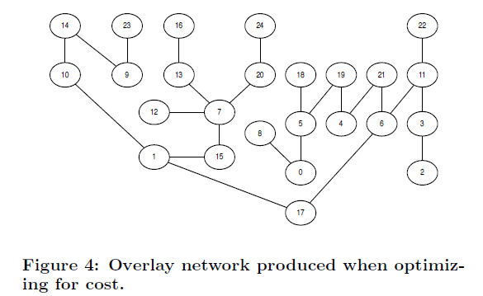
Case Study

Slide 19
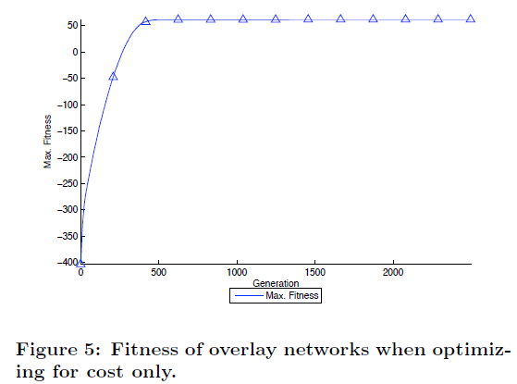
Case Study
GA converges

Slide 20
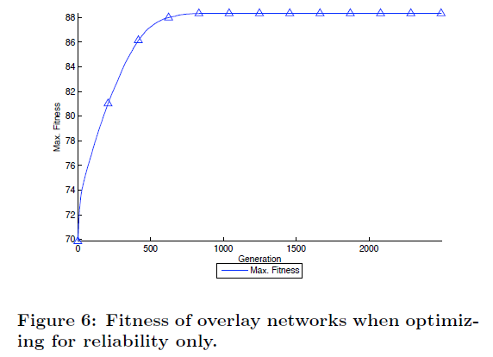
Case Study
Maximum fitness around 88, not 100!
Activate all 300 links for maximum reliability
Synchronous propagation is dominant

Slide 21
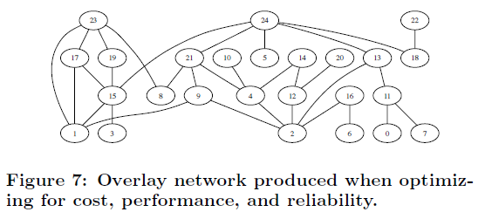
Case Study
Network has 32 links, majority use asynchronous propagation
Overall, provides a combination of performance and reliability while keeping the cost low

Slide 22
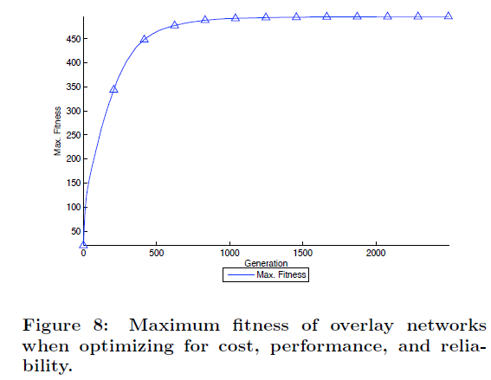
Case Study

Slide 23
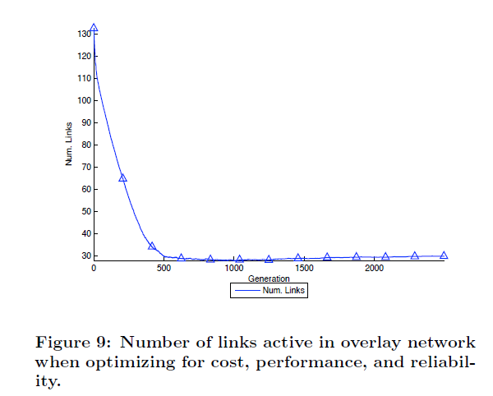
Case Study
At first more fit network has fewest active links. But, at the end 8 additional links were added.

Slide 24
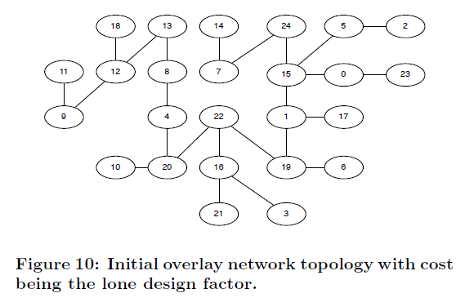
Case Study

Slide 25
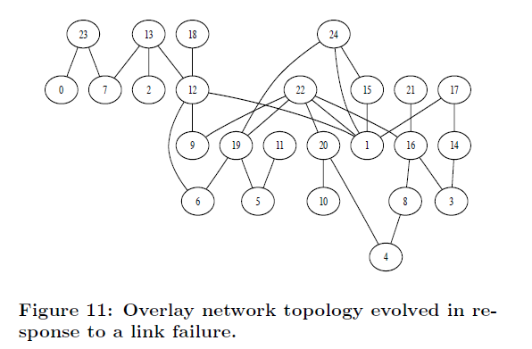
Case Study

Slide 26
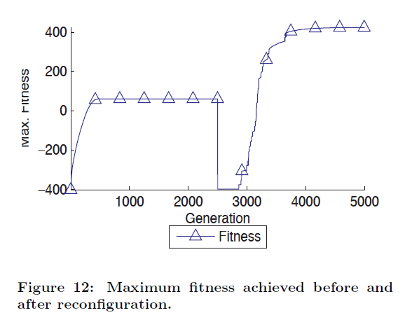
Case Study
Link failure

Slide 27
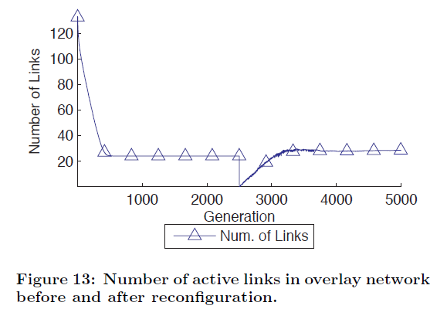
Case Study
Minimize cost
Link failure
Improved robustness

Slide 28
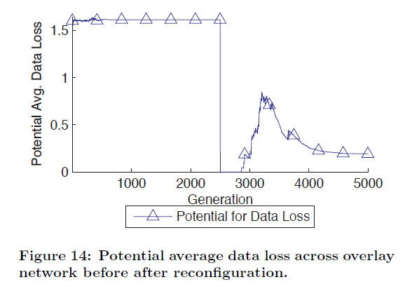
Case Study
Link failure
Data loss: measured on a log scale; byproduct of the propagation methods

Slide 29
Conclusion
Plato integrates GA into decision making process of adaptive and autonomic systems
Supports dynamic reconfiguration
Does not explicitly encode prescriptive reconfiguration strategies to address scenarios which may arise in future
It uses user defined fitness to evolve reconfiguration plans in response to environmental changes

Slide 30
Thanks!

