Slide 1
Ant Colony Optimization (ACO) ComSens Research Group
Founding Head: Dr. Nadeem Javaid
Ph.D, University of Paris-Est, France.
Senior Member IEEE,
Associate Professor, Department of Computer Science,
COMSATS Institute of Information
Technology, 44000, Islamabad, Pakistan.

Slide 2
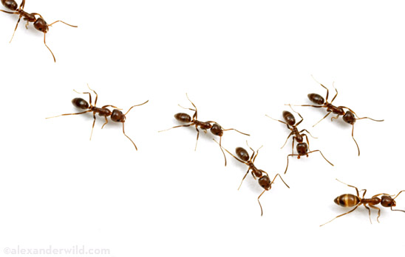
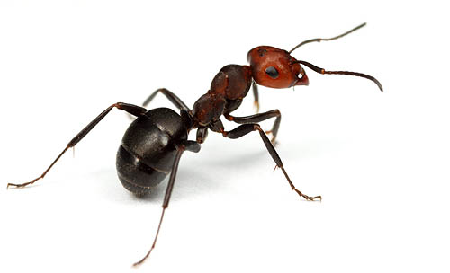
Real Ants
1
Limited individual capabilities
Rudimentary sight
Limited visual and auditory communication
Not capable of achieving complex tasks on there own
Capable of impressive group results
Nest building and defence
Nest temperature regulation
Forming bridges
Cooperatively carrying large items
Sorting brood and food items
Foraging for food sources.
Notes:
The last point that we will focus on today. Thats because the foraging of food is a natural optimization problem. Where you are going to balance the food that you gather against the energy you are spending. This leads to the creation of shortest path.

Slide 3
Basic Concept
2
In the real world, ants(initially) wander randomly.
Upon finding food, ants return to their colony while laying down pheromone trails.
If other ants find such a path, they are likely not to keep travelling at random.
Instead they follow the trail laid by earlier ants, returning and reinforcing it if they eventually find food.
Overt time, the pheromone trail starts to evaporate, thus reducing its attractive strength.

Slide 4
Basic Concept
3
In comparison to the long path, a short path gets marched over faster, and thus the pheromone density remains high.
Pheromone Evaporation:
Advantage:
Avoiding the convergence to a locally optimal solution.
If there were no evaporation at all, the paths chosen by the first ants would tend to be excessively attractive to the following ones. In that case, the exploration of the solution space would be constrained.

Slide 5
Basic Concept
4
Thus, when one ant finds a good (short) path from the colony to a food source, other ants are more likely to follow that path.
Such positive feedback eventually leaves all ants following a single path.
The idea of the ant colony algorithm is to mimic this behaviour with “simulated ants” walking around the search space representing the problem to be solved
ACO algorithm have been used to produce near-optimal solutions to the travelling salesman problem.
This is of interest in network routing and urban transportation systems.

Slide 6
Basic Concept
5

Slide 7
ACO Definintion
6
A heuristic optimization method for shortest path and other optimization problems which borrows ideas from biological ants.
Based on the fact that ants are able to find shortest route between their nest and source of food

Slide 8
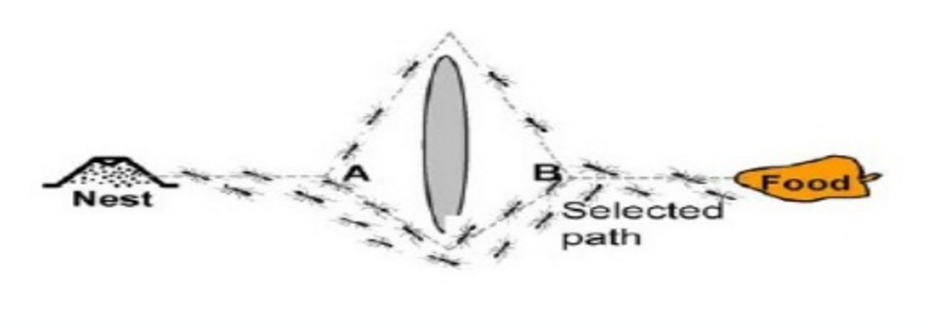
Shortest Route
7
Shortest route is found using pheromone trails which ants deposit whenever they travel, as a form of indirect communication.

Slide 9
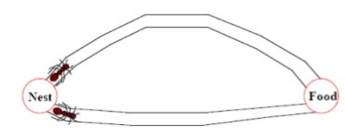
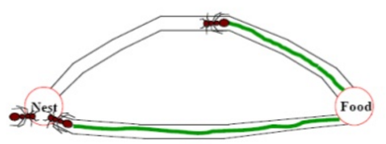
Ant foraging- Co-operative Search by Pheromone Trails
8
When ants leave their nest to search for a food source, they randomly rotate around on obstacle.
Initially the pheromone deposit will be the same for right and left directions.
When the ants in the shorter direction find a food source, they carry the food and start returning back, following their pheromone trails, and still depositing more pheromone.

Slide 10
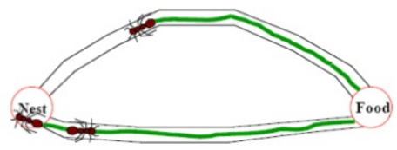
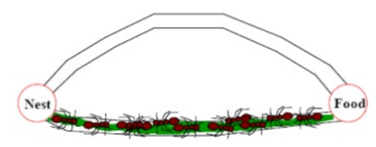
Ant foraging- Co-operative Search by Pheromone Trails
9
An ant will most likely choose the shortest path when returning back to the nest with food as this path will have the most deposited pheromone.
For the same reason, new ants that later starts out from the nest to find food will also choose the shortest path.
Overtime, this positive feedback (autocatalytic) process prompts all ants to choose the shorter path.

Slide 11
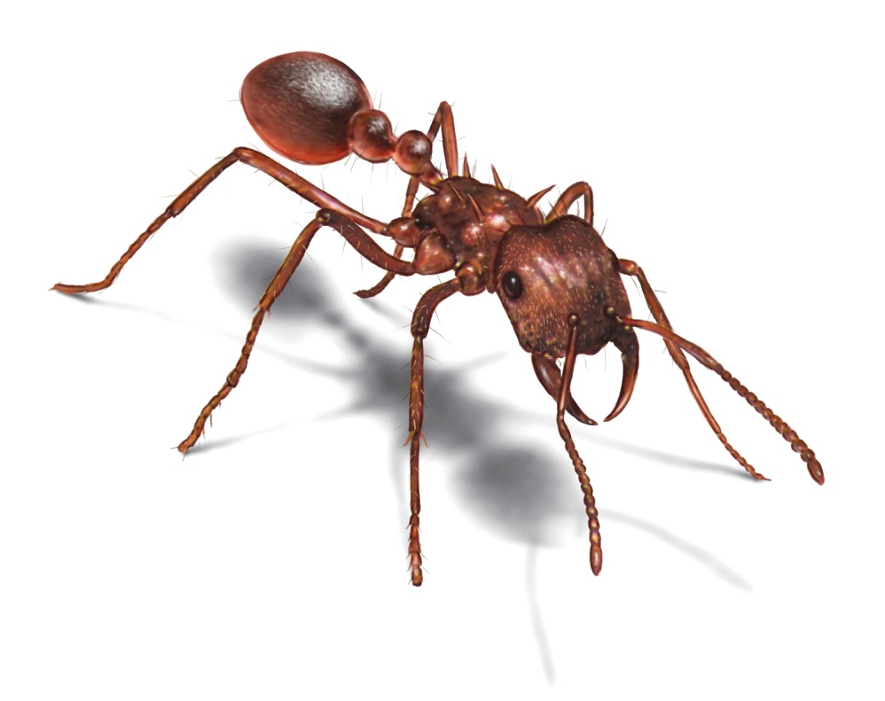
ACO-Algorithm
10
Begin
Initialize
While stopping criterion not satisfied do
Position each ant in a starting node
Repeat
For each ant do
Choose next node by applying the state transition rule
Apply step by step pheromone update
End For
Until every ant has built a solution
Update best solution
Apply pheromone update
End While
End

Slide 12
ACO
11
The main characteristic of this algorithm is that, at each iteration, the pheromone values are updated by all the m ants that have built a solution in the iteration itself. The τij , associated with the edge joining cities i and j, is updated as follows [1]:
Where ρ is the evaporation rate, m is the number of agents, and is the quantity of pheromone laid on edge (i, j) by ant k:
Where Q is a constant and L is the length of the tour constructed by ant k.
[1] Dorigo, Marco. "Ant colony optimization."
Scholarpedia 2, no. 3 (2007): 1461.

Slide 13
ACO
12
At each point, the ants traverse the construction graph and make a probabilistic decision.
Where N is the set of components that do not belong to the partial solution of ant k, α and β are parameters that control the relative importance of the pheromone versus the heuristic information.
ηij=1/dij is the heuristic information, where dij is the length of the component.

Slide 14
How to implement in a program
13
Ants | Simple computer agents
Move ant | Pick next component in the const. solution
Pheromone
Memory | M_{K} or Tabu_{K}
Next move: | Use probability to move ant

Slide 15
A simple Travel Salesman Problem example
14
[]
1
[]
A
2
B
[]
3
C
[]
4
[]
D
E
5
d_{AB} =100;d_{BC} = 60…;d_{DE} =150

Slide 16
Iteration 1
15
[A]
[B]
1
A
2
B
[C]
3
C
[D]
[E]
D
5
4
E

Slide 17
How to build next sub-solution?
16
[A]
1
A
B
[A]
1
[A]
C
1
[A,D]
[A]
1
1
D
E

Slide 18
Iteration 2
17
[E,A]
[C,B]
5
A
3
B
[B,C]
2
C
[A,D]
[D,E]
1
D
4
E

Slide 19
Iteration 3
18
[D,E,A]
[E,A,B]
4
5
A
B
[A,D,C]
1
C
[B,C,D]
[C,B,E]
2
D
3
E

Slide 20
Iteration 4
19
[B,C,D,A]
[D,E,A,B]
2
A
4
B
[E,A,B,C]
5
C
[C,B,E,D]
[A,DCE]
D
3
1
E

Slide 21
Iteration 5
20
[C,B,E,D,A]
[A,D,C,E,B]
3
1
A
B
[D,E,A,B,C]
4
C
[E,A,B,C,D]
[B,C,D,A,E]
D
5
E
2

Slide 22
Path and Pheromone Evaluation
21
[A,D,C,E,B]
[D,E,A,B,C]
L₁ =300
L₄ =280
1
4
[B,C,D,A,E]
[E,A,B,C,D]
L₂ =450
L₅ =420
2
5
[C,B,E,D,A]
L₃ =260
3

Slide 23
Advantages/Disadvantages
22
Advantages:
Positive Feedback accounts for rapid discovery of good solutions
Distributed computation avoids premature convergence
The greedy heuristic helps find acceptable solution in the early solution in the early stages of the search process.
The collective interaction of a population of agents.
Disadvantages:
Slower convergence than other Heuristics
No centralized processor to guide the AS towards good solutions

Slide 24
23
Any Questions?

