Slide 1
Activity-Based Costing and Other Cost Management Tools
Notes:
Chapter 18 explains activity-based costing and other cost management tools.

Slide 2
Learning Objectives
 | Develop activity-based costs (ABC)
 | Use activity-based management (ABM) to achieve target costs
 | Describe a just-in-time (JIT) production system, and record its transactions
 | Use the four types of quality costs to make decisions
Notes:
Learning objectives for this chapter include to:
Develop activity-based costs (ABC).
Use activity-based management (ABM) to achieve target costs.
Describe a just-in-time (JIT) production system, and record its transactions.
Use the four types of quality costs to make decisions.

Slide 3
1
Develop activity-based costs (ABC)
Notes:
The first learning objective is to develop activity-based costs (ABC).

Slide 4
Today’s approach to ABC
Define Activity Based Costing (ABC)
Theory behind ABC
ABC process steps
I demonstrate those steps
You do problem stages for each step
Realize applications, benefits and shortcomings of ABC

Slide 5
Activity Based Costing Defined
We spent $2,000 selling orders. Driven by making 400 calls.
A method of assigning indirect costs to cost objects
ABC first pools costs caused by performing activities,
Then applies costs to cost objects based on their usage of the activities.
Example: A slice of costing out an order.
Activity:
$5 per call
We used 2 calls selling an order
Selling Cost of the order $10

Slide 6
Today’s approach to ABC
Define Activity Based Costing (ABC)
Discuss the theory behind ABC
ABC implementation steps
Do in class exercises to practice those steps
Draw conclusions about the value of ABC

Slide 7
A Familiar Starting Point in indirect cost allocation
Activity Based
Costing
Departmental
Overhead
Rates
One Plant-wide
Overhead
Rate
Level of complexity & accuracy
Cost to run the system

Slide 8
One Plant-wide Overhead Rate
Traditional Job Order Product Costing
Direct Materials
Direct Labor
Manufacturing overhead
Applied by a predetermined overhead rate (POHR) hopefully based on a meaningful cost driver!

Slide 9
A problem with single overhead rates: Cross subsidizing
If we apply MOH based on Direct Labor
10 orders at 10 units per order will be charged with the same overhead as a single 100 unit order.
Large single set-up orders are cross-subsidizing small multiple set-up orders.
If we try fixing it by using # of batches to allocate MOH then short production runs may absorb too much of the duration driven costs of huge production runs:
A single 4 day production run would absorb the same amount of MOH as a tiny 4 hour run.
The shorter runs are cross-subsidizing the duration driven costs of the long runs.

Slide 10
The Next Step: Departmental Overhead Rates
Manufacturing
Overhead Costs
Stage One:
Costs assigned
to departments
Milling Department
Fabrication
Department
Finishing
Department
Machine
Hours
Raw
Materials
Cost
Direct
Labor
Hours
Stage Two:
Costs applied
to products
Products
Departmental Allocation Bases

Slide 11
Problems with Departmental Overhead Rates
Cross subsidization still occurs within departments
Costs are pooled by department not by process, so
Still creates substitution related inefficiencies
Skimp on machine hours to save costs, even if that causes more use of labor or material waste costs.
ABC enables us to assign costs by consumption of activities, across departmental boundaries.
Costs are more accurate and cost saving behavior incents real cost savings vs. cost shifting

Slide 12
Activity Based Costing: Pooling activity costs and assigning based on consumption
Manufacturing
Overhead Costs
Costs pooled by business activities
Materials processing activities
Fabricating
activities
Finishing
activities
Machine
Hours
Raw
Materials
Cost
Finishing Direct
Labor Hours
Costs applied
to products using measures of consumption (cost drivers)
Cost objects
Activity Based Allocation Bases

Slide 13
ABC Theory Recap
ABC works much like multiple POHR rates.
Focus on activity not just department
May use multiple rates within a department
Not limited to just production activities
A strong emphasis on CONSUMPTION of the applied activity cost to accurately reflect different cost consumption in different cost objects.
We can cost out any object, not just products.

Slide 14
ABC Theory Non-Production Costs
Consider these NON-Production activities that we can link to profitability of a cost object.
Selling-time intensive products
Rush Orders
High-maintenance customers
High frequency, small orders
Heavy user of technical support time
What else?
Dealing with this information: Sprint Luggage

Slide 15
ABC Theory: Cost of Idle Capacity
Total Production Facility Rent = $100,000
Unused floor space = 50% of available space
Units produced = 100
Traditional Cost Accounting
Per unit MOH =
$100,000 ÷ 100
= $1,000 per unit
Activity Based Costing
Per Unit MOH =
$100,000 * 50%
100 units
=$500 per unit
AND
$50,000 as a period expense

Slide 16
Activity-Based Costing
More accurate method to attach costs to products
Refines the way indirect costs are allocated to production
Focuses on costs incurred by each production activity
Activity costs become the building blocks for allocating costs to products and services
Each activity has its own cost driver
Notes:
Now we turn to a more accurate method to attach costs to products, called activity based costing. We’ll discuss how to develop an ABC system and compare it to traditional methods you learned about in the previous chapter.
We have seen that direct costs (materials and labor) are easy to assign to products. But indirect costs (utilities, supervisor salaries, and plant depreciation) are another story. It is the indirect costs—and they are significant—that must be allocated somehow.
One way to manage costs is to refine the way indirect costs are allocated. Before business got so competitive, managers could limit their focus to a broad business function such as production, and use a single rate to allocate manufacturing overhead cost to their inventory, as we demonstrated in Chapter 17.

Slide 17
Activity-Based Costing
Activity-based costing
Divides production process into activities
Assigns costs to products based on how much the product USES those activities
Cost drivers
Activity that drives the cost to being accumulated
Examples
Quality inspections–number of inspections
Warranty Services–number of service calls
Shipping–number of pounds
Notes:
Today’s environment calls for more refined cost accounting. Managers need better data to set prices and identify the most profitable products. They drill down to focus on the costs incurred by each activity within the production function. This has led to a better way to allocate indirect costs to production—activity-based costing. Activity-based costing (ABC) focuses on activities. The costs of those activities become the building blocks for measuring (allocating) the costs to products and services. Many large companies use ABC. Each activity has its own (usually unique) cost driver.

Slide 18
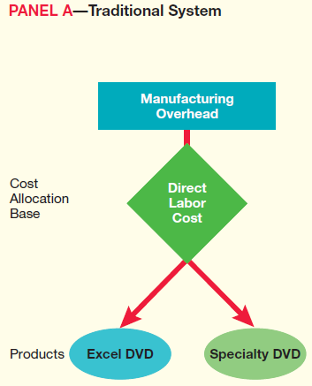
Overview of Traditional and ABC Systems
Traditional system
Uses a plant-wide manufacturing overhead allocation rate
Notes:
The main difference between ABC and traditional systems is that ABC uses a separate allocation rate for each activity. Traditional systems, as demonstrated in Chapter 17, usually use one rate.

Slide 19
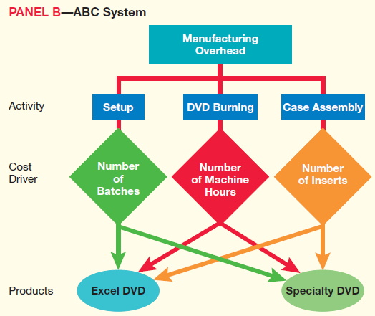
Overview of Traditional and ABC Systems
ABC system
Uses a separate allocation rate for each activity
Notes:
Each activity has its own cost driver. Activity-based costs are more accurate because ABC considers the resources (activities) each product actually uses.

Slide 20
Today’s approach to ABC
Define Activity Based Costing (ABC)
Discuss the theory behind ABC
ABC implementation steps
Do in class exercises to practice those steps
Draw conclusions about the value of ABC

Slide 21
Developing an Activity-Based Costing System
Notes:
There are four steps to activity-based costing. The first is to identify each activity and estimate its total indirect cost. Next, the cost driver for each activity is identified, and then management estimates the quantity of each driver’s allocation base. Third, a cost allocation rate is computed for each activity. Last, the indirect costs are allocated to the cost object–the product or service.
In Step 3 of ABC, the cost allocation rate is determined by dividing the estimated total indirect cost by the estimated total quantity of the allocation base. Notice how this formula is really the same as the predetermined overhead allocation formula described in the prior chapter.
In Step 4, the cost allocation rate determined in Step 3 is multiplied by the actual quantity of the allocation base to compute the allocated activity cost.

Slide 22
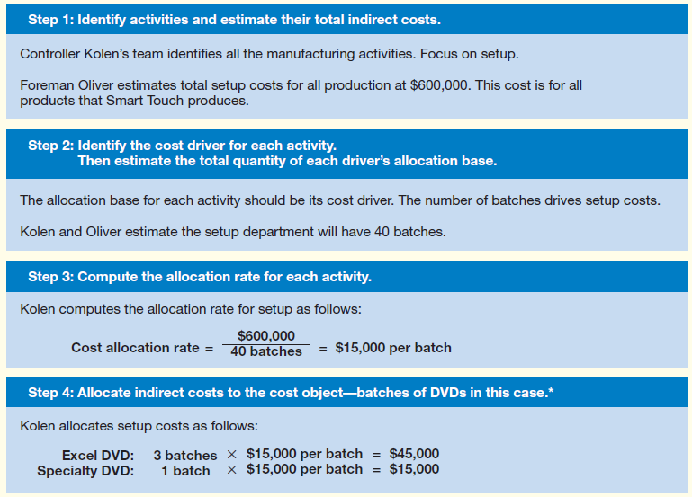
ABC System
Notes:
Controller Kolen then uses the ABC costs allocated from Exhibit 18-7 to recompute manufacturing overhead costs, as shown in Exhibit 18-8. For each product, Kolen adds the total costs of setup, DVD burning, and assembly. He then divides each product’s total manufacturing overhead cost by the number of DVDs produced to get the overhead cost per DVD product. Activity-based costs are more accurate because ABC considers the resources (activities) each product actually uses.

Slide 23
Step 1: Activities & Cost Pools
Identify major company activities
Activities are things the company does related to cost objects.
Ask “How do you produce value for your customers?”
Group activities into “pools” that behave the same.
Examples:
Design custom products
Build products
Process orders
Travel to job sites
Service customer issues
What activities would be grouped together in these pools?
Think “What do we spend on our money on to get these things done?”

Slide 24
Cupcakes & muffins
What activities does such a bakery do?
What expenditures would likely make up those processes in their value chain?
How did we get this information from them?

Slide 25
ABC System
Notes:
Controller Kolen then uses the ABC costs allocated from Exhibit 18-7 to recompute manufacturing overhead costs, as shown in Exhibit 18-8. For each product, Kolen adds the total costs of setup, DVD burning, and assembly. He then divides each product’s total manufacturing overhead cost by the number of DVDs produced to get the overhead cost per DVD product. Activity-based costs are more accurate because ABC considers the resources (activities) each product actually uses.

Slide 26
Step 2: Identify cost drivers and estimate total usage of allocation base
Concerns with ABC cost drivers
Consumption of these inputs should cause indirect cost expenditures
Consumption differences yield corresponding differences in cost objects
If indirect costs do not behave as above, you may need more/other cost drivers.
Duration drivers vs. transaction drivers
Consider selections of baking cost drivers
Small or large batches all require 12 minutes mixing each: Transaction
Cupcake decoration takes longer than muffin decoration: Duration
Significant costs within a cost pool should behave the same
Are all mixing costs roughly the same for any given batch of dough?
If too many transaction and duration drivers are mixed, cost distortion can result.

Slide 27
Cupcakes & muffins
What drives expenditures in each activity?
Where would we find the quantity of each cost driver used?

Slide 28
ABC System
Notes:
Controller Kolen then uses the ABC costs allocated from Exhibit 18-7 to recompute manufacturing overhead costs, as shown in Exhibit 18-8. For each product, Kolen adds the total costs of setup, DVD burning, and assembly. He then divides each product’s total manufacturing overhead cost by the number of DVDs produced to get the overhead cost per DVD product. Activity-based costs are more accurate because ABC considers the resources (activities) each product actually uses.

Slide 29
Computing the allocation rate for each activity
How to get it done:
Divide spending on each activity by the volume of that activity performed.
The result is a cost rate to help assign consumption of that activity by cost objects.

Slide 30
Cupcakes & muffins
Cost allocation rate determined by total activity costs and quantity of cost driver used.
Note units of cost allocation for each activity

Slide 31
ABC System
Notes:
Controller Kolen then uses the ABC costs allocated from Exhibit 18-7 to recompute manufacturing overhead costs, as shown in Exhibit 18-8. For each product, Kolen adds the total costs of setup, DVD burning, and assembly. He then divides each product’s total manufacturing overhead cost by the number of DVDs produced to get the overhead cost per DVD product. Activity-based costs are more accurate because ABC considers the resources (activities) each product actually uses.

Slide 32
Cupcakes & muffins
Attach the indirect costs to the cost objects by their use of the cost driver.
Note: The cost object here is the product line.

Slide 33
Cupcakes & muffins
We can use this information to assess our full product costs, unit product costs, profitability, and pricing policy:

Slide 34
Cupcakes & Muffins Analysis:
Why where Muffins a hard sell?
What pricing changes could we suggest?
What effects might these changes have on our business?
Who will be hurt?
Who will benefit?

Slide 35
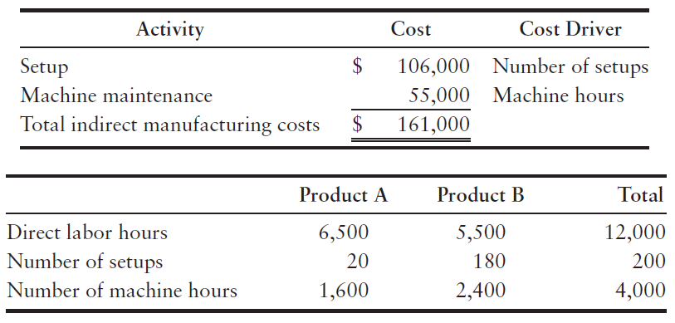
S18-3: Computing indirect manufacturing costs per unit
Day, Corp. is considering the use of activity-based costing. The following information is provided for the production of two product lines:
Day plans to produce 400 units of Product A and 375 units of Product B.
1. Compute the ABC indirect manufacturing cost per unit for each product.
Notes:
Short Exercise 18-3 reviews the computations of indirect manufacturing costs per unit.

Slide 36
S18-3: Computing indirect manufacturing costs per unit
Setup = $106,000 / 200 = $530.00 per set-up
Maintenance = $55,000 / 4000 = $13.75 per machine hour
 |  | A |  | B
Set-up | 530.00 x 20 = | $10,600 | 530.00 x 180 = | $95,400
Machine Maintenance | 13.75 x 1,600 = | 22,000 | 13.75 x 2,400 | 33,000
 |  | 32,600 |  | 128,400
Divide by # units |  | ÷ 400 |  | ÷ 325
Cost per unit |  | $81.50 |  | 342.40
The indirect manufacturing cost for Product A is:
The indirect manufacturing cost for Product B is:
$81.50
$342.40
Notes:
The exercise continues on this slide.

Slide 37
2
Use activity-based management (ABM) to achieve target costs
Notes:
The second learning objective is to use activity-based management to achieve target costs.

Slide 38
Day 2: Activity-Based Management
The context of decision making
Long term strategic approaches to business
Quality management
Tools to define your approach
Target pricing (target costing) vs cost-based pricing
Just-in-time (JIT) systems
Types of decisions where ABC fits in:
Pricing and product mix
Cost management
Spend where it adds value, cut where it doesn’t
Notes:
Activity-based management (ABM) uses activity-based costs to make decisions that increase profits, while meeting customer needs. In this section, we show how Smart Touch can use ABC in two kinds of decisions:
1. Pricing and product mix
2. Cost cutting

Slide 39
Value Engineering, a subset of quality management
Common elements in quality management:
Aka: TQM, ISO, Kaizen, Six Sigma, etc
Customer focus – what do they want to pay for?
Marketers identify customer needs
People involvement in leadership & teams
Build commitment and involvement in improvements
Process systems focus
Engineering to provide customer indicated value
Continual improvement based on data
Alignment of accounting approach with objectives
This is not just pursuit of quality in products, it is a pursuit of quality in every aspect of the organization.
Notes:
Most companies adopt ABC to get better product costs for pricing and product-mix decisions. However, they often benefit more by cutting costs. ABC and value engineering can work together. Value engineering means reevaluating activities to reduce costs. It requires these cross-functional teams:
• Marketers to identify customer needs
• Engineers to design more efficient products
• Accountants to estimate costs
American companies are following Japanese automakers setting sale prices based on target prices—what customers are willing to pay for the product or service.

Slide 40
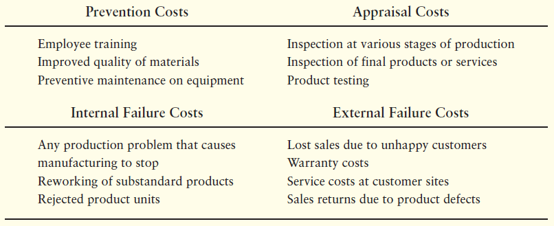
The Four Types of Quality Costs
Notes:
This table provides examples of the four quality costs. Remember, prevention is much cheaper than external failure. Most prevention costs occur in the R&D stage of the value chain. In contrast, most appraisal and internal failure costs occur while the product is being made; thus, they ultimately become part of the cost of the finished product. External failure causes an increase in customer service costs, or it could cause lost sales due to an unhappy customer. External failure costs ultimately affect warranty expense claims or worse, potential lawsuit liability exposure. Prevention is much cheaper than external failure.

Slide 41
Managing the Improvement Process
Results:
Top down control
→ Focus at end
“J” curve
Process:
Delegated control
Focus on determinants of goal - processes
Constant improvement
100%
100%
90%
90%
Usable Production
Usable Production
80%
80%
70%
70%
60%
60%
0
1
2
3
4
0
1
2
3
4
Time in Quarters
Time in Quarters

Slide 42
Activity-Based Management
The context of decision making
Long term strategic approaches to business
Quality management
Tools to define your approach
Target pricing (target costing) vs cost-based pricing
Just-in-time (JIT) systems
Types of decisions where ABC fits in:
Pricing and product mix
Cost management
Spend where it adds value, cut where it doesn’t
Notes:
Activity-based management (ABM) uses activity-based costs to make decisions that increase profits, while meeting customer needs. In this section, we show how Smart Touch can use ABC in two kinds of decisions:
1. Pricing and product mix
2. Cost cutting

Slide 43
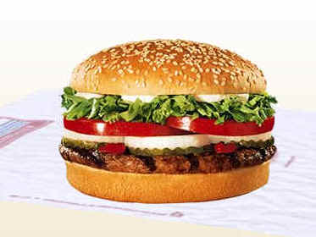
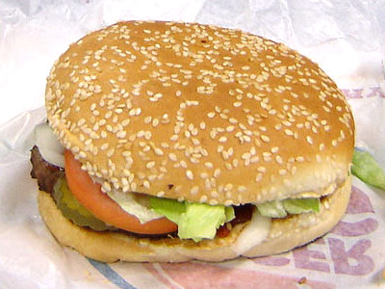
Target pricing vs. Cost-based pricing
Cost based pricing
Target pricing
Customer
Focus:
Build what customers want. Build processes to deliver that, and only that.
Happy customers, earn high margins, innovate
Company
focus:
Create products as we see fit. Focus on cost reductions to increase margins.
Pricing reflects our internal needs, not customers’
Unfair Comparison?

Slide 44
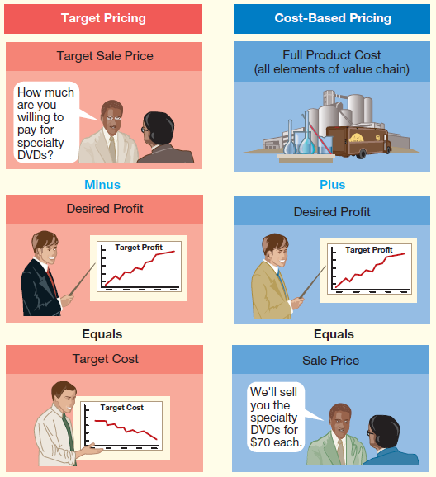
Target Pricing Versus Cost-Based Pricing
Cost-based:
Full cost
+ Desired profit
Sales Price
Target based:
Target price
- Desired profit
Target Cost
Notes:
Instead of starting with product cost and then adding a profit to determine the sale price (right column of the exhibit), target pricing (left column) does just the opposite. Target pricing starts with the price that customers are willing to pay and then subtracts the company’s desired profit to determine the target cost. Then the company works backward to develop the product at the target cost.

Slide 45
Meeting target pricing cost structure
Target Cost
Full Cost
Assemble team to:
Cut costs where expenditures do not provide customer perceived value
Shift costs to provide higher value where needed
Notes:
Does Smart Touch’s current full-product cost meet this target? Smart Touch’s current cost does not meet the target cost. Because Smart Touch’s current full-product cost, $8.10, exceeds the target cost of $8.00, Bright assembles a value engineering team to identify ways to cut costs. The team analyzes each production activity. For each activity, the team considers how to:
● cut costs, given Smart Touch’s current production process.
● redesign the production process to further cut costs.

Slide 46
S18-11: Using ABC to derive cost based pricing Bonus? What to do if customers won’t pay the price?
In Short Exercise 18-5, Accel Corp. desires a 25% target profit after covering all costs.
1. Considering the total costs assigned to the Products C and D in S18-5, what would Accel have to charge the customer to achieve that profit?
 | Product C | Product D
Direct materials cost per unit | $ 700 | $ 2,000
Direct labor cost per unit | 300 | 100
Indirect manufacturing cost per unit | 492 | 1,070
Product cost per unit | $ 1,492 | $ 3,170
Total costs divided by (100% - target profit) =
$1,492 ÷ 0.75 = $ 1,989.33
Total costs divided by (100% - target profit) =
$3,170 ÷ 0.75 = $ 4,226.67
Notes:
Short exercise 18-11 reviews using ABC to achieve target profit.

Slide 47
Activity-Based Management
The context of decision making
Long term strategic approaches to business
Quality management
Tools to define your approach
Target pricing (target costing) vs cost-based pricing
Just-in-time (JIT) systems
Types of decisions where ABC fits in:
Pricing and product mix
Cost management
Spend where it adds value, cut where it doesn’t
Notes:
Activity-based management (ABM) uses activity-based costs to make decisions that increase profits, while meeting customer needs. In this section, we show how Smart Touch can use ABC in two kinds of decisions:
1. Pricing and product mix
2. Cost cutting

Slide 48
Just-in-Time Systems
Materials purchased and goods completed “just in time” for delivery
Deliveries are small and frequent
Suppliers must guarantee a defect rate close to zero
Minimizes investment the company has in its inventories
Lowers risk of the inventory becoming obsolete or unsalable
Same concepts apply to service providers and merchandisers
One application of “Lean management”
Notes:
The cost of buying, storing, and moving inventory can be significant. To lower inventory costs, many companies use a just-in-time (JIT) system. Companies with JIT systems buy materials and complete finished goods just in time for delivery to customers. In traditional manufacturing, materials would be ordered in large quantities to obtain volume discounts and to have surplus materials on hand in case some of the materials turn out to be defective. Under the JIT system, the manufacturer contracts with suppliers to deliver small quantities of goods, as needed. Deliveries are small and frequent, and the suppliers must guarantee a close to zero defect rate. That way, the manufacturers hold only small amounts of raw materials in the warehouse, use only materials as needed, and—because of the zero defect rate and quick delivery—can be assured they won’t run out of materials and have to shut down production.
Because of JIT, relationships with suppliers of raw materials must be very reliable to ensure that the company has raw materials just when needed to manufacture products. Because products are made as ordered, finished goods inventories are kept to a minimal amount. This reduces the company’s cost to store and insure inventory. It also allows the company to minimize the resources it has invested in raw materials and in inventory. Lastly, because the inventories are low, the risk of the inventory becoming “obsolete” or unsaleable is very small.

Slide 49
Just-in-Time Work Cells
Production completed in work cells
Area where resources are readily available
Employee work teams, little outside supervision
Goods completed in small batches that are inspected for quality
As completed products move out, suppliers deliver more materials
Traditional systems
Production moves to various departments
Movement between departments consumes non-value-added resources
Notes:
Production in JIT systems is completed in self-contained work cells, as shown in Exhibit 18-13. A work cell is an area where everything needed to complete a manufacturing process is readily available. Each work cell includes the machinery and labor resources to manufacture a product. Employees work in a team in the work cell and are empowered to complete the work without supervision. Workers complete a small batch of units and are responsible for inspecting for quality throughout the process. As the completed product moves out of the work cell, the suppliers deliver more materials to the work cell just in time to keep production moving along.
By contrast, traditional production systems separate manufacturing into various processing departments that focus on a single activity. Work in process must be moved from one department to another. More movements waste time, and wasted time is wasted money.

Slide 50
Traditional Airplane builder
Functional organization
Centralized authority
Move it down the line
President
VP Production
VP Purchasing
VP Sales
Purchasing Manager
Line Manager Materials Fabrication
Line Manager Major Assembly
Line Manager Finish Assembly
Sales Manager
Purchasing Agent
Materials Fabrication
Workers
Major Assembly
Workers
Finish Assembly
Workers
Sales Person

Slide 51
JIT airplane manufacturer
Flat organization
Customer Departmentalization
Decentralized decision making authority
President
Director Type A Customers
Director Type B Customers
Purchasing Agents
Materials Fabrication
Workers
Major Assembly
Workers
Finish Assembly
Workers
Sales People
Purchasing Agents
Materials Fabrication
Workers
Major Assembly
Workers
Finish Assembly
Workers
Sales People

Slide 52
JIT Issues
Lost sales if materials do not arrive on time or if the materials are of poor-quality
Strong relations with vendors of quality materials essential
Teams feel ownership of final product
Degrees of JIT balancing risk of:
Shortages
Expertise
Capturing upside sales
Notes:
Companies like Toyota, Carrier, and Dell credit JIT for saving the companies millions of dollars. But JIT systems are not without problems. With no inventory buffers, JIT users lose sales when they cannot get materials on time, or when poor-quality materials arrive just in time. There is no way to make up for lost time. As a result, strong relationships with quality vendors of raw materials are very important to JIT. Additionally, many JIT companies still maintain small inventories of critical materials.

Slide 53
Smart Touch’s JIT Costing Accounts
Full JIT does not use a separate Work in process inventory account
Only two inventory accounts:
Raw and in-process inventory
Finished goods inventory
Notes:
As noted previously, JIT does not use a separate Work in process inventory account. Instead, it uses only two inventory accounts:
● Raw and in-process inventory, which combines direct materials with work in process
● Finished goods inventory
The system does not track costs as the products move through manufacturing. Instead, completion of the DVDs triggers the accounting system to go back and move costs from Raw and in-process inventory (credit) and to allocate conversion costs (credit) to attach those costs to the finished products (debit).
Combining the Materials inventory account with the Work in process inventory account to form the single Raw and in-process inventory account eliminates detail.

Slide 54
Tailoring accounting systems to match business objectives
http://www.nwlean.net/article0803.htm
Notes:
Value Stream Costing: aka Value Stream Mapping: a Six Sigma methodology
Mapping the product delivery process from in to out. Factoring in all costs related to the product, (like ABC).
Measurements include !st time defects, Throughput,

Slide 55
Activity-Based Management
The context of decision making
Long term strategic approaches to business
Quality management
Tools to define your approach
Target pricing (target costing) vs cost-based pricing
Just-in-time (JIT) systems
Types of decisions where ABC fits in:
Pricing and product mix
Cost management
Spend where it adds value, cut where it doesn’t
Notes:
Activity-based management (ABM) uses activity-based costs to make decisions that increase profits, while meeting customer needs. In this section, we show how Smart Touch can use ABC in two kinds of decisions:
1. Pricing and product mix
2. Cost cutting

Slide 56
Cupcakes & Muffins costing sensitivity analysis
Assess customer input on post-ABC pricing
Maybe Muffins don’t meet expectations, or
Maybe Cupcakes are too pricey
Evaluate changes to our pricing and cost structure that would meet customer needs and profit needs
Our ABC Excel spreadsheet is an excellent tool for this Link to Excel file

Slide 57
The “You need ABC” red flag
Traditional Cost Accounting System
200,000 units x $50/Unit = $10,000,000
4,000 units x $50/Unit = $200,000
Predetermined manufacturing
overhead rate
= $50/Unit

Slide 58
The “You need ABC” red flag
Activity Based Cost Accounting System
Overhead resources consumed applied to products consuming them
Several Activity rates used, including one to apply resources consumed due to job complexity

Slide 59
Chapter 18 Summary of the chapter
Activity-based costing (ABC) focuses on activities. The costs of those activities become the building blocks for measuring (allocating) the costs of products and services. The total production process and the related costs are divided among the various production activities.
A cost driver for the activity is identified, and a rate per activity is calculated. The costs are then allocated to individual products based on the amount of products’ USE of each activity.
Notes:
Activity-based costing (ABC) focuses on activities. The costs of those activities become the building blocks for measuring (allocating) the costs of products and services. The total production process and the related costs are divided among the various production activities.
A cost driver for the activity is identified, and a rate per activity is calculated. The costs are then allocated to individual products based on the amount of the products’ USE of each activity.

Slide 60
Chapter 18 Summary
Activity-based management (ABM) uses activity-based costs to make decisions that increase profits while meeting customer needs. Most companies adopt ABC to get better product costs for pricing and product-mix decisions. However, they often benefit more by cutting costs. Target pricing takes the sales price and subtracts desired profit to determine the target cost of manufacturing.
Notes:
Activity-based management (ABM) uses activity-based costs to make decisions that increase profits while meeting customer needs. Most companies adopt ABC to get better product costs for pricing and product-mix decisions. However, they often benefit more by cutting costs. Target pricing takes the sales price and subtracts desired profit to determine the target cost of manufacturing.

Slide 61
Chapter 18 Summary
ABC and value engineering work together to re-evaluate activities with the goal of reducing manufacturing overhead costs to meet the target cost. By reducing costs, companies can maintain desired profit levels.
Just-in-time (JIT) systems streamline manufacturing and accounting by developing relationships with suppliers, resulting in no need for the company to maintain large supplies of raw materials on hand. Defect-free raw materials arrive JIT to the work cell for production.
Notes:
ABC and value engineering work together to reevaluate activities with the goal of reducing manufacturing overhead costs to meet the target cost. By reducing costs, companies can maintain desired profit levels.
Just-in-time (JIT) systems streamline manufacturing and accounting by developing relationships with suppliers, resulting in no need for the company to maintain large supplies of raw materials on hand. Defect-free raw materials arrive JIT to the work cell for production.

Slide 62
Chapter 18 Summary
Because of the more efficient production process, the accounting is streamlined to match it. Only two inventory accounts need to be kept—Raw and in-process inventory and Finished goods inventory. Labor and overhead are tracked in a temporary account—Conversion costs—where they are allocated to products as they are completed.
The four types of quality related costs are prevention, appraisal, internal failure, and external failure costs. Quality improvement programs that reduce internal and external failure costs by more than the increased cost to prevent or appraise the product are smart total quality management decisions.
Notes:
Because of the more efficient production process, the accounting is streamlined to match it. Only two inventory accounts need to be kept—Raw and in-process inventory and Finished goods inventory. Labor and overhead are tracked in a temporary account—Conversion costs—where they are allocated to products as they are completed.
The four types of quality related costs are prevention, appraisal, internal failure, and external failure costs. Quality improvement programs that reduce internal and external failure costs by more than the increased cost to prevent or appraise the product are smart total quality management decisions.

Slide 63
Notes:
Are there any questions?

Slide 64
Copyright
All rights reserved. No part of this publication may be reproduced, stored in a retrieval system, or transmitted, in any form or by any means, electronic, mechanical, photocopying, recording, or otherwise, without the prior written permission of the publisher. Printed in the United States of America.

