Slide 1
ACCRUAL ACCOUNTING CONCEPTS

Slide 2
STUDY OBJECTIVES
SO 1: Explain when revenues and expenses are recognized and how this forms the basis for accrual accounting.
SO 2: Describe the types of adjusting entries and prepare adjusting entries for prepayments.
SO 3: Prepare adjusting entries for accruals.
SO 4: Prepare an adjusted trial balance.
SO 5: Prepare closing entries and a post-closing trial balance.

Slide 3
Timing Issues
Companies need immediate feedback on how well they are doing
Accounting divides the economic life of a business into artificial time periods
Month, quarter (three months), year
One-year period is known as the fiscal year
Shorter periods are known as interim periods
Many transactions affect more than one time period

Slide 4
Revenue Recognition
Revenue is earned (recognized) when:
Sales or performance effort is substantially complete
Amount is determinable (measureable)
Collection is reasonably assured
In a merchandising company:
When merchandise is sold (point of sale)
In a service company:
When the service is performed

Slide 5
Discussion Question
How might revenue be recognized for a construction company?
Compare this to how revenue might be recorded for a small convenience store.

Slide 6
Expense Recognition
Expenses are recognized when:
Due to ordinary activity, a decrease in future economic benefits occurs
A decrease in an asset or an increase in a liability
Can be measured reliably
Tied to changes in assets and liabilities
Often (but not always) coincides with revenue recognition
Known as matching

Slide 7
Discussion Question
Identify some expenses that can be easily matched to revenue and some that aren’t as easily directly matched to the revenue they help produce.

Slide 8
Accrual Basis Accounting
Transactions affecting a company’s financial statements are recorded in the period the events occur, rather than when cash is received or paid
Revenue is recorded when earned, rather than when cash is received
Expenses are recorded when goods or services are consumed or used, rather than when cash is paid

Slide 9
Cash Basis Accounting
Revenue is recorded only when cash is received
Expenses are recorded only when cash is paid
Can lead to misleading information for decision-making:
Revenue and expenses can be manipulated by timing the receipt and payment of cash
Can increase or decrease profit

Slide 10
Adjusting Entries
Entries made to adjust or update accounts at the end of the accounting period
Required because the trial balance may not contain complete and up-to-date data
Some items are not recorded daily
Some costs are not recorded during the accounting period, as they expire due to the passage of time
Some items may be unrecorded

Slide 11
Types of Adjusting Entries
Prepayments
Prepaid expenses
Unearned revenues
Accruals
Accrued revenues
Accrued expenses

Slide 12
Prepaid Expenses
Expenses paid in cash and recorded as assets before they are used
When the cost is incurred, an asset (prepaid) is increased (debited) to show the future service or benefit, and cash is decreased
Expire with the passage of time or through use
Not practical to record this expiration on a daily basis, so done when statements are prepared
Adjusting entry increases an expense account and decreases the asset (prepaid) account

Slide 13
Unearned Revenue
Cash received and recorded as liabilities before revenue is earned
When the cash is received, cash is increased (debited), and a liability account (unearned revenue) is increased (credited)
The opposite of prepaid expenses
Adjusting entry decreases the liability (unearned revenue) account and increases a revenue account
Reflects amount of revenue earned in the period and the remaining liability at the end of the period

Slide 14
Discussion Question
Why are prepaid expenses a current asset?
Why are unearned revenues a current liability?

Slide 15
Accruals
Accruals have not been recognized at all until an adjustment is made
Revenues that have been earned, but not received in cash (accrued revenues)
Adjusting entry results in an increase to both an asset and a revenue account
Expenses that have been incurred, but not yet paid or recorded (accrued expenses)
Adjusting entry results in an increase to both an expense and a liability account

Slide 16
Summary of Basic Relationships

Slide 17
Adjusted Trial Balance
Prepared after all adjusting entries have been journalized and posted
Shows the balances of all accounts at the end of the accounting period
Including those accounts that have been adjusted
Proves total debit balances and total credit balances are equal after the adjusting entries have been made
The main source for preparation of financial statements

Slide 18
Closing the Books
Revenue and expense accounts are subdivisions of retained earnings
Considered to be temporary accounts
Statement of financial position accounts carry forward into the future
Considered to be permanent accounts
Closing entries
Temporary account balances are transferred to Retained Earnings
Produce a zero balance in the temporary accounts to prepare them for the next period’s activity

Slide 19
Temporary and Permanent Accounts

Slide 20
The Closing Process
1. Close revenue accounts:
Debit each revenue account for its balance and credit Income Summary
2. Close expense accounts:
Debit Income Summary and credit each expense account for its balance
3. Close Income Summary:
Debit (or credit) Income Summary for the balance in the account and credit (debit) Retained Earnings
4. Close Dividends account:
Debit Retained Earnings and credit Dividends account for the balance

Slide 21
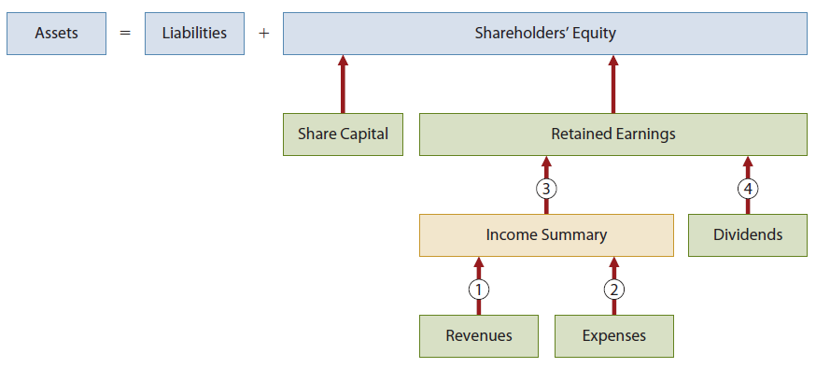
The Closing Process Illustrated

Slide 22
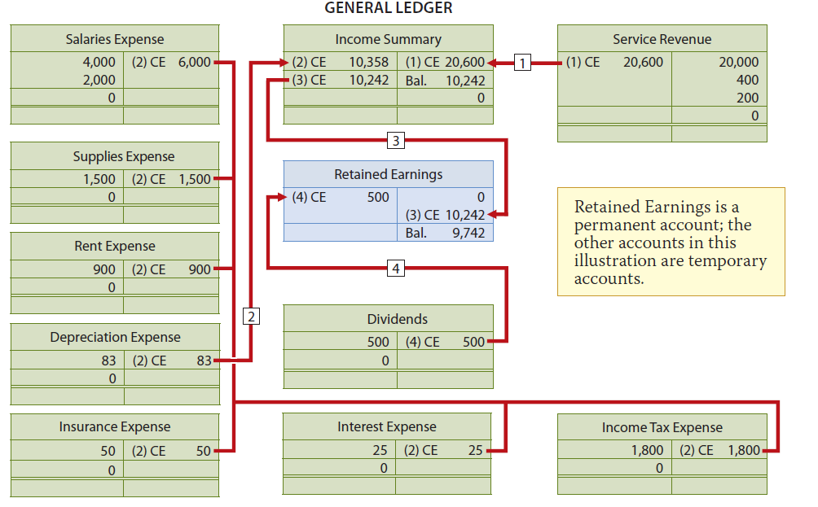
General Ledger

Slide 23
Post-Closing Trial Balance
Lists all permanent accounts and their balances
After all closing entries are journalized and posted
Proves that total debit balances and total credit balances are equal after the closing entries have been made

Slide 24
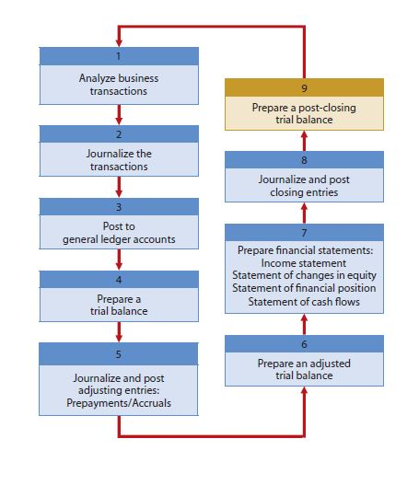
Summary of the Accounting Cycle

Slide 25
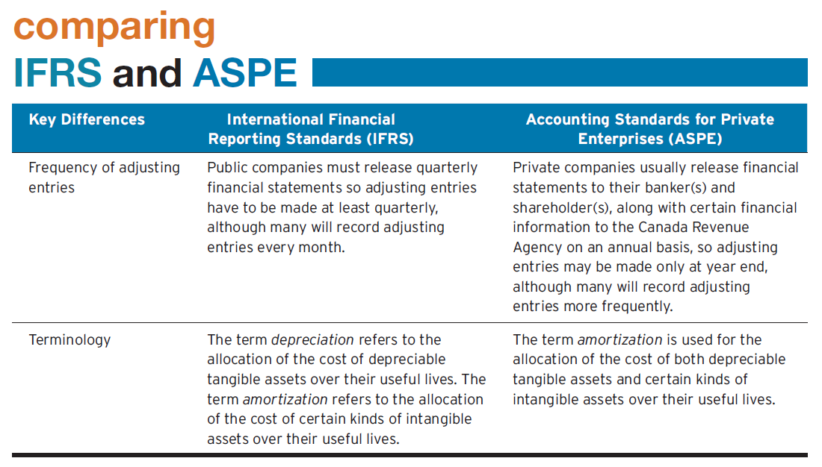
Comparing IFRS and ASPE

Slide 26
COPYRIGHT
Copyright © 2014 John Wiley & Sons Canada, Ltd. All rights reserved. Reproduction or translation of this work beyond that permitted by Access Copyright (The Canadian Copyright Licensing Agency) is unlawful. Requests for further information should be addressed to the Permissions Department, John Wiley & Sons Canada, Ltd. The purchaser may make back-up copies for his or her own use only and not for distribution or resale. The author and the publisher assume no responsibility for errors, omissions, or damages caused by the use of these programs or from the use of the information contained herein.

