Slide 1
The Basics of Financial Reporting
Presented by - Kristin Bahn, University Financial Services

Slide 2
Objectives
Become familiar with important PeopleSoft terms and understand how to run core reports and other tools in PeopleSoft Financials
Discuss the key differences between budgetary and actuals accounts
Understand the difference between Commitment Control and the General Ledger
Understand the Basic Financial Reports and which ones to use for specific purposes (Monthly Operating Report, Projects Monthly Report, Inquiries)

Slide 3
PeopleSoft Terms
Transactions occur in various modules within PeopleSoft, and transactions are accumulated in a few places for reporting.
General Ledger
Commitment Control (KK)
Also known as Actuals ledger, is where the financial transactions ultimately post. Various modules in PS generate accounting entries and send these entries via journals to the ledger.
ONLY revenue and expense post to the KK ledgers. Transactions post as soon as a budget check is valid. KK is used for internal management purposes to compare actuals to budget.
Timing – since most transactions are budget checked before they are posted to the GL, there can be a difference between what you see in KK vs. GL.

Slide 4
PeopleSoft Terms- KK
How Commitment Control (KK) is used
Budgeting creates valid chartstring combinations
Management tool to compare budget to actuals for revenue and expense transactions
“Commit” funding for future obligations (Encumbrances)
For some funds, KK checks to see if there is available funding before a valid budget status can be achieved
Commitment Control Terms
Budget:
Example of Spending Authority is fund 100
Example of Spending Plan is fund 150
Pre-Encumbrance : Amount that is planned to be spent, but which there is no legal obligation – only seen with requisitions
Encumbrance: Amount that you have an obligation to spend in the future. Ex. - Issuance of a Purchase Order to a vendor will encumber those funds against budget

Slide 5
Commitment Control Ledgers
Ledger Group | Description
AG_RELATED | This ledger group is being phased out. An expense ledger that shows detail for the Restricted Agriculture funds.
BUMP_REV | This is where revenue that increases spending authority of an expense chartstring will post in commitment control.
DETAIL_KK | The ledger that stores information for all expense transactions at the detail account level for fiscal year 2008 and forward.
DETAIL_REV | The ledger that stores information for all revenue transactions at the detail account level for fiscal year 2008 and forward.
OPS_CH | The Operations Child ledger shows the detail of expenses by budgetary account for all operating funds.
OPS_PA | The Operations Parent Ledger shows total expenses for all operating funds.
OPREV | The Operations Revenue Ledger shows operating revenue for all operating funds.
PC_CHILD | The Project Costing Child ledger shows the detail of expenses by account for non-sponsored projects.
PC_PARENT | The Project Costing Parent ledger shows total expenses for non-sponsored projects.
PC_REV | The Project Costing Revenue ledger shows revenue for all projects.
SP_CHILD1 | (No Longer Used)
SP_CHILD2 | The Sponsored Projects Child 2 ledger shows the detail of expenses by account for all direct costs in relation to sponsored projects (i.e., operating, equipment, salary, fringe and F&A).
SP_PARENT | The Sponsored Projects Parent ledger shows total expenses for salary, fringe, F&A and other direct costs in relation to sponsored projects.
SP_PARENT2 | (No Longer Used)
SP_REV | The Sponsored Projects Revenue ledger shows revenue for all sponsored projects.
SP_SUM_BUD | The Sponsored Projects Summary Budget ledger shows expenses for the budget bump sponsored projects.

Slide 6
UVM Budgeting - KK
Annual Budgeting is done in the PeopleSoft Enterprise Performance Module (EPM)
Line item budgets (funds 100 & 150) include revenues and expenses which is loaded via budget journals to KK
Salary distributions (using all funds) for each UVM employee with a position which is uploaded to HCM
Unrestricted General Fund - FAB produces “targets” for each operating unit on campus to use for EPM budget building
Unrestricted Income & Expense Fund - Units budget based on yearly rate calculations
Unrestricted Non-Sponsored Projects – Unit sets up “spending plan” as each project is created (PC_Child budget does not have to be tied to the fiscal year)

Slide 7
UVM Budgeting – Cont.
Restricted Sponsored Project Budgeting – Sponsored Project Administration Analyst creates project budgets as each contract is awarded by sponsor (not tied to a fiscal year)
Restricted Non-Sponsored Project Budgeting – University Financial Services created project budgets for projects using fund 305 (not necessarily tied to a fiscal year)
Restricted Gift Budgeting
Fund 310 setup by University Financial Services based on prior year end net position (formerly net asset) balances
Fund 311 setup by University Financial Services based on information from the UVM Foundation
Restricted Endowment Budgeting
Fund 320 setup by University Financial Services
Fund 321 setup by University Financial Services based on information from the UVM Foundation

Slide 8
Dept. Budget Building Lifecycle
Late April: EPM (Budget Module of PeopleSoft) is opened up with new fiscal year model
Early May: FAB releases targets (General Fund targets and Income/Expense targets)
May: Departments input planned budgets into EPM – must tie out to target(Submission end of May)
June: FAB reviews EPM, and then UFS/ETS imports data to PeopleSoft HR and Finance. HR is completing salary reviews
July 1 – New fiscal year begins using imported budgets
July – June: Departments’ Responsibility: Run Monthly Operating Reports to track actuals against budget – quarterly meetings to track budget and forecast year end actuals to budget.
Notes:
Mention how restricted gifts and endowments are only budgeted at 50% of previous fiscal year net position balance as of early June until around August when final year end figures are known.

Slide 9
Financial Terms - GL
General Ledger (Actuals)
All financial transactions are recorded in the General Ledger based on the fiscal year and accounting periods. You will find activity for assets, liabilities and net position (formerly net asset), as well as revenue and expenses in the General Ledger
The Actuals ledger does not store budgets, pre-encumbrance, or encumbrances amounts
The data in the General Ledger is what is used for external financial statements and reporting and is reviewed by the auditors annually

Slide 10
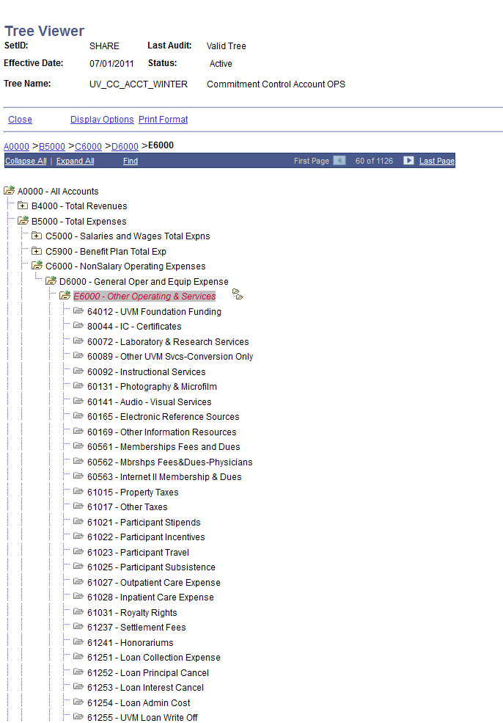
Budget Accounts vs. Actual Accounts
PeopleSoft Financials > Tree Manager > Tree Viewer > Search
Budgets are established using BUDGETARY ONLY accounts. For grants (SP ledgers), this is typically F-level accounts, and for OPS it is E-level accounts
KK Account Trees determine which actuals accounts roll up to the budgetary accounts

Slide 11
Actuals Accounts
Assets – accounts begin with 1
Liabilities – accounts begin with 2
Net Position (formerly Net asset) – account is 30000
Revenue – accounts begin with 4
Expenses – accounts begin with 5,6,7,8, and 9
Salary and Benefit Expenses – accounts begin with 5
Operating Expenses – accounts begin with 6
Cost of Goods Sold – accounts begin with 7
Internal Charges– accounts begin with 8
Suspense - accounts begin with 9

Slide 12
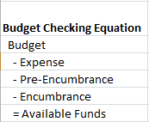
Budget and Actual Accounts

Slide 13
Reporting Terms
Budget Period - Financial transactions are posted to a specific budget period. UVM’s Operating budget period is July 1 – June 30 while a Project budget period (Period 1) is equal to the start and end dates of each specific project.
Fiscal Year & Accounting Period - Each transaction recorded in PeopleSoft will be posted to a specific Accounting Period based on the Journal date. These are the months within a Fiscal Year. Period 1 = July, Period 2 = August, etc.
Chartstring/Chartfields - The concatenation of the PeopleSoft chartfields is the chartstring.
Trees - In PeopleSoft trees are used to represent a hierarchy or reporting structure. They are helpful in reporting because they specify how the data is rolled up for reporting purpose.

Slide 14
Budget vs. Actuals
We’ve loaded budgets, and understand the commitment control ledger vs. actuals ledger. Now, how do we know we’re spending within budget?
University Recommended Reports
Monthly Operating Budget Report
Endowment and Gift Report
UVM Projects Budget Report
Closeout report – run to see if there are any budget checking errors which will cause transactions to not be included in KK reporting
Quarterly Reporting Process (Advanced Reporting – not shown in this class)
Simple Inquiries (for a quick check of spending vs. actuals)
Budget Overview
Budget Transaction Detail

Slide 15
Monthly Operating Report
Purpose of Report
Monitor status of operating budgets
Expenses and/or revenue that posted during an accounting period range, as well as budgetary information for a year.
Data Retrieved From
Budget, encumbrance, and pre-encumbrance transactions and are retrieved from Commitment Control ledgers
Expenses and revenue transactions, and net position (formerly net asset) balances come from the General Ledger (Actuals)

Slide 16
Monthly Operating Report
Accounting Period: The data in PER REV and PER EXP will be the sum of revenue and expense for the accounting period selected or most current month of a range. The data in YTD REV and YTD EXP will be the sum of all accounting periods in the selected fiscal year less than or equal to the “To Period” selected.
Useful info: The From and To should be the same number to save time. In this example PER EXP and PER REV will be December’s Expense and Revenue. The YTD figures will be for July – December.

Slide 17
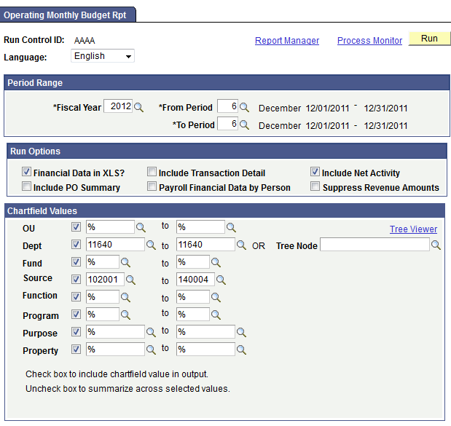
Monthly Operating Report - Tree
UVM Department Tree
By selecting a tree node, you can submit one report request for an entire unit without having to list ALL departments within that unit.
Select “Tree Viewer” to view all Trees. If you already know the tree node to select, you may type it.
Notes:
What is the salary spent to date?
What has been spent on travel to date?
What has been spent by property?
What is encumbered on salaries?

Slide 18
Commitment Control Reports/Inquiries
Information posts to KK as soon as the transaction achieves valid budget check – most transactions have to achieve valid budget check before being submitted for posting to the general ledger
Exception to the rule: Payroll transactions are posted to the GL and budget checked separately, which is the one exception for timing of data showing in KK.
Because budgets are based on the budget period, Budgetary Reports and Inquiries will show data from the selected budget period rather than an accounting period. The Monthly Operating/Project report is a hybrid of budgetary and actuals data which allows it to be run for an accounting period.

Slide 19
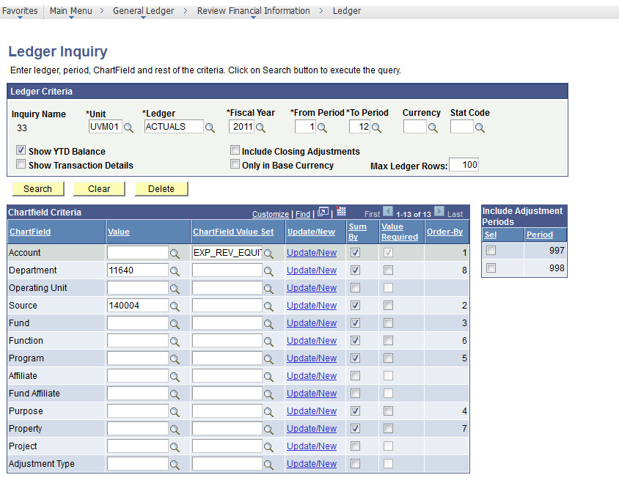
General Ledger Inquiry

Slide 20
Wrap-Up
University Recommended Reporting:
Monthly Operating Report
Project Monthly Budget Report
Endowment & Gift Monthly Budget Report
Diagnostic tool:
Closeout Report (budget checking errors, journals not submitted, etc.)
Quick Drill Down:
Budget Overview
General Ledger Inquiry

Slide 21
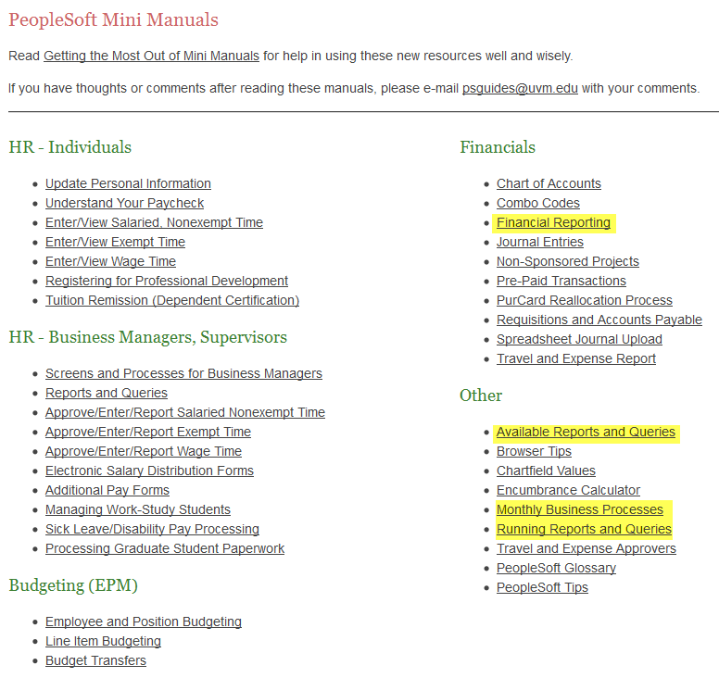
Helpful Webpages
http://www.uvm.edu/hrs/?Page=skills/manuals/manuals.html&SM=skills/skillsmenu.html

Slide 22
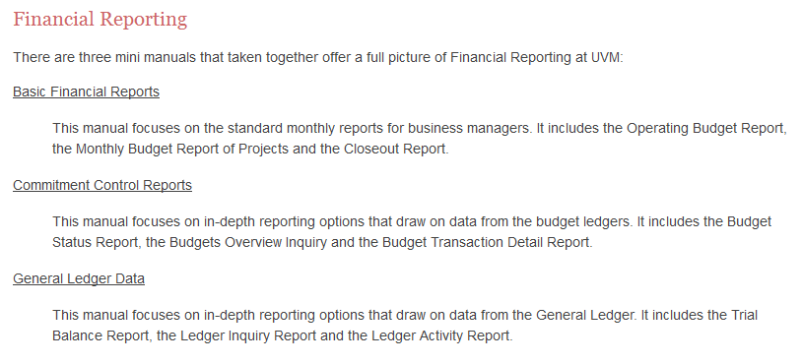
Helpful Webpages cont’d.
http://www.uvm.edu/hrs/?Page=skills/manuals/financialreporting.html&SM=skills/skillsmenu.html

Slide 23
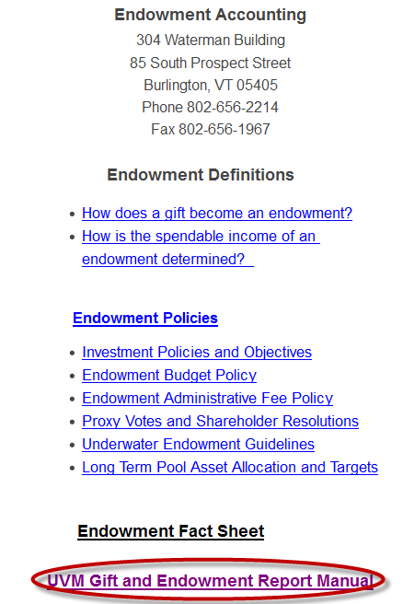
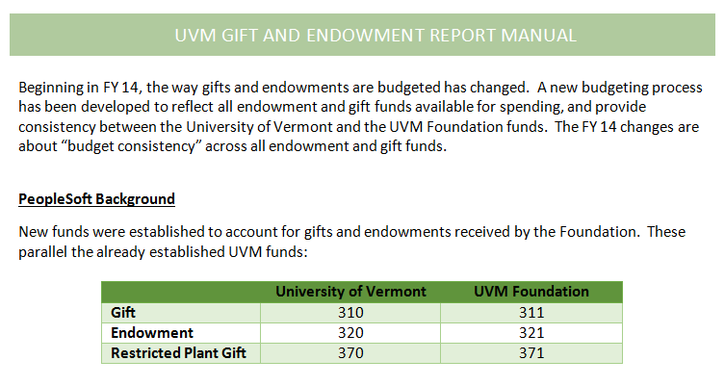
Helpful Webpages cont’d
http://www.uvm.edu/~cntrllrs/?Page=endowment.html

