Slide 1
Accrual Accounting

Slide 2
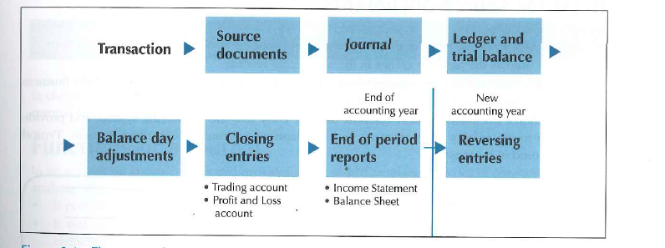
The accounting process

Slide 3
Key Terms
The Matching Principle
Cash Accounting
Accrual Accounting
Balance day adjustments

Slide 4
Accounting Period and Profit Determination
For accounting purposes, the accounting period assumption assumes that the life of a business is divided into arbitrary time periods
Many parties, such as owners, creditors or the ATO (Australian Taxation Office), wish to know how the business is progressing on a more regular and periodic basis.
Many business transactions do not fit neatly into these various accounting periods. Some adjustments therefore must be made to recorded figures at the end of the accounting period, on a day usually called the balance day- thus known as balance day adjustments

Slide 5
Exercise 4.1- pg 106
Question: Briefly explain the meanings of, and the relationship between, the accounting period assumption and the matching principle.
The accounting period assumption assumes that the life of a business is divided into arbitrary time periods. This is done in accounting because although an absolutely accurate determination of profits can be made only after the liquidation of a business, many parties interested in the financial results of an organisation, e.g. owners, creditors or the ATO, cannot wait until liquidation occurs. They wish to know how the business is progressing on a more regular periodic basis.
Thus, accountants aim to calculate a profit figure for each accounting period that is as accurate as possible (and to determine a financial position that is as accurate as possible at the end of that accounting period).
Profit is obtained by applying what is known as the matching principle, i.e. matching revenue for the period with the expenses incurred in earning that revenue (Profit = Revenue - Expenses).

Slide 6
The Matching Principle
Profit is obtained by matching revenue for the period with the expenses incurred in earning that revenue
Profit = Revenue - Expenses

Slide 7
Accrual Accounting
Accrual accounting recognises transactions and events when revenues are earned and expenses are incurred
(whether we have paid for them or not!)
It allows the matching principle to be applied

Slide 8
WHY IS ACCRUAL ACCOUNTING SO IMPORTANT??
If we only use cash accounting- where the effects of transactions are recognised only when cash is received or paid out- we are not showing a complete picture

Slide 9
Is this a big tough and safe truck?

Slide 11
Is this big scary crocodile invincible?

Slide 13
Balance Day Adjustments
Balance day adjustments are general journal entries made as at balance day in order to compare the revenues and expenses accurately so that the profit (loss) can be determined.

Slide 14
Balance Day Adjustments
The accounting process so far:
Transaction Source Documents Journal Ledger and Trial Balance
However, the trial balance does not show the results of the period, so we need to go further to determine if a profit or loss has been made for the period = balance day adjustments.
Balance day adjustments are general journal entries made as at balance day in order to compare the revenues and expenses accurately so that the profit (loss) can be determined.
Balance day adjustments fall into one of two categories:
Accruals
Prepayments

Slide 15
Accruals- Accrued Expenses
What do you think are Accrued Expenses?
They are expenses incurred but not yet paid!
Accrued expenses are amounts owed by the business and are therefore liabilities
Examples???
Wages?
Marketing and advertising costs?
Interest on a loan?

Slide 16
Example:
Assume that wages are paid every week and that an entry is made in the journal and then posted to the Wages and Salaries account in the ledger
Wages and Salaries
June 6 Cash 1000
13 Cash 1000
20 Cash 1000
27 Cash 1000
Balance day is 30th June, which is a Friday
Employees are paid every Tuesday
Total wages bill is $200 per day
On balance day (30th June) it's obvious that the employees have worked 3 extra days, but they will not be paid for these days until the next payday, which falls outside the accounting period.
It is necessary that the Wages and Salaries account include the wages for these three days because they were expenses incurred in earning the revenue for the period.

Slide 17
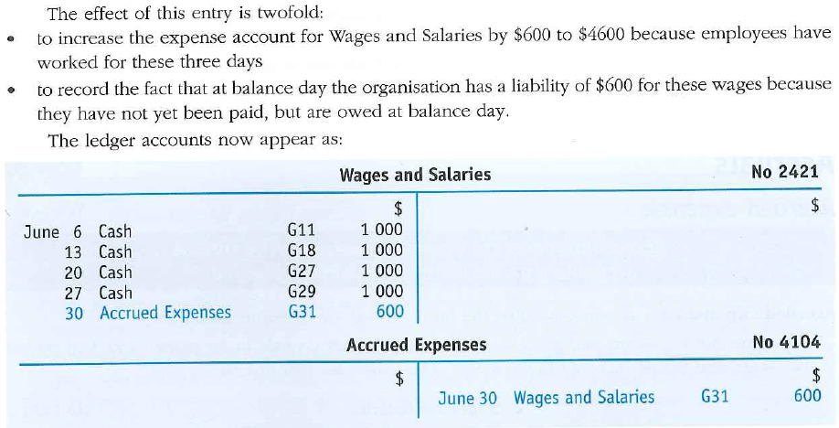
The General journal entry necessary to incorporate these wages into the record is:

Slide 18
What is the journal entry?
DR ………… Expense xxxx
CR Accrued Expenses (L) xxxxx

Slide 19
As at 30 June 2012 we have owing
$6,230 sales commission
$10,000 advertising
$1,200 interest on loan owing

Slide 20
Sales commission expense Dr 6,230
Accrued expenses (Liability) Cr 6,230
(Balance-day adjustment)

Slide 21
Advertising (Expense) Dr 10,000
Accrued expenses (Liability) Cr 10’000
(Balance-day adjustment)
Interest (Expense) Dr 1,200
Accrued expenses (Liability) Cr 1,200
(Balance-day adjustment)

